Slide 1


Food Safety for
Dare to Care Partners
Presented by Cassie Cairns, and Ruthe Holmberg

Slide 2
Contents
Pre-Test
Why are we here?
Pathogens
Prevention
The Dreaded Paperwork
Where to find more information
Certificates

Slide 3

Pre-Test
What is a FOODBORNE ILLNESS?
A foodborne illness outbreak consists of ____people?
Which THREE populations are most at risk of a foodborne illness?
What is the TEMPERATURE DANGER ZONE?
How often should temperatures be CHECKED AND RECORDED?
What is the most effective way to PREVENT foodborne illness?

Slide 4
Pre-Test
How long should temperature recording sheets be kept on-site, and on-file?
What do pathogens need to grow and multiply?
What are the three types of contamination?
In what order should dry goods, frozen foods, and refrigerated foods be put away?
TRUE or FALSE: Each food storage area should have a unique name or number, and should also be listed on the temperature chart.
TRUE or FALSE: Thermometers should be kept in every refrigerator, every freezer, and every dry stock area.

Slide 5
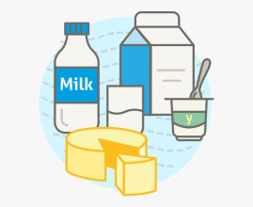
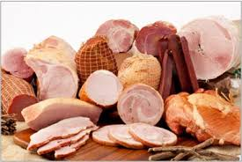
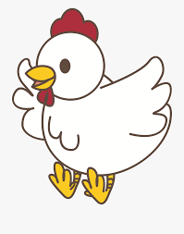
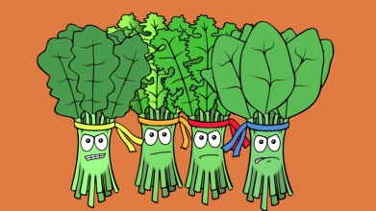



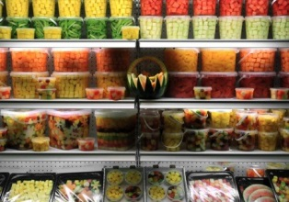

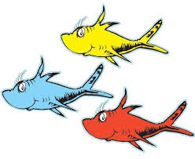
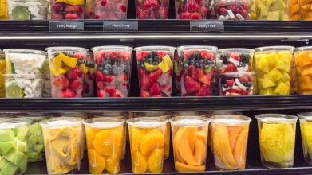
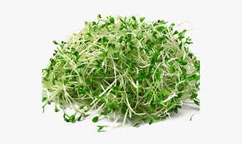
RISKY FOODS:
The FDA’s “Most Wanted” List
Notes:
Top Risky Foods -Poultry, Pre-cut Fruits & Veggies, Leafy Greens, Fish & Shellfish, COOKED Rice, Deli Meat, Dairy, Eggs, Sprouts, Ice Cream

Slide 6

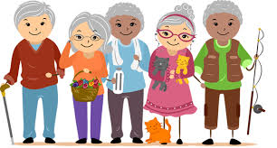
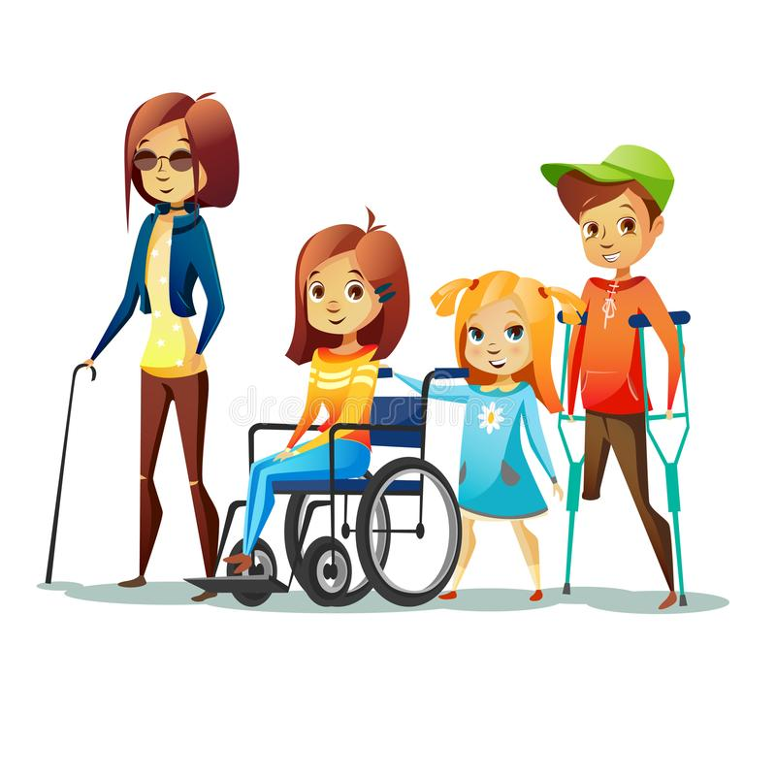
Keeping food safe is important because…
We serve populations that are considered high risk
  Elderly
  Young children
  Immune-compromised
It takes commitment from EVERYONE who comes in contact with food
  Accountable to regulators
  Accountable to our clients
Notes:
High Risk Categories: Elderly, Young Children, and those who are Immune-Compromised (chronically ill)
Regulators include the local health department, USDA inspectors, DTC representatives

Slide 7
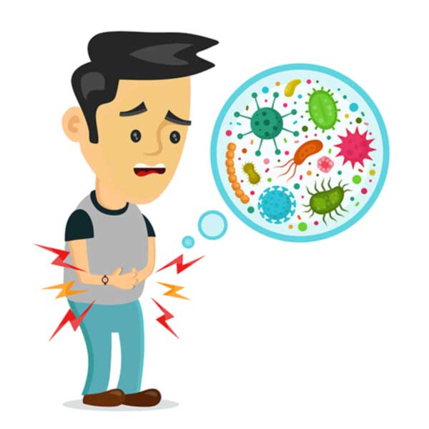



Simply put, it is an illness caused by eating contaminated food. Commonly, it can cause vomiting, diarrhea, abdominal pain, fever, and chills. It may lead to more serious problems, up to and including death.
What is a foodborne illness?
What is a foodborne illness outbreak?
Just TWO people are considered an outbreak
What micro organisms cause foodborne illnesses?
The four categories of pathogens are: bacteria, viruses, parasites and fungi

Slide 8
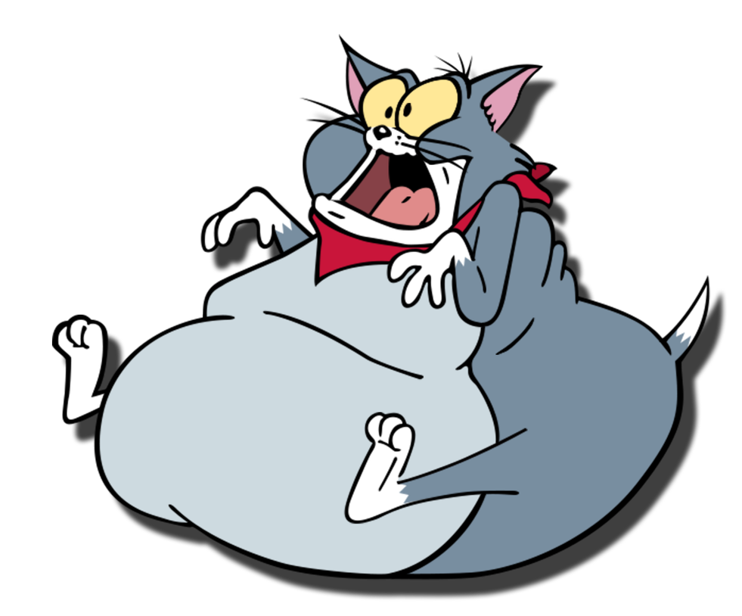
FAT TOM
Food
Acidity
Time
Temperature
Oxygen
Moisture
What do pathogens need to grow and survive?
Notes:
FAT TOM –Food, Acidity, Time, Temperature, Oxygen, Moisture

Slide 9
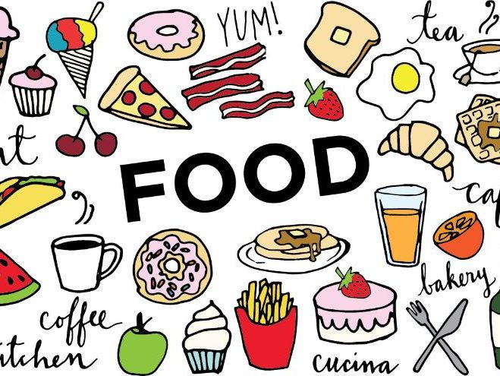
Contamination is the presence of PHYSICAL, CHEMICAL or BIOLOGICAL MATTER in our food or food environment
Food may become contaminated:
Before delivery
Due to poor hygiene
By clients
Notes:
Food may become contaminated during production, or in the fields
Hand washing is always going to be the first line of defense in keeping food safe
The clients themselves may be the source of the contamination –long bus rides, improper thawing or storage, improper cooking temperatures

Slide 10
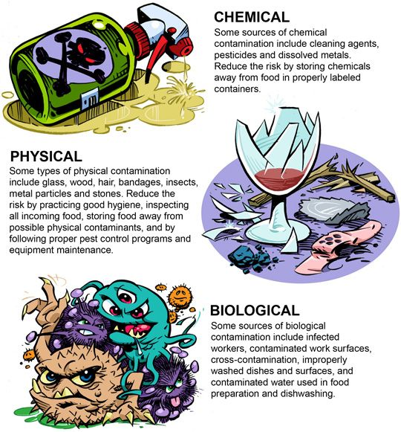
Types of Contamination
Chemical
Physical
Biological

Slide 11
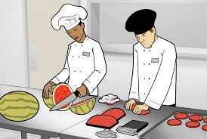
A few more words on contamination…
What are the causes of contamination?
Cross contamination
Poor personal hygiene
Improper cleaning & sanitation
Time & temperature abuse
Notes:
Cross contamination is the process by which pathogens are unintentionally transferred from one substance or object to another, with harmful effect
WASH YOUR HANDS!
Cleaning requires the use of soap or detergents to remove visible soils. Sanitation requires the use of heat (180F or above) or chemicals to reduce pathogens to a safe level
Time & Temperature abuse –4 hours for food to become unsafe at the improper temperatures

Slide 12
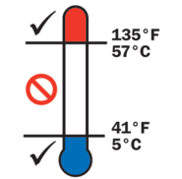
Time &
Temperature Abuse
What is the temperature danger zone?
Harmful pathogens multiply and grow at a rapid rate between 41F-135F.
Notes:
Temperature Danger Zone: 41F-135F
Pathogens will quickly double; growing from a single organism to 64,000 in just four hours.

Slide 13

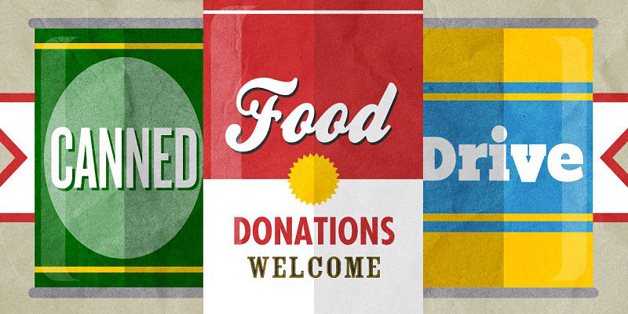
PREVENTION
Receiving
(Cans)

Slide 14
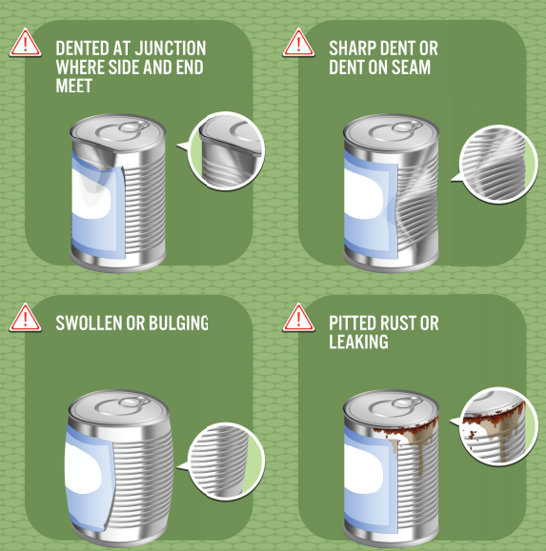

Slide 20
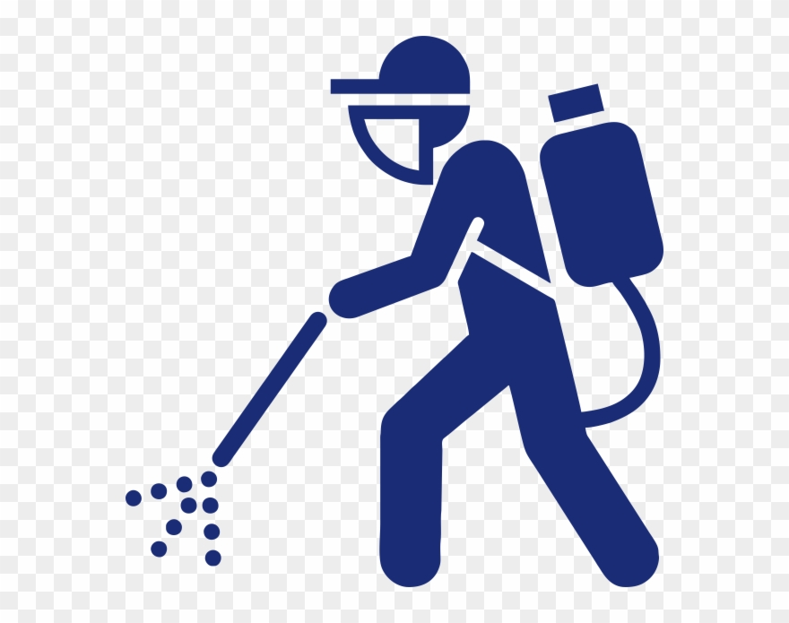
PREVENTION
Ripped or chewed packaging
Evidence of nesting, or pests
Products that have been thawed and refrozen

Slide 21
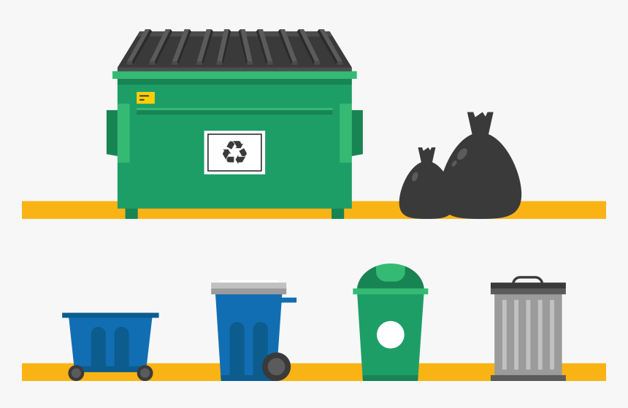
What to do with
rejected foods?

Slide 22
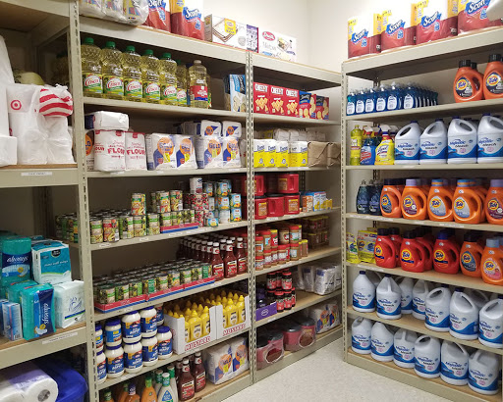
PREVENTION
Storage
Put food away in a certain order: Refrigerated, Frozen, Dry
Store food in its original packaging
Use the FIFO method
Minimize time in the danger zone
Prevent cross contamination
Dry shelf stable goods should be stored at 50F-70F
Refrigerated goods should be stored at 35F-41F
Frozen goods should be stored at -10F-0F
All goods should be stored 6” from the wall and 6” from the floor.
Pantry temperatures should be checked and recorded on the Temperature Recording Chart weekly; Kitchen will check and record temperatures daily
Temp sheets must be kept on-site and on file for 3 years plus the current year.

Slide 23
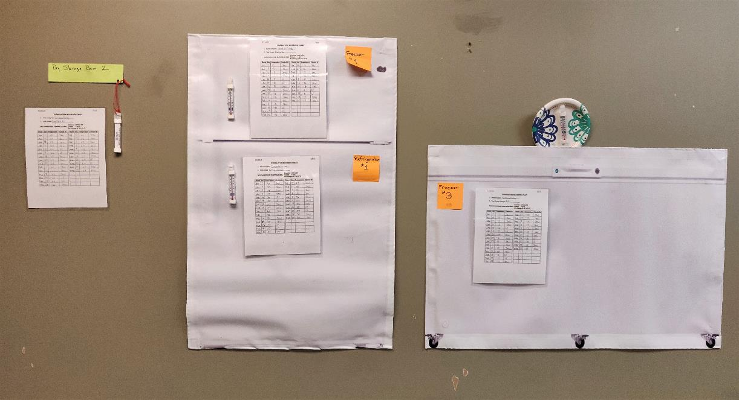

Slide 24
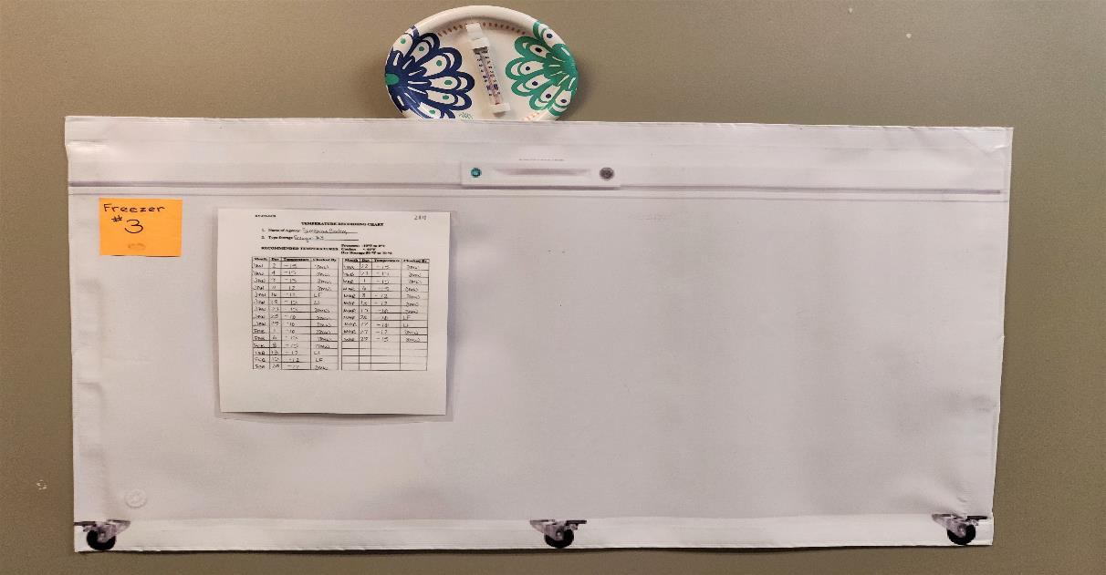

Slide 25
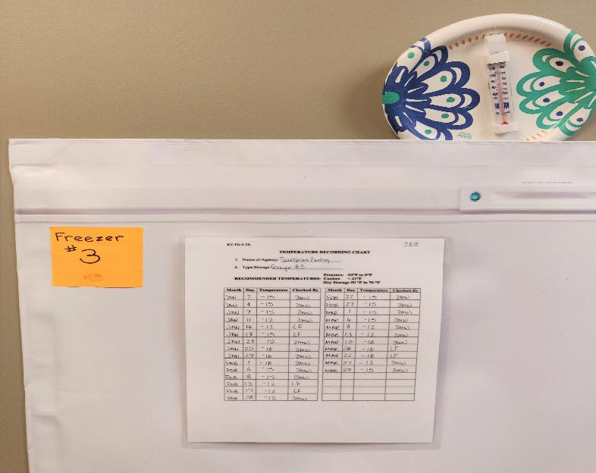

Slide 26
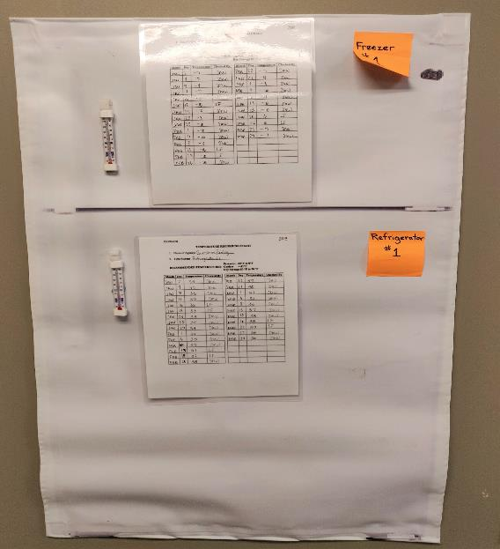

Slide 27
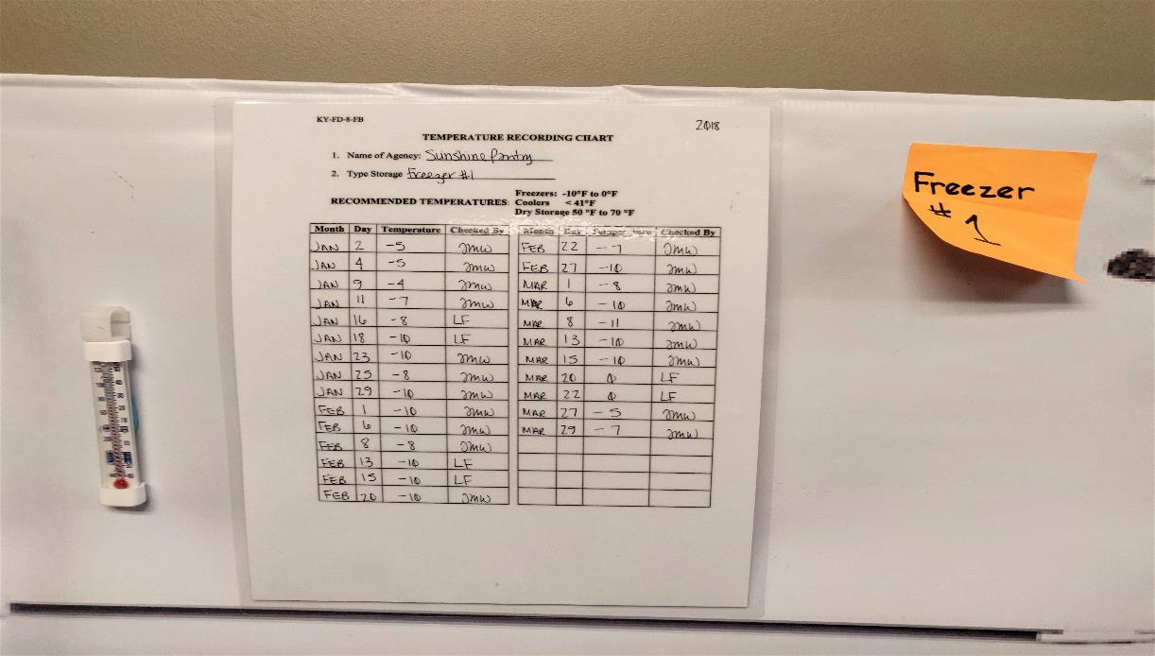

Slide 28
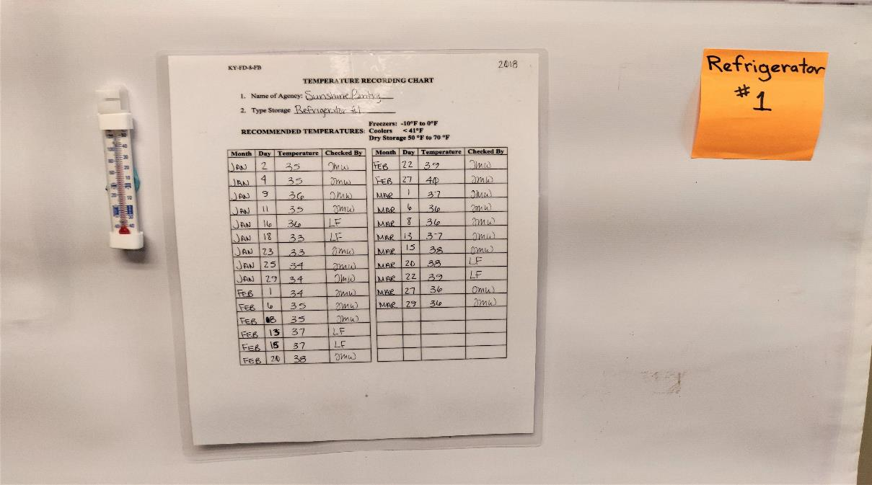

Slide 29
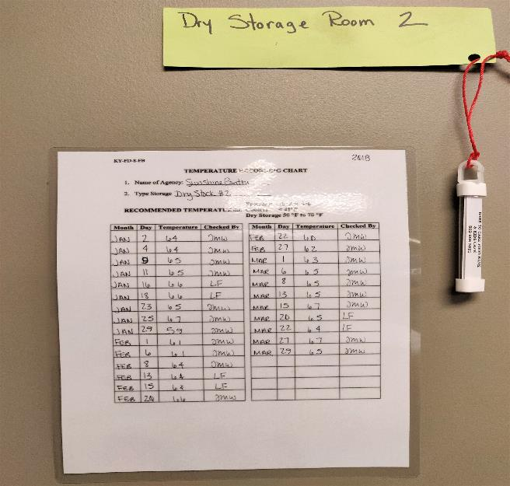

Slide 30
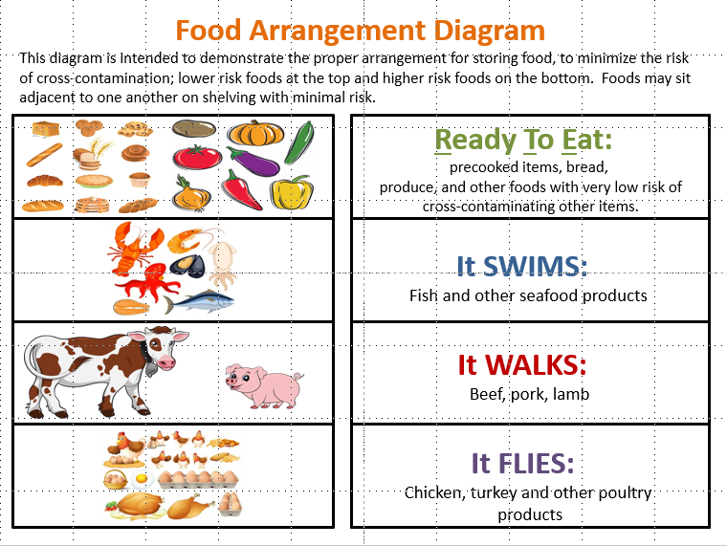
PREVENTION -Storage
RTE
SWIMS
WALKS
FLIES
Notes:
This training aid demonstrates where to place foods to minimize the risk of cross-contamination.

Slide 31
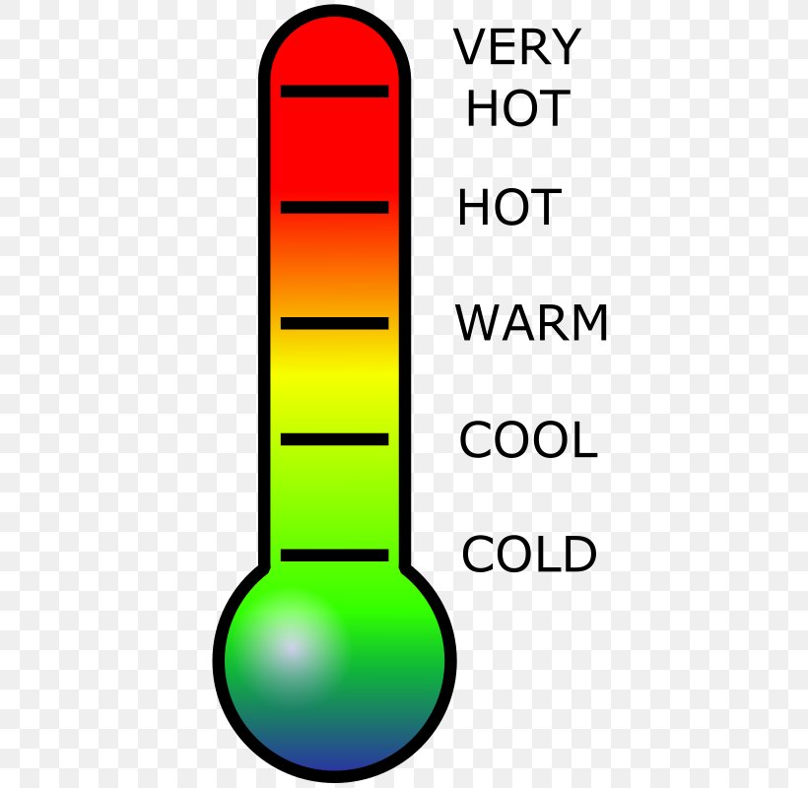
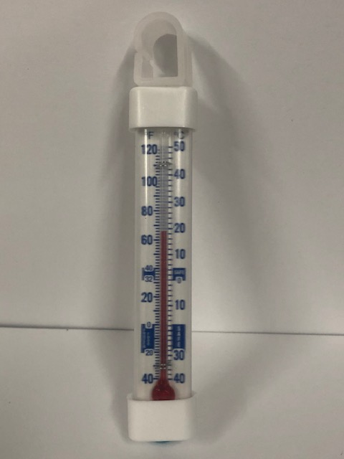
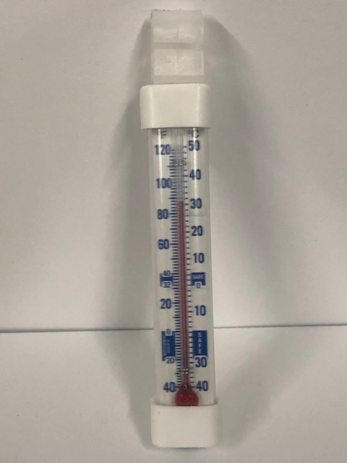
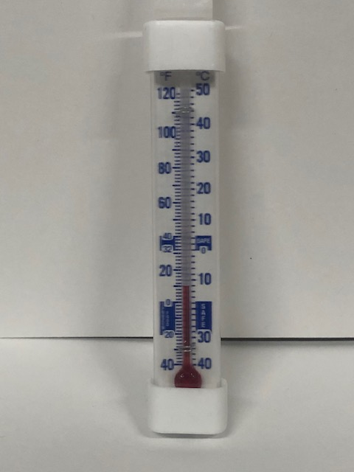
THERMOMETERS –The Tools of Our Trade
Test Your Knowledge

Slide 33
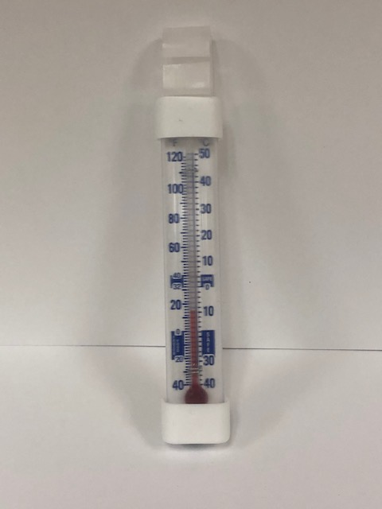
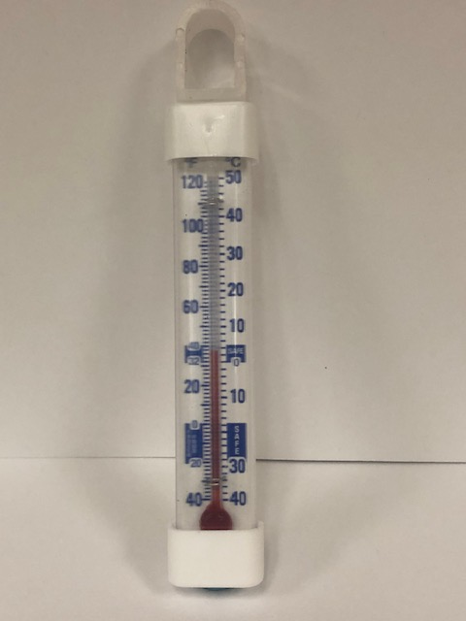
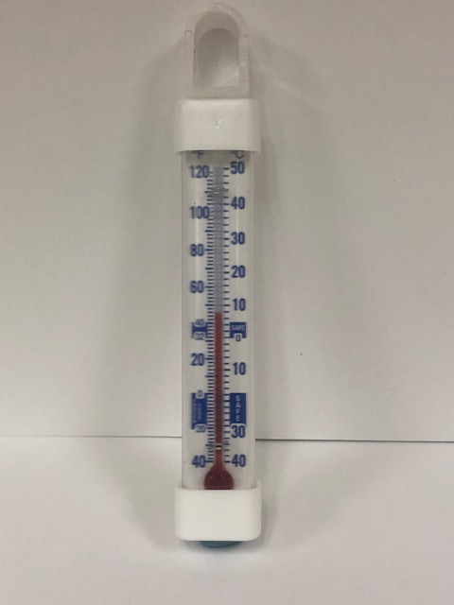

Slide 34

PREVENTION
What about hand sanitizers?
After washing your hands with soap and water
When there is no access to soap and water
When hands are not visibly soiled or greasy
HAND WASHING –Wash your hands frequently, especially after easting, drinking, smoking, touching your face or hair, after handling waste, using the restroom, coughing or sneezing, handling raw foods, etc. Use hot water (100F) and wash with soap for 15-20 seconds
PERSONAL CLEANLINESS –Bathe regularly, keep fingernails short and clean, do not handle food if you are ill or have infected wounds or cuts. Cover wounds with a bandage and gloves before handling food. Eat, drink, and smoke in designated areas only.

Slide 35
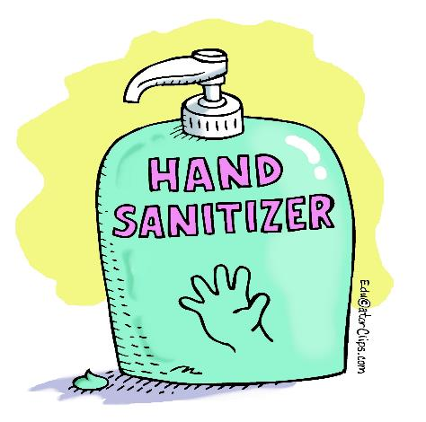
Prevention
Cleaning & Sanitizing
Cleaning requires the use of a soap or detergent to remove visible soil and grease
Sanitizing requires the use of heat (180F or above) or a chemical, such as chlorine, iodine, or a quaternary to reduce pathogens to a safe level
Store all chemicals in their original containers
Store chemicals and cleaning equipment away from food and food preparation areas

Slide 36
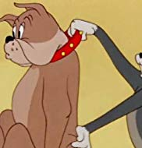
And just a bit more on contamination…
Q7. What questions can a covered entity's employees ask to determine if a dog is a service animal?
In situations where it is not obvious that the dog is a service animal, staff may ask only two specific questions:
(1) is the dog a service animal required because of a disability?
(2) what work or task has the dog been trained to perform? Staff are not allowed to request any documentation
for the dog, require that the dog demonstrate its task, or inquire about the nature of the person's disability.
Q8. Do service animals have to wear a vest or patch or special harness identifying them as service animals?
A. No. The ADA does not require service animals to wear a vest, ID tag, or specific harness.
DEFINITION OF A SERVICE ANIMAL
Q1. What is a service animal?
A. Under the ADA, a service animal is defined as a dog that has been individually trained to do work or perform tasks for an individual with a disability. The task(s) performed by the dog must be directly related to the person's disability.
Q2. What does "do work or perform tasks" mean?
A. The dog must be trained to take a specific action when needed to assist the person with a disability. For example, a person with diabetes may have a dog that is trained to alert him when his blood sugar reaches high or low levels. A person with depression may have a dog that is trained to remind her to take her medication. Or, a person who has epilepsy may have a dog that is trained to detect the onset of a seizure and then help the person remain safe during the seizure.
Dare to Care expects all of its partners to make reasonable accommodations to serve people with disabilities who use service animals per the ADA directive.
Notes:
Agencies are referred to the ADA for more information on allowing service animals into the pantries and community kitchens. DTC’s guidance follows the ADA: Agencies may only ask two questions: 1. Is the animal required for a disability and 2. What tasks are the animal trained to perform? Agencies may not ask what disability the client may have, and may not require any identification or special identifiers for the animal. DTC expects that partners make reasonable accommodations to serve people with disabilities and service animals per the ADA directive.

Slide 37

What is a RECALL?
A recall is an industry and regulatory response to food which is unsafe for consumption, because of adulteration (contamination) and/or misbranding (mislabeling).
As part of the food industry, food banks are required to react to recalls by identifying and removing recalled product from inventory. Tracing and accounting for all recalled product is also necessary.
Notes:
The team in the warehouse looks for and discards recalled product
Agencies might have received recalled product from food drives, church donations, or other means.
Agencies should put up a bulletin board, and print out the recall emails to inform clients of the recall.

Slide 38
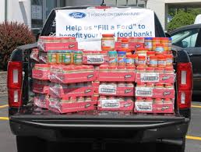
SCENARIO 1 -Receiving
After picking up your food bank order, and are on your way back to the pantry, your driver mentions that you have received a 50 lb box of bulk chicken. The driver also asks to stop at Subway on the way back.
Notes:
Non-feeding sites should call DTC and find out where the nearest community kitchen partner is located, then make arrangements to transfer the product. Product should NEVER be repackaged.
Avoid detours to keep food safe.

Slide 39
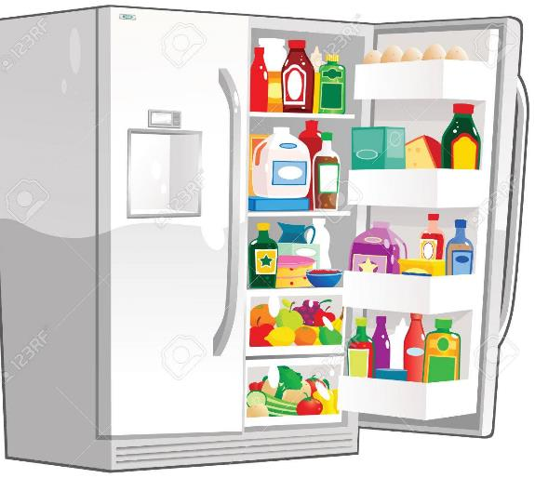
SCENARIO 2 -Storage
You go into the church basement for your weekly temperature check, and notice a refrigerator is at 45F, and a freezer is at 10F.
Notes:
Temperatures that are out of range must be taken seriously; any product held at improper temperatures should be discarded and doused with bleach to keep dumpster divers safe as well.

Slide 40
Post-Test
What is a FOODBORNE ILLNESS?
What is a FOODBORNE ILLNESS OUTBREAK?
Which THREE populations are most at risk of a foodborne illness?
What is the TEMPERATURE DANGER ZONE?
How often should temperatures be CHECKED AND RECORDED?
What is the most effective way to PREVENT foodborne illness?

Slide 41
Post-Test
How long should temperature recording sheets be kept on-site, and on-file?
What do pathogens need to grow and multiply?
What are the three types of contamination?
In what order should dry goods, frozen foods, and refrigerated foods be put away?
What is the best defense against foodborne illness?
TRUE or FALSE: Thermometers should be kept in every refrigerator, every freezer, and every dry stock area.

Slide 42

USDA FOODKEEPER
This free app is available
for both Android, and iPhones

Slide 43
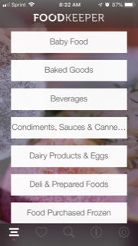
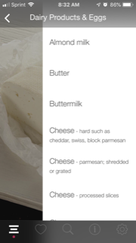
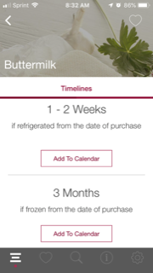

Slide 44
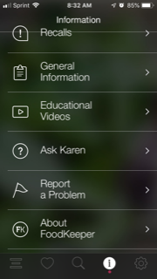
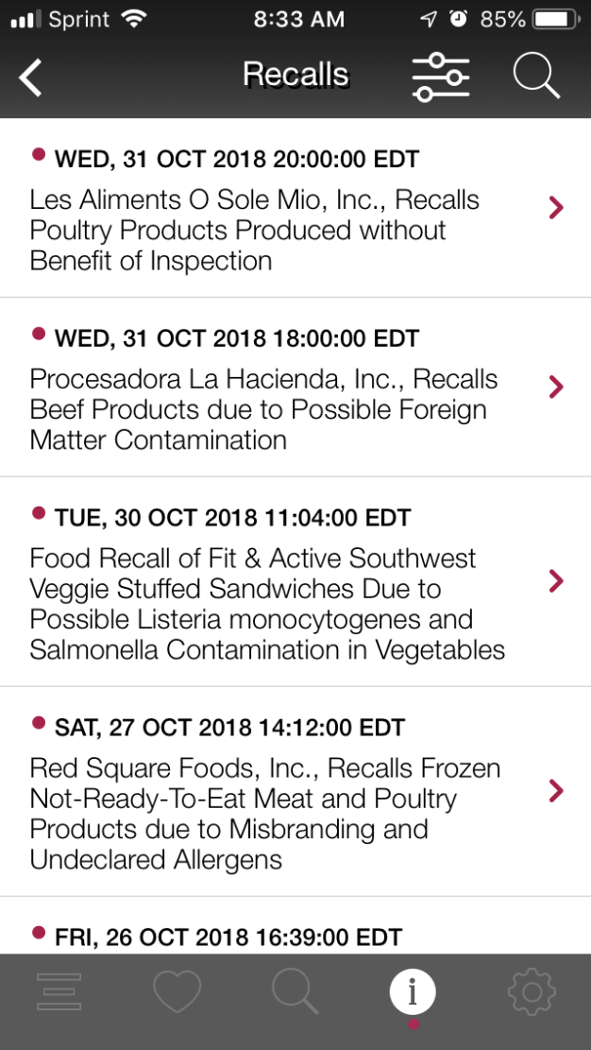




Slide 45

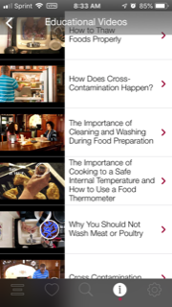
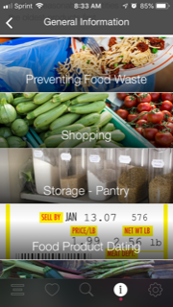

Slide 46

Our Commitment
Share our knowledge
Be proactive
3rd party audits for the Food Bank
Bi-annual monitoring for Partners

Slide 47
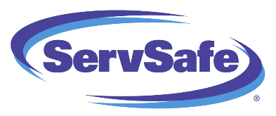

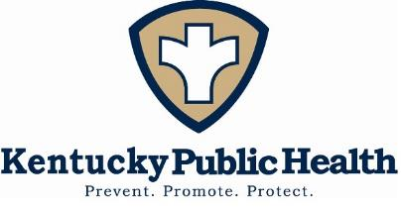
For more information…

Slide 48
Questions?
Cassie Cairns: (502) 736-9915 or cassie.cairns@daretocare.org
Ruthe Holmberg: (502) 736-9918 or ruthe.holmberg@daretocare.org

Slide 49

CONGRATULATIONS!

