Slide 1
SFSP TRAINING 2024
June 3rd-August 2nd

Slide 2
Agenda
Program Requirements
Menus
Paperwork
Food Safety
Monitoring
Responsibilities
Civil Rights Training
Online Processes
Questions?

Slide 3
What is SFSP?
The Summer Food Service Program is a federally funded and regulated program that provides free meals to children and teens age 18 and under during the summer months.

Slide 4
How SFSP Works?

Slide 5
How does SFSP work?
Food delivered to DTC
Delivery Drivers deliver food
Funds
Kitchen staff prepare meals
Menu created; We look at meal count sheet
Site Sponsor receives paperwork
Paperwork entered
Claim filed
Site supervisor signs tablet
Kids Eat & Site Sup. Completes & sends in paperwork
Notes:
Turn in paperwork weekly. THis process is a cycle, this is why it is important to turn in complete, accurate and on time paperwork. For deliveries, please make sure to be on site and available to receive food. Drivers are on a tight schedule and cannot wand will not wait on site for you to pick up your food. If you need to make any changes, please let us know through the portal , not the driver. For our drivers, please also make sure any ramps or paths that the drivers needto take to deliver food to your facility is clear. For example, if there is snow, debris, walnuts on the ramp or stairs, please clear it off. Or if there are any designated areas the driver shoul park, please make sure it is cleared

Slide 6
Who can eat?
Children and teens 18 and younger
A person aged 19-21 who has a mental or physical disability and participates in a school program (K-12)
Can adults eat?
Program adults – hot kitchen meals ONLY
This is an employee or volunteer who works with SFSP
A monitor, kitchen staff, supervisor, etc.
Non-program adults
A person over the age of 18 who does not work with SFSP
Parents, guardians, staff that doesn’t work with meal service
Notes:
while we encourage all students to eat, alls students do not have to eat

Slide 7
When can I serve?
Meals must be served during approved meal service times
Any changes in meal service time must be approved by DTC prior to service
Any meals served outside of the approved meal service time may not be claimed for reimbursement

Slide 8
Where can I serve?
CONGREGATE FEEDING IS A FEDERAL REQUIREMENT
Locations in approved meal service areas are determined by DTC
Location may not be changed or moved without prior approval
Locations should be easily accessible and a safe place for children to gather
All meals must be eaten in the presence of site staff

Slide 9
Types of Sites
Closed – enrolled only
Open or Open-Restricted (preferred!!)
This site is open to all children, without prior enrollment
Children do not have to participate in enrichment activities to receive a meal.
We prefer that all sites are open or open-restricted to feed as many kids as possible.
Open-restricted would be used in the case that you don’t have enough space to allow many children, but don’t require that they be previously enrolled at the site.
This site is only open to children previously enrolled in programming.
Children do not have to participate in activities to receive a meal.
If you choose to have a closed enrolled only site, you will need to provide reasoning to the sponsor and further questions may be asked for clarification.
If operating in an area that doesn’t have at least a 50% F/R lunch rate, you will be required to collect income eligibility information.

Slide 10
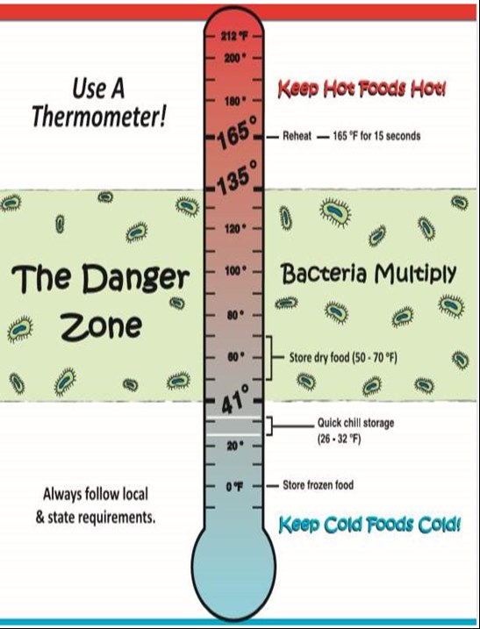
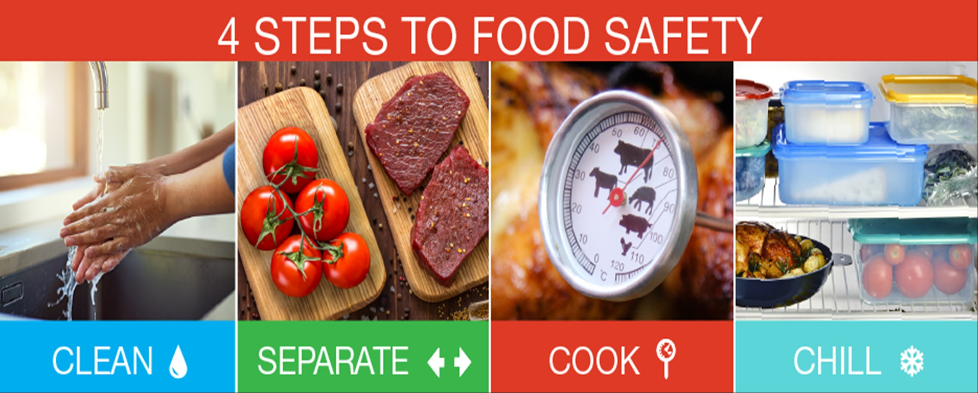
Food Safety
Notes:
Food Safety for Healthy Summer Meals Food safety is one of the key aspects of having a successful SFSP. Safe steps in food handling, cooking, and storage are essential in preventing foodborne illness. You can't see, smell, or taste harmful bacteria that may cause illness.
For food preparation: Kitchen staff• Clean—Wash hands and surfaces often. • Separate—Don't cross- contaminate. • Cook—Cook to proper temperatures, checking with a food thermometer. • Chill—Refrigerate promptly. To ensure that food children consume in SFSP sites are safe and reduce the risk of a foodborne outbreak, it is important to keep these things in mind: (for sponsors & sites)a. Follow all Health Department guidelines - b. Practice good personal hygiene - Sponsors can practice good personal hygiene by ensuring their staff handling and preparing food are using effective handwashing procedures, wearing gloves properly and arriving to a summer meals site properly dressed. c. Checking & documenting Food Safety temperatures - Bacteria exist everywhere in nature. They are in the soil, air, water, and the foods we eat. When bacteria have nutrients (food), moisture, time, and favorable temperatures, they grow rapidly, increasing in numbers to the point where some can cause illness. Sponsors can prevent foodborne illnesses outbreak by properly handling, cooking, and storing foods at safe temperatures. Cold foods should be kept below 41 ⁰F while hot foods should be kept above 135 ⁰F. Using a calibrated food thermometer is recommended to make sure food stays out of danger zone.
Practice proper cleaning and sanitizing –Proper cleaning and sanitization of food preparation equipment and work surfaces can minimize food contamination and prevent outbreak of foodborne illnesses at summer sites. The following steps can be followed to ensure proper cleaning: o Wash – Wash surface with soap and water solution to clean. o Rinse – Rinse surface with clean water to remove debris and soap. o Sanitize - Sanitize surface using a sanitizing solution mixed at the concentration specified on the manufacturer’s label. Allow items to air dry.
If you need a thermometer let us know
Make sure all cleaning products are stored away from food and kids
For pans/utensils that are staying on site, please make sure to wash and sanitize before the next meal service. Please make sure pans/utensils are cleaned off to the best of your ability before sending them back if you have no sink.

Slide 11
Food Allergies
A doctor or other who can write prescriptions, must complete a form confirming a child has a disability to omit or substitute an item. This does not have to meet the meal pattern.
If doctor marks that the child has special dietary needs but does not have a disability, no accommodations will be made.
If a child never brings a doctor’s note, you are required to serve the entire meal.
If a child is lactose intolerant and does not bring a note, they must still be served milk. They are not required to drink it, but they must take it.

Slide 12
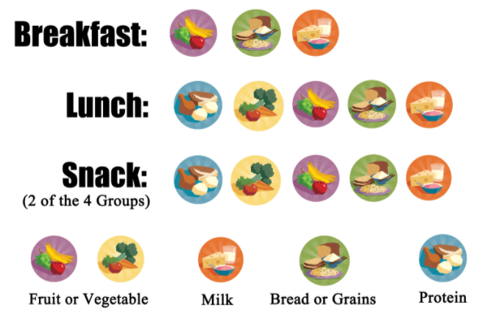
Meal Pattern & Menus
Menus must be always posted.
Children must take all items.
Milk is a requirement and must be taken.
You may serve water with meals, but it does not replace milk.
Do not serve additional items with the meal – serve them after meal service.
Make changes to the menu as needed.

Slide 13
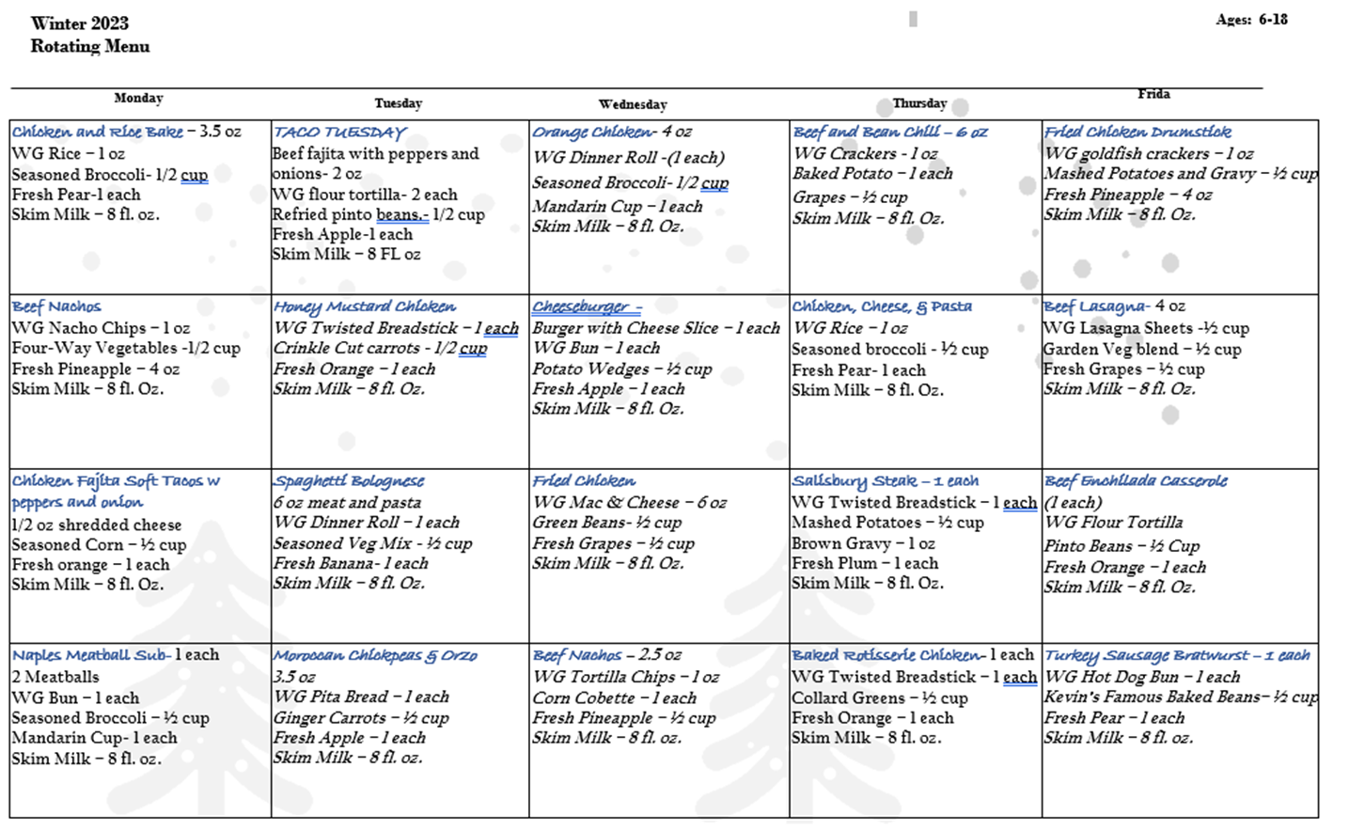
Menu- sample menu
Notes:
THis is a picture of a sample menu. The menu will be a rotating menu. Each site will need to have this menu posted including snack and lunch. Lunch will operate on a week cycle,s similar to the school year. And snack will operate on a 2 week cycle. This will be available on the website
If there are any menu changes, these will be sent via email to sites, please make these changes on your menu

Slide 14
Meal Counting
ACCURACY IS IMPORTANT!!
Each meal served MUST meet the meal pattern to be counted on the Meal Count & Delivery Ticket.
The count is to be taken as the children go through the line at the point of meal service.
The count can’t be completed before or after meal service, it must be completed during the meal service.

Slide 15
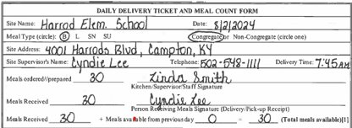
Daily Meal Count Form & Delivery Ticket
Please have this form available each day for our drivers
Address should be site physical address, not sponsor address.
Congregate or non-congregate must be indicated as approved in the site application,
Phone number for the site may be the number of the Site Supervisor, not the sponsor.
Site Supervisor must be trained before meal service begins.
The number of meals available must be completed daily. You cannot claim more meals than are listed.
Delivery time (if applicable) and date are important to ensure food safety.
NEW FORM!
The Delivery Ticket information must be completed.
DTC Staff will complete the number of meals ordered/prepared and sign. When meals are delivered, the site personnel will count the meals and sign to verify the number received.
The Site Supervisor will also sign the bottom of the form to confirm the meal count.
Notes:
Please have this form available for when your driver gets to you. Driver will need to sign a form for each meal service that they are delivering food for in the Cambro. Please have top filledout, except meals ordered/prepared amd kitchen supervisor/staff signature. Very similar to when you receive a package
Drivers will deliver around
You’ll fill out one of these a day
Drivers- this must be signed by you. Still sign tablets too

Slide 16
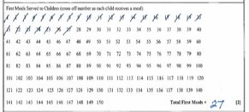
Daily Meal Count & Delivery Ticket
Each meal must be marked individually. Do not draw a line through multiple numbers.
The meals must be marked at the time of meal service.
A Daily Meal Count & Delivery Ticket Extension is available for meals over 250.
The number of first meals must match the number of individual meal count marks.

Slide 17
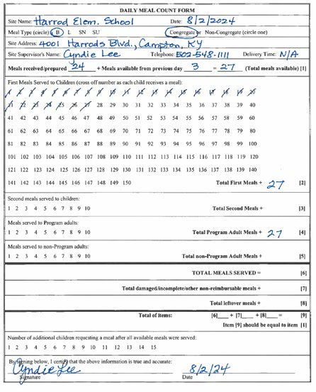
Individual meal counting is still required for Second Meals and meals served to adults. These must be complete meals, not only one component or leftovers.
The totals must match the individual meal count marks total all meal served, damaged/incomplete/other and leftover. This total should match the number of meals available for the day.
Line 9 is not required but is a good way to check your accounting. The total should match the number of meals available for the day
*For breakfast, start with total number delivered at beginning and keep inventory as you use meals/more are delivered.
Notes:
Print this sheet

Slide 18
This section is not required to be completed but helpful for determining how many meals are needed for the next meal service.
Signature and Date are REQUIRED. The form should be signed by the person counting meals on the day of meal service. All forms should be signed by a trained staff member. The signatures will be compared to training sign in sheets if the sponsor is reviewed.
Notes:
This form needs to be downloaded from Cartewheel and saved to a folder

Slide 19
Weekly meal count rules
For meals to be reimbursable:
Meals must be counted individually, not one line through many numbers (/ is only acceptable mark)
All required info must be completed daily & turned in weekly online
Can’t claim more meals than the number of meals available – except kitchen meals
Can’t claim more first meals served than children in attendance
The meal count shouldn’t repeat daily with no variation
Must claim at least 85% of Meal Delivered
Notes:
If you need to decrease your meal counts, the latest this can be done is 8:30am the morning of. If you need to increase your meal counts, this needs to be done no less than two business days in advance

Slide 20
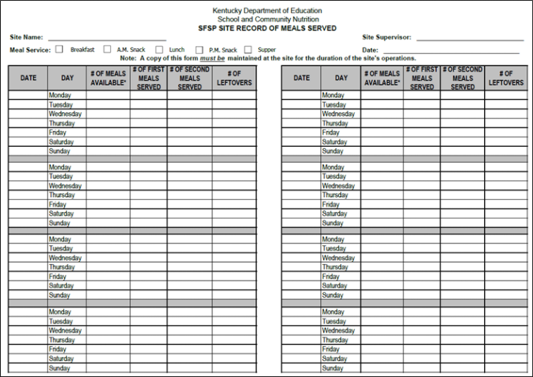
Site Record of Meals Served (At Risk form)
# of meals available = meals delivered + leftover meals from previous day
For breakfast, start with total number delivered at beginning and keep inventory as you use meals/more are delivered.
FILL OUT COMPLETELY
Complete daily and turn in weekly ONLINE.
Must be always available for monitoring.
Must have a Site Record for each meal service type.
Must match Weekly Meal Count & Delivery Ticket
Notes:
Different from cacfp

Slide 21
Why 85% rule?
The expectation is that a minimum of 85% of meals delivered will be served….we know that attendance fluctuates, but we ask that you keep the 85% goal in mind and adjust as soon as one is needed to avoid wasting food. Please reach out to Taylor if you have concerns about your % of meals served.

Slide 22
SFSP 85% rule
Site serves meals for 3 weeks
After 3 weeks, Sponsor reviews meal counts
Sponsor will decrease/increase to average meal count
Site serving below 85%
Yes- Sponsor will reduce prepared/delivered meal counts to avg meal served. If meal count average falls below 20, DTC will pause meal delivery
Yes- may receive shelf stable meals
No- receive hot meals
Notes:
To reduce waste, after three weeks of your site starting meal service, we will review your meal counts. based off your meal conts, we will decrease/increase your meal counts to the average meal counts you had for the previous three weeks. We will continue to monitor these meal counts and if the site is serving below 85% we will reduce meal counts. If the sites meal counts fall below 20, we will shift meals to shelf stable

Slide 23
Paperwork Timeliness & Accuracy
For the summer, ALL Paperwork needs to be turned in weekly. This includes the weekly meal counts and weekly at-risk form. If a site is late for one week, we will document this, the second week this occurs, we will suspend meals for the third week. If this happens the third week or an additional occurrence, we will discontinue meal delivery.
Paperwork submitted after the deadline after two occurrences, site will be put on notice after third time- discontinued

Slide 24
Paperwork Recap
Menu posted for each day
Weekly Meal Count & Delivery Ticket(NEW!!)
Site Record of Meals Served
AJFA Poster
Notes:
Please turn in weekly

Slide 25
Breakfast Kits
NEW!!-Place order by 5pm the Tuesday before the next week starts.
Only order enough to serve first meals – do not order more to accommodate seconds or program adults.
Sites will order by case. Multiply your meal counts by the number of days you serve and that’s how many meals you need, then order this by how many is in a case.
Breakfast order form:
Breakfast Order Form | Dare to Care
Notes:
How to put this on the meal count sheet
All sites must feed congregate

Slide 26
Lunch(Hot Kitchen) meals
Only serve as congregate meals
Check temperature 30 minutes prior to serving and at serve time.
Changes and closures must be submitted at least 2 business days in advance.

Slide 27
SNACK
Snack will be a cold Meal or shelf stable
This meal also needs to be claimed on meal count sheet and Record of meals served sheet

Slide 28
Field Trip Meals
Field Trip meals will be shelf stable
Please let us know of all planned field trips
Send field trip dates through the site
State & Sponsor Reviews
Dare to Care food orders

Slide 29
Sponsor and State reviews
Dare to Care will conduct a review of the site to make sure that the site is following all program rules and regulations
KDE may choose to visit your site at any point during the summer
Any areas of noncompliance will be addressed in a corrective action plan. The site must indicate the immediate corrective action that was taken and identify the plan in place to ensure future compliance.
A site must be terminated from participation if many violations are found and/or if the health, safety, or wellbeing of children is threatened.
Notes:
For new sites, we have conducted a pre-op visit. We will also complete an initial site visit within the first four weeks from your start date and review to make sure meal service and operations are moving smoothly

Slide 30
Sponsor & State Reviews
Your Responsibilities(Site Supervisor) | Our Responsibilities (Sponsor Site)
Attend training Ensure civil rights requirements is properly implemented. Stay at the site for the entire meal service Serve meals Clean up Food safety Receive and account for delivered meals(sign off) Ensure children eat on site Plan & organize daily activities Ensure safe & sanitary conditions at site Have a backup supervisor | Visit sites at least once during the summer Staff can show up any time and should be unannounced. Check on site operations to ensure site personnel maintain records. Conduct pre-op visit (must view prior to approval). Review food service operations Prepare report of visits and reviews-revisit site if necessary-conduct trainings. If issues are found, a corrective plan will be developed with site staff. Email site with monitoring form

Slide 31
Sponsor & State Reviews
What does your site need?
All records kept for current plus 3 years prior
Documents needed
Corrective Action Plans
Any paperwork we have sent
Income applications (closed only sites)
Menus- changes, records
Civil rights data collection
Site reviews
Paperwork- meal counts, at-risk, forms and agreements

Slide 32
Civil Rights

Slide 33
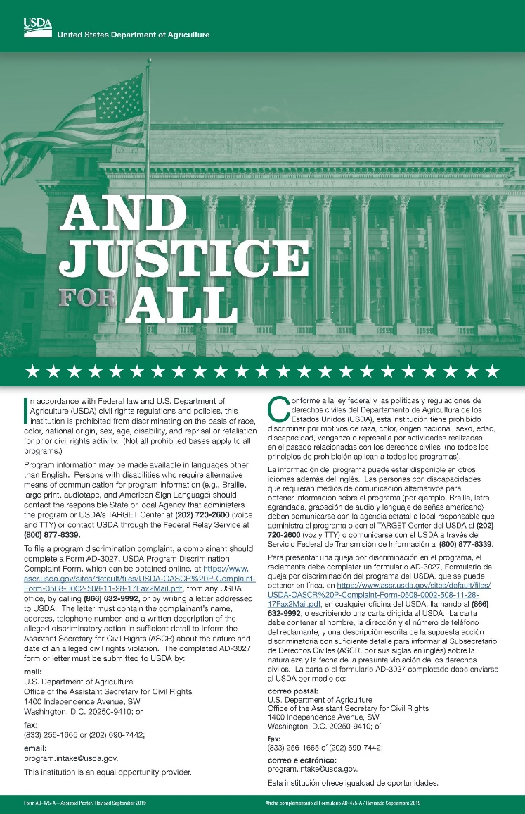
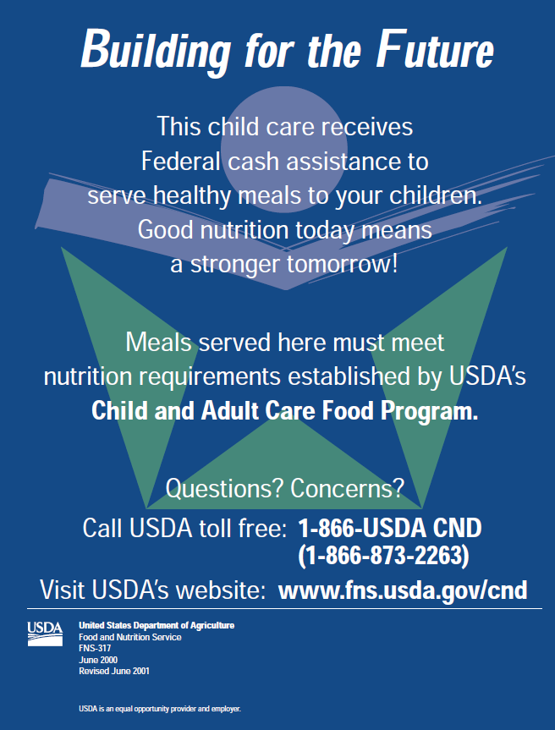
CIVIL RIGHTS
PUBLIC NOTIFICATION
Include USDA non-discrimination on all materials
01
Prominently display the "And Justice for All" poster in the food service area. The full-size 11"x17" poster must be used.
02
02
Notes:
I have some here if you need them.

Slide 34
Civil Rights
Goals of Civil Rights
CIVIL RIGHTS
GOALS
What is Discrimination?
Different treatment which makes a distinction of one person or group of persons from others; either intentionally, by neglect, or by actions or lack of actions based on any persons or group who has characteristics for which discrimination is prohibited based on the law, regulation, or executive order.
1. Knowledge for rights and Responsibilities
01
2. Elimination of illegal barriers that prevent or deter people from receiving benefits
02
3. Dignity and Respect for All
02
4. Equal treatment for all applicants and beneficiaries
Six Protected Classes: Race, Color, National Origin, Age, Sex, Disability
Notes:
For example, if your site has steps, is there an alternate route for someone who comes with a wheelchair?

Slide 35
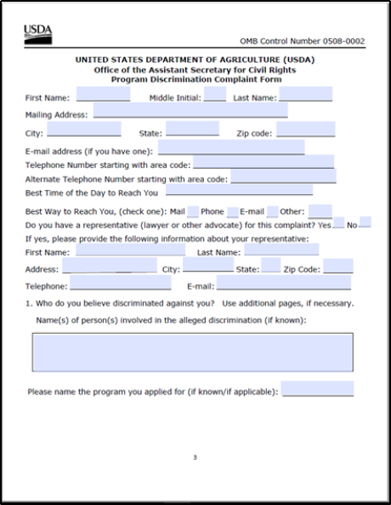
CIVIL RIGHTS
GRIEVANCE PROCEDURES
Accept verbal or written grievances.
Complaint must be made in 180 days.
Available on DTC website or USDA
Keep procedures and report forms at site.
Never try to impede or "work it out"
Complaint goes directly to USDA - information is on the form.
02
Notes:
This is located on our website

Slide 36
Site Supervisor responsibility recap
Trained site supervisor must be present during ALL meal services and serve all children.
Ensure accurate meal count & Civil Rights Compliance are followed.
Submit all forms to DTC each week and inform sponsor of any changes.
Keep all necessary forms on siter

Slide 37
Remember-This is a Partnership!
Mission
Communication
Compliance
Responsibility
*We are here to help, please reach out!
Notes:
With this being said, we are in partnership with you and you with us. We, as well as you reserve the right to terminate partnership if either parties do not uphold to compliance or partnership requirements. We will also send to you our updated policies for you to sign. These will also be on our website.

Slide 38
Online Processes
New-->
NEW SITE STAFF
https://daretocare.org/kids-cafe-new-site-staff/
SUBMITTING PAPERWORK
CHANGING MEAL COUNTS
CLOSURES/CHANGES IN MEAL SERVICE
https://daretocare.org/kids-cafe-file-upload/
https://daretocare.org/meal-count-change-request/
https://daretocare.org/kids-cafe-closures/
Notes:
deadline for school year applications

Slide 39
School Year Application Deadlines
June 17th-July 15th

Slide 40
Any questions?
Notes:
This training will be available online
Did everyone sign the attendance sheet?

Slide 41
Thank you
Taylor Thompson
taylor@daretocare.org
502-736-9917

