Slide 1


Kentucky TEFAP
2020 TEFAP Policies and Civil Rights Training

Slide 2

PURPOSE
This presentation is directed to representatives of organizations that serve as Sub-Outlets for TEFAP to provide an overview of TEFAP program requirements and Civil Rights training.

Slide 3
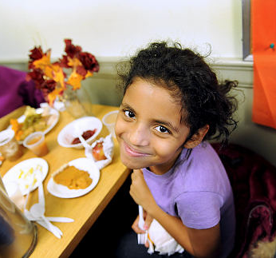
OUR GOALS
Review TEFAP Agreement and related policies/ requirements
Review the proper client in-take process for gathering and reporting service statistics
Learn about Civil Rights and how they relate to the processes a Sub-Outlet must adopt to participate in TEFAP

Slide 4
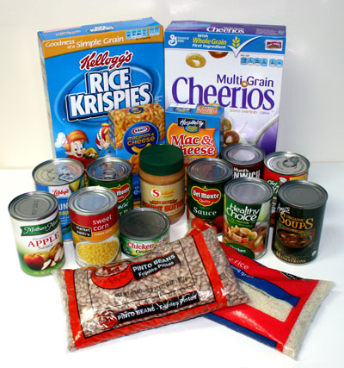
WHAT IS TEFAP?
The Emergency Food Assistance Program (TEFAP) is a federal program that helps supplement the diets of low-income Americans by providing them with emergency food assistance at no cost. USDA provides 100% American-grown USDA Foods and administrative funds to states to operate TEFAP.

Slide 5

TEFAP AGREEMENT
The current version of the TEFAP Agreement
became effective on July 1, 2017.

Slide 6
TEFAP AGREEMENTS
Unlike in the past, the Agreement does not have a dated expiration, but the income guidelines are subject to change at any time and usually do on an annual basis.
As a Sub-Outlet, your agency is required to keep a copy of the current, signed Agreement on file at the agency site; this document must be available for review upon request.
It is the organization’s responsibility to make DTC aware of a staff change in writing 30 days prior to that change to ensure continual program participation.
By signing the Agreement, your agency agrees to the stated USDA and DTC policies, so it is important to read the document in its entirety.
*If both parties agree to terminate the Agreement, a written 30-day notice must be given. Un-foreseen circumstances may cause termination in less than 30 days by either or both parties.

Slide 7

TEFAP REQUIREMENTS
All of the TEFAP things/processes for which
there are no substitutes

Slide 8
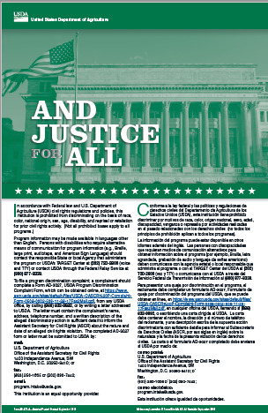
TEFAP Sub-Outlets Must Post the And Justice For All Poster in Clear View
This poster should be considered the “key to the door”; if you can’t see it, you can’t open the door.
What does this poster mean?
We cannot discriminate based on:
Race
Color
National origin
Gender
Religion
Age
Disability
Political beliefs
Sexual orientation
Marital & family status
Notes:
Most of you are familiar with this poster and know that the US Department of Agriculture requires that each participant in the TEFAP program post this sign within their service site for clientele to see.
But what does the poster say?
Most often, when we think of discrimination, we focus in on race and color. However, this notification puts emphasis on PROHIBITING in ALL of its programs/ activities discrimination by each of these things. It also lists the means by which participants in your programs can contact USDA to file a complaint. This poster keeps us accountable to those we serve and to those we acquire our resources from.
Note: Race is Caucasian, African, Asian, etc. Color is skin tone- within a race there can be different skin tones.

Slide 9
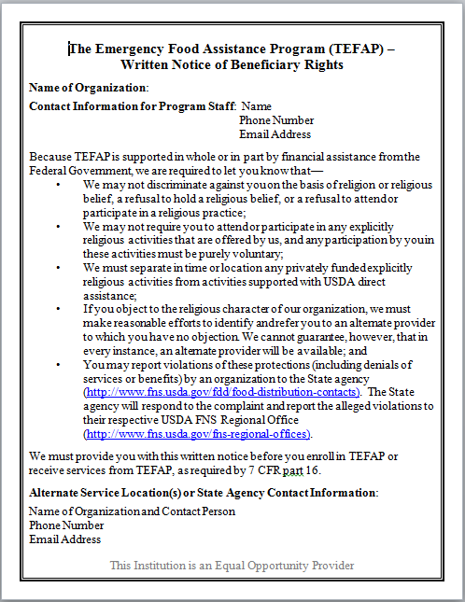
Written Notice of Beneficiary Rights
The Written Notice of Beneficiary Rights must be posted alongside the And Justice For All poster at faith-based sites. This document identifies an Alternate Service Location which is not faith-based.

Slide 10
Receiving Orders
Dare to Care creates the monthly TEFAP orders.* *There are a few exceptions to this rule for agencies with limited storage capacity.
Sub-Outlets agree to accept and distribute all of the products on the monthly order; picking and choosing products is not allowed.
Sub-Outlets must keep an accurate record of the products received each month.
All TEFAP products must be stored separately on shelving labeled “USDA”; this rule applies to dry stock shelving, refrigerators, and freezers.

Slide 11
Distributing TEFAP Products
Sub-Outlets must use the most-current Commodity Application Register, provided by the KY Dept. of Agriculture, to establish the eligibility of program Applicants; this is done by using the income guidelines each time the Applicant accesses the food stream. (more on this later)
All qualifying Applicants must provide their signature to receive TEFAP products.
Ideally, TEFAP products should be supplemented with food from other food streams.

Slide 12
Distributing TEFAP Products
Homebound Applicants must have a Proxy Form on file at the Sub-Outlet which identifies their Proxy; this establishes the identity of the person/s who are authorized to receive food on the Applicant’s behalf.
A Proxy must arrive with a dated & signed note from Applicant and his/her own photo ID. The Proxy’s photo ID should identify them as the authorized Proxy listed on the Proxy Form the Applicant has on file at the Sub-Outlet.
A Proxy should sign his/her own name followed by the word “Proxy” and the note should be stapled to the back of the Commodity Application Register.

Slide 13
Food Storage & Safety
USDA products must be stored in a locked, temperature-controlled place. Dry products must be held on shelving at least 6 inches from the floor and 4 inches from the wall; this rule also applies to fresh produce.
Thermometers must be in all dry, refrigerated, and frozen food storage areas, and a separate temperature recording chart must be maintained for each of these storage area.
If food loss occurs: the food should be quarantined; photos should be taken of the food; and Dare to Care should be contacted immediately to report the loss and to gain approval for disposal from the KY Dept. of Agriculture.
All USDA food must be stored or prepared and distributed from the approved Sub-Outlet site.

Slide 14
Establishing Eligibility Per Income Guidelines
Pantry:
DTC will forward the most-current Commodity Application Register when the income guidelines are updated.
Income is self-declared and no proof of income may be requested
Commodity Application Registers must be kept on file and available for review for 3 years plus the current year.
Soup Kitchen:
Kitchens do not use the Commodity Application Register; they serve all without question.
Kitchens must maintain a dated log of the number of people served and number of meals prepared with USDA products.
The dated log must be kept on file for 3 years plus the current year.

Slide 15

Reporting Monthly Statistics & Inventory
TEFAP service statistics must be entered online via the DTC website by the 7th of every month.
USDA commodity inventory must entered online via the DTC website by 7th of every month. It is best to keep TEFAP products in their cases until distribution to ease this process.
Failure to submit statistics and inventory promptly can result in suspension or cancellation of the TEFAP Agreement.

Slide 16
CIVIL Rights

Slide 17

WHAT ARE CIVIL RIGHTS?
Function: noun plural
the nonpolitical rights of a citizen; especially ; the rights of personal liberty guaranteed to United States citizens by the 13th and 14th amendments to the Constitution and by acts of Congress.

Slide 18
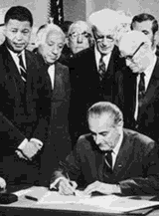
NOT SO LONG AGO….
Women couldn’t vote in the U.S until 1920.
Native Americans weren’t considered U.S. citizens until 1924.
Black and white students were provided seperate restrooms lawfully until 1964.
Discrimination was allowed in all public places until 1964.
The right to vote was based on literacy tests and poll taxes in many U.S. states until 1964.
Institutions with federal funding could discriminate based on gender until 1964.
Notes:
The following are repercussions which reversed each act of discrimination…

Slide 19
THE BASIS OF CIVIL RIGHTS TODAY
Title VI of the Civil Rights Act of 1964 makes it unlawful to discriminate on race, color, religion, gender, or origin.
Title VII of the Civil Rights Act of 1964 makes it unlawful for employers to discriminate based on race, color, religion, gender, or origin.
Title IX of the Education Act of 1972 addresses gender discrimination.
Section 504 of the Rehabilitation Act of 1973 makes it unlawful to discriminate based on disability.
The Age Discrimination Act of 1975 addresses age discrimination.
The Americans with Disabilities Act of 1990 also addresses disability discrimination.

Slide 20
UPHOLDING CIVIL RIGHTS
How to ensure equality at food pantries or kitchens

Slide 21
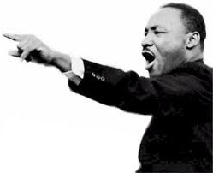
STEP 1: PROVIDE EQUAL ACCESS TO PROGRAMS
As a TEFAP administrator, YOU and your volunteers are responsible for ensuring everyone has equal access to the USDA food stream. Your agency may not discriminate in program participation on:
Race
Color
National origin
Sex
Age
Disability

Slide 22
STEP 2: PUBLIC NOTIFICATION
Civil Rights Statement: TEFAP is an equal opportunity provider- must be printed on all pamphlets, sign in sheets, intake forms and certificates of eligibility in English and Spanish
Convey the message of equal opportunity in all photos and other graphics
Reach out to un-served or underserved populations
And Justice for All Poster: Displayed in a prominent location, in clear view of all who enter
Written Notice & Referral Requirements: Displayed
Inform potentially eligible persons of programs or changes in programs

Slide 23
STEP 2: PUBLIC NOTIFICATION
Include the required nondiscrimination statement on all appropriate agency publications, web sites, posters and informational materials.
“In accordance with Federal law and USDA policy, this institution is prohibited from discriminating on the basis of race, color, national origin, sex, age or disability, and reprisal or retaliation for prior civil rights activity. To file a complaint…”
(See And Justice for All Poster for remainder of statement)

Slide 24
STEP 3: DATA COLLECTION
Maintain all TEFAP records 3 years
People self-declare their eligibility by signing the Commodity Application Register; if a person refuses to sign, advise that you or someone else will enter a denial code for them based on perception.
All data MUST be secure and confidential
Notes:
Can code two races for one person. FCCH must collect for providers and children. Must use translation or language line if necessary.

Slide 25
STEP 4: COMMUNICATION
What do you do if you are serving someone with limited literacy?
TEFAP staff are required to read the “And Justice for All” poster and complaint notice for all those who are unable to read.
What do you do if you are serving someone who doesn’t speak English?
The “And Justice for All” poster must be translated or else the agency is at risk of violation of Title VI and its regulations. The poster is available in many languages.
Notes:
Flexibility and outreach is key. Children should not be used as interpreters. Volunteers may be used but make sure they understand interpreter ethic- particularly confidentiality.

Slide 26

STEP 5: COMMUNICATION
For Braille, large print, audiotape communications, contact USDA’s TARGET center at 202.720.2600
In Kentucky, for hearing impaired services: http://www.kyrelay.org/
Language Assistance: www.lep.gov

Slide 27

Thank you
for your attention and participation in TEFAP!

Slide 28
HELPFUL RESOURCES
FNS 113-1: www.fns.usda.gov/cr/crregulation.htm
www.civilrights.org
www.usccr.gov/pubs/pubsndx.htm
Dare to Care: www.daretocare.org
Feeding America: www.feedingamerica.org

