Slide 1

Food Safety Training for Pantries
Partner Conference 2011
…because nobody wants shigellosis.
Notes:
Welcome/ Introductions, brief overview, how long it will take, where restrooms are. After the course, attendees should be able to: describe the importance of food safety, identify the causes of food borne illness and explain the consequences of food borne illness.

Slide 2
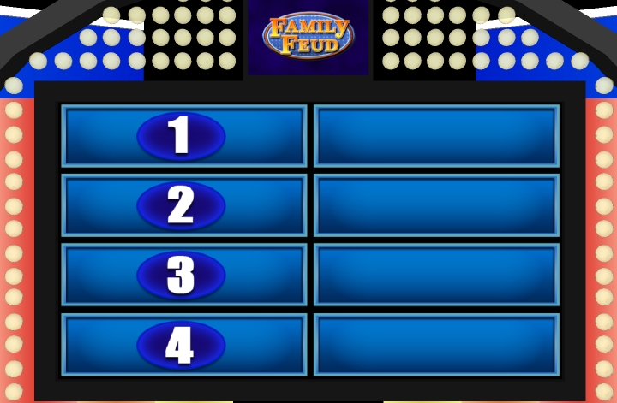
A Warm-Up !
Ten Riskiest Foods Regulated by the FDA
Notes:
Illnesses caused by these ten foods may be as minor as stomach cramps and diarrhea for a day or two, or as serious as kidney failure or death. Salmonella and E. coli have been repeatedly linked to these food items.

Slide 3
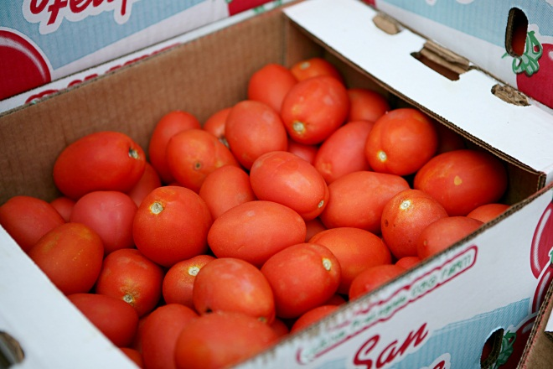
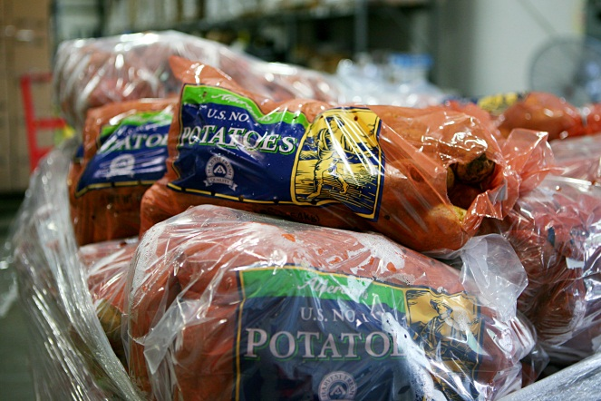
A Warm-Up !
Ten Riskiest Foods Regulated by the FDA
LEAFY GREENS
EGGS
TUNA
OYSTERS
POTATOES
CHEESE
ICE CREAM
TOMATOES
SPROUTS
BERRIES
Notes:
Unfortunately, most of the most dangerous items are also the healthiest. Salad can actually make you sick. In 2006, leafy greens hit the national radar screen as a high risk food when bagged spinach contaminated with E. coli caused several deaths and hundreds of illnesses. Contamination may be present from production and processing, or may occur through improper handling and preparation, such as inadequate hand washing. Pathogens need FATTOM (Food, Acidity, Temperature, Time, Oxygen, Moisture) to grow and grow well, as they do in these foods.

Slide 4
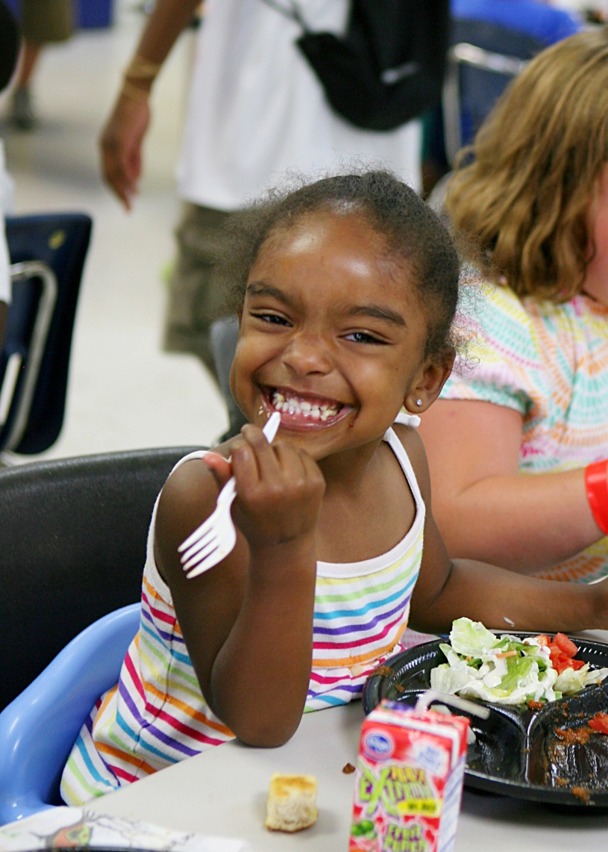
The Importance of Food Safety
We are accountable to our regulators.
We must protect the people we serve.
We feed a population at risk.
Notes:
The objective of this session is to provide you with information that can help you protect the safety of the food you or others handle. Your efforts must be proactive versus reactive.
Food safety is the most important thing we do. We are part of the food industry and viewed as such by federal, state, and local regulators. Our responsibility and liability grows as our network grows.
As a food handler, you are part of the food industry, and the care you provide protects the consumer you serve. There are 76 million outbreaks of foodborne illness per year.
When discussing food safety with the network, we occasionally rely on the Good Samaritan clause. These are reactive positions versus proactive. What we all need is a proactive strategy to keep food safe that is both realistic and attainable. We all agree that we feed a population at risk. Therefore, we require food safety standards that are greater than those required in the food industry. We need to be the food safety leader in our section of the food industry.

Slide 5
An Introduction to Food Safety
What is a foodborne illness?
An illness caused by eating contaminated food.
What is a foodborne disease outbreak?
The occurrence of two or more cases of the same illness.
What microorganisms cause foodborne illnesses?
Bacteria, viruses, fungi, parasites.
Notes:
May want to list common foodborne illnesses: E. Coli, Shigellosis, etc.

Slide 6
Foodborne Illness
General Symptoms of Food Borne Illness Include:
Abdominal Pain
Stomach Cramps
Diarrhea
Vomiting
Nausea
Fever
The first symptoms usually occur during the onset time or first 38 hours.
The duration of the symptoms can be one to seven days.
Notes:
Most food borne illnesses express these symptoms.
High risk populations include: elderly, pregnant, children, ill

Slide 7

Potentially Hazardous Foods
Pathogens need FAT TOM to survive and grow in food:
Food
Acidity
Time
Temperature
Oxygen
Moisture
Potentially Hazardous Foods (PHF)
or Time & Temperature Control for Safety Foods (TCS) allow pathogens to grow and multiply.
Notes:
Pathogens need: food (lots of it, like a carb or protein), acidity (little to none), temperature (in the danger zone: 41-135 degrees Fahrenheit), time (if they are in the danger zone for 4+ hours), oxygen (lots of it), moisture (lots of it)
Potentially Hazardous Foods (PHFs)/Time/Temperature Control for Safety Foods (TCS Foods) allow microorganisms to grow and multiply. What foods were named at the beginning of the presentation? What would an example of a low-risk food be? (Anything dry or high acidity like a canned good or cereal)

Slide 8
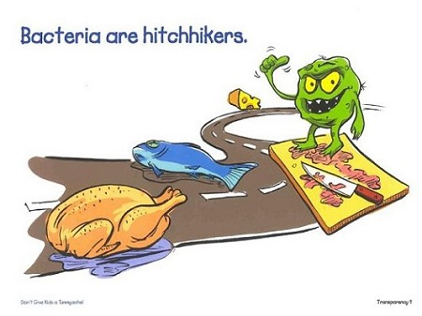
ACTIVITY
See if you can identify if these are high or low risk foods:
SPAGHETTI
OMELETTE
TURKEY
APPLE
CHEESE PIZZA
JUMBO SHRIMP
PLAIN BAGEL
Notes:
LOW
HIGH
HIGH
LOW
HIGH
HIGH
LOW

Slide 9
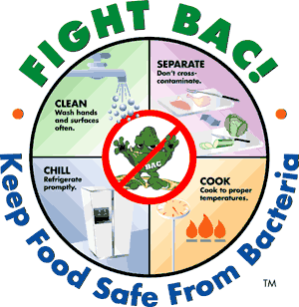
TYPES OF CONTAMINATION
Contamination is the presence of PHYSICAL, CHEMICAL, or BIOLOGICAL MATTER in our food or food environment.
Food may be contaminated:
Before delivery
Because of poor hygiene
By customers
Notes:
Types of Contamination
Contamination is the presence of physical, chemical, or biological matter in or on food or the food environment.
Food may be contaminated:
Before delivery
Because of poor hygiene
By customers

Slide 10
TYPES OF CONTAMINATION
PHYSICAL: hair, glass, paper, plastic, scabs, rodent droppings, flies, bones from meat/ fish.
CHEMICAL: pesticides sprayed on fruit or vegetables, freezer refrigerants, drugs, food additives, and chemicals from cleaning products and metal or non-food-grade cookware and storage
BIOLOGICAL: bacteria, viruses, fungi, parasites.
Notes:
Examples of physical contaminants include: glass, sharp metal objects, pieces of paper, plastic and stones, human hair, scabs and nails, rodent and insect droppings, and dead pests such as flies. Food items themselves, or parts of food items, may also physically contaminate food ready to be served, such as bones in meat or fish, or stalks in vegetables.
Examples of chemical contaminants include pesticides sprayed on fruit or vegetables, freezer refrigerants, drugs, food additives, and chemicals from cleaning products and metal or non-food-grade cookware and storage. Keeping cleaning chemicals in food storage or preparation areas or failing to label containers are common causes of chemical hazards.
Examples of biological contaminants include bacteria, viruses, fungi, and parasites. These microorganisms may be transferred to food from a variety of sources, such as people, raw food, contact surfaces, pests, and garbage.
Biological contamination usually occurs due to ignorance, a lack of space, or poor building design. It may also occur when food handlers take shortcuts or do not practice good hygiene.
WHICH TYPE OF CONTAMINATION DO YOU THINK OCCURS MOST OFTEN?
Biological contamination is the most common type of contamination and can have very serious consequences. It is usually hard to detect at first, but may result in spoiled food, foodborne illnesses, or even death.

Slide 11
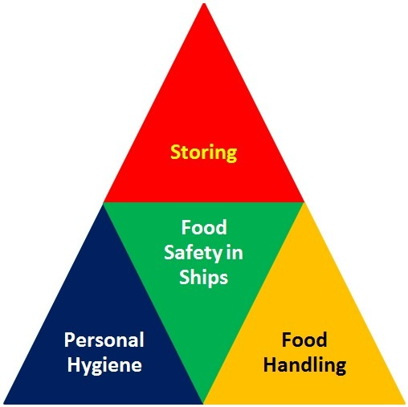
CAUSES OF CONTAMINATION
Cross Contamination
Poor Personal Hygiene
Improper Cleaning and Sanitation
Time and Temperature Abuse…
WHAT IS THE TEMPERATURE DANGER ZONE?
Notes:
Cross-contamination is the transfer of microorganisms or chemicals from contaminated food, hands or contact surfaces to other foods or surfaces. Proper hand washing, cleaning, sanitizing and storage can prevent cross-contamination. Raw food must always be stored below ready-to-eat food to avoid cross-contamination.
Employees who don't wash their hands properly or often enough are one of the biggest risks to proper food safety. Other measures, such as wearing proper attire, using hair restraints, and covering sores and cuts, also help to prevent contamination of food.
Unclean or unsanitized equipment can contaminate food.
Abuse of the temperature danger zone is not a cause of food contamination, but rather it allows bacteria that are there to multiply rapidly. Food must be stored at the proper temperature to ensure its quality. A temperature danger zone exists between 41° F (5° C) and 135° F (57° C). Minimize the time that food is exposed to this temperature danger zone.

Slide 12
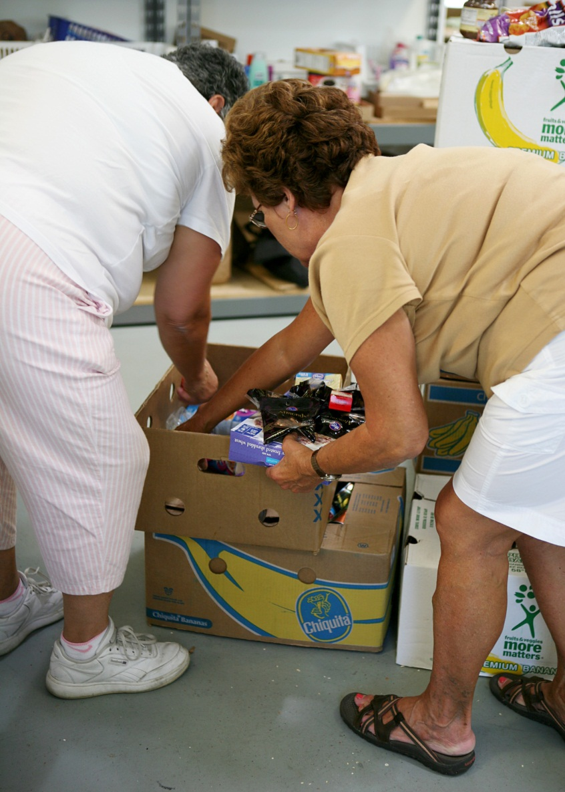
PREVENTION: RECEIVING FOOD
What do you check for when receiving food?
Correct labeling
Proper temperature
Proper appearance
Delivery vehicle
Signs of Pests
Placement of Raw Foods
What should you do with rejected food?
Notes:
Labeling: all must have correct label, especially salvage items
Proper temperature: food does not show ice crystals or is wet or damp
Proper appearance: note quantity and quality of each item, damaged/ mislabeled/ unlabeled packaging
Delivery vehicle: note vehicle and driver, vehicle should not be left unattended, driver should have good hygiene
Signs of pests: feces, legs, eggs
Placement of foods: Raw and cooked foods kept separate
If you reject food:
Keep the rejected product away from other food
Record the rejection
Inform the delivery person of the rejected product
Inform your manager

Slide 13
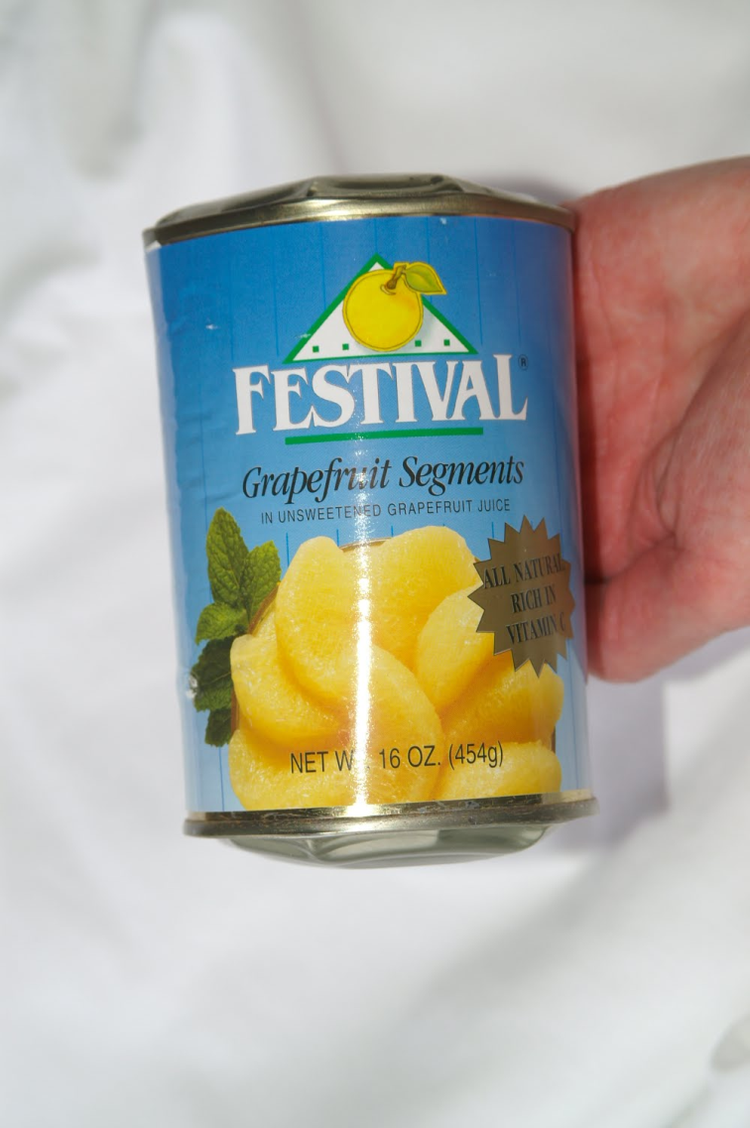
PREVENTION: RECEIVING FOOD
Canned food must be labeled and not have:
Swollen ends
Leaks
Seal problems
Lids that are popped
Major dents
Rust
When in doubt, throw it out!
Notes:
Highlight that we do have volunteers that go through salvage can, but they may miss a few errors. All agencies receiving salvage must have undergone salvage training.
The picture is of a bulged can. It should be thrown out!

Slide 14
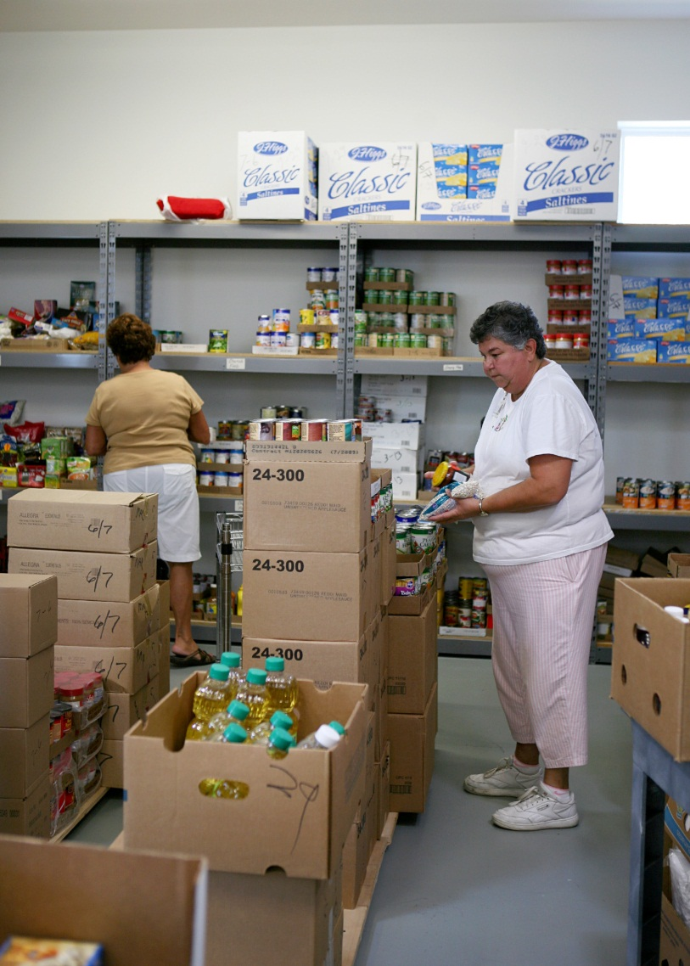
PREVENTION: STORING FOOD
Put food away in a certain order: Chilled, Frozen, Dry
Store food in original packaging
Use FIFO
Minimize time in the danger zone
Prevent cross contamination
Notes:
Store food in the following order:
Chilled food in refrigerators
Frozen food in freezers
Dry or canned goods in dry storage
Food should be stored in its original packaging. If moved to a new container, the container should be clean, sanitized, and labeled with the food name and original use-by date. Repackaging is usually not permitted, however. Certain foods can be difficult to identify if not in original packaging, which can lead to allergic reactions or possibly chemical poisoning.
Labels for PHFs/TCS Foods or foods with a short shelf life will have a use-by date or expiration date. Labels for foods with a longer shelf life will have a best-before date. t is essential that stored goods are correctly rotated. Correct stock rotation reduces the risk of pest infestation and food going out-of-date. Remember the rule 'First In, First Out' (FIFO). This way, older food will always be used first and you will avoid waste.
When storing food, remember the following:
Minimize time in the temperature danger zone. Keep raw food below PHFs/TCS Foods and other ready-to-eat foods.
Do not allow raw meat to touch PHFs/TCS Foods or ready-to-eat foods. Do not store food in hallways, utility rooms, restrooms, and sleeping or dressing rooms. Ideally, keep PHFs/TCS Foods and raw foods in separate refrigerators. Ready-to-eat foods are meant for consumption without any treatment that is intended to destroy any pathogens that may be present. They include all high-risk foods and such foods as fruit, salad, vegetables and bread.

Slide 15
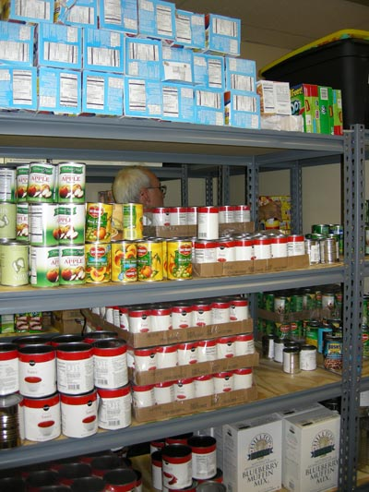
PREVENTION: STORING FOOD
A good storage area has:
Refrigerators, freezers and dry storage at the correct temperature
Refrigerators and freezers that are not overloaded
A lock and key
A well-maintained, dry, cool, clean, well-lit, ventilated dry storage
Food six inches above the floor and four inches away from the walls
Food separate from all cleaning chemicals and clothing closets

Slide 16
PREVENTION: STORING FOOD
Check the temperature of food and storage areas with a verified thermometer.
Store refrigerated foods at 41°F, or less.
Store frozen foods at 0°F, or less.
Store dry foods between 50 - 70°F.
Store whole produce at room temperature, and cut produce at 41°F, or less.
Document temperature readings for your refrigerators, freezers and dry storage once a week.

Slide 17
PREVENTION: TRANSPORTING FOOD
To transport food without temperature control, you must do the following:
Clean the inside of the delivery vehicle regularly
Pack food in insulated containers that can keep food at 41°F or lower if possible
Make a note of the time at which you left the food bank
Ensure that refrigerated food does not exceed 70°F
Ensure that frozen food does not thaw

Slide 18


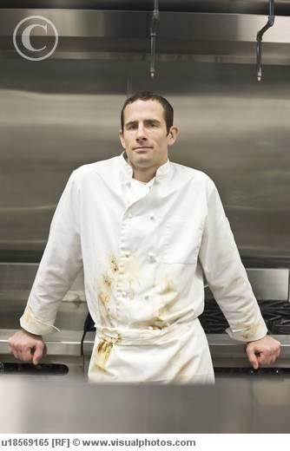



PREVENTION: PERSONAL HYGIENE
Actions that can contaminate food…
Notes:
Scratching the scalp, running fingers through hair, wiping or touching nose, rubbing an ear, touching a pimple of an infected wound, wearing a dirty outfit, coughing/ sneezing into the hand, spitting or chewing gum.
Avoid these actions around food.

Slide 19
PREVENTION: PERSONAL HYGIENE
WASH YOUR HANDS
Wash your hands frequently, especially after eating, drinking, smoking, touching your face, nose, ears, hair, handling waste, using the restroom, coughing or sneezing, handling raw foods, etc. Use hot water (100°) and wash for 15-20 seconds.
PROPER WORK ATTIRE
Wear gloves or aprons if available, clean clothing, appropriate shoes and a hat or hair restraint. Remove jewelry before handling food.
PERSONAL CLEANLINESS
Bathe regularly, keep short fingernails, do not handle food if you are ill, or have infected wounds or cuts. Infected wounds or cuts on the hands need to be covered with a bandage and glove before handling food. Eat, drink, and smoke only in designated areas away from food.
Notes:
Explain how to wash hands properly. Must use soap and hot water at least 100 degrees, rubbing soap on hands for 10-15 seconds in a hand-washing specific sink.
Explain how to use gloves, changing gloves with tasks.
Explain how to properly use dressing for wounds and cuts. Explain how smoking can cause contamination (smokers touch their lips and then the food, lay cigarettes on working areas, cigarette butts and ash may land on food).
Lay emphasis on the following:
Food handlers are particularly hazardous when they are ill. They can be restricted from work and usually return after medical clearance is given or 24 hours have passed (diarrhea, vomiting, fever)
Inform your manager whenever:
You or any member of your household has symptoms such as diarrhea, vomiting, nausea, or abdominal pain
You have a boil or skin lesion
You have conditions, such as colds, which result in excessive sneezing
You have a sore throat with fever
You have jaundice
You have eaten a meal known to have caused a foodborne illness
You have a foodborne illness, caused by one these pathogens: Norovirus, Hepatits A, Shigella, Shiga toxin-producing E. coli, and Salmonella

Slide 20
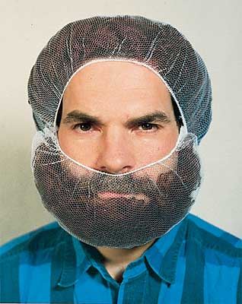
PREVENTION: PERSONAL HYGIENE
And, if burly, wear a beard restraint…
Notes:
•

Slide 21
PREVENTION: CLEANING/ SANITIZING
  Clean and sanitize food handling equipment after every use. Always inspect prior to use.
  Sanitize hand-contact surfaces such as taps or door handles.
  Use cleaning and sanitation chemicals according to label instructions. Use Personal Protection Equipment (PPE).
  Make sure all cleaners are in their original container.
  Store chemicals and cleaning equipment separate from food and utensils.

Slide 22
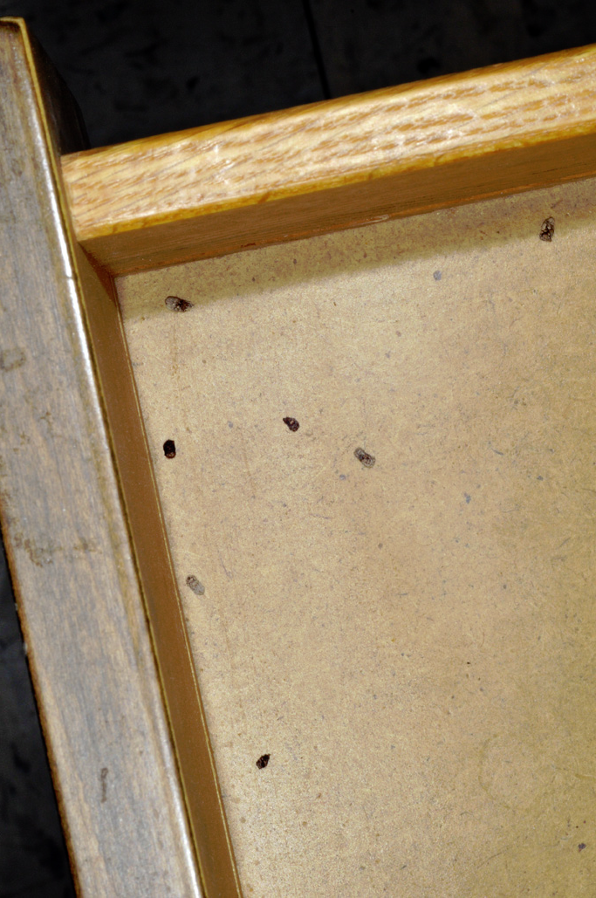
PREVENTION: PEST CONTROL
Pests like dimly-lit, moist, warm locations with food and water. Signs of pest include:
RODENTS
Sightings of live or dead bodies
Droppings/ smear marks against walls
Glow in the dark urine
Damaged packaging
Gnawed plugs, electrical wires and wood
Scratching, gnawing noises, weird smells
INSECTS
Sightings of adults, eggs, maggots or pupae
Droppings from cockroaches or flies
Unusual smells, especially from roaches
Notes:
Photo is of cockroach droppings.

Slide 23
PREVENTION: PEST CONTROL
Removing these conditions minimizes the risk of infestation:
Report defects in the building
Seal access points and openings
Protect the bottom of wooden doors with metal kick plates
Keep doors and windows closed or use screens
Inspect all deliveries closely
Maintain a well planned cleaning schedule
Never leave food outside
Store food in pest-proof containers off the floor and away from walls
Rotate stock
Maintain drains and water taps
Remove vegetation from around the premises
Make regular inspections

Slide 24
PREVENTION: RECALLS
A recall is an industry and regulatory response to food which is unsafe for consumption, because of adulteration (contamination) and/or misbranding (mislabeling).
As part of the food industry, food banks are required to react to recalls by identifying and removing recalled product from inventory. Tracing and accounting for all recalled product is also necessary.

Slide 25
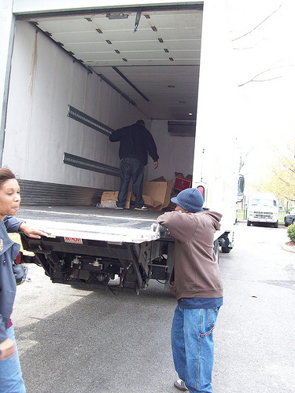
SCENARIO 1: RECEIVING
After leaving the food bank, you notice that you’ve received bulk chicken instead of retail packaged chicken and you know your families will not want to take a 20 pound bag of meat. Your co-volunteer also asks if you can stop by the Subway on the way home to grab something to eat.
Notes:
The bulk chicken should NEVER be re-packaged. It must be immediately returned to the food bank or given to families with specific instruction. It should only be taken by the agency if they have the means to store large packages of food.
There should also be no stops between pick-up at the food bank and the ride home. The frozen goods could thaw out.

Slide 26
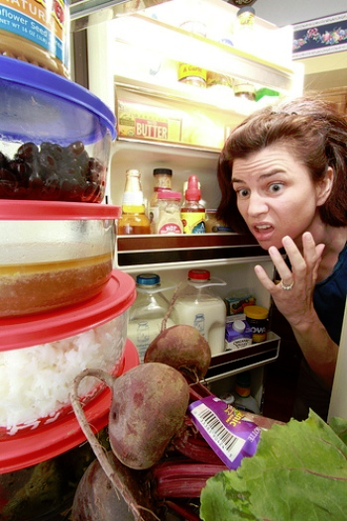
SCENARIO 2: STORING
You go into the church basement to update your temperature logs and you notice that one of the refrigerators is at 43°F. You open it and notice that the Egg Beaters you received from the food bank, that were frozen, are now all stored in the fridge.
Notes:
All items in the fridge must be thrown out. The egg beaters should have been kept in a freezer so they could be kept on site for distribution longer.

Slide 27
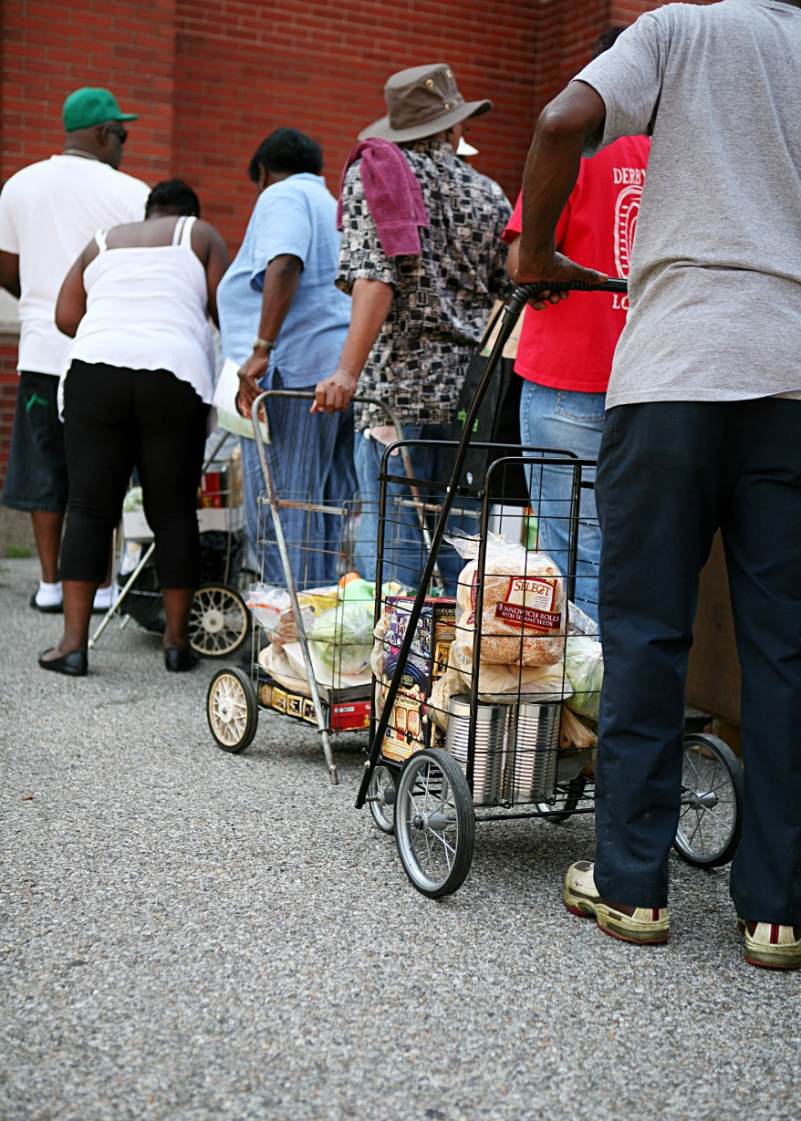
SCENARIO 3: DISTRIBUTION
You are short handed on your distribution day. However, your clients are not quick to notice since they are so happy to receive food. Several of them give you hugs and handshakes as you hand out each box of food. You’ve also left the produce and bread out on a table so they can have client’s choice.
Notes:
Hands should be washed after EVERY human contact. The produce and bread, unless packaged, should also not be left out.

Slide 28
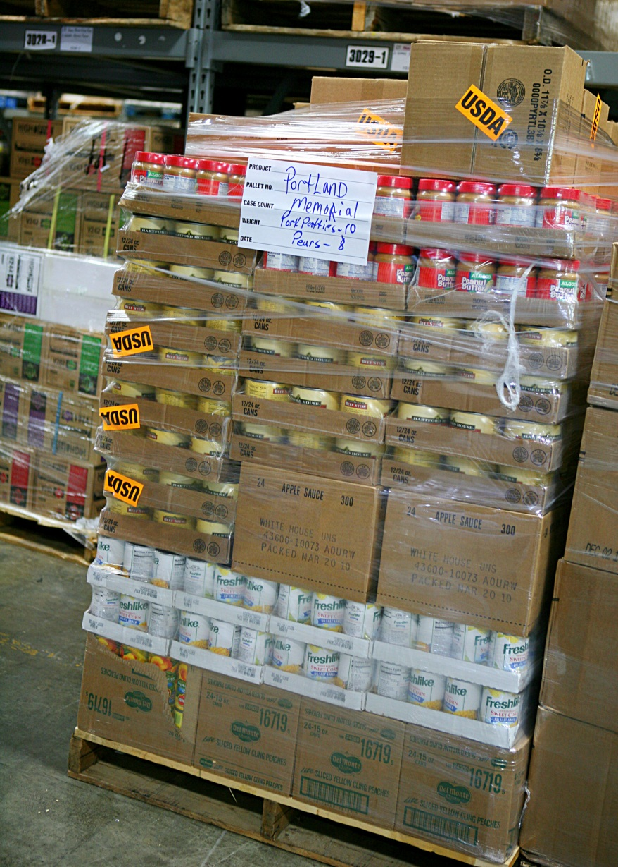
OUR COMMITMENT
SHARE OUR KNOWLEDGE
ACT PROACTIVELY
3RD PARTY AUDITS FOR FOOD BANK
BI-ANNUAL MONITORING APPOINTMENTS FOR PARTNERS
Notes:
As a Food Bank, we promise to share our food safety knowledge with our partners whenever it is requested of us. Simultaneously, we expect all training attendees to share the knowledge of this training with their co-workers or co-volunteers.
It is essential that we all act proactively, doing our best to prevent breeches in food safety before an incident occurs.
Therefore, DTC will be audited every 2 years, as will each partner by the partner development team.

Slide 29

FOR MORE INFORMATION…
For more information on food safety:
http://www.servsafe.com/foodsafety
OR contact your local health department

Slide 30
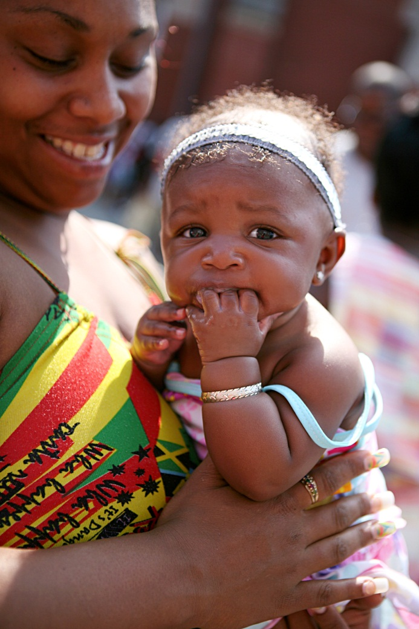
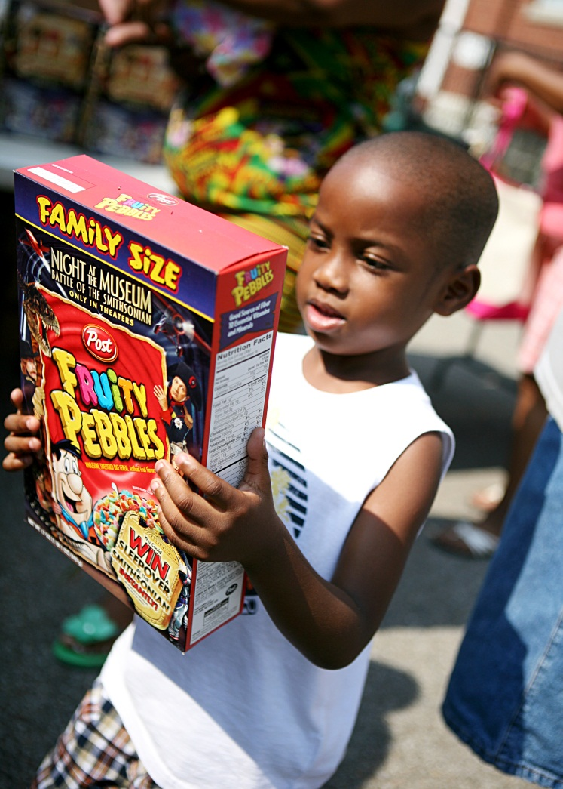
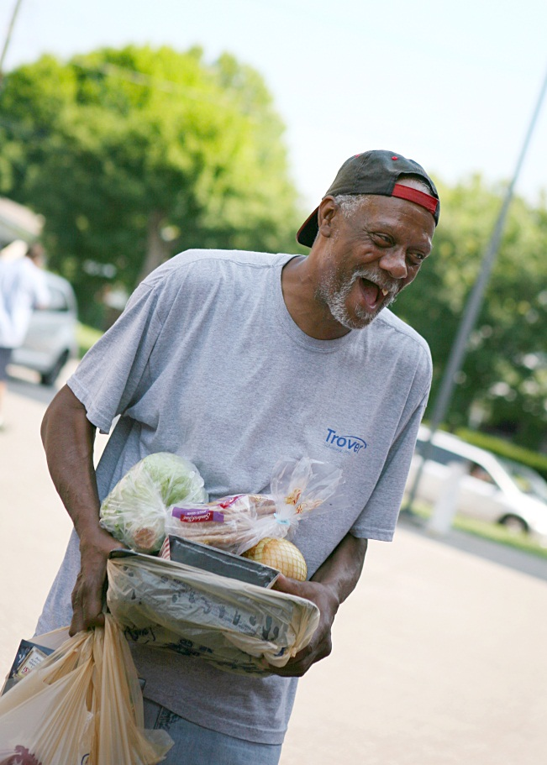
THANK YOU FOR ALL YOU DO!!

