Slide 1
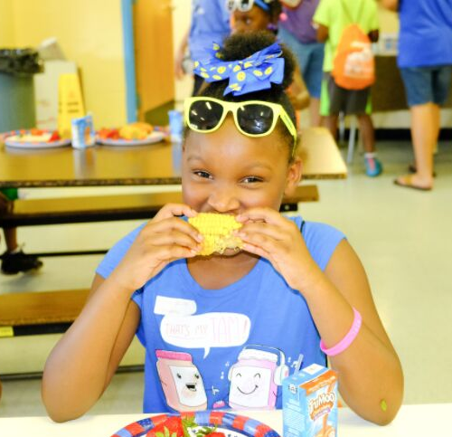
CACFP TRAINING

Slide 2
WHAT IS CACFP?
The Child and Adult Care Food Program (CACFP) partners with childcare centers, adult daycares, head starts, family daycare homes, emergency shelters and at-risk programs to provide healthy meal. This USDA program, administered by the State Department of Education, and then through sponsors such as Dare to Care.

Slide 3
SITE RULES
Site Rules
Must have programming for the ages you serve
Children do not have to participate in programming to get the meal
Post a Calendar of Activities
Update DTC on new staff and any changes in meal service
WHO CAN EAT?
•Children and teens 18 and younger
•A person age 19-21 who has a mental or physical disability and still participates in a school program

Slide 4
SITE RULES
WHEN CAN I SERVE?
Served during approved meal service times
Changes must be pre-approved
Cannot claim meals served outside of the approved meal service time.
Notes:
Meals must be served during approved meal service times
Any change in meal service time must be approved by DTC prior to meal service.
Any meals served outside of the approved meal service time may not be claimed for reimbursement.

Slide 5
SITE RULES
WHERE?
Locations must be preapproved
Location changes must be preapproved via website
Locations should be easily accessible and a safe place for children to gather
Congregate feeding is a federal requirement
Meals must be eaten in the presence of site staff
Any meal taken off site may not be claimed
Notes:
Locations in approved meal service areas are determined by the program sponsor
Location may not be changed or moved without prior approval
Locations should be easily accessible and a safe place for children to gather
Congregate feeding is a federal requirement
Meals must be eaten in the presence of site staff
Any meal taken off site may not be claimed for reimbursement

Slide 6
Menus must be posted at all times
Children must take all items
Milk is a required
Do not add food
May serve water
Change menu if needed
MEAL PATTERN & MENUS
Serve EVERTHING and a FULL PORTION
Notes:
Menus must be posted at all times
Children must take all items
Milk is a requirement and must be taken
Do not add food
May serve water with meals
Make changes to menu, as needed

Slide 7
SITE RULES
FOOD WASTE
Children may take one of the following off site from their meal:
1. Fruit
2. Grain
3. Vegetable
Whole or unopened fruits, grains, or vegetables may be served at another time.
Everything else MUST be discarded.
SHARE TABLE
In a designated area
All food safety guidelines must be followed.
Food must be kept at the appropriate temperature.
Food left on share table may be served at another time.
Notes:
Participants may take one whole or unopened fruit, grain, or vegetable off site after the meal service.
Leftovers must be discarded except for whole or unopened fruit, grain, or vegetable - this can be served at another time.
Designated area where unopened, whole fruit, vegetable, or grain may be placed.
Children who are still hungry may take an item from the share table.
All food safety guidelines must be followed.
Food must be kept at the appropriate temperature.
Food left on share table may be served at another time.

Slide 8
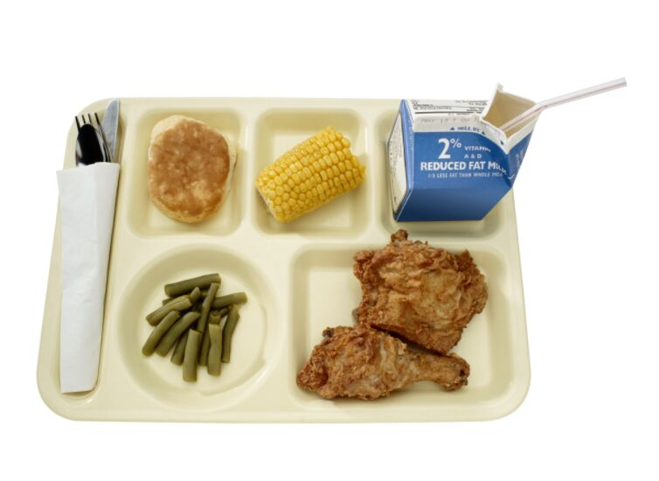
MEAL COUNTING
Accuracy is Important!!!
Each meal served MUST meet the meal pattern to be counted on the Meal Count form
01
Count must be taken as the children go through the line at the point of meal service.
02
The count can’t be completed before or after meal service, it must be completed during the meal service.
03

Slide 9
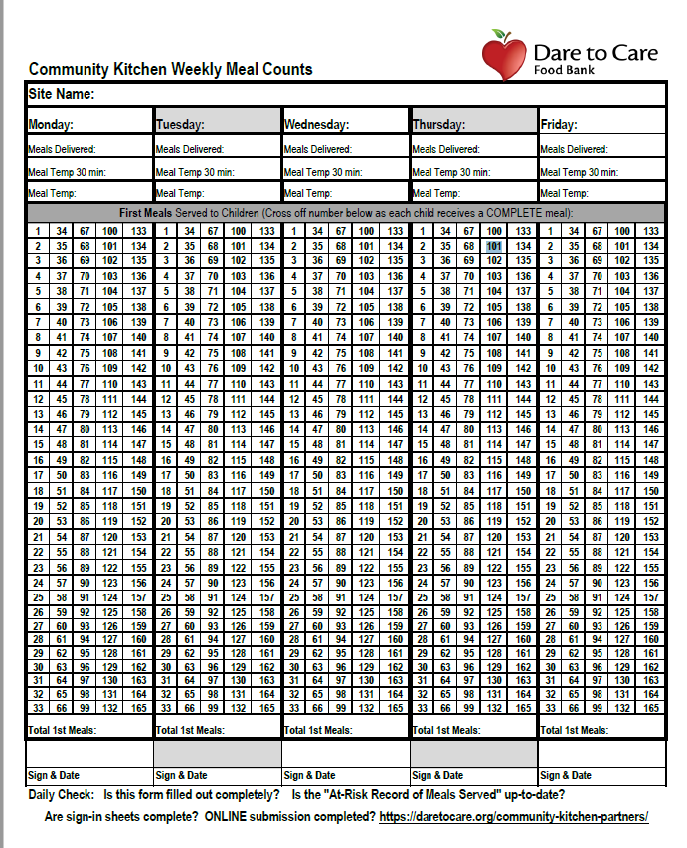
MEAL COUNT FORM BEST PRACTICES
Designate one person to take the meal count at the end of the service line
Look over meal count form to ensure completeness and accuracy before signing and before submitting each week
FILL OUT COMPLETELY

Slide 10
Meals must be counted individually, not one line through many numbers
1
DAILY MEAL COUNT FORM
RULES
All required information must be completed at POS & turned in weekly
2
For meals
to be reimbursable:
May count/serve over what was delivered –
Complete Meals ONLY
3
Meal count shouldn’t repeat daily with no variation.
4
Must Claim 85% Meals Delivered

Slide 11
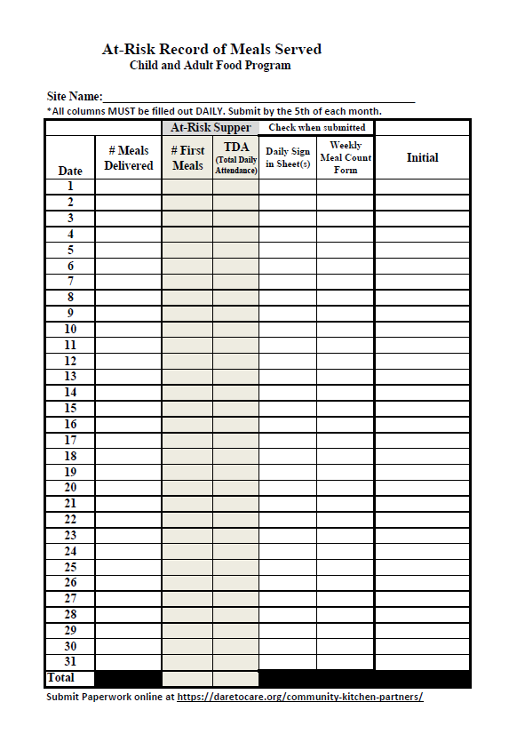
SITE RECORD OF MEALS SERVED
FILL OUT COMPLETELY

Slide 12
RECORD OF MEALS SERVED
RULES
Complete Daily & Turn in Monthly
1
Must be available at all times for monitoring
2
For meals
to be reimbursable:
Complete all columns including initials
3
Must match Meal Count Form
4

Slide 13
KITCHEN MEALS
LUNCH/SUPPER
Delivery tickets should be signed after cambro is checked. Keep Nestform.
1
Check temperature 30 minutes prior to serving and at serve time
2
Pans and utensils MUST be free of food debris after meal service. Put back in Cambro.
3
Closures must be submitted one week in advance and changes 2 business days.
4

Slide 14
SITE RULES
FOOD ALLERGIES
Doctors note stating child has confirmed disability – substitution required - Dare to Care will reimburse.
If doctor marks that the child has special dietary needs but does not have a disability, no accommodations will be made.
If a child never brings a doctor’s note, you are required to serve the entire meal.
If a child is lactose intolerant and does not bring a note, they must still be served milk. They are not required to drink it, but they must take it.
Notes:
A doctor or other who can write prescriptions, must complete a form confirming a child has a disability to omit or substitute an item. This does not have to meet the meal pattern. Dare to Care will reimburse you for required substitution.
If doctor marks that the child has special dietary needs but does not have a disability, no accommodations will be made.
If a child never brings a doctor’s note, you are required to serve the entire meal.
If a child is lactose intolerant and does not bring a note, they must still be served milk. They are not required to drink it, but they must take it.

Slide 15
ONLINE PROCESSES
Changing Meal Counts
01
Cancellations/Changes in Meal Service
02
Submitting Paperwork
03
WEDELIVERHEALTHY.CO

Slide 16
DTC will conduct site reviews to make sure the site is following program rules and regulations.
1
SPONSOR & STATE REVIEWS
Any areas of noncompliance will be addressed in a corrective action plan.
2
This program relies on you!
The site must indicate that immediate corrective action was taken and identify the plan in place to ensure future compliance.
3
A site must be terminated from participation if many violations are found and/or if the health, safety, or wellbeing of children is threatened.
4

Slide 17
Civil Rights
Goals of Civil Rights
CIVIL RIGHTS
GOALS
What is Discrimination?
Different treatment which makes a distinction of one person or group of persons from others; either intentionally, by neglect, or by actions or lack of actions based on any persons or group who has characteristics for which discrimination is prohibited based on the law, regulation, or executive order.
1. Knowledge for rights and Responsibilities
01
2. Elimination of illegal barriers that prevent or deter people from receiving benefits
02
3. Dignity and Respect for All
02
4. Equal treatment for all applicants and beneficiaries
Protected Classes: Race, Color, National Origin, Age, Sex, Disability

Slide 18
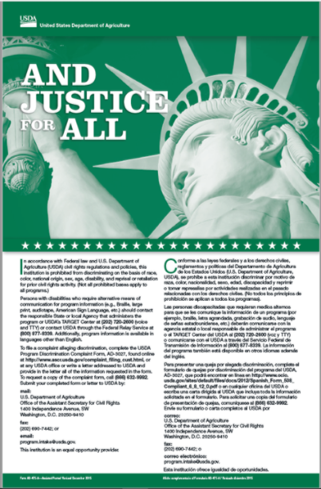
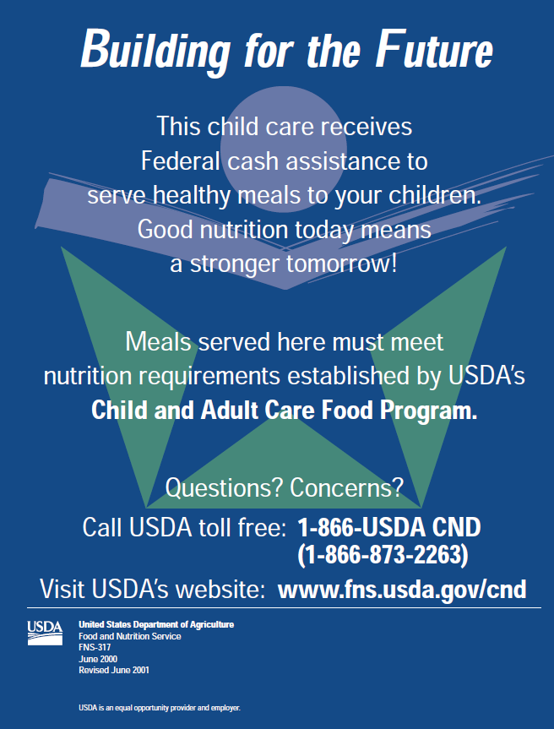
CIVIL RIGHTS
PUBLIC NOTIFICATION
Include full USDA non-discrimination on all materials
01
Prominently display the "And Justice for All" poster in the food service area. The full size 11"x17" poster must be used.
02
02

Slide 19
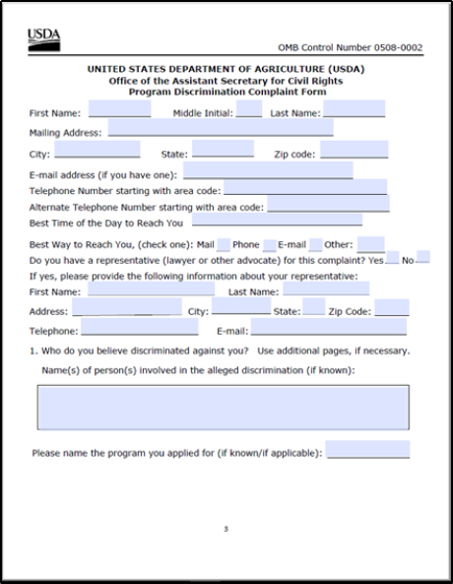
CIVIL RIGHTS
GRIEVANCE PROCEDURES
Accept verbal or written grievances.
Complaint must be made in 180 days.
Available on DTC website or USDA
Keep procedures and report forms at site.
Never try to impede or "work it out"
Complaint goes directly to USDA - information is on the form.
02

Slide 20
SITE SUPERVISOR
RESPONSIBILITIES
Trained site supervisor must be present during ALL meal services and serve ALL children.
Ensure Accurate Meal Count documentation
and Civil Rights Compliance.
Submit all forms to DTC each week and inform sponsor of any changes.

Slide 21
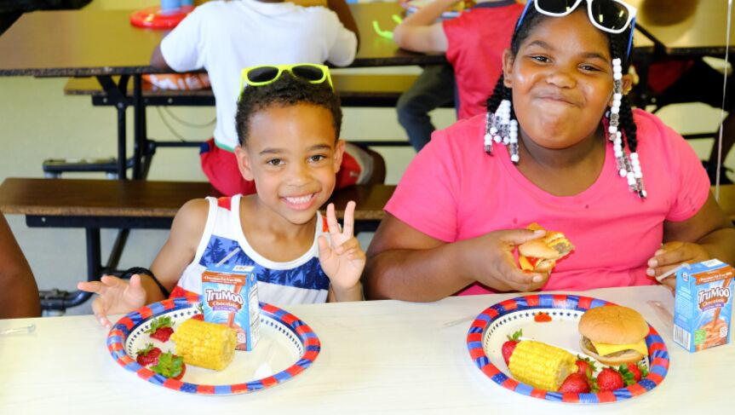
Questions?
2020 MARKETING STRATEGY
WE DELIVER HEALTHY CO.

