Slide 1
SFSP
TRAINING
2021

Slide 2
WHAT IS SFSP?
The Summer Food Service Program is a federally funded and regulated program that provides free meals to children and teens age 18 and under during the summer months when school is not in session.

Slide 3
SITE RULES
CAN ADULTS EAT?
Program adults
Hot Kitchen Meals ONLY
•An employee or volunteer who works with SFSP
•A monitor, kitchen staff, supervisor, etc.
Non-program adults
•A person over the age of 18 who does not work with SFSP
•Parents, guardians, staff that doesn’t work with meal service
WHO CAN EAT?
•Children and teens 18 and younger
•A person age 19-21 who has a mental or physical disability and still participates in a school program
Parent or guardian may pickup a meal for a child during COVID19
Children must wash hands or use hand sanitizer before meal service.

Slide 4
SITE RULES
WHEN CAN I SERVE?
Exempt during COVID-19 BUT MUST BE APPROVED!
Meals must be served during approved meal service times
Any change in meal service time must be approved by DTC prior to meal service.
Any meals served outside of the approved meal service time may not be claimed for reimbursement

Slide 5
SITE RULES
WHERE?
Locations in approved meal service areas are determined by Dare to Care
Location may not be changed or moved without prior approval
Locations should be easily accessible and a safe place for children to gather
Exempt during COVID-19 MUST BE APPROVED FOR NON-CONGREGATE
Congregate feeding is a federal requirement
Meals must be eaten in the presence of site staff
Any meal taken off site may not be claimed for reimbursement

Slide 6
SITE RULES
FOOD ALLERGIES
A doctor or other who can write prescriptions, must complete a form confirming a child has a disability to omit or substitute an item. This does not have to meet the meal pattern. Dare to Care will reimburse you for required substitution.
If doctor marks that the child has special dietary needs but does not have a disability, no accommodations will be made.
If a child never brings a doctor’s note, you are required to serve the entire meal.
If a child is lactose intolerant and does not bring a note, they must still be served milk. They are not required to drink it, but they must take it.

Slide 7
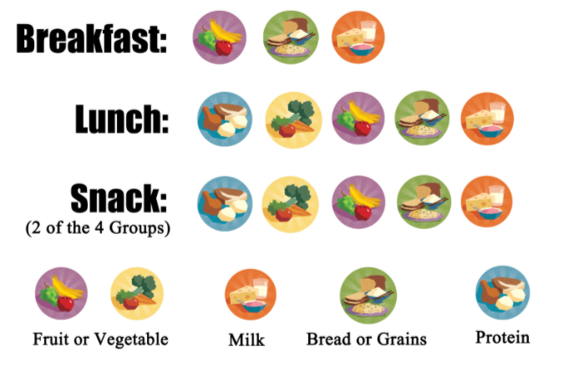
Menus must be posted at all times
Children must take all items
Milk is a requirement and must be taken
May serve water with meals
Do no add food
Make changes to menu, as needed
MEAL PATTERN & MENUS
Serve EVERTHING and a FULL PORTION

Slide 8
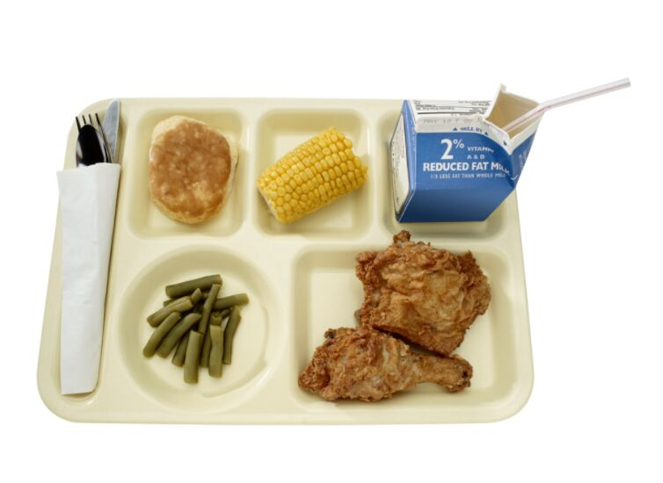
MEAL COUNTING
Accuracy is Important!!!
Each meal served MUST meet the meal pattern to be counted on the Meal Count form
01
The count is to be taken as the children go through the line at the point of meal service.
02
The count can’t be completed before or after meal service, it must be completed during the meal service.
03

Slide 9
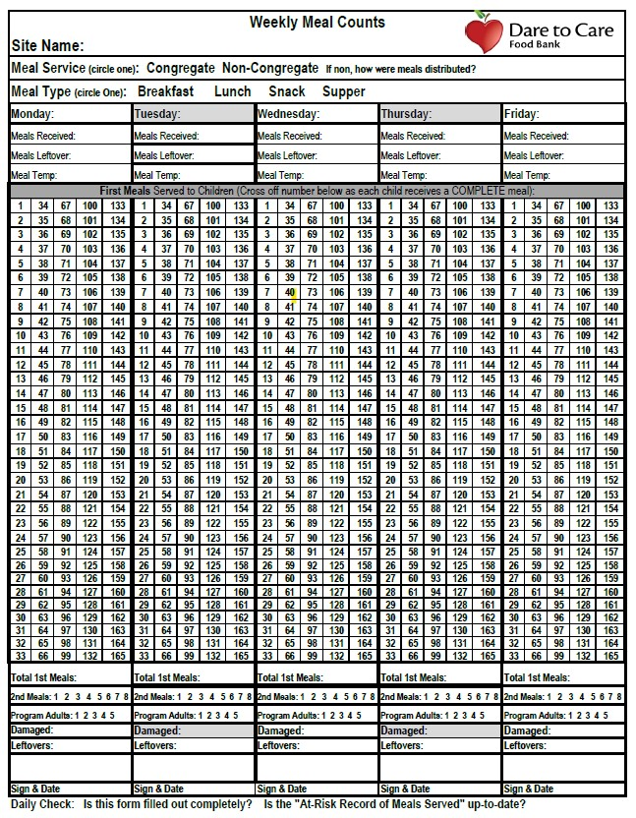
MEAL COUNT FORM BEST PRACTICES
Designate one person to take the meal count at the end of the service line
Look over meal count form to ensure completeness and accuracy before signing and before submitting each week
FILL OUT COMPLETELY

Slide 10
Weekly Meal Count Form
Meal Service and Type is required for claiming!
Site name is important!!
The number of meals received/Meal Leftover must be completed daily. You can not claim more meals than are listed here.
Date is required
Meal Temp only needs to be recorded for hot entrée item. If individually plated, pick one from the middle and poke through the plastic.

Slide 11
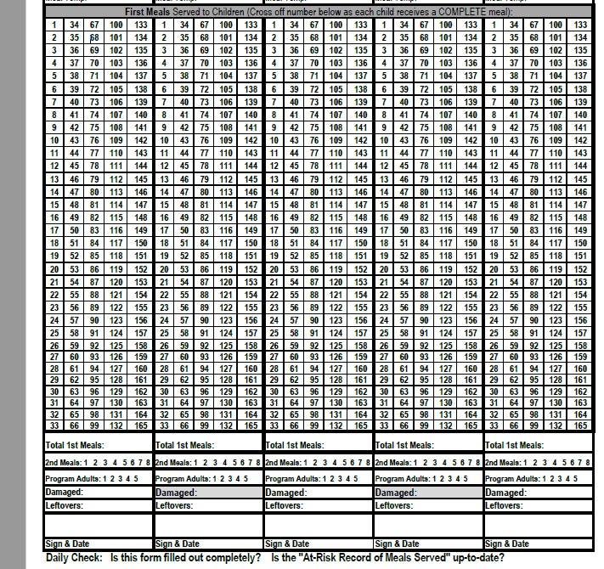
Weekly Meal Count Form
Only first meals are counted here! Each meal must be marked individually. Do not draw a line through multiple numbers. The meals must be marked at the time of meal service.
This number must match the number of individual meal count marks.

Slide 12
Weekly Meal Count Form
Individual meal counting is still required. These must be complete meals, not only one component or leftovers.
Subtract total 1st meals, 2nd meals, program adult meals, and damaged meals from Meals Delivered + Leftovers from previous day.
Don’t forget to Sign/Initial and Date
Damaged meals include any that you need to throw away due to expiration.

Slide 13
Meals must be counted individually, not one line through many numbers
1
WEEKLY MEAL COUNT FORM
RULES
All required information must be completed & turned in weekly ONLINE
2
For meals
to be reimbursable:
Can’t claim more meals that the number of meals available - except kitchen meals
3
The meal count shouldn’t repeat daily with no variation.
4
Must Claim 80% Meals Delivered

Slide 14
Maintain 80% Reimbursement
The expectation is that a minimum of 80% of meals delivered will be served….we know that attendance fluctuates, but we ask that you keep the 80% goal in mind and make adjustments as soon as one is needed to avoid wasting food and a possible invoice. Please reach out to Johnna if you have concerns about your % of meals served

Slide 15
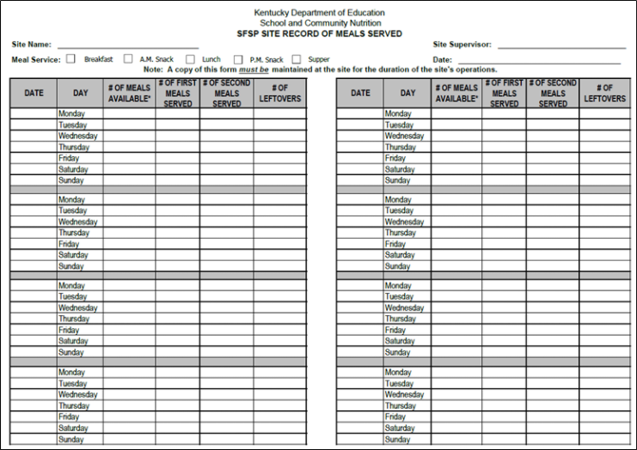
SITE RECORD OF MEALS SERVED
# Meals Available = Meals Delivered + Leftovers from previous day
FILL OUT COMPLETELY

Slide 16
RECORD OF MEALS SERVED
RULES
Complete Daily & Turn in Monthly ONLINE
1
Must be available for monitoring
2
For meals
to be reimbursable:
Must have a Site Record for each meal service type
3
Must match Weekly Meal Count Form
4

Slide 17
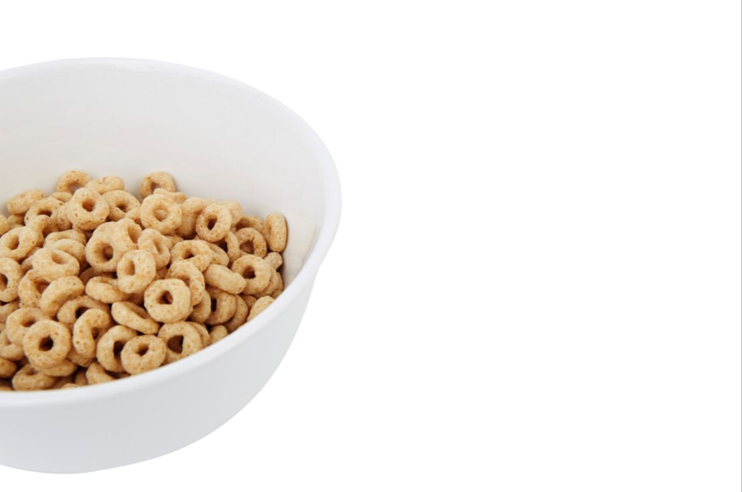
BREAKFAST
KITS
Place order each week to prevent overstock - order by case
1
First meals only - do not order enough for seconds
2
Don’t forget to add milk!
3

Slide 18
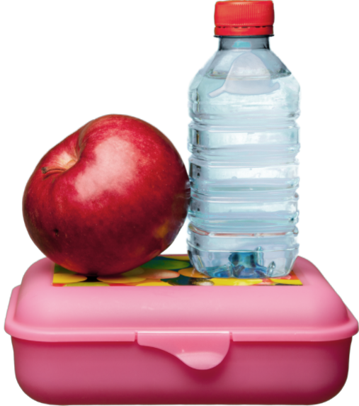
Individually Plated
Meals
1
Lunch/Supper = hot meal
Snack = cold meal
*Unless told differently by DTC
May serve for up to 3 days after delivery, if refrigerated. Date all leftovers.
2
You may give out meals for up to 5 days in advance. Count all as first meals and on date they are for. *must receive approval
3
4
Changes in numbers or cancellations should be submitted 2 days business days, in advance

Slide 19
Cafeteria Style MEALS
Only serve as congregate meals – may take one whole item offsite
(whole fruit, vegetable, or grain)
1
Check temperatures 30 minutes prior to serving and at serve time
2
Pans and utensils MUST be free of any food debris after meal service and put back into cambros
3
Changes and Closures must be submitted at least two business days, in advance
4

Slide 20
ONLINE PROCESSES
https://daretocare.org/community-kitchen-partners/
Ordering Breakfast & Changing Meal Counts
01
Cancellations/Changes in Meal Service
02
Submitting Paperwork
03
WEDELIVERHEALTHY.CO

Slide 21
DTC will conduct a review of the site to make sure the site is following program rules and regulations
1
SPONSOR & STATE REVIEWS
2
Any areas of noncompliance will be addressed in a corrective action plan.
This program relies on you!
The site must indicate the immediate corrective action that was taken and identify the plan in place to ensure future compliance.
3
A site must be terminated from participation if many violations are found and/or if the health, safety, or wellbeing of children is threatened.
4

Slide 22
Civil Rights
Goals of Civil Rights
CIVIL RIGHTS
GOALS
What is Discrimination?
Different treatment which makes a distinction of one person or group of persons from others; either intentionally, by neglect, or by actions or lack of actions based on any persons or group who has characteristics for which discrimination is prohibited based on the law, regulation, or executive order.
1. Knowledge for rights and Responsibilities
01
2. Elimination of illegal barriers that prevent or deter people from receiving benefits
02
3. Dignity and Respect for All
02
4. Equal treatment for all applicants and beneficiaries
Protected Classes: Race, Color, National Origin, Age, Sex, Disability

Slide 23
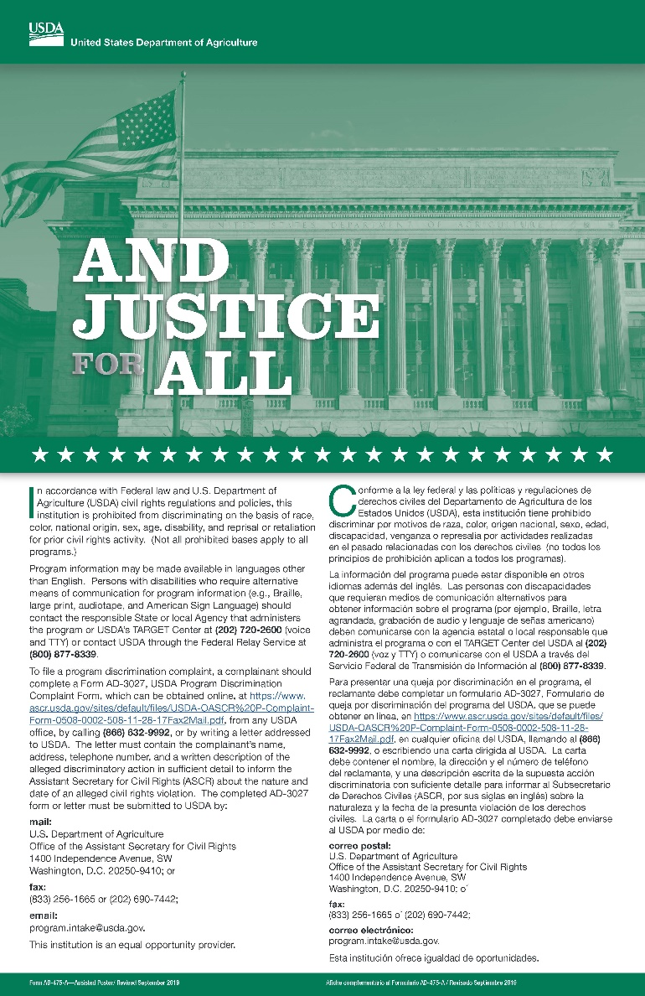
CIVIL RIGHTS
PUBLIC NOTIFICATION
Include full USDA non-discrimination on all materials
01
Prominently display the "And Justice for All" poster in the food service area. The full size 11"x17" poster must be used.
02
02

Slide 24
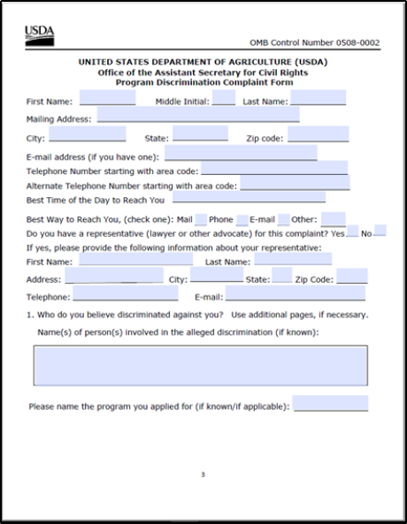
CIVIL RIGHTS
GRIEVANCE PROCEDURES
Accept verbal or written grievances.
Complaint must be made in 180 days.
Available on DTC website or USDA
Keep procedures and report forms at site.
Never try to impede or "work it out"
Complaint goes directly to USDA - information is on the form.
02

Slide 25
SITE SUPERVISOR
RESPONSIBILITIES
Trained site supervisor must be present during ALL meal services and serve ALL children.
Ensure Accurate Meal Count documentation
and Civil Rights Compliance.
Submit all forms to DTC each week and inform sponsor of any changes.

Slide 26
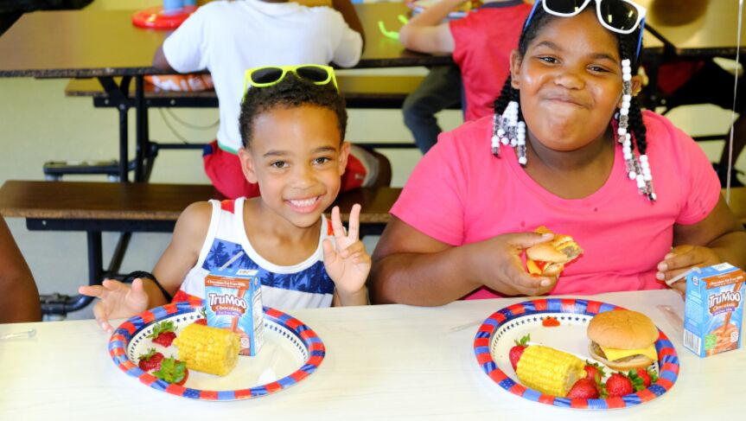
Questions?
2020 MARKETING STRATEGY
WE DELIVER HEALTHY CO.

Slide 27
THANK YOU AND HAVE A GREAT SUMMER!
2020 MARKETING STRATEGY
WE DELIVER HEALTHY CO.

