Slide 1
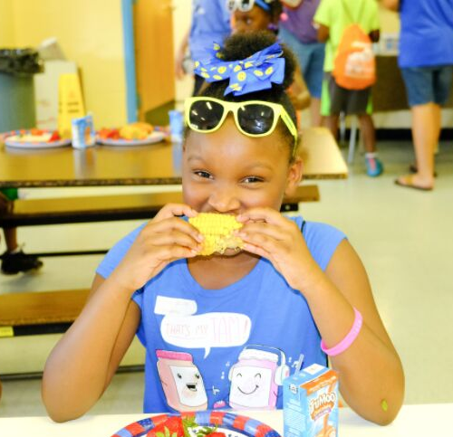
SFSP TRAINING 2019

Slide 2
WHAT IS SFSP?
The Summer Food Service Program is a federally funded and regulated program that provides free meals to children and teens age 18 and under during the summer months when school is not in session.

Slide 3
SITE RULES
CAN ADULTS EAT?
Program adults
Kitchen Meals ONLY
•An employee or volunteer who works with SFSP
•A monitor, kitchen staff, supervisor, etc.
Non-program adults
•A person over the age of 18 who does not work with SFSP
•Parents, guardians, staff that doesn’t work with meal service
WHO CAN EAT?
•Children and teens 18 and younger
•A person age 19-21 who has a mental or physical disability and still participates in a school program

Slide 4
SITE RULES
WHEN CAN I SERVE?
Meals must be served during approved meal service times
Any change in meal service time must be approved by DTC prior to meal service.
Any meals served outside of the approved meal service time may not be claimed for reimbursement.

Slide 5
SITE RULES
WHERE?
Locations in approved meal service areas are determined by the program sponsor
Location may not be changed or moved without prior approval
Locations should be easily accessible and a safe place for children to gather
Congregate feeding is a federal requirement
Meals must be eaten in the presence of site staff
Any meal taken off site may not be claimed for reimbursement

Slide 6
SHARE TABLE
SITE RULES
Designated area where unopened, whole fruit, vegetable, or grain may be placed.
Children who are still hungry may take an item from the share table.
All food safety guidelines must be followed.
Food must be kept at the appropriate temperature.
Food left on share table may be served for a snack.
FOOD WASTE
Participants may take one whole or unopened fruit, grain, or vegetable off site after the meal service.
Leftovers must be discarded except for whole or unopened fruit, grain, or vegetable - this can be served at another time.

Slide 7
SITE RULES
FOOD ALLERGIES
A doctor or other who can write prescriptions, must complete a form confirming a child has a disability to omit or substitute an item. This does not have to meet the meal pattern. Dare to Care will reimburse you for required substitution.
If doctor marks that the child has special dietary needs but does not have a disability, no accommodations will be made.
If a child never brings a doctor’s note, you are required to serve the entire meal.
If a child is lactose intolerant and does not bring a note, they must still be served milk. They are not required to drink it, but they must take it.

Slide 8
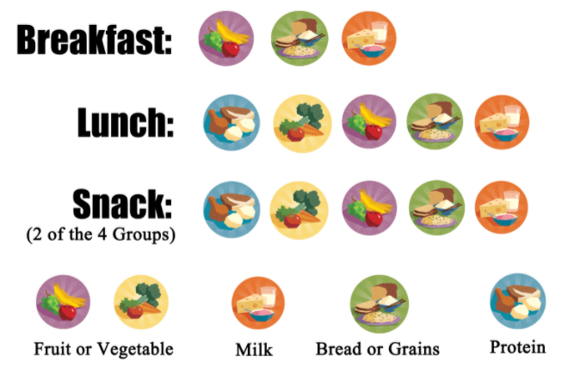
Menus must be posted at all times
Children must take all items
Milk is a requirement and must be taken
May serve water with meals
Do no add food
Make changes to menu, as needed
MEAL PATTERN & MENUS
Serve EVERTHING and a FULL PORTION

Slide 9
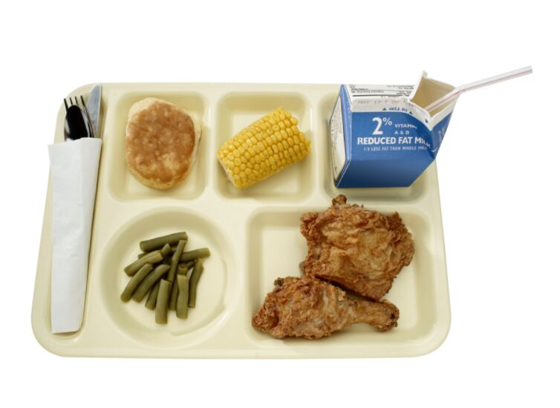
MEAL COUNTING
Accuracy is Important!!!
Each meal served MUST meets the meal pattern is to be counted on the Meal Count form
01
The count is to be taken as the children go through the line at the point of meal service.
02
The count can’t be completed before or after meal service, it must be completed during the meal service.
03

Slide 10
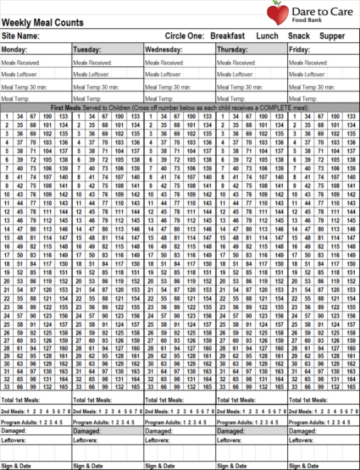
MEAL COUNT FORM BEST PRACTICES
Designate one person to take the meal count at the end of the service line
Look over meal count form to ensure completeness and accuracy before signing and before submitting each week
FILL OUT COMPLETELY

Slide 11
Meals must be counted individually, not one line through many numbers
1
DAILY MEAL COUNT FORM
RULES
All required information must be completed & turned in weekly
2
For meals
to be reimbursable:
Can’t claim more meals that the number of meals available - except kitchen meals
3
The meal count shouldn’t repeat daily with no variation.
4
Must Claim 85% Meals Delivered

Slide 12
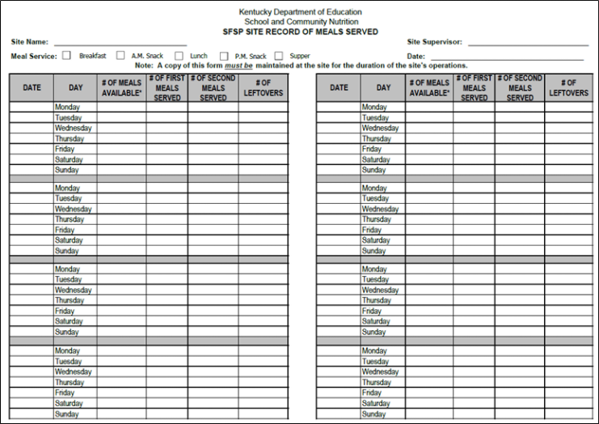
SITE RECORD OF MEALS SERVED
FILL OUT COMPLETELY

Slide 13
RECORD OF MEALS SERVED
RULES
Complete Daily & Turn in Monthly
1
Must be available at all times for monitoring
2
For meals
to be reimbursable:
Must have a Site Record for each meal service type
3
Must match Meal Count Form
4

Slide 14
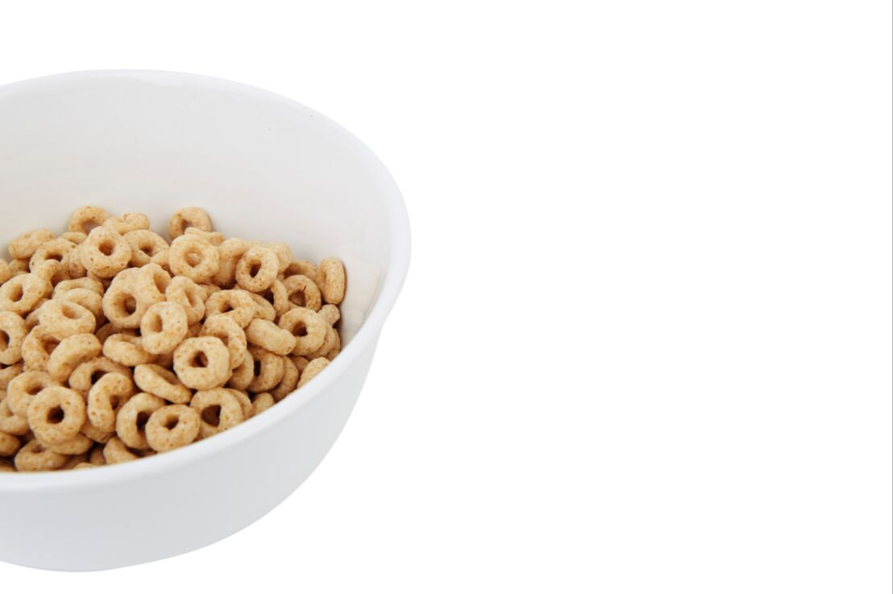
BREAKFAST
KITS
First delivery week before you start - email to set date if needed
1
Place order each week to prevent overstock - order by case
2
First meals only - do not order enough for seconds
3
Changes in counts may take up to three days
4

Slide 15
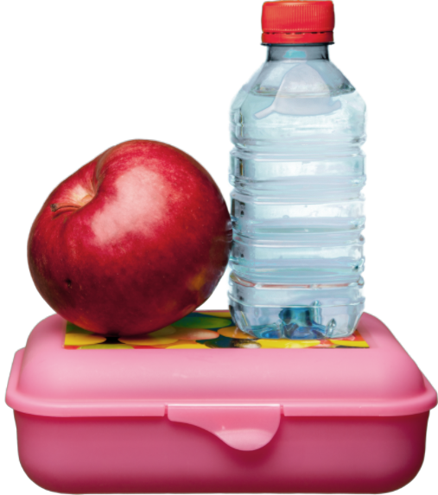
MASTERSON'S
SNACK
1
Report as a snack on paperwork.
**June 10-14 count as lunch.** Serve w/ milk and vegetable/fruit
May serve for up to 3 days after delivery. Date all leftovers.
2
DO NOT order or give out seconds. These are not reimbursable meals except for a few sites.
3
Changes in counts may take up to three days.
4

Slide 16
KITCHEN MEALS
LUNCH/SUPPER
Delivery tickets should be signed after cambro is checked
1
Check temperatures 30 minutes prior to serving and at serve time
2
Pans and utensils MUST be free of any food debris after meal service
3
Closures must be submitted one week in advance
4

Slide 17
ONLINE PROCESSES
Ordering Breakfast & Changing Meal Counts
01
Cancellations/Changes in Meal Service
02
Submitting Paperwork
03
WEDELIVERHEALTHY.CO

Slide 18
MARKETING TEAM
site name
site name

Slide 19
DTC will conduct a review of the site to make sure the site is following program rules and regulations.
1
SPONSOR & STATE REVIEWS
Any areas of noncompliance will be addressed in a corrective action plan.
2
This program relies on you!
The site must indicate the immediate corrective action that was taken and identify the plan in place to ensure future compliance.
3
A site must be terminated from participation if many violations are found and/or if the health, safety, or wellbeing of children is threatened.
4

Slide 20
Civil Rights
Goals of Civil Rights
CIVIL RIGHTS
GOALS
What is Discrimination?
Different treatment which makes a distinction of one person or group of persons from others; either intentionally, by neglect, or by actions or lack of actions based on any persons or group who has characteristics for which discrimination is prohibited based on the law, regulation, or executive order.
1. Knowledge for rights and Responsibilities
01
2. Elimination of illegal barriers that prevent or deter people from receiving benefits
02
3. Dignity and Respect for All
02
4. Equal treatment for all applicants and beneficiaries
Protected Classes: Race, Color, National Origin, Age, Sex, Disability

Slide 21
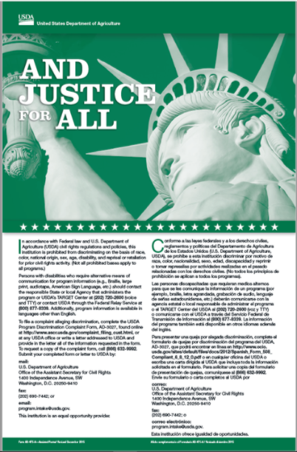
CIVIL RIGHTS
PUBLIC NOTIFICATION
Include full USDA non-discrimination on all materials
01
Prominently display the "And Justice for All" poster in the food service area. The full size 11"x17" poster must be used.
02
02

Slide 22
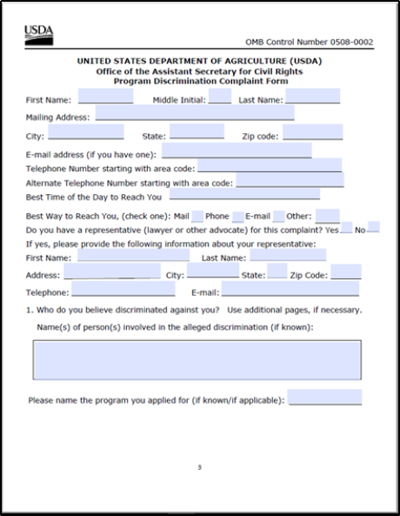
CIVIL RIGHTS
GRIEVANCE PROCEDURES
Accept verbal or written grievances.
Complaint must be made in 180 days.
Available on DTC website or USDA
Keep procedures and report forms at site.
Never try to impede or "work it out"
Complaint goes directly to USDA - information is on the form.
02

Slide 23
SITE SUPERVISOR
RESPONSIBILITIES
Trained site supervisor must be present during ALL meal services and serve ALL children.
Ensure Accurate Meal Count documentation
and Civil Rights Compliance.
Submit all forms to DTC each week and inform sponsor of any changes.

Slide 24
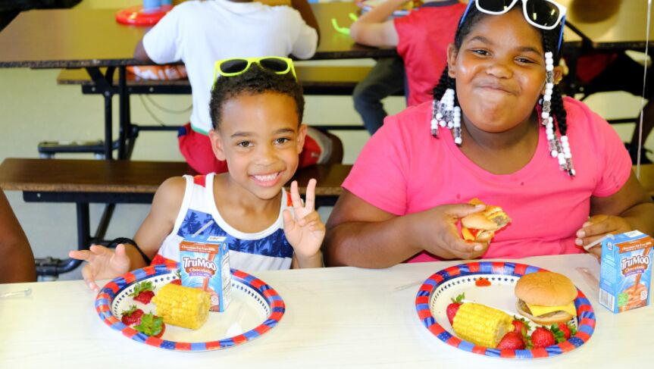
Questions?
2020 MARKETING STRATEGY
WE DELIVER HEALTHY CO.

Slide 25
THANK YOU AND HAVE A GREAT SUMMER!
2020 MARKETING STRATEGY
WE DELIVER HEALTHY CO.

