Slide 1
CACFP Training
2022-2023

Slide 2
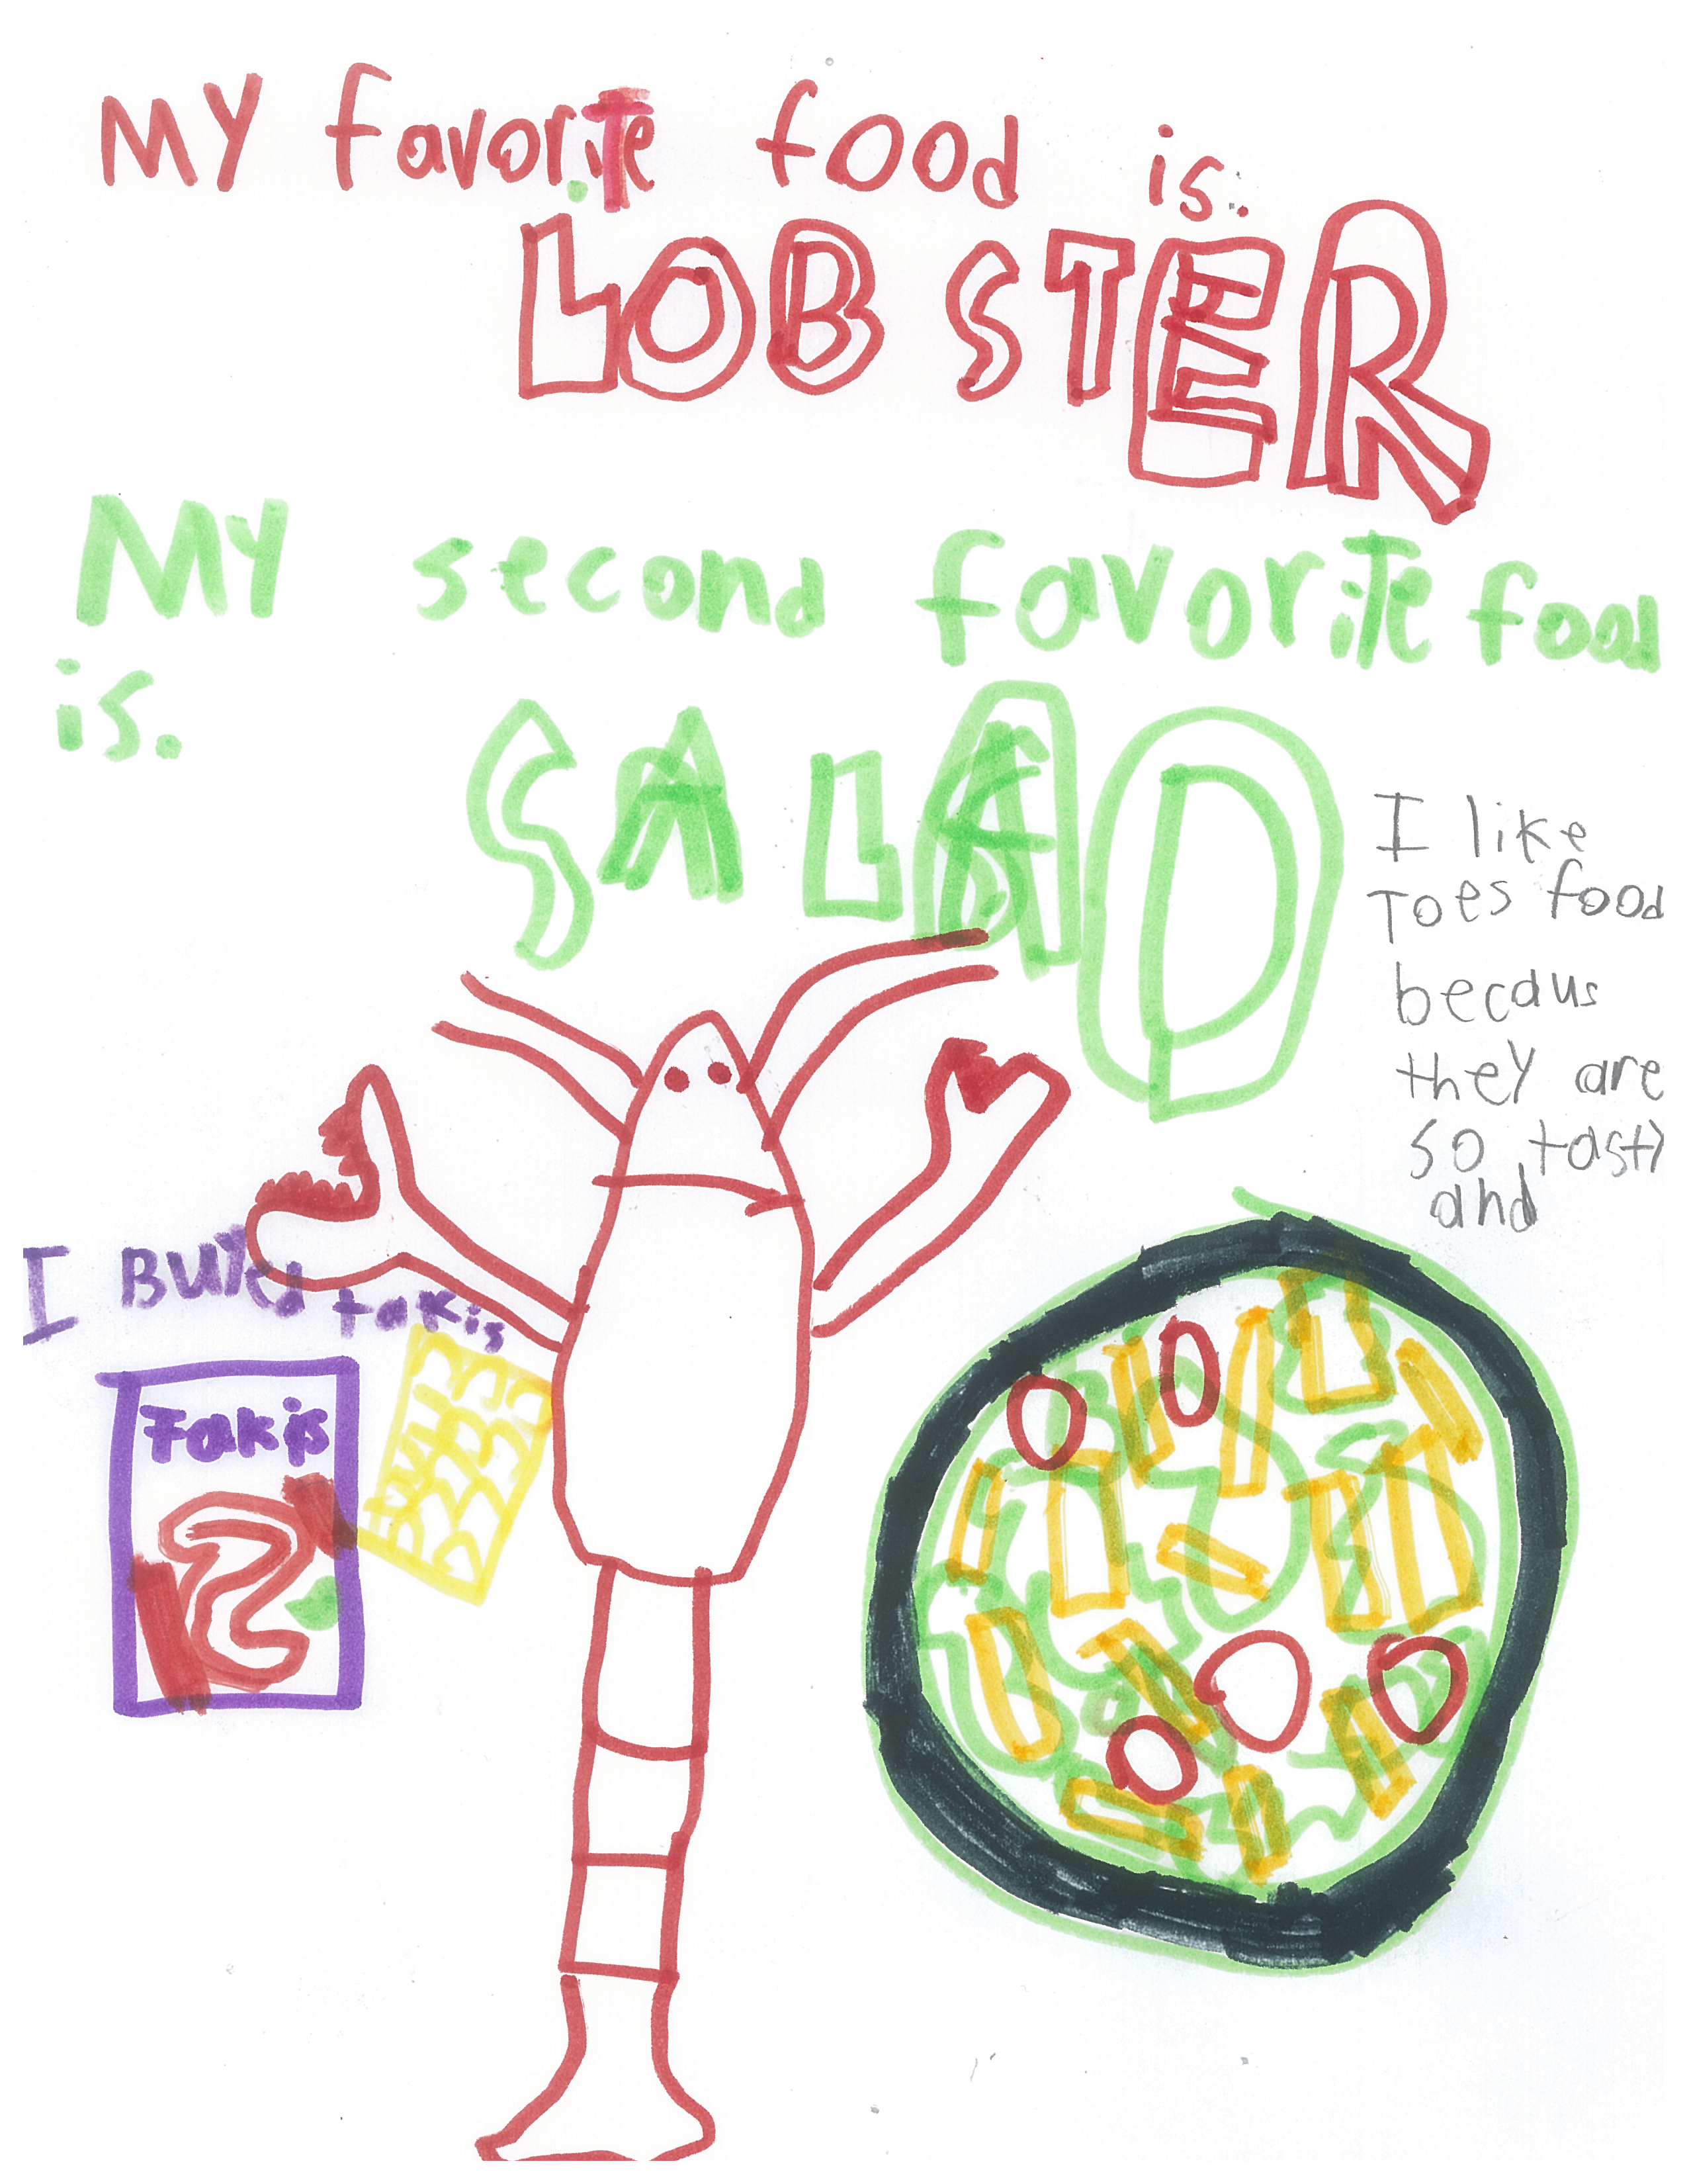
AGENDA
Program Requirements
Menus
Paperwork
Monitoring
Civil Rights Training
Online Processes
Questions?

Slide 3
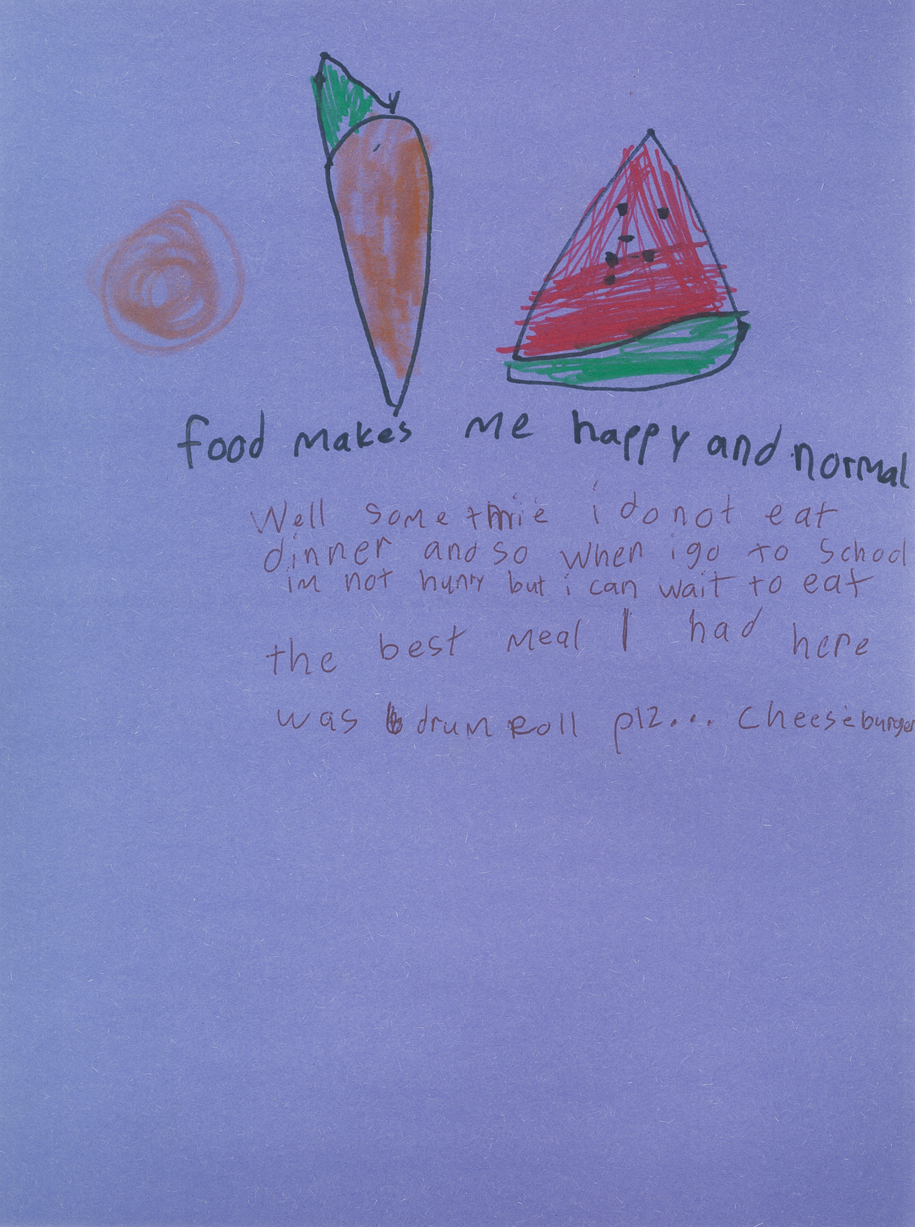
What is CACFP?
The Child and Adult Care Food Program (CACFP) partners with childcare centers, adult daycares, head starts, family daycare homes, emergency shelters and at-risk programs to provide healthy meal. This USDA program, administered by the State Department of Education, and then through sponsors such as Dare to Care.

Slide 4
Who can eat?
Children and teens 18 and younger
A person between the ages of 19 and 21 who has a mental or physical disability and still participates in a school program (K-12, not college students)

Slide 5
Site Requirements
Must provide programming for the ages you serve
Children do not have to participate in programming in order to receive a meal
Post a Calendar of Activities
Update Dare to Care on new staff and any changes in meal service

Slide 6
When can I serve meals?
Meals may only be served during the approved meal service times
Changes must be submitted to the sponsor ahead of time – if you need to change your service time for any reason, you must let us know ahead of time.
Meals that are served outside of your approved meal service time cannot be claimed on your Daily Meal Count sheet and are not reimbursable.

Slide 7
Where can I serve meals?
Meals can only be served at previously approved locations
Location changes must be submitted and approved via DTC website
Locations should be easily accessible and a safe place for children to gather

Slide 8
Where must the meals be eaten?
The meals must be eaten in the presence of site staff
Congregate feeding is a federal requirement (this is a federal nutrition program)
Any meal taken off site may not be claimed. Sites that are found to have meals going off site will be presented with a Corrective Action Plan and failure to correct may result in termination of the partnership with DTC

Slide 9
Meal Pattern and Menus
Menu must be posted
Children MUST take ALL items
Milk is required
Do not add food (or serve any special items after supper)
You may serve water, but it does not replace milk
Change menu as needed – sponsor will communicate any changes

Slide 10
Sample Menu

Slide 11
Other Meal Service Guidelines
Share table
Food waste
Must be in a designated area at the site
All food safety guidelines must be followed
Food must be kept at the appropriate temperature
Shelf stable food left on the share table may be served at another time
Children may take a fruit, grain, or vegetable off site
Whole or unopened fruits, grains, or vegetables may be served at another time
Everything else MUST be discarded – cannot be donated or eaten elsewhere

Slide 12
Meal Counting Accuracy is important!!!
1
2
3
Each meal must meet meal pattern requirement to be counted on Meal Count Form
Count must be taken as children go through the line at point of service
The count can’t be completed before or after meal service, it must be completed during!

Slide 13
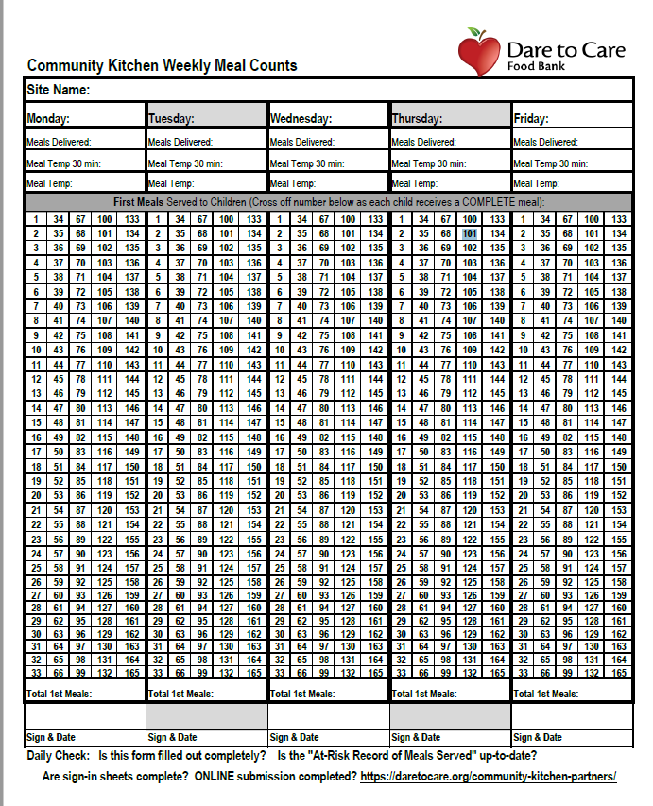
Daily Meal Count Form
Designate one person to take the meal count at the end of the service line
Meals must be counted individually (/) - not one line through many numbers, circling, or coloring in the square
Meal count shouldn’t repeat daily without variation
It is possible that you could serve more meals that what were designated to be sent – but only count WHOLE meals that were served above the number you anticipated delivered
Look over meal count form to ensure completeness and accuracy before signing and submitting to the sponsor
FILL OUT COMPLETELY

Slide 14
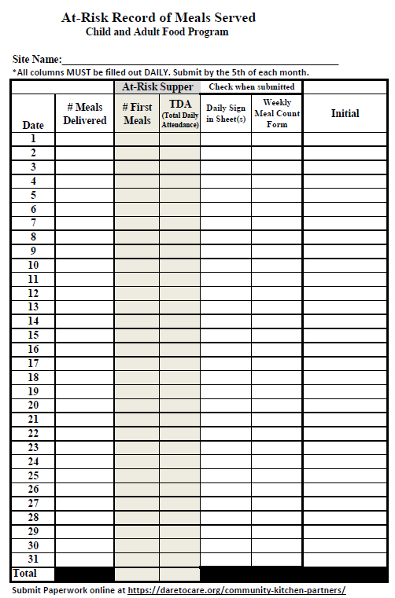
Site Record of Meals Served (At Risk Form)
Complete daily and turn in monthly
Must be always available and up to date for monitoring
Complete ALL columns, including initials
Must match meal count form and attendance numbers
FILL OUT COMPLETELY

Slide 15
Kitchen Meals – Lunch/Supper
Delivery tickets should be signed after Cambro is checked – if driver doesn’t present the ticket, please remind them
Check the food temperature 30 minutes prior to serving and at serve time
Pans and utensils MUST be free of food debris after meal service and before they are put back into the Cambro.
Closures must be submitted at least 2 days in advance and changes should be submitted 2 days in advance, allowing our kitchen time to adjust their ordering and food preparation schedule.
* special note * our kitchen staff works M-F to prepare upwards of 1,600 meals at one time and cannot accommodate last minute changes. Failure to submit changes and closures may result in invoices sent to your sites to cover the price of food lost.

Slide 16
Food Allergies
Doctors’ note stating child has confirmed disability – substitution required - Dare to Care will reimburse.
If doctor marks that the child has special dietary needs but does not have a disability, no accommodations will be made.
If a child never brings a doctor’s note, you are required to serve the entire meal.
If a child is lactose intolerant and does not bring a note, they must still be served milk. They are not required to drink it, but they must take it.

Slide 17
State & Sponsor Reviews
Dare to Care will conduct site reviews to make sure the site is following all program rules and regulations
Any areas of noncompliance will be addressed in a corrective action plan
The site must indicate that immediate correction action was taken and identify the plan in place to ensure future compliance
A site must be terminated from participation if many violations are found and/or if the health, safety, or wellbeing of children is threatened.

Slide 18
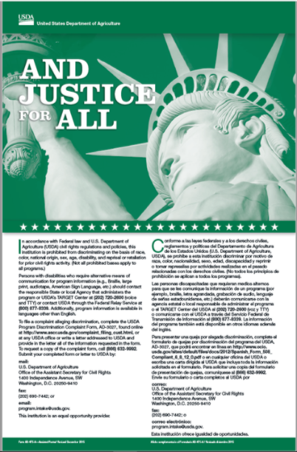
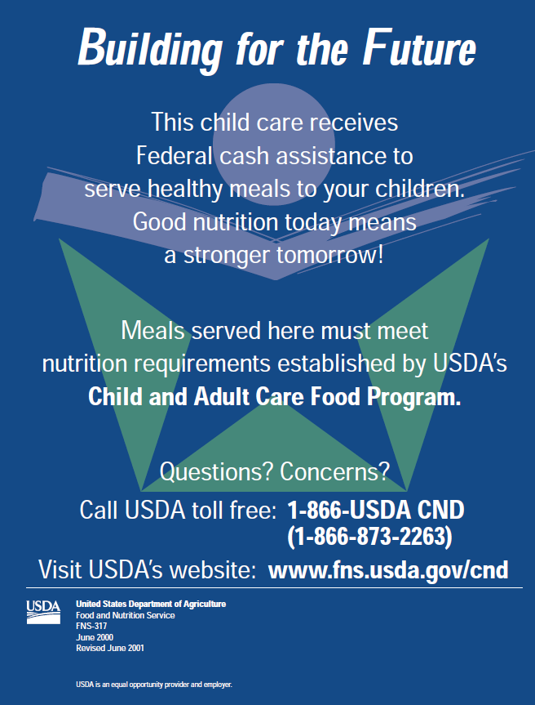
Civil Rights Training
KDE Training Video

Slide 19
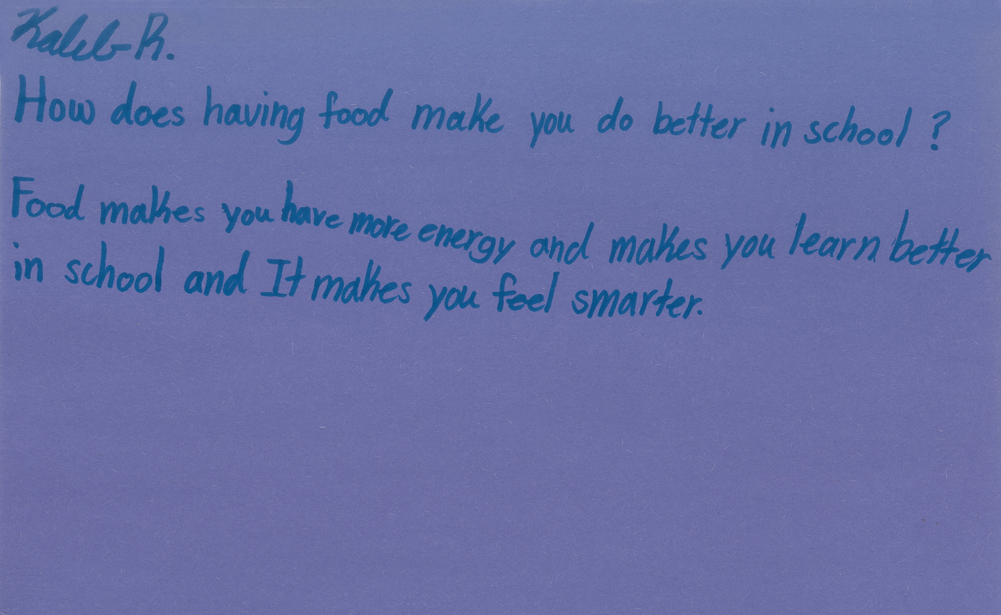
Site Supervisor Responsibility Recap
Trained site supervisor must be present during ALL meal services and serve all children
Ensure accurate meal count documentation and Civil Rights Compliance
Submit all forms to DTC each week and inform sponsor of any changes

Slide 20
Any questions?

Slide 21
Online Processes
Submitting paperwork
Changing meal counts
Closures/changes in meal service
https://daretocare.org/kids-cafe-file-upload/
https://daretocare.org/meal-count-change-request/
https://daretocare.org/kids-cafe-closures/

