Slide 1


SFSP TRAINING 2023

Slide 2
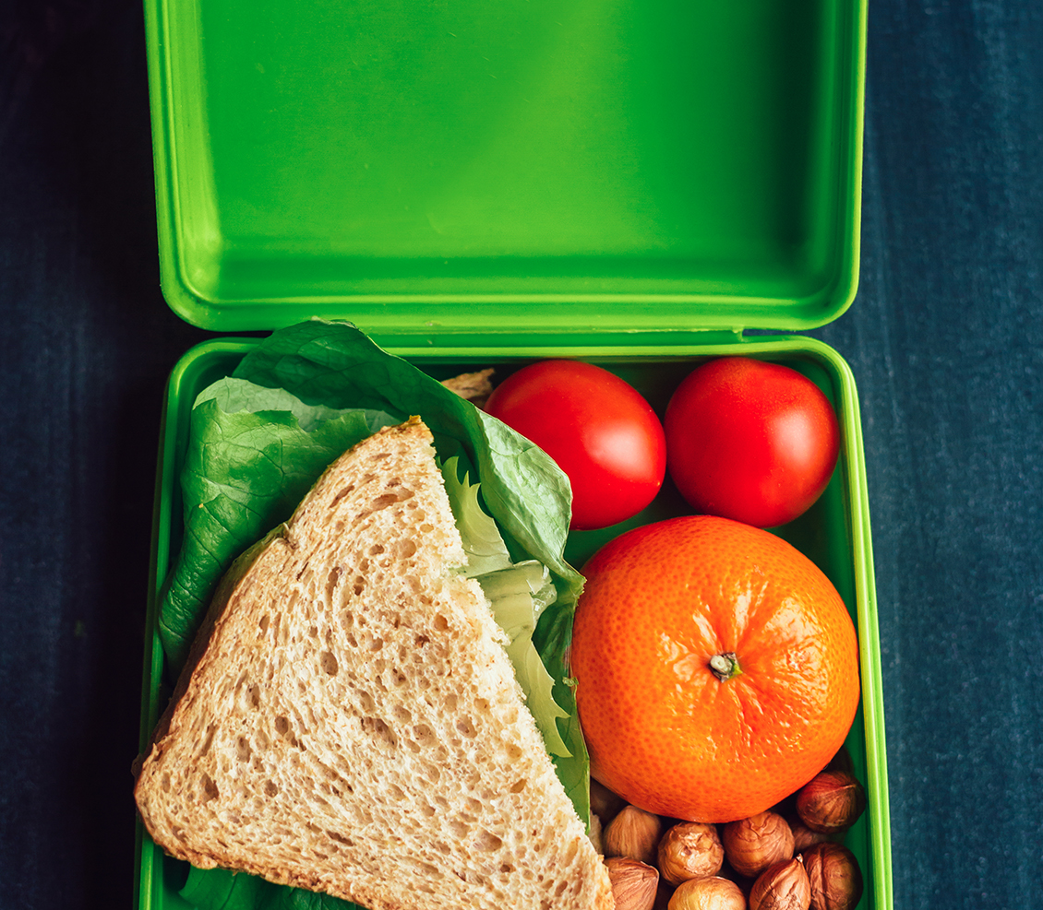



Agenda
Program Requirements
Menus
Paperwork
Monitoring
Civil Rights Training
Online Processes
Questions?

Slide 3
What is sfsp?
The Summer Food Service Program is a federally funded and regulated program that provides free meals to children and teens age 18 and under during the summer months when school is not in session.

Slide 4
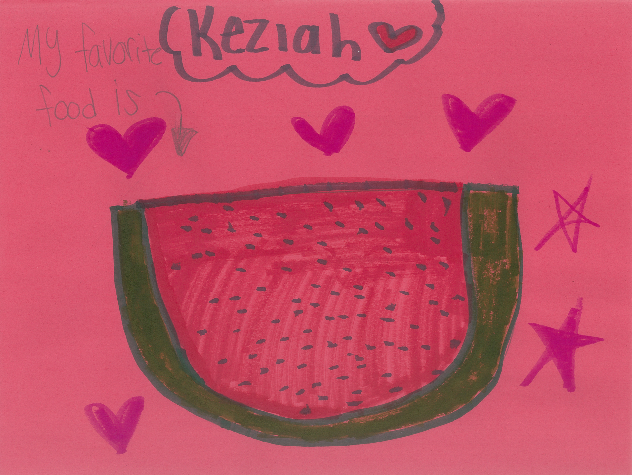

Who can eat?
Children and teens 18 and younger
A person age 19-21 who has a mental or physical disability and still participates in a school program (K-12)
Can adults eat?
Program adults – hot kitchen meals ONLY
This is an employee or volunteer who works with SFSP
A monitor, kitchen staff, supervisor, etc.
Non-program adults
A person over the age of 18 who does not work with SFSP
Parents, guardians, staff that doesn’t work with meal service

Slide 5
When can I serve?
Meals must be served during approved meal service times
Any changes in meal service time must be approved by DTC prior to service
Any meals served outside of the approved meal service time may not be claimed for reimbursement

Slide 6
Where can I serve?
CONGREGATE FEEDING IS A FEDERAL REQUIREMENT
Locations in approved meal service areas are determined by DTC
Location may not be changed or moved without prior approval
Locations should be easily accessible and a safe place for children to gather
All meals must be eaten in the presence of site staff
Any meal taken off site may not be claimed for reimbursement
Notes:
(These don’t have designer IDs since they were based off the default master slides already in the deck.

Slide 7
Types of sites
Open or Open-Restricted (preferred!!)
Closed – enrolled only
This site is open to any and all children, without an enrollment required.
Children do not have to participate in enrichment activities to receive a meal.
We prefer that all sites are open or open-restricted to feed as many kids as possible.
Open-restricted would be used in the case that you don’t have enough space to allow a large number of children, but don’t require that they be previously enrolled at the site.
This site is only open to children previously enrolled in programming.
Children do not have to participate in activities to receive a meal.
If you choose to have a closed enrolled only site, you will need to provide reasoning to the sponsor and further questions may be asked for clarification.
If operating in an area that doesn’t have at least a 50% F/R lunch rate, you will be required to collect income eligibility information.

Slide 8


Food allergies
A doctor or other who can write prescriptions, must complete a form confirming a child has a disability to omit or substitute an item. This does not have to meet the meal pattern. Dare to Care will reimburse you for required substitution.
If doctor marks that the child has special dietary needs but does not have a disability, no accommodations will be made.
If a child never brings a doctor’s note, you are required to serve the entire meal.
If a child is lactose intolerant and does not bring a note, they must still be served milk. They are not required to drink it, but they must take it.

Slide 9
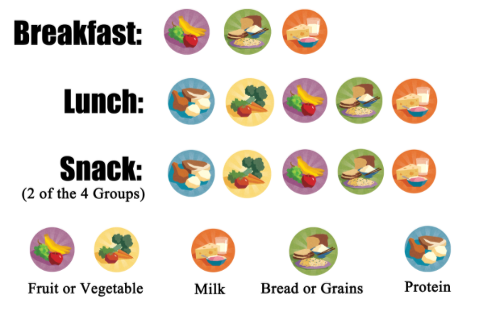
Meal pattern & menus
Menus must be posted at all times
Children must take all items
Milk is a requirement and must be taken
You may serve water with meals, but it does not replace milk
Do not serve additional items with he meal – serve them after meal service
Make changes to the menu as needed

Slide 10
Meal counting
ACCURACY IS IMPORTANT
Each meal served MUST meet the meal pattern to be counted on the Meal Count form
The count is to be taken as the children go through the line at the point of meal service
The count can’t be completed before or after meal service, it must be completed during the meal service

Slide 11
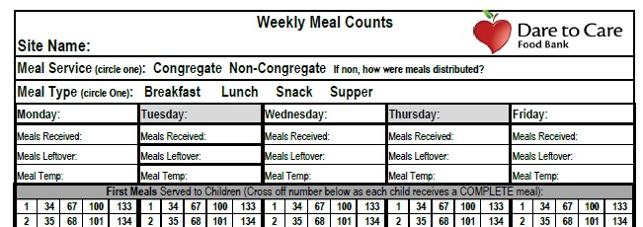
Weekly Meal Count Form
Site name is important!!
Meal Service and Type is required for claiming!
The number of meals received/Meal Leftover must be completed daily. You can not claim more meals than are listed here.
Date is required
Meal Temp only needs to be recorded for hot entrée item. If individually plated, pick one from the middle and poke through the plastic.

Slide 12
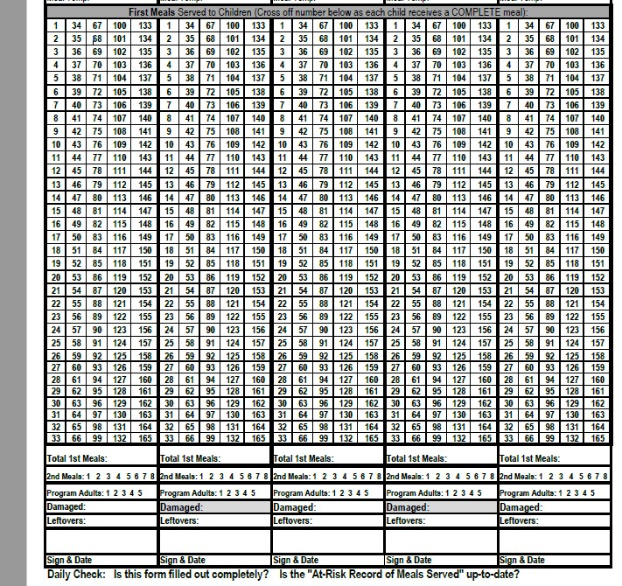
Weekly Meal Count Form
Only first meals are counted here! Each meal must be marked individually. Do not draw a line through multiple numbers. The meals must be marked at the time of meal service.
This number must match the number of individual meal count marks.

Slide 13
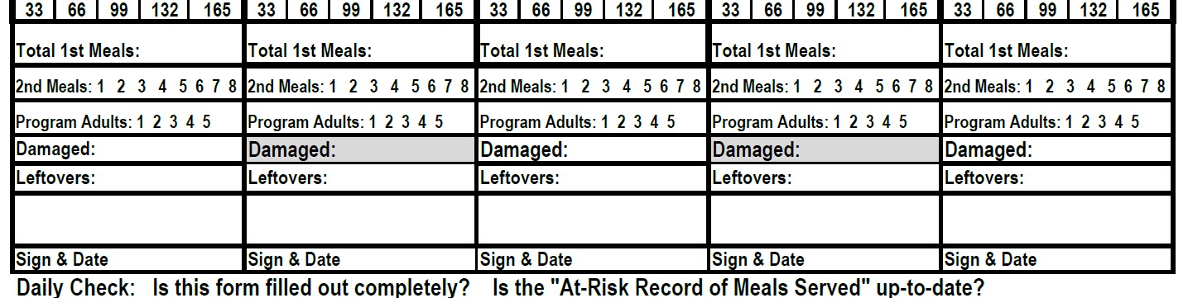
Weekly Meal Count Form
Individual meal counting is still required. These must be complete meals, not only one component or leftovers.
Subtract total 1st meals, 2nd meals, program adult meals, and damaged meals from Meals Delivered + Leftovers from previous day.
Don’t forget to Sign/Initial and Date
Damaged meals include any that you need to throw away due to expiration.

Slide 14
Weekly meal count form rules
For meals to be reimbursable:
Meals must be counted individually, not one line through many numbers (/ is only acceptable mark)
All required info must be completed daily & turned in weekly online
Can’t claim more meals than the number of meals available – except kitchen meals
Can’t claim that more first meals were served than children in attendance
The meal count shouldn’t repeat daily with no variation
Must claim at least 85% of Meal Delivered

Slide 15
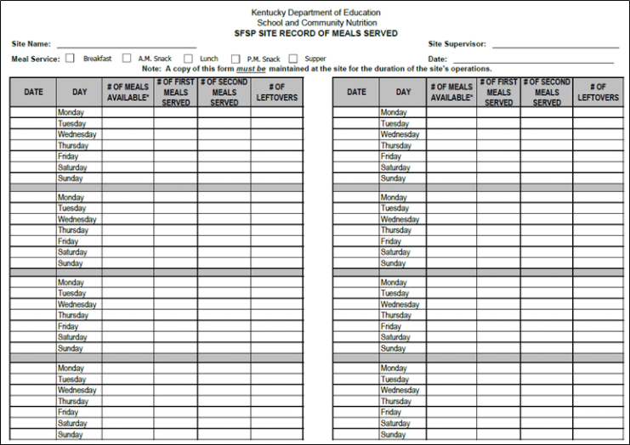
Site record of meals served (at risk form)
FILL OUT COMPLETELY
# of meals available = meals delivered + leftover meals from previous day
For breakfast, start with total number delivered at beginning and keep inventory as you use meals/more are delivered

Slide 16
Record of meals served (at risk form) rules for reimbursement
Complete daily and turn in monthly ONLINE
Must be available at all times for monitoring
Must have a Site Record for each meal service type
Must match Weekly Meal Count Form

Slide 17

Paperwork recap
Menu posted for each day
Weekly meal count form
Site Record of Meals Served
Attendance

Slide 18


Breakfast kits
Place order weekly to prevent overstock – order by the case
If you do not place an order at least 2 business days in advance, you will not receive the breakfast kits on time (or at all if you don’t place any order)
Only order enough to serve first meals – do not order enough to accommodate seconds or program adults
DON’T FORGET TO ADD MILK!

Slide 19
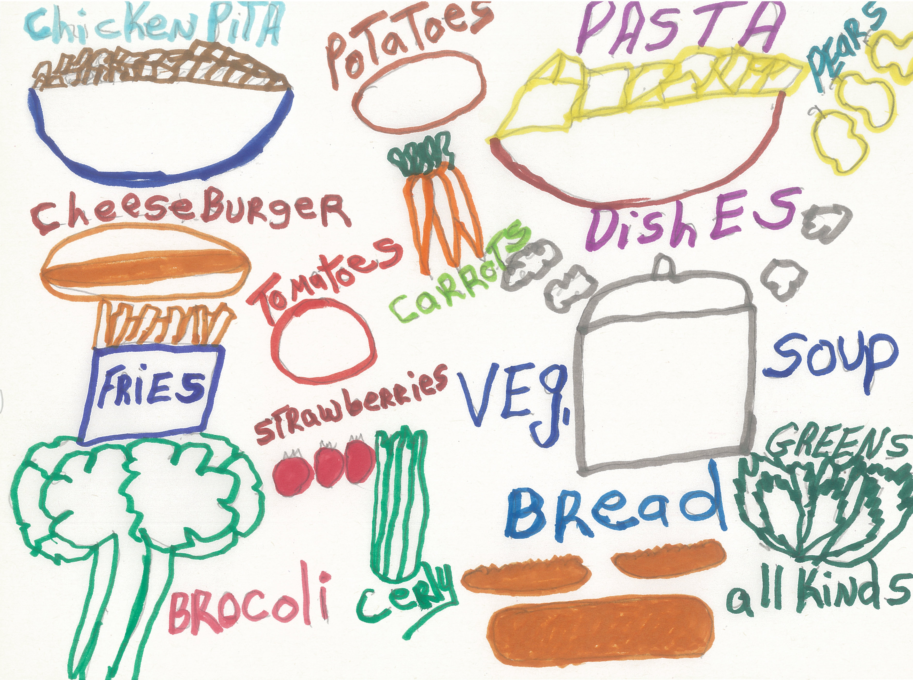
Cafeteria style (hot kitchen) meals
Only serve as congregate meals – may take one whole item (whole fruit, grain or vegetable) off site
Check temperatures 30 minutes prior to serving and at serve time
Pans and utensils MUST be free of any food debris after meal service and put back into the cambros. If the pans are not clean, we will not take them away until they have been cleaned. This is not only unfair to our drivers/kitchen staff to deal with cleaning once there’s mold and bugs, but it is unsafe to put that food into our trucks or our kitchen with other fresh food.
Changes and closures must be submitted at least 2 business days in advance

Slide 20
Sponsor and state reviews
Dare to Care will conduct a review of the site to make sure that the site is following all program rules and regulations
KDE may choose to visit your site at any point during the summer (they WILL be visiting some of our sites this summer as we are under review)
Any areas of noncompliance will be addressed in a corrective action place. The site must indicate the immediate corrective action that was taken and identify the plan in place to ensure future compliance.
A site must be terminated from participation if many violations are found and/or if the health, safety, or wellbeing of children is threatened.

Slide 21
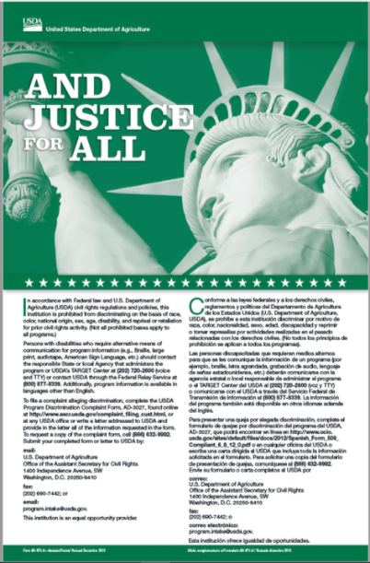
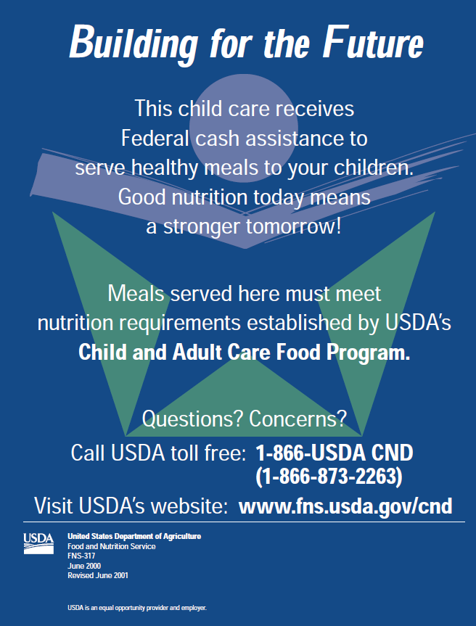
Civil rights
KDE Training Video

Slide 22
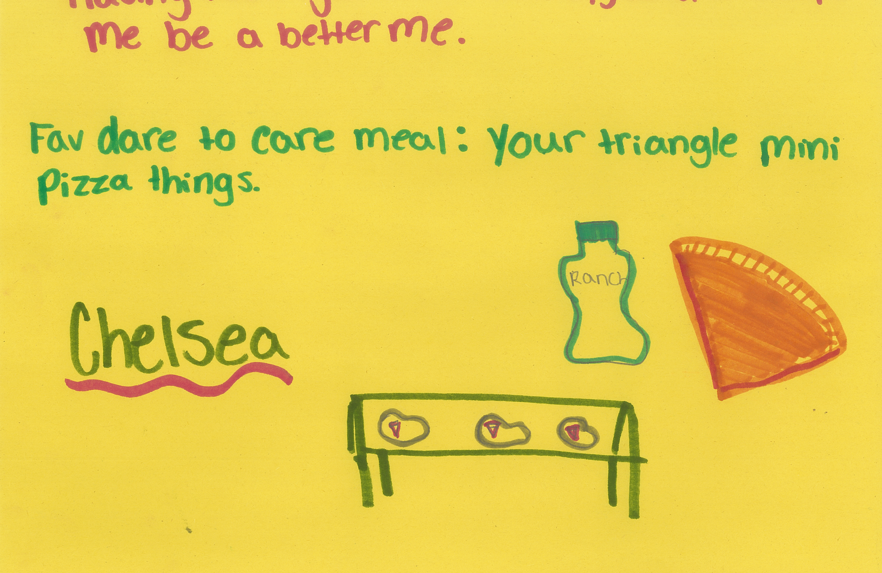
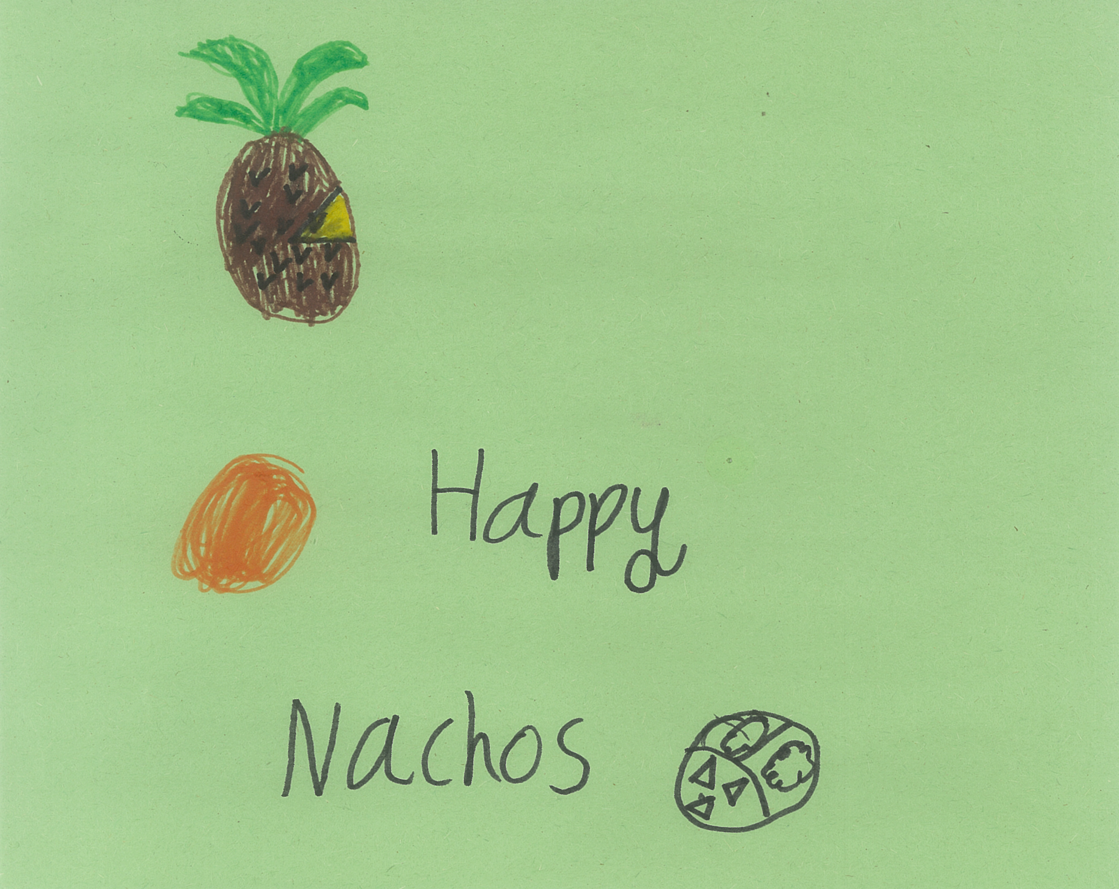
Site Supervisor responsibility recap
Trained site supervisor must be present during ALL meal services and serve all children
Ensure accurate meal count documentation and Civil Rights Compliance
Submit all forms to DTC each week and inform sponsor of any changes

Slide 23

Any questions?

Slide 24
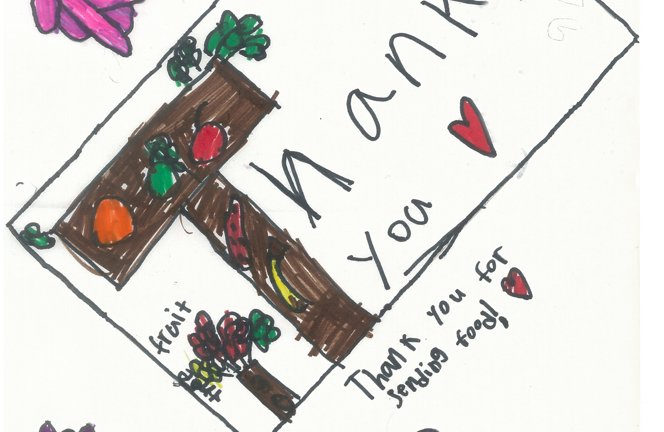

Thank you
Mary Jo Mullen
maryjo@daretocare.org
502-736-9414
724-493-7633
Taylor Thompson
taylor@daretocare.org
502-736-9917

Slide 25
Online Processes
Submitting paperwork
Changing meal counts
Closures/changes in meal service
https://daretocare.org/kids-cafe-file-upload/
https://daretocare.org/meal-count-change-request/
https://daretocare.org/kids-cafe-closures/

