Slide 1
MORGAN STANLEY
CHILD & FAMILY CHOICE GRANT
YEAR 3
Notes:
Welcome to the kick off of the Morgan Stanley Child & Family Choice Grant! Congratulations on being a part of this year's grant!
This grant has had two prior years of testing out tools and learning. However, this year is different. The requirements to be eligible were that sites have could not have any level of choice being offered.
The focus of this year is finding ways to make choice accessible to other pantries and food access points.
We'll consider
What resources are needed to make this change?
What kind of tools can food banks and sites work through to switching to choice models?
How to incorporate a trauma-informed approach
This funding round, there were fewer food banks awarded. There is a lot of room for experimentation and adjusting. Not everything will work, and that’s okay! We just need to document what worked well, what would be better, and keep adjusting to find the right fit.

Slide 2
AGENDA
Introduction​s
Goals
​Defining Choice
Expectations & Roles
Steps for Change
Choice Capacity Institute for Partners
Timeline
Resources
​Q&A
Notes:
Here’s what we’ll cover today.
More information will be provided at the upcoming virtual Choice Capacity Institute for partners later this month hosted by Feeding America.

Slide 3
MEET THE TEAM
DARE TO CARE TEAM
Trish Tobbe
Clifton Griffin
Maddie Monahan
Jill Luckett
Partner Development Manager
Partner Development Manager
Partner Development Manager
Grants Director
trish.tobbe@daretocare.org
clifton.griffin@daretocare.org
maddie@daretocare.org
jill.luckett@daretocare.org
(502) 736-9918
(502) 736-9915
(502) 736-9423
(502) 931-4895
EVALUATION TEAM
Feeding America
NORC at the University of Chicago
More than Food Consulting
Notes:
Here’s the Dare to Care team you’ll be working with! Each partner will be working with one member of the partner development team.
We’ve also included our Grants Director, Jill Luckett, here who is in charge of grant logistics.
The Evaluation Team consists of
Feeding America
NORC at the University of Chicago
More than Food Consulting
You’ll see faces from each of these team members on the bi-monthly calls. They will be taking the information we all (sites and foodbanks) provide to keep revamping and tweaking tools.

Slide 4
MEET THE PARTNERS (SITES)
FOOD BANK GRANTEES (11 TOTAL) | YEAR 3 COHORT SITES (27 TOTAL)
Banco de Alimentos de Puerto Rico | 3 Agency Partners
Central California Food Bank | 2 School Pantries
Community Foodbank of New Jersey | 1 School Pantry and 1 Agency Partner
Concho Valley Regional Food Bank | 3 Agency Partners
Dare to Care Food Bank | 3 Agency Partners
Feeding Tampa Bay | 2 School Pantries and 1 Agency Partner
Food Bank for New York City | 2 School Pantries
Food Bank of Eastern Oklahoma | 3 Agency Partners
MANNA FoodBank | 2 Agency Partners
Second Harvest Food Bank of Greater New Orleans and Acadiana | 2 Agency Partners
Second Harvest of the Big Bend, Inc | 2 School Pantries
Introduction
Notes:
There are a lot of hands in the pot on this grant! 11 food banks with 27 sites will be testing, changing, and providing feedback.
This is really interesting opportunity to learn about processes and ideas and collaborate with other sites from coast to coast….and a little off the coast. We’ll be able to share our pros and grows and learn from each other during this process.

Slide 5
MEET THE DARE TO CARE PARTNERS
Introductions
AGENCY PARTNERS (SITES)
Catholic Enrichment Center
Historic Calvary Baptist Church
Neighborhood House
PARKLAND
PORTLAND
Tell us:
Your name
Your agency's name
What is something you're most excited about?
What are you most nervous about?
Notes:
Enjoy the local cohort of the Dare to Care team. You are close in proximity and have varying years of experience to connect and share.
So, let's meet each other! We are looking forward to working you all to work with over the next year (and some change) to collaborate on creating a choice service model at your pantry and creating a landscape and foundation for other food pantries to learn from you all!
Please tell us your name, what agency you’re from, something that you’re most excited about and what you are most nervous about!
Please note this is an open and safe space where we can be honest and discuss pain points, frustrations, and more.

Slide 6
GOALS
FOR PARTNERS:
GOALS OF THE GRANT
EXPAND TO FULL CHOICE MODEL
INCREASE SATISTFACTION AMONG NEIGHBORS, STAFF, AND VOLUNTEERS
DECREASE FOOD WASTE
Assess the process and resources needed to implement choice at sites.
Engage neighbors to gather feedback to meet needs and preferences.
Measure the impact on site staff and volunteers of increasing choice.
Test and revisit tools intended to build choice capacity.
Support the creation of the Choice Toolkit for the broader food bank network.
Notes:
These are the results we’re looking for at the site (partner) level
Moving to full choice
Increase satisfaction in those involved in the pantry, and a
Decrease in food waste.
However, there are broader goals that hopefully will have a ripple effect amongst food banks in the Feeding America network. The work we’re doing in the grant will hopefully outline processes and tools to provide other sites routes to offering choice at their locations. It will be a co-developed set of tools for a wider audience of food access organizations.
Choice is best practice, but it’s not a requirement by most food banks or funders. By making the path to choice accessible, more sites and food banks can jump on board and promote choice.
Consider yourselves thought leaders in this process. You are setting a pathway for other pantries to offer dignity through a choice model and the tools they will need to do so!

Slide 7
TERMINOLOGY
Sites: grant language used for agency partners
Neighbor: person receiving food from your pantry
Stigma: negative associations that a society or group of people have about something.​
Rapid-Cycle Evaluation: way to gather feedback in real time, from food banks, pantries, and neighbors to improve learning tools.​
CHOICE: allowing neighbors to handle and choose their food with dignity when getting food from a pantry. ​
Notes:
Just a few words and terms that you may be hearing on future calls with the evaluation team (or from us!).
You may hear the term "sites" that is just referring to you all, the agency partners.
Neighbor is being used to replace the term client. It helps people take a beat to realize the food insecurity is in every community and neighborhood. And helps destigmatize the nature of seeking help.
We often talk about the stigma people feel of having to come to a pantry.
Working to move towards choice and away from distributing identically prepacked back to neighbors. Model may see efficient for the volunteers and for distribution, it can create stigma for the neighbors to ask for “charity” and create a power dynamic between the “give and the “receiver”.
Rapid-cycle evaluation is a fancy way to giving feedback in real time for things to undergo changes and be able to be tweaked more quickly.
Choice – allows neighbors to handle and choose their food with dignity when getting food from a pantry.
Choice can help reduce food waste, as neighbors may not want or need some of the items you have in stock. We’ll see the different levels of choice pantries offer; it’s not a binary state of offering choice or not. The goal of this grant is to get to FULL choice.

Slide 8
DEFINING CHOICE
WHY CHOICE?
More efficient use of resources: "It's been really easy for them to transition to this [full choice] model because not only does it take less time, but we can serve a lot more families." | Providing a more dignified experience for neighbors: "Allowing choice has been so powerful for people....They feel worthy and valued because we care enough to check in with them and provide an opportunity for them to shop."
Enriched relationships between neighbors and volunteers, reducing stigma and power dynamics: "It's much more personal, it's much more about being with the person...[W]e have regulars [who] look for a certain volunteer...and it becomes a bond. For some people that's the only warm face they see." | Better meeting neighbor food needs and preferences (reducing food waste): "It's just a matter of being willing to recognize the value of giving people choice in terms of just the dignity factor of it, but also in that if you make me take food that I don't like or I'm not going to eat, it is going to be wasted and what's the point?"
Notes:
Here is the why behind the grant.
Feel free to save these as talking points for volunteers, staff, and organizational members, we can provide you quotes, frequently asked questions, and data/results from the first two years of this grant.
These themes and quotes are from feedback from participants in the previous grant cycles.
We are so happy that you are a part of this process and are looking forward to working together on the Year 3 launch!

Slide 9
“
79% of pantries that increased their level of choice said overall operations improved.
”
-Morgan Stanley Choice & Family Grant Finding (Year 2 Evaluation)
Notes:
Here are some other key findings:
Shorter wait times
Higher levels of satisfaction for neighbors
Higher levels of satisfaction for volunteers and staff
Full choice pantries reported less food waste.

Slide 10
DEFINING CHOICE
LEVELS OF CHOICE
NO CHOICE
LIMITED CHOICE
MODIFIED CHOICE
FULL CHOICE
Neighbors can choose between 2+ types of boxes or prepacked bags
May also be able to choose additional items for the prepacked bag or decline food
Pantry feels like a mini-supermarket; neighbors touch their own food
If online ordering, neighbors order food as if they are shopping through a grocery store
"Traditional" food pantry model
Bags/boxes are packed in advanced, and everyone receives the same items.
Neighbors can choose from a menu of options or tell volunteers what they want
Volunteers select and bag the food
Notes:
Here is the spectrum of choice. You can see how it goes from no choice to having the neighbors be able to touch the food.
While the goal is to get everyone to full choice, how that happens will vary from site to site.
Some may hit every level as they work their way towards full.
Others may skip a level or two. And still others may decide to switch from none to shopping overnight.
It is not required to log time at every level listed.

Slide 11
GRANT EXPECTATIONS & ROLES
GRANT EXPECTATIONS & ROLES
FEEDING AMERICA
PARTNER FOOD BANK
AGENCY PARTNERS
Create and facilitate virtual peer learning opportunities
Develop resources based on food bank and agency partner feedback
Offer support, creative thinking, and technical assistance throughout the grant period
Learn from food banks and sites to identify best practices around choice
Be active participants in the peer learning opportunities
Provide direct technical assistance and regular support to sites through the choice implementation phase (including site visits)
Support the development of the Choice Toolkit by testing resources and sharing feedback
Participate in bi-monthly peer learning opportunities
Work with the food bank to engage neighbors and develop an action plan to offer more choice
Support the development of the Choice Toolkit by testing resources and sharing feedback
Host site visits periodically
Notes:
Dare to Care: You are not alone in this work! Here’s how we will be supporting you and the grant work.
We’re jumping on calls and will be communicating with you all monthly to offer support, assess progress, and share updates and resources .
(If asked: grant total awarded is $149,250 to support this week at the site level and Dare to Care. There is flexibility in how this money can be used by Dare to Care and the sites. Physical infrastructure, salary support, neighbor feedback incentives, food, etc.)
Potentially sourcing food or purchasing equipment (we may have some bargaining power we can use).
Partners - this is a reminder of likely logging up to 10-18 hours per month towards this grant.
There will be calls and site visits and continued conversations with Dare to Care.
If not in person, there will be a virtual site visit with the evaluation team, in addition to the Dare to Care team coming to visit.
This grant provides the space to work with neighbors to gather input on service models and ways to improve their experiences. You will be conducting listening session and surveys to hear their ideas. What you learn will be valuable in your service and when connecting with donors and funders (“research-driven changes that are working and proving successful” type of phrasing…)
We want to pull everyone together a few times through out this grant (separate from the calls and individual sites visits) to discuss collectively what is working, where there are challenges, and how Dare to Care can continue supporting the work. We will also stay in touch with you about engaging the local staff of Morgan Stanley as volunteers. They have expressed an interest in participating in a volunteer day.

Slide 12
STEPS FOR CHANGE
HOW DO WE GET THERE?
BUILD BUY-IN
PLAN FOR CHANGE
TEST, ADAPT, REVISE
From volunteers and staff
Discuss motivations​ and successes of choice
Be open to notes​
Neighbor feedback methods
Service model layout
Volunteer roles
Distribution times
Equipment needed
By evaluating neighbor and volunteer experience​ and
Employing a feedback loop with additional rounds of feedback
Notes:
We talked about the goals. We talked about the expectations. But how are we going to get there?
Have to get volunteers and staff on board with change coming and how it will impact them. Have some information (that we can share) ready about the success of choice for encouraging change. Maybe someone will find the impact of choice on neighbors in other pantries inspiring. Maybe it will tap into a currently under-utilized skill set for them or improve operations.
Be ready for notes and concerns from volunteers and staff. They need to feel that their concerns and questions are also heard.
Talk to neighbors, and then make a plan for change. And that change may impact some or all of these areas.
Neighbor and volunteer feedback is not a one-and-done check box. It is ongoing. Maybe you start with a listening session and then several surveys throughout the grant period to check in and make adjustments. It will take some time to find the right groove for your pantry that works for volunteers and for neighbors.

Slide 13
STEPS FOR CHANGE
NEIGHBOR ENGAGEMENT
CREATE
REVISE
SHARE
HOW
WHEN
WHO
WHERE
WHAT
Listening sessions
Surveys
One-on-one interviews
Compensation
Neighbor engagement commences in Sept.-Oct. 2023
Gather findings Nov.-Dec. 2023
Intentionality
Wide range of neighbors served
Quiet, private space
Virtual (i.e., Zoom)
Identify common themes
Implement changes
Feedback loop
Notes:
As we mentioned earlier, pantries collecting neighbor feedback is an expectation of the grant, and we are here to help support you in this process! It may be old-hat for some, but for others this can be an exciting new area to explore and see what you can learn from those accessing your pantry.
After the virtual trainings later this month, we plan on circling back on this topic to go in more detail if it is needed. There are three main ways people typically ask for feedback, and the timing can be important. It’s key that your neighbors know there is anonymity there. That you will not share their names or identifiable information with the foodbank or with the public when using this data for changes, fundraising, or advocacy. There’s a level of care taken with the information and vulnerability neighbors are sharing.
Why-to see how your neighbors would like to access the food pantry and evaluating the impact of those changes along the way. We want to see data-driven changes. Maybe the layout of the pantry is causing traffic jams in the space. Maybe there isn’t a big enough lot to operate a drive thru.
How-listening session, or a focus group. Gather 8 or so neighbors together to answer questions as a group. Could be an ideal first way to gather feedback. Surveys are great tools for quick touches on the changes that have been implemented. Can potentially reach more people, can be done by pen and paper or online/qr codes. One on one interviews can be wonderful for digging into a lot of deeper questions. However, be careful of setting up too many of these in a row. Because then you have to dig through all of that data you just collected. Which brings up a point of going through the answers as soon as possible after the collection event. It’s still fresh; it won’t build up on the to-do list, and you can make tweaks/plans for change faster.
When - how often-one session or collection at the beginning so know how to make plans for change. Then touchpoints throughout to evaluate how that change is working.
Who-trying to get a snapshot of the whole community. Try not to just ask people who are using other services or have kids or speak or are of one gender. Try to widen representation at the table. Have intentionality in the approach. Or a seemingly random process. Maybe it’s every 4th person in line is asked if they want to participate. Also, it does not have to be the same people every time. It’s great to have a wide range of engaged neighbors.
What-you are going to dig through what you collect to find common themes. And figure out what is do-able. Be sure to have a way to let those in the pantry know that they were heard and how you are addressing those concerns (or if it isn’t feasible.) We have an example of a feedback flyer you can use to share with your neighbors. This shouldn’t be about collecting feedback to check a box, but rather implement change.
Neighbor incentives: we have some guidelines on ways you can compensate neighbors for their lived experience and time. It should relate to the amount of time they are sharing. For instance, a survey response gift card will be less than a gift card for someone participating in a listening session.
We can also help support the collection process. We can sit in on listening sessions and take notes. We have examples of questions that other grantees have asked their neighbors. One key take away is to not ask/offer a change you cannot make. Keep it realistic and reasonable

Slide 14
STEPS FOR CHANGE
SITE VISITS
Pantry’s strengths and opportunities for growth.​
Provide resources and discuss ideas for increasing choice.​
Discuss any concerns, questions, and pain points. ​​
Notes:
These are not the traditional compliance monitoring visits. These will be specific to implementing choice and looking at capacity building.
This is an example of a tool that we will be testing out and giving feedback on. Does it help organize thoughts and start the conversation? What would you add or remove?
We’re going to document before, during, and after with note and photos, and maybe the occasional video.
And what is discussed at the site visit may change based on what you learn from your neighbor engagement.
There is going to be trial and error in this process. We’re going to have conversation and site visits to discuss successes and less successful implementations. It’s okay for something to not work immediately! It will take some tweaking or sometimes scrapping an idea.

Slide 15
WHAT’S NEXT?
VIRTUAL CHOICE CAPACITY INSTITUTE FOR PARTNERS
THURSDAY, AUGUST 24, 2023
1-3PM
SATURDAY, AUGUST 26, 2023
11AM-1PM
Catholic Enrichment Center
Historic Calvary
Neighborhood House (Lindsay)
Partner Development (Maddie & Clifton)
Neighborhood House (Billie)
Partner Development (Trish)
Notes:
What’s next? Before the neighbor engagement and site visit pieces of the grant, you will be attending the Virtual Choice Capacity Institute hosted by Feeding America.
The link should be in your inbox soon, if not already! They’re also linked on the slide here. Please let us know if you did not receive the link.
Here’s when you signed up to attend.
While we will be on this training with you all, we will not be on the bi-monthly calls. That’s a time for sites to connect and feel comfortable to share what’s working or not without the food banks.

Slide 16
TIMELINE
Notes:
This is the overall timeline of the grant.
We were awarded the grant in July of 2023, and it ends October of 2024.
Clifton and Trish made it to Chicago to participate in the grant training. And virtual training will be later this month.
We're in the Preparation Phase from now until October 2023 – where we roll into site visits and start thinking through what could work. In the fall, the neighbor engagement piece should begin. And we are here to help you all with that! We can help with questions, take notes in a listening session. And we’ll gather together again before then to review some tips and tricks to collecting feedback. For some, it may be a refresher. For others it may be a new skill set to develop!
We expect that we will have a visit (virtual or in person) from the evaluation team early in this grant year. It will likely look at how the food bank is supporting and sharing/training partners about choice and how well the tool kit is working up to this point.

Slide 17
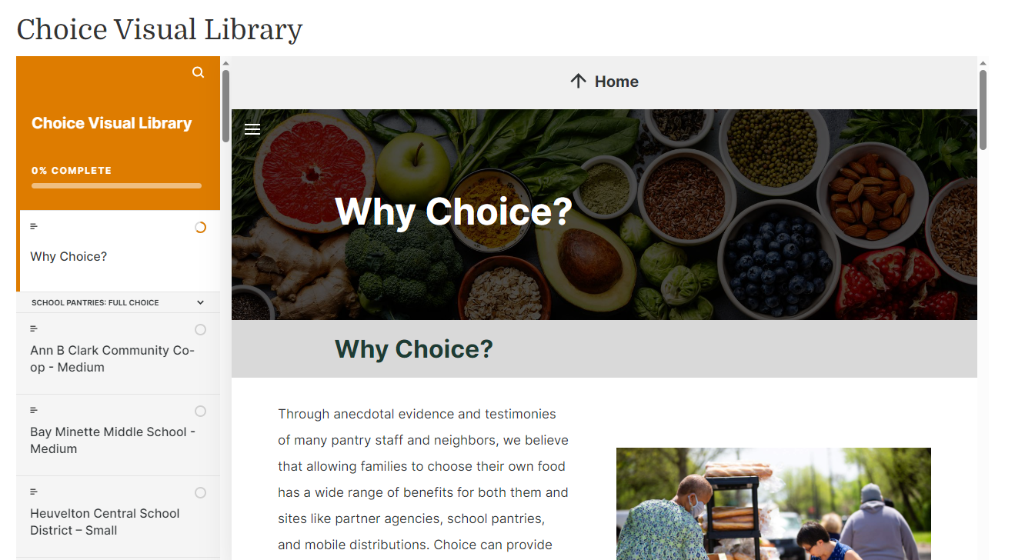
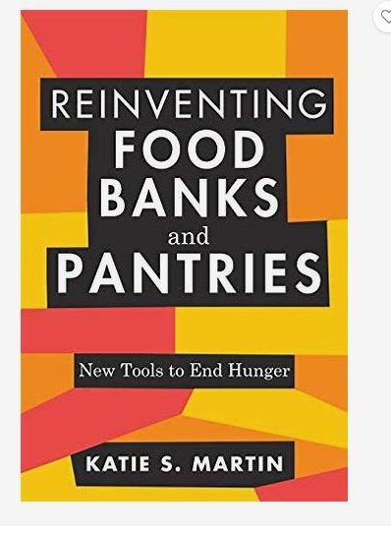
RESOURCES
CHOICE RESOURCES
Choice Visual Library: Choice Visual Library (feedingamerica.org)​
Channel One Mobile Market – Small - Choice Visual Library | Rise 360 (articulate.com)
Reinventing Food Banks and Pantries: New Tools to End Hunger by Katie S. Martin
Notes:
There are some great resources for partners who have made the switch to full choice and what it looks like at their locations.
You can explore this site to see small, medium, and large pantry operations. You can also find videos on neighbor intake process, staff interviews, and how they transitioned to choice.
This resource is to not be shared outside of the partnership, so please do not put any links on social media or email with donors or anything like that. We'll send you the links as well.
We've also linked to Katie S. Martin's book Katie Martin (she/her) is the CEO of More Than Food Consulting, LLC and a member of the evaluation team for this grant.
She is recognized as a thought leader on food security issues and has over 25 years of experience developing and evaluating holistic solutions to hunger.

Slide 18
THANK YOU!
Q&A
Notes:
Questions & Concerns?
Make some notes of the areas where you are wanting more information after the virtual trainings as well.
Then let’s hit on those topics in this smaller group or one on one. Do you want more information on collecting neighbor feedback, for instance?
We'll see you at the virtual trainings later this month. Then we'll talk about site visits and neighbor engagement.

