Slide 1
Capturing and Reporting Neighbor Statistics
Presented by Partner Development Team
September 2023

Slide 2
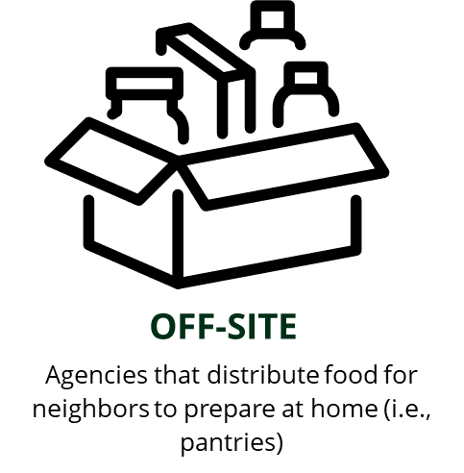
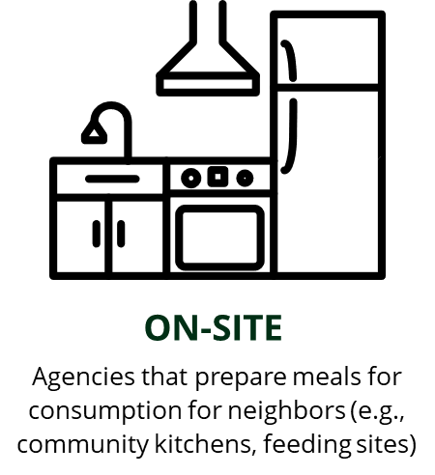
Overview
Importance of Statistics
Reporting Deadlines in Primarius
How to Track & Report Statistics:
  Pantry Partners (Off-site)
  Partners who don't receive TEFAP
  Partners who receive KY TEFAP
  Partners who receive IN TEFAP
  Kitchen Partners (On-site)
Notes:
Broad strokes of what we’re going to cover today. Refresher for some of you, but we have a change coming for our pantry partners in counting and reporting. We’ll follow it up with some scenarios of how counting and reporting unfolds.

Slide 3
Importance of Statistics
Partner Size
Fundraising
Grant Reporting
Increasing Community Awareness
Notes:
Statistics impacts your organizations and Dare to Care in a variety of ways.
Partner Size: it’s an internal metric that plays a part in the amount of food partners can access. Part of an annual evaluation of network. There are ranges of numbers served impacting the size assignment.
Grant reporting: several of our funding sources are from specific grants that require metrics from the work they supported.
Fundraising: development uses the stats of network to find additional resources for Dare to Care and the partners.
Increasing community awareness: we make presentations, hand outs, flyers, and information so the community can learn more about the work and find ways to engage, be it with resources, time, or advocacy.

Slide 4
Statistics Reporting Due Dates
(in Primarius)
Partners who DO NOT receive TEFAP/USDA Product
  Due by the 3rd of the following month
    Example: July statistics will be due by August 3rd
Partners who receive TEFAP/USDA Product
  Due by the 7th of the following month
    Example: July statistics will be due by August 7th
Notes:
Not entering your statistics by these deadlines will prevent your organization from placing food orders with the food bank or can result in a disruption of your TEFAP/USDA monthly allocations.

Slide 5
Off-Site Partners without TEFAP Counting and Reporting
Notes:
Reminder, stats are due by the 3rd of the following month. For example, July’s information should be updated by August 3rd.

Slide 6
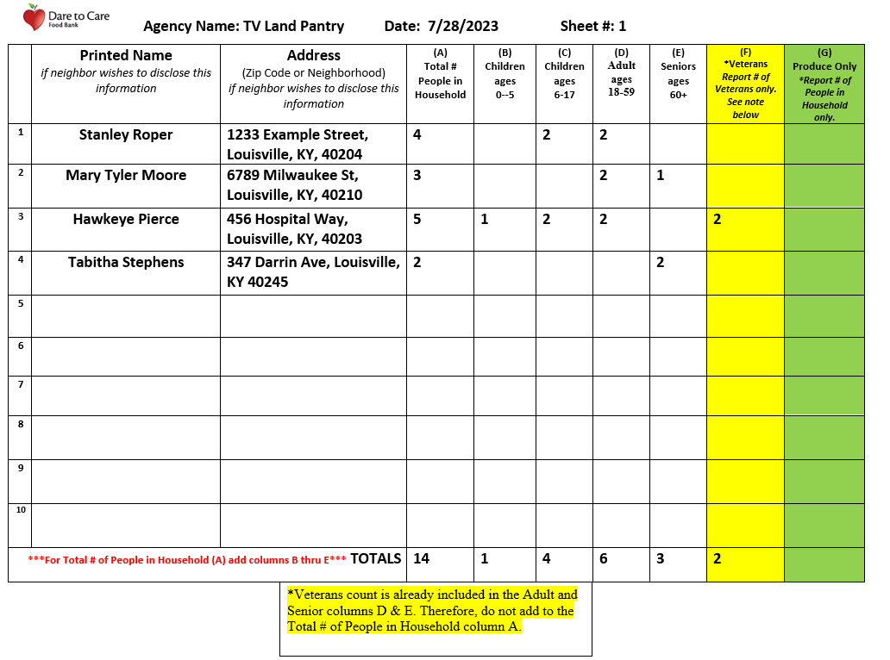
NO SIGNATURES REQUIRED
Notes:
Produce only recipients can be tracked on this sheet or a separate document, like we see on the next slide. Produce only recipients are not counted in the total number of people served.
The number of veterans served is not included in the total number people served, as that information would be captured in the age breakdown/total number of people in household category.
B, C, D, E should add up to A.

Slide 7
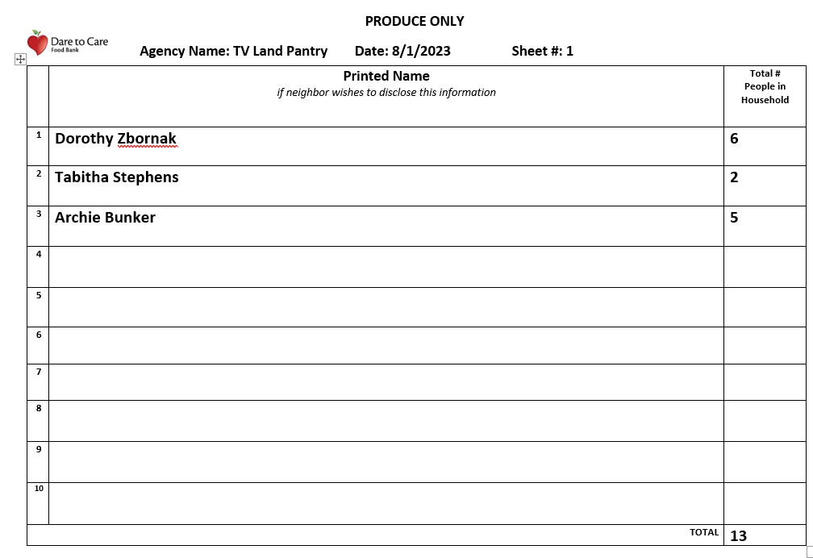
Notes:
Produce only recipients are kept separate from the total number of people served as well.

Slide 8
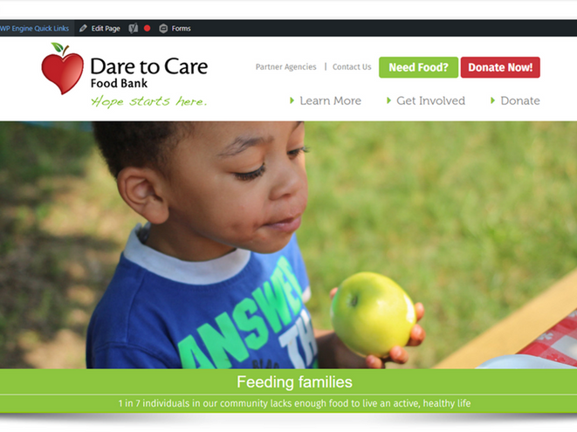
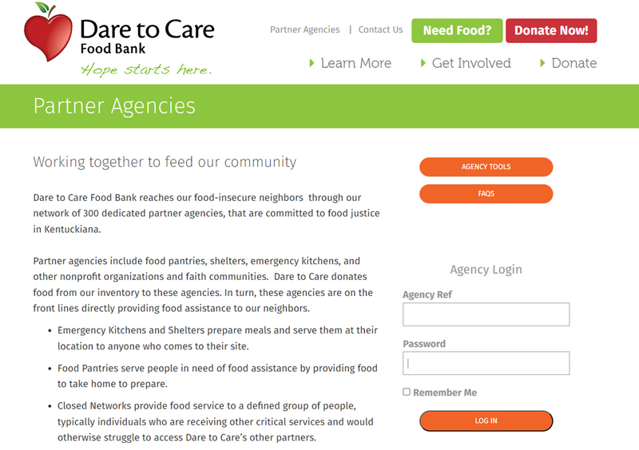



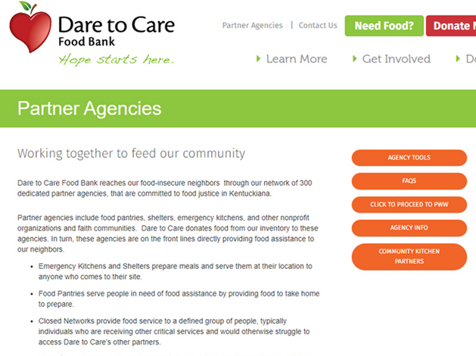
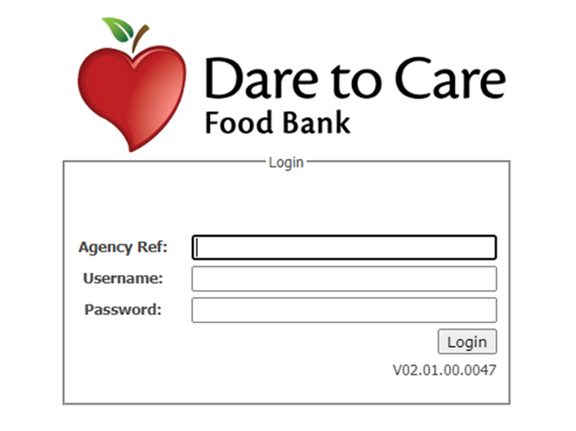



Notes:
You have your sheets for the month. You've counted up your people served, households, and age brackets.
How does that information get reported online? Login with your PWW credentials. If you do not have your PWW credentials, we can get them to you!

Slide 9
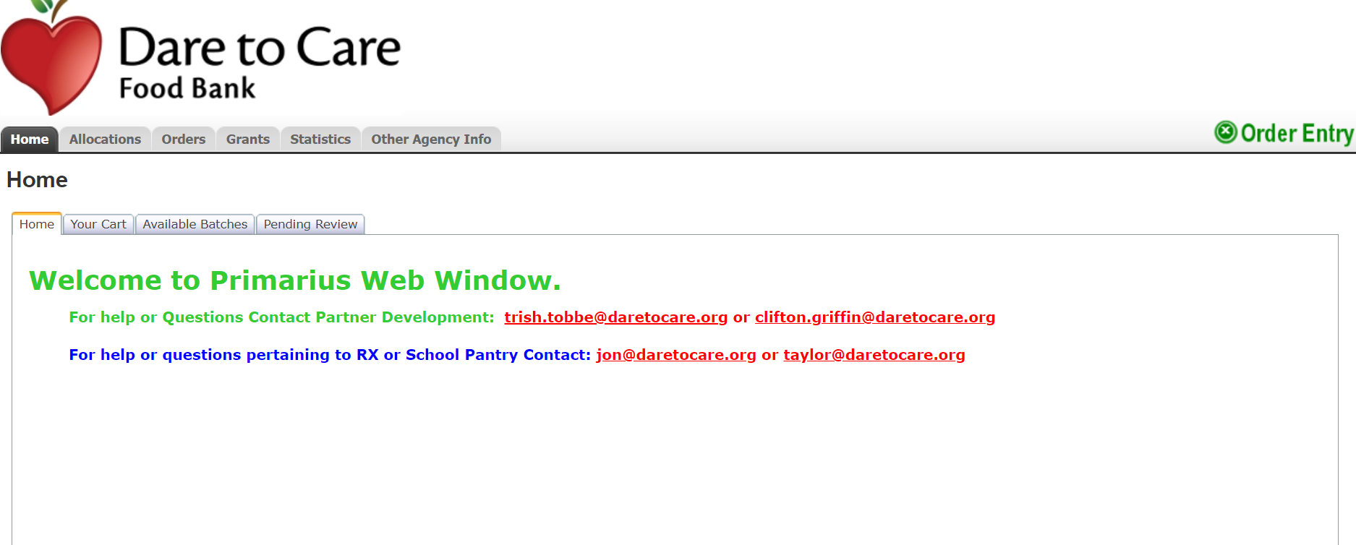
Notes:
Reminder for all on where to enter your statistics on the website. You will have logged in as you do for building orders-the PWW system:
DTC main page > partner agencies > entering agency reference number and password > click to proceed to PWW > entering agency ref number, username, and same password from the other login page.

Slide 10
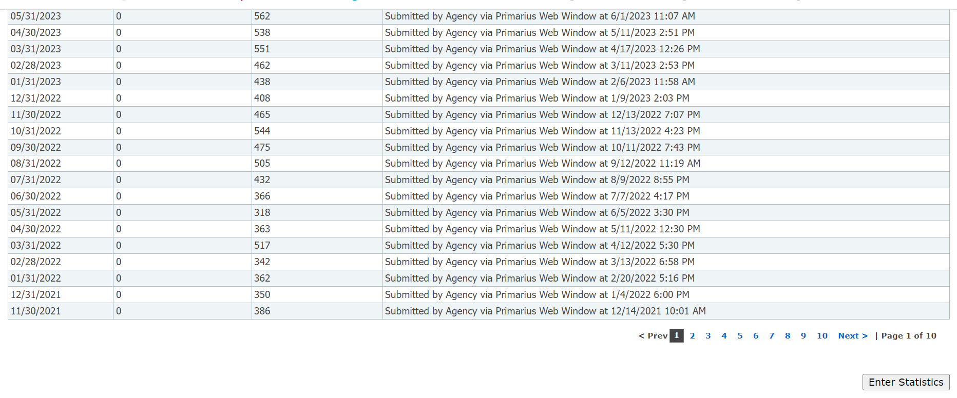

Slide 11
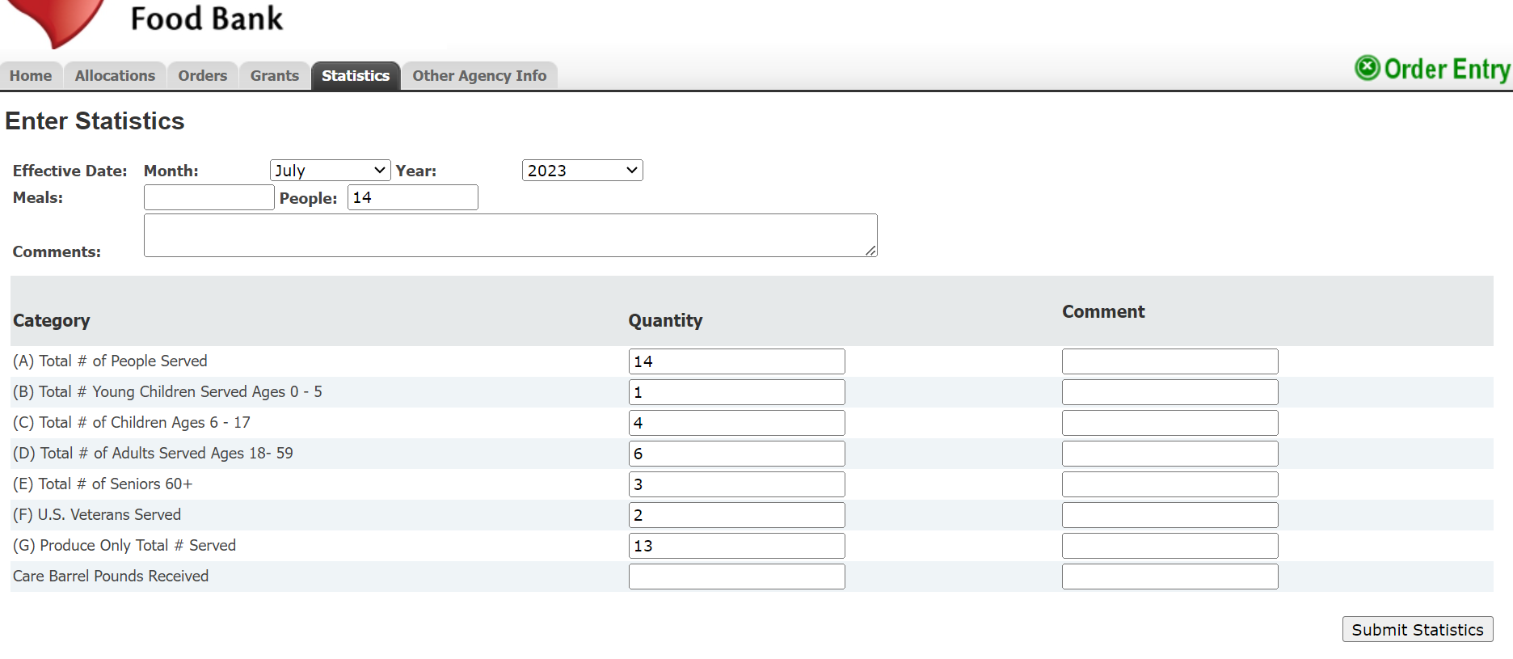
Notes:
You will see that the veterans count and the produce only counts are NOT included in the total number of people served row or in the "people" box at the top. Just like on the intake sheet, letters B, C, D, E should add up to A.

Slide 12
KY TEFAP Off-Site Partners Counting and Reporting

Slide 13
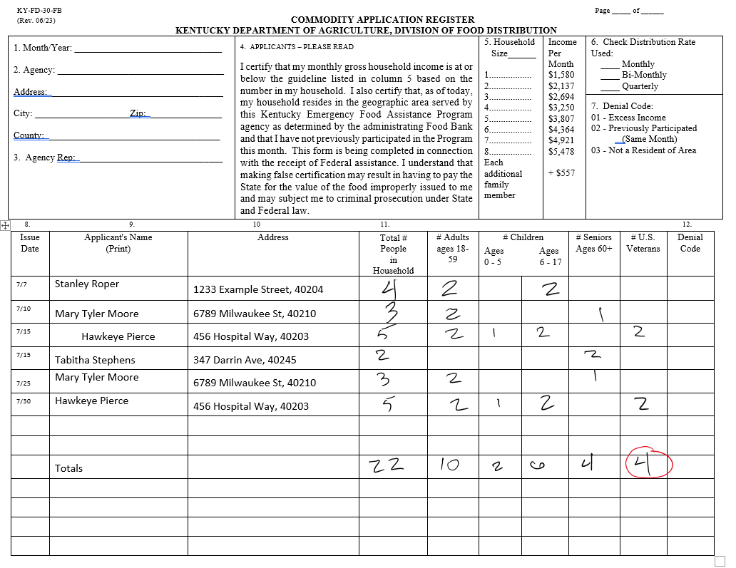
NO SIGNATURES REQUIRED
Notes:
Discuss counting households as well. 6 for this slide.
TEFAP numbers are a subset of the total number of people served, if everyone does not qualify or receive TEFAP product.

Slide 16
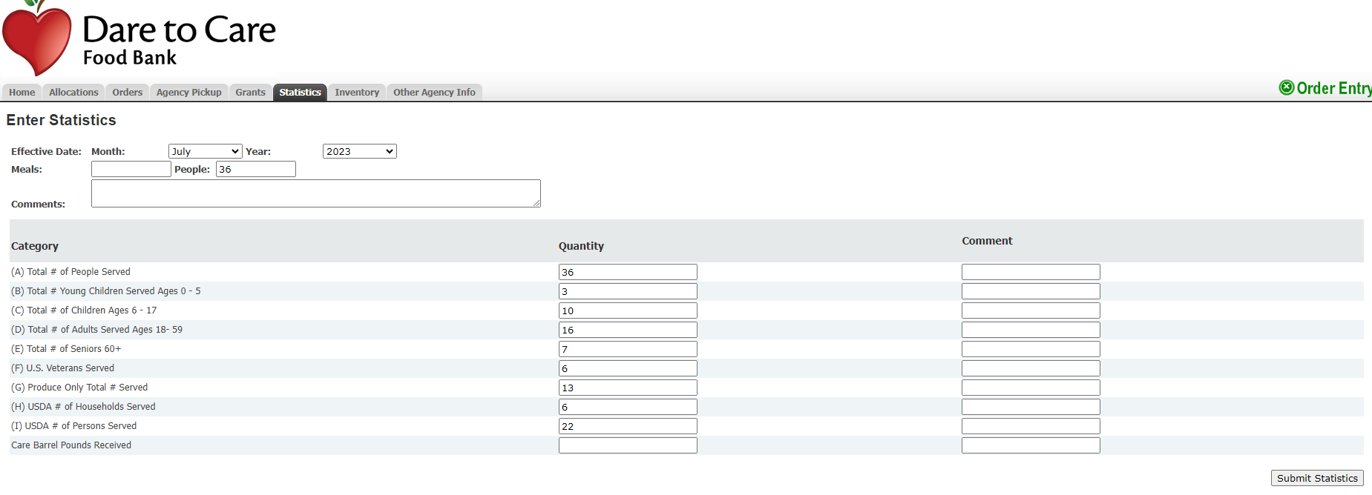

Slide 17
IN TEFAP Off-Site Partners Counting and Reporting

Slide 18
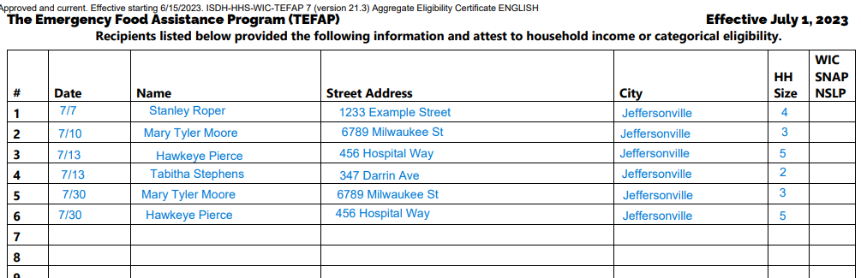
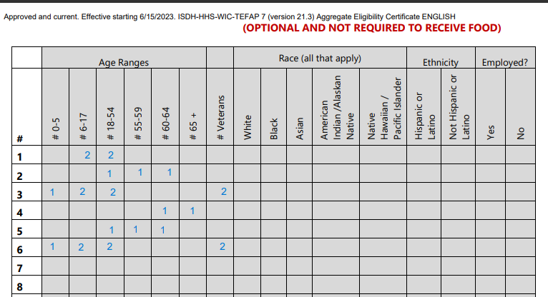
Page 1: Required Neighbor Information
NO SIGNATURES REQUIRED
Page 2: Dare to Care Requested Information

Slide 19
NO SIGNATURES REQUIRED

Slide 20
NO SIGNATURES REQUIRED

Slide 21
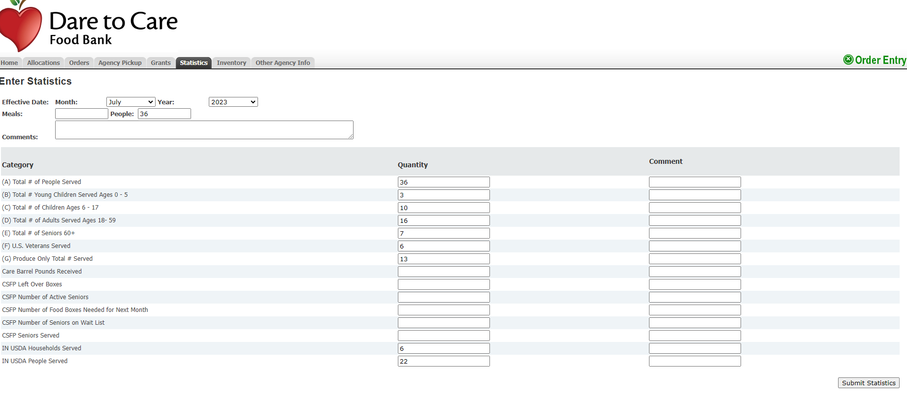

Slide 22
On-Site Partners with or without TEFAP Counting and Reporting
Notes:
Reminder, stats are due by the 3rd of the following month. For example, July’s information should be updated by August 3rd.

Slide 23
Community Kitchens
Residential Facilities
Shelters
Report the number of meals served and the number of people served.
  Capture AND document the numbers of meals* and people served.
  Do not collect names, household counts, addresses, or any other information beyond numbers.
  *If your agency receives USDA/TEFAP product, count meals prepared with USDA/TEAP items as the subset of Total Meals Served.
Notes:
On-site partners are those who prepare meals at their location to distribute.

Slide 24
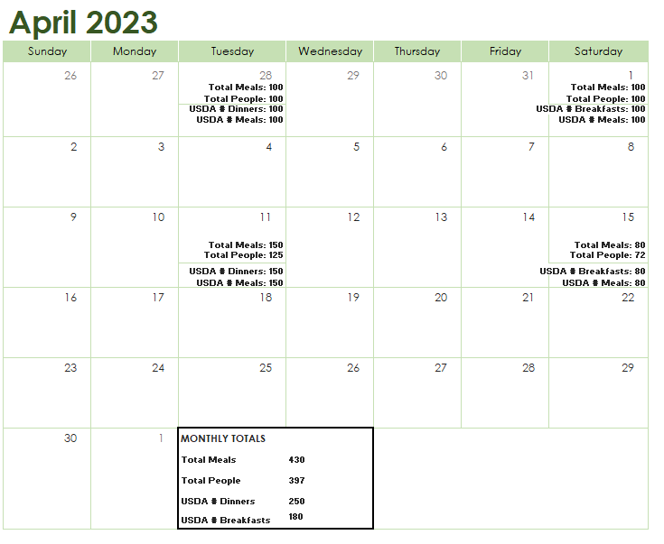
Notes:
We still need on-site partners to show a paper trail of their counts. It can be a calendar like this, or it can be a notebook or spreadsheet logging those counts. These records should be kept for three years plus the current year. And it should be identifiable when the record was kept (year and month at a minimum). You can see this location receives TEFAP/USDA product and are counting those meals as a subset of the total number of meals served.
So you have your document of the month’s work. What’s next? Need to report it to DTC.

Slide 25
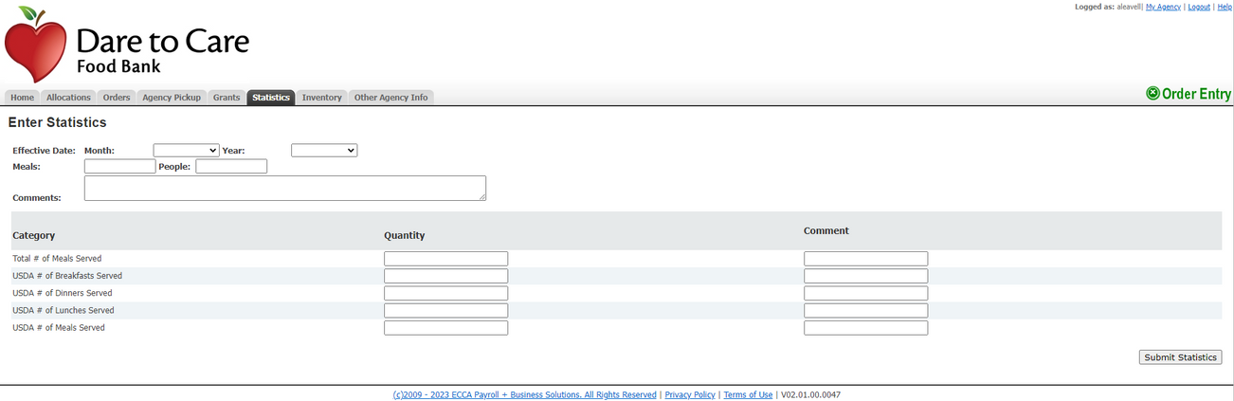
Notes:
Put the total meals served at the top and the total number of people served at the top.
Under category provide the total number of meals served.
And if you have USDA, you will enter the total number of meals served that have that product in it. It will either be equal or less than total number of meals served. Example: If only one dinner served in this month has USDA product in it, that’s fine. Just report the number of meals served at that dinner as the USDA dinners served AND the USDA meals served.

Slide 26

QUESTIONS?

