Slide 1

ONBOARDING
FOR PARTNERS

Slide 2

OUTLINE
About Dare to Care
Operations
Media & Outreach
Agency Partner Network
Requirements
Service Guidelines
Suspension & Termination
Online Resources
Ordering & Pickups
Partner Handbook

Slide 3
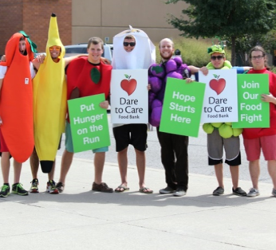
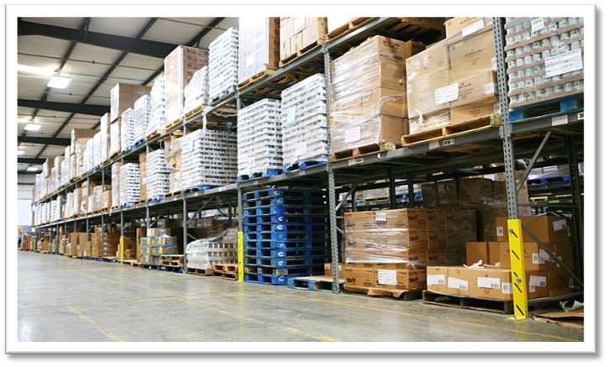
ABOUT
DARE TO CARE
Founded in 1971, after a stunned Louisville community was confronted with the horrifying news that right in their own city, on Thanksgiving Day 1969, a nine-year-old boy, named Bobby Ellis, had died of starvation.
The name “Dare to Care” became the rallying cry of people throughout the area as they joined together to attack the very real problem of food insecurity and hunger in many of their neighborhoods.
Notes:
Dare to Care Food Bank was founded officially in 1971, after a stunned Louisville community was confronted with the horrifying news that right in their own city, on Thanksgiving Day 1969, a nine-year-old boy, named Bobby Ellis, had died of starvation.
The name “Dare to Care” became the rallying cry of people throughout the area as they joined together to attack the very real problem of hunger in many of their neighborhoods.

Slide 4
VISION
A Hunger-Free Kentuckiana
MISSION
To lead our community to feed the hungry and conquer the cycle of need.
Notes:
Here's our vision...and our mission - how do we get there? We can't accomplish our vision and mission without our partner network.

Slide 5


Notes:
Dare to Care is a part of the Feeding America Network.
Feeding America is the nation’s largest non-governmental feeding program. Feeding America is now the nation’s largest domestic hunger-relief organization – a powerful and efficient network of 200 food banks located throughout all fifty U.S. states.
We're also a part of Feeding Kentucky
Feeding Kentucky is a 501(c)(3) charitable organization working to end hunger in Kentucky. Feeding Kentucky’s seven member food banks (Dare to Care is one of these) serve all 120 Kentucky counties in partnership with a network of over 1,000 local food pantries and shelters.

Slide 6
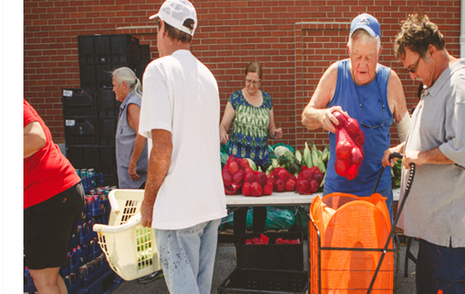
PROGRAMS & EVENTS
Programs
Kids Cafe
School Pantry
Mobile Market
Rx Pantry
Patrol Against Hunger
Cooking Matters
CSFP
Annual Events
Bobby Ellis Vigil
Taste of Derby
CANstruction

Slide 7



PARTNER DEVELOPMENT &
MOBILE PANTRY
Teresa Parris
Trish Tobbe
Clifton Griffin
Mobile Pantry Transportation Manager
Maddie Monahan
Partner Development Manager
Partner Development Manager
Partner Development Manager
teresa@daretocare.org
trish.tobbe@daretocare.org
clifton.griffin@daretocare.org
maddie@daretocare.org
(502) 736-9918
(502) 736-9915
(502) 736-9423
OPERATIONS
Jeffrey Steele
Erick Speith
Kaitlin Michaels
Tommy Gibson
Transportation Manager
Warehouse Inventory Control Manager
Dock Manager
Operations Manager
jeffrey@daretocare.org
erick@daretocare.org
kaitlin.michaels@daretocare.org
tommy@daretocare.org
Kayla Slade
Food Procurement Coordinator
kayla.slade@daretocare.org
RETAIL PICKUPS
(502) 890-5592

Slide 8
FANO - Feeding America Network
DTC - Dare to Care Food Bank
Community Kitchen - DTC’s kitchen in Parkland (Development, Kids’ Cafe, etc.
Agency Partners - organizations that partner with Dare to Care (also referred to as partners)
Neighbors - people we serve
TIA - Trauma Informed Approach
USDA - United States Department of Agriculture
CSFP - Commodity Supplemental Food Program
PWW - Primarius Web Window
Food Bank line - donated food that is available for order and pick up through PWW
Choice - Distribution model is built on the idea of allowing neighbors to choose their own food
TERMS, ACRONYMS & DEFINITIONS
Notes:
Neighbors - we try not to use the term "clients"
PWW - Primarius web window where you will place orders, review order history, and enter statistics.
Term coined by Leah's Patnry. This means that people should not only have access to healthy food, but that they receive and learn about it in a way that:
-Recognizes how stress and adversity affect human health and behavior
-Avoids shaming, stigma, and blame
-Promotes resilience

Slide 9
HOURS OF OPERATION
DAYS | OFFICE HOURS | WAREHOUSE HOURS
Monday | 8am-4:30pm | 7:30am-1:30pm
Tuesday | 8am-4:30pm | 7:30am-1:30pm
Wednesday | 8am-4:30pm | 7:30am-1:30pm
Thursday | 8am-4:30pm | 7:30am-1:30pm
Friday | 8am-2:30pm | 7:30am-12:pm
Saturday | CLOSED | CLOSED
Sunday | CLOSED | CLOSED

Slide 10



CLOSURES
New Year’s Day
Martin Luther King Jr’s Day
Oaks Day
Memorial Day
Juneteenth
Independence Day
Labor Day
Thanksgiving & Following Friday
Christmas Eve
Christmas Day
ANNUAL INVENTORY
(LAST WEEK OF JUNE EVERY YEAR)
Notes:
These are the holidays that we'll be closed.
Additionally, Dare to Care conducts an annual, week-long audit of the warehouse inventory at the end of the fiscal year. This takes place at the end of June each year.
During inventory week, ordering is suspended and no orders are available for pick-up at the dock.
The date of inventory week is announced in April of each year. Additional information relating to warehouse closings and delivery changes will be communicated via email and posted on the Dare to Care website.
Lastly, as a general rule, the Dare to Care warehouse makes every effort to remain open during inclement weather. Our trucks are pulled from the road when snow or ice creates unsafe conditions.
Dare to Care’s Partner Agencies set their own inclement weather policies.
Please see the Dare to Care website for updated information.

Slide 11

FOOD SOURCING
Where does the product come from?
The majority of our product is donated!
Individual donors
Community food drives
Retail partners
Farms
Manufacturers
USDA
We also purchase product to supplement what we receive from donors.
PRODUCT INVENTORY IS ALWAYS CHANGING!

Slide 12
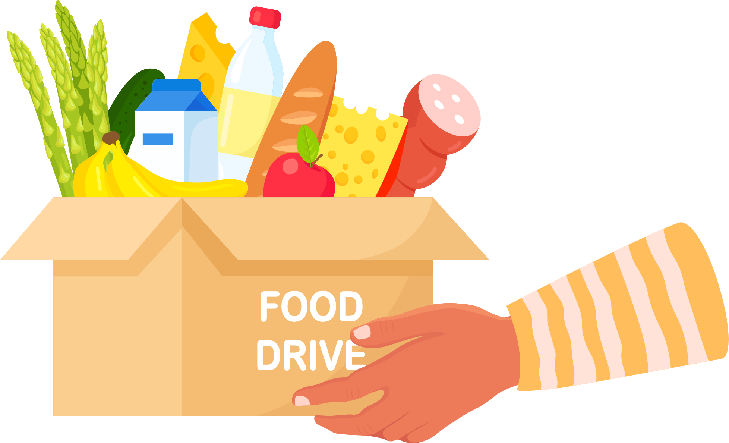
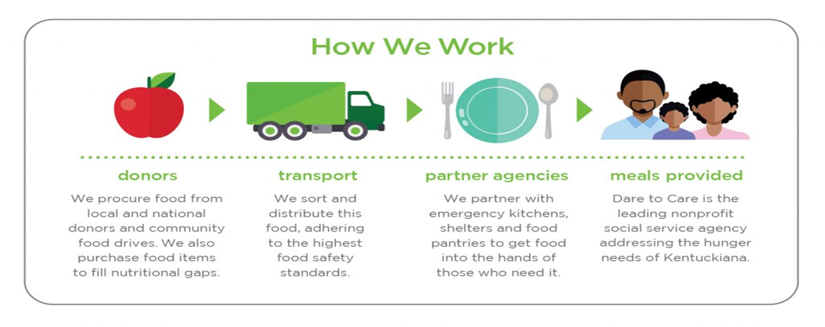
HOW WE ALL WORK TOGETHER

Slide 13
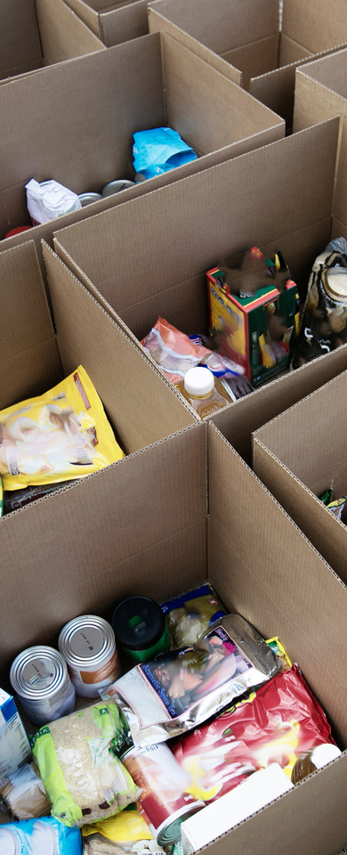
FOOD & FUND STREAMS
MAXIMIZE YOUR INVENTORY!
Retail pickups
Co-op
Corporate, community, fiscal donations
Grants
Farmers
Individual donors

Slide 14

MEDIA, OUTREACH & LOGO USAGE

Slide 15
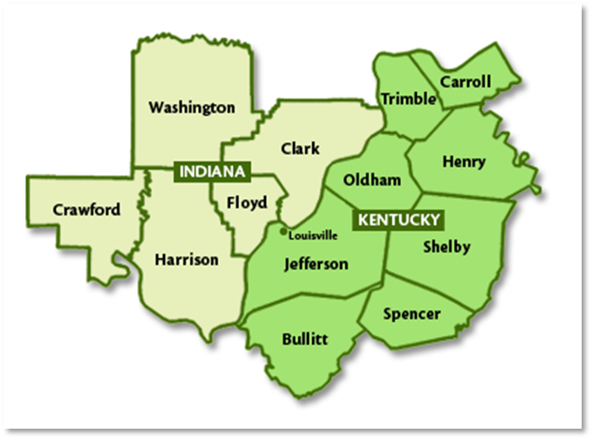
AGENCY PARTNER NETWORK
Types of Agencies
Pantries
Kitchens
Residential/Shelters
Service Types
Open Network
Closed Network
Boundaries
~210 PARTNERS IN THE DARE TO CARE PARTNER NETWORK
Types of Meal Distribution
Off-site
On-site
Models
Notes:
Dare to Care operates in 13 counties. Five in Indiana and 8 in Kentucky.
We can only partner with organizations in this county.
Types of agencies that partner with us are pantries, kitchens, and residential facilities and shelters.
Organizations that are open network serve the public. Organizations are closed network serve only residents that meet the requirements of the program (i.e., residents only).
Agencies have the autonomy to institute boundaries. While we request that all partners serve without boundaries, we understand that there may be restrictions (i.e., you only serve in a certain zip code). With boundaries, make sure to have a note to serve the first time like neighbor...and maybe share how Bethlehem Baptist does their service for out of area neighbors
Type of meal distribution
Off site - give food to neighbors for them to prepare off site (at home)
On -site prepare meals on-site for consumption (i.e. kitchens).
You also have the autonomy to select what type of distribution model you would like to utilize which we'll cover in the next slide.

Slide 16
Must be open for a minimum of 90 minutes per month
Must access the food bank at least once every 30 days to remain active
Must keep records for 3 years plus the current year
Must adhere to food safety standards
Must have a standard intake process
Must maintain a fair equitable process for distributing food
Must be willing to be monitored by DTC
Must be willing to resolve corrective actions and non-compliance within 30 days.
Must pick up food from the Fern Valley Warehouse
Must report monthly statistics
Must attend Dare to Care’s Food Safety training at least once every 2 years
Maintain consistent communication with Dare to Care
Must have at least one active email address and reliable internet access
AGENCY PARTNER REQUIREMENTS

Slide 17

COMMUNICATION
Email is our biggest form of communication. You must have an active email that is checked regularly.
When do you need to reach out to us?
Changes to your order
Food quality issue
Location changes
Staff changes
Temporary closures
Changes in distribution hours or days
Changes to your distribution model
Complaints
Agency Partner Information Change Request Form

Slide 18



SERVICE GUIDELINES

Slide 19
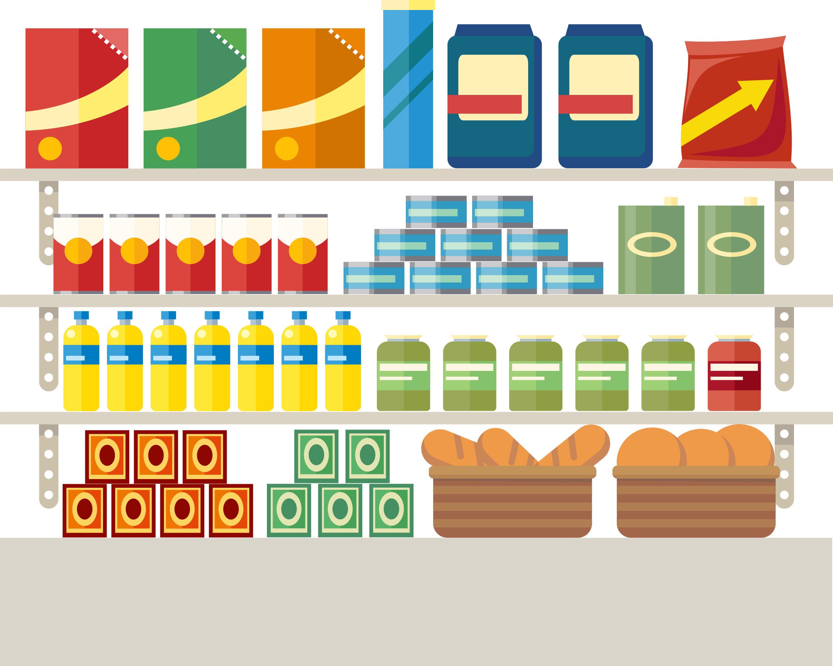
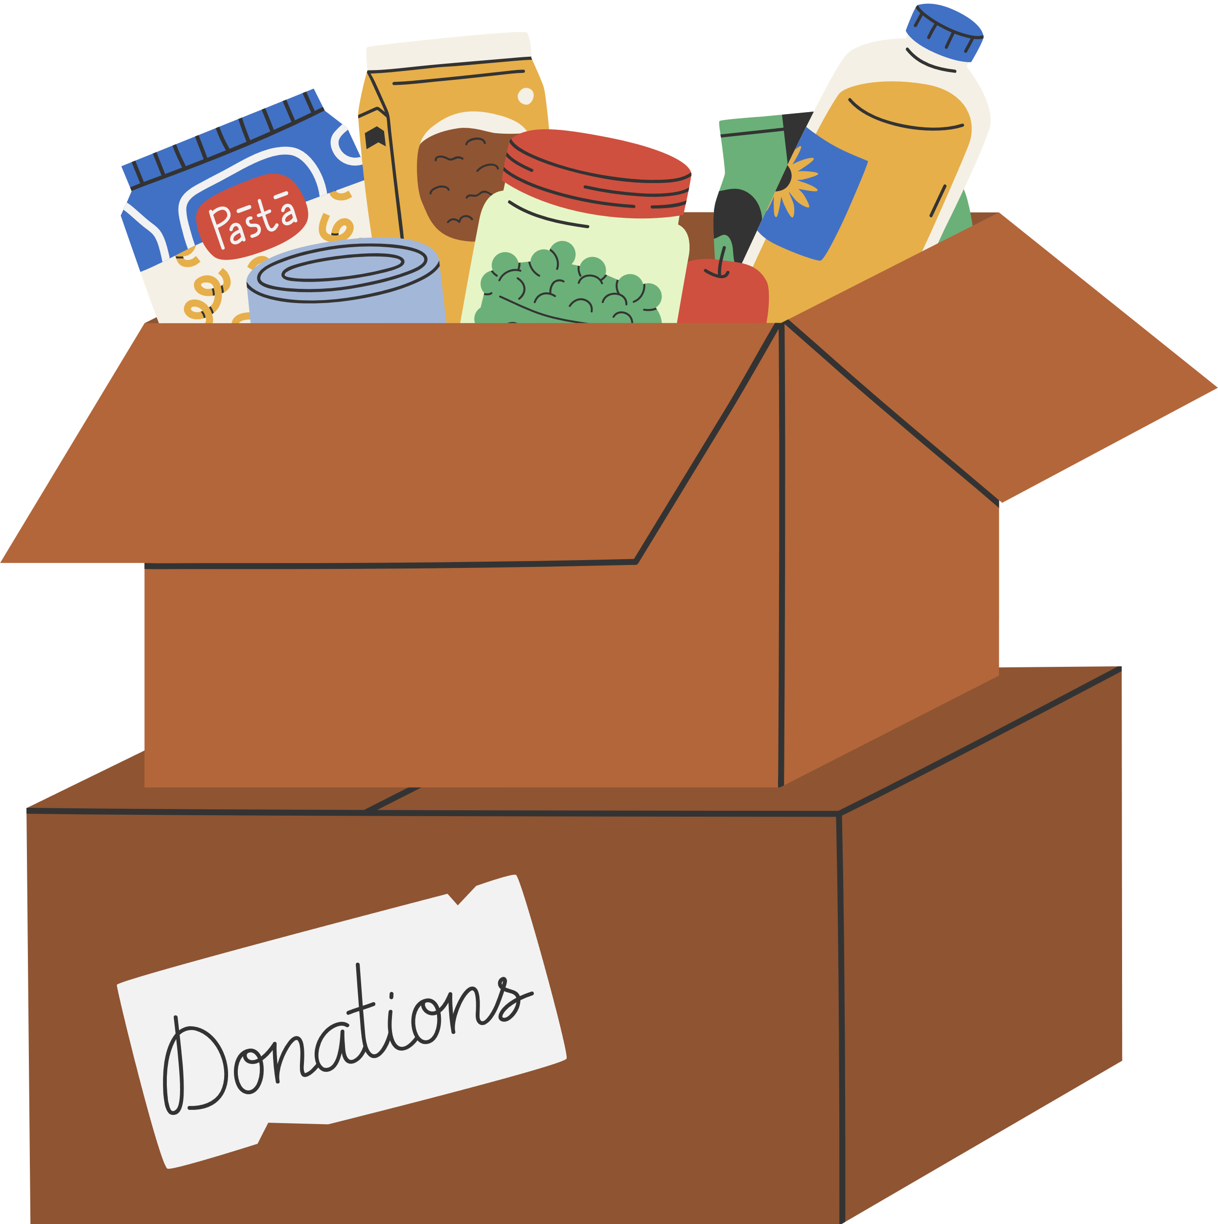
DISTRIBUTION MODELS
TOTAL # OF ITEMS
PRE-PACKED
MENU OF ITEMS
SHOPPING
Each household is given a total number of items to choose, for example:
35 items to a household of 1-3
50 items to a household of 4-5
75 items to a household of 6 or more
Neighbors can choose between 2+ types of boxes or prepacked bags
May also be able to choose additional items for the prepacked bag or decline food
Pantry feels like a mini-supermarket; neighbors can touch and select their own food.
If online ordering, neighbors order food as if they are shopping through a grocery store
Neighbors can choose from a menu of options or tell volunteers what they want
Volunteers select and bag the food
Drive-thru
Pre-box
Shopping
Outdoor distribution
Produce Only distributions
Incorporating choice
Notes:
Choice can provide dignity to the neighbor and helps your product go further.
Here are some different examples of choice distribution models. You would meet the choice criterion by implementing any of these models.
Partners can implement an element of choice in several ways:
-Total Number of Items: A simple method for pantries to use when first switching to a client choice model. Each household is given a total number of items to choose. There are no constraints except the available amount of food. For example, shelf tags may read "up to 3 meat items per household" in order to keep enough stock available for the average number of households served by the pantry.
-Offer neighbors a choice between two different pre-packed boxes. They can refer to a listing of what is in each box to make their choice.
-If you are making a deliveries, consider having additional items in the vehicle so that substitutions can be made in real time.
-drive thru models can also use a multiple box approach.
You can see some of these examples listed in the TEFAP manual on page 47 and 48.
-creating a shopping list or menu with items available. The neighbor makes their selections and a volunteer packs it up.
-Offer full choice where neighbors can come in and touch and select their foods. If using an online ordering system, they can order foods like they're ordering from a grocery store.
You can offer pre-packed boxes.

Slide 20

WHY CHOICE?
More efficient use of resources: "It's been really easy for them to transition to this [full choice] model because not only does it take less time, but we can serve a lot more families." | Providing a more dignified experience for neighbors: "Allowing choice has been so powerful for people....They feel worthy and valued because we care enough to check in with them and provide an opportunity for them to shop."
Enriched relationships between neighbors and volunteers, reducing stigma and power dynamics: "It's much more personal, it's much more about being with the person...[W]e have regulars [who] look for a certain volunteer...and it becomes a bond. For some people that's the only warm face they see." | Better meeting neighbor food needs and preferences (reducing food waste): "It's just a matter of being willing to recognize the value of giving people choice in terms of just the dignity factor of it, but also in that if you make me take food that I don't like or I'm not going to eat, it is going to be wasted and what's the point?"
Notes:
Here is the why behind the choice. Feel free to save these as talking points for volunteers, staff, and organizational members. ​
These themes and quote came from participants in a Feeding America grant focused on choice.

Slide 21

DISTRIBUTION DON’TS
 | Charge for food or use food as payment
 | Store food in a private home
 | Require ID
 | Collect information such as Social Security or driver’s license numbers
 | Proselytize or require attendance at a religious service in order to receive food
 | Deny someone food based on any of the protected classes (USDA Non-Discrimination Statement)
 | Use food for programs outside of its intended use (i.e., volunteer dinners)
Notes:
*Right to refuse service, but must have a procedure in place.
Practice good customer service.

Slide 22
Have a standard intake process (some sort of declaration of need)
Serve without judgement
Less barriers as possible
You can request ID but not require it
You can request a piece of non-junk mail or utility bill to verify address if you have service boundaries
Neighbors do not need to sign their name
Keep records on file for 3 years plus the current year
Report statistics monthly
NEIGHBOR INTAKE PROCESS

Slide 23
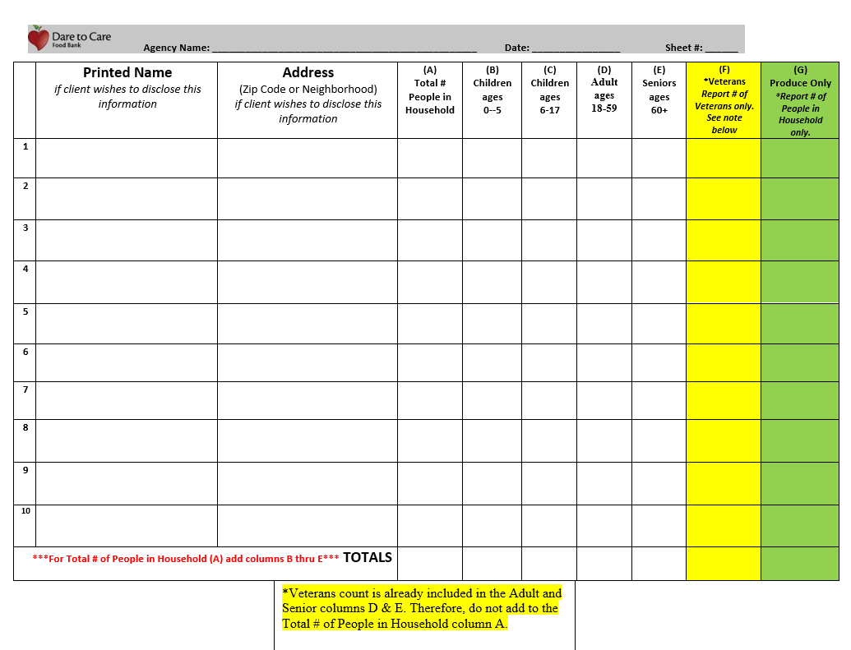
PANTRIES ONLY

Slide 24
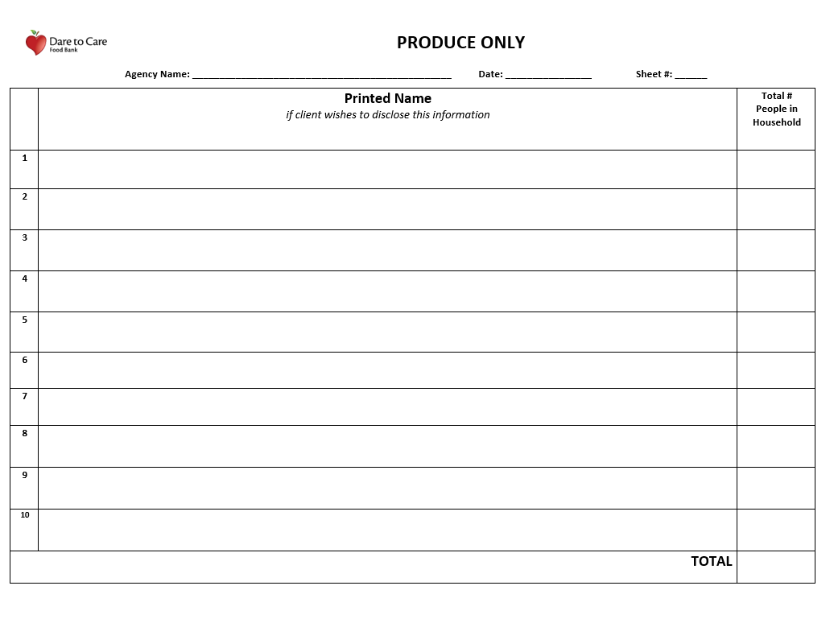
PANTRIES ONLY

Slide 25
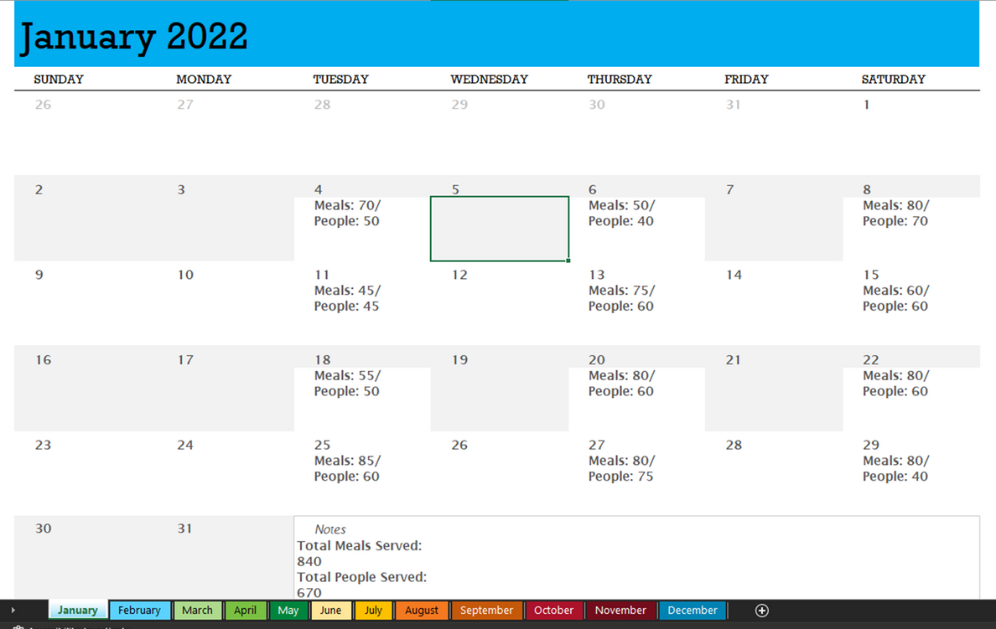
KITCHENS ONLY

Slide 26
SUSPENSION & TERMINATION/
INACTIVATION
Non-compliance
Lack of communication
Missing statistics
Not ordering once every 30 days
Capacity/closures
With or without cause
Notes:
Dare to Care or you as an organization can terminate the partnership.
Suspension is a temporary designation. If your agency is suspended, you will no longer be able to have access to order until the suspension has been lifted.

Slide 27
ONLINE RESOURCES

Slide 28
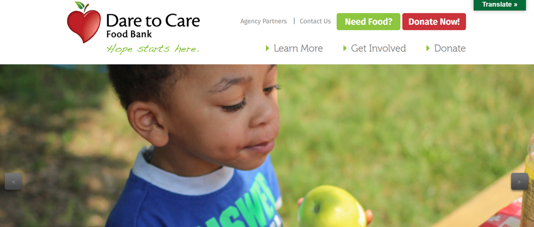
HOME PAGE: DARETOCARE.ORG

Slide 29

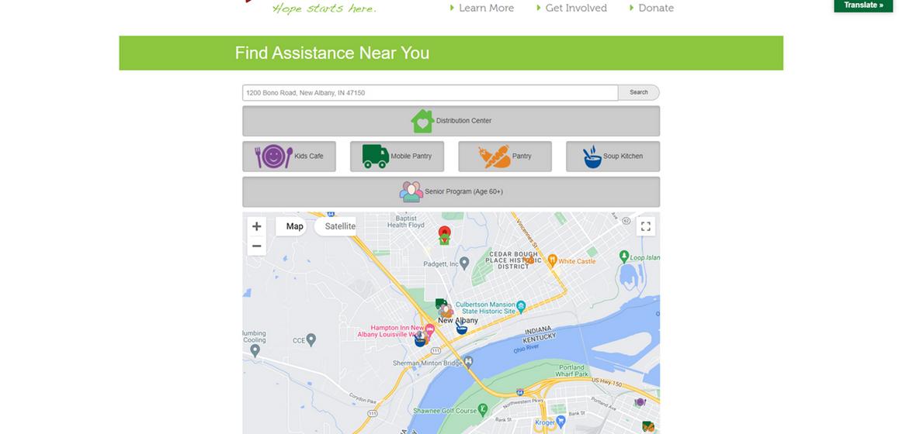
NEED FOOD MAP
Notes:
Assisting a neighbor that lives in another service area? help them find a distribution near them.
If you have boundaries, please make sure you serve them the first time and give them resources to access distributions closer to them.

Slide 30
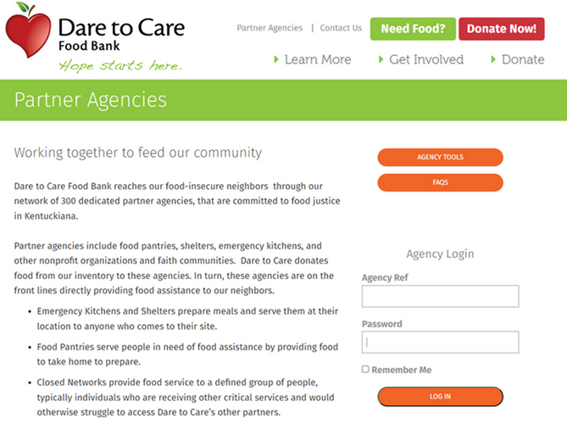
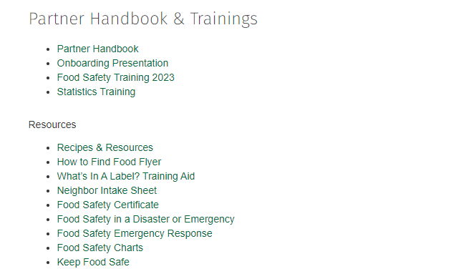
AGENCY TOOLS

Slide 31
PWW

Slide 32
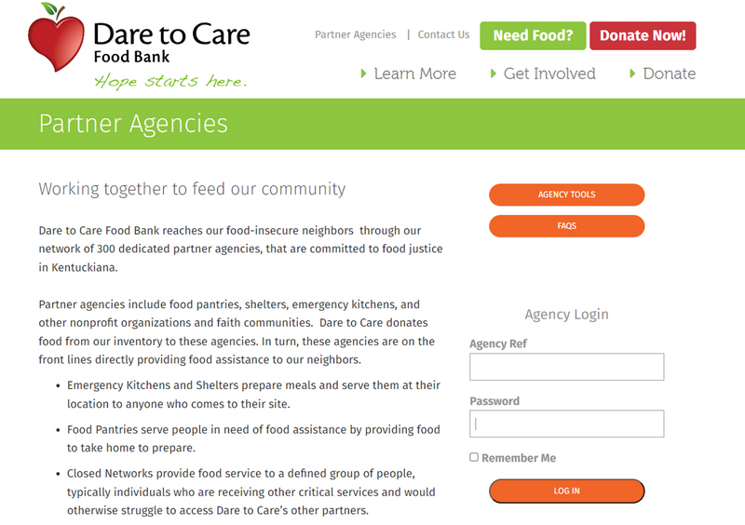


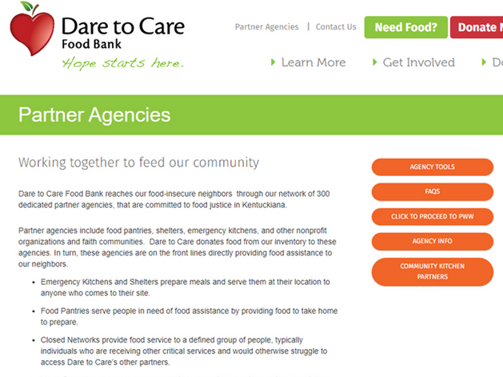
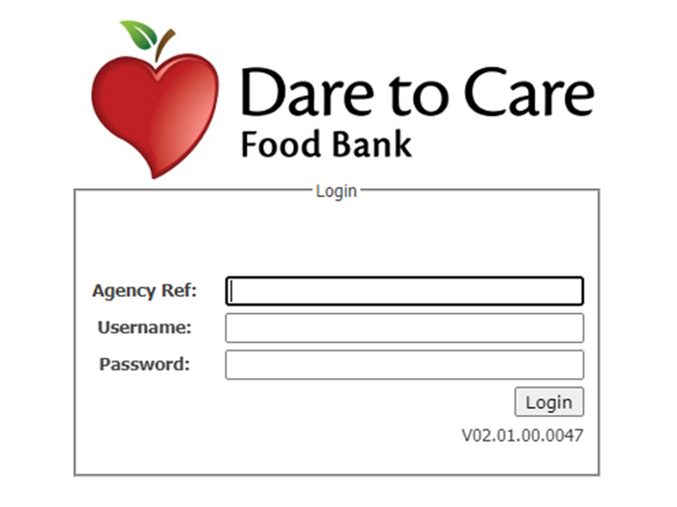



Notes:
You have your sheets for the month. You've counted up your people served, households, and age brackets.
How does that information get reported online? Login with your PWW credentials. If you do not have your PWW credentials, we can get them to you!

Slide 33
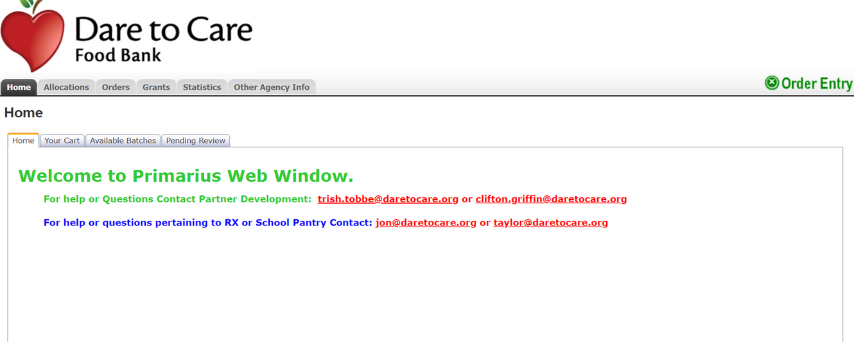
PLACING AN ORDER
Notes:
You can place orders once a week. Must place orders at least once every 30 days.

Slide 34
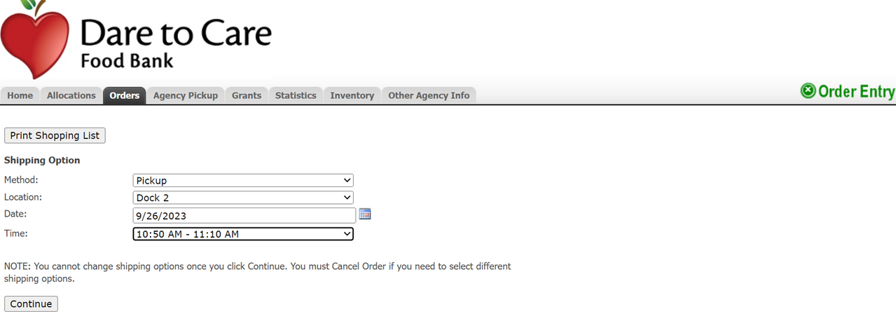
PLACING AN ORDER

Slide 35
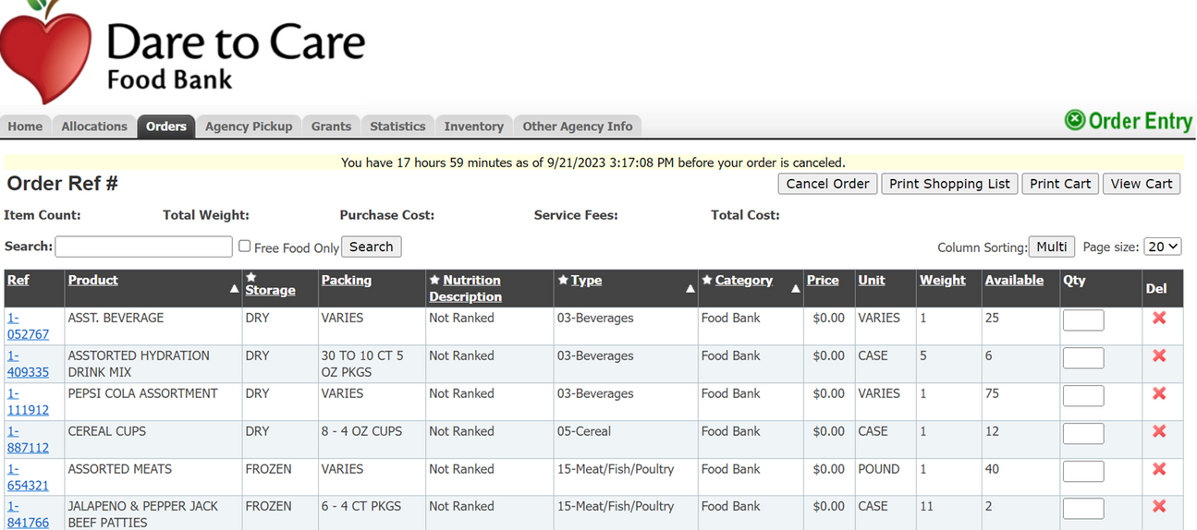
PLACING AN ORDER

Slide 36
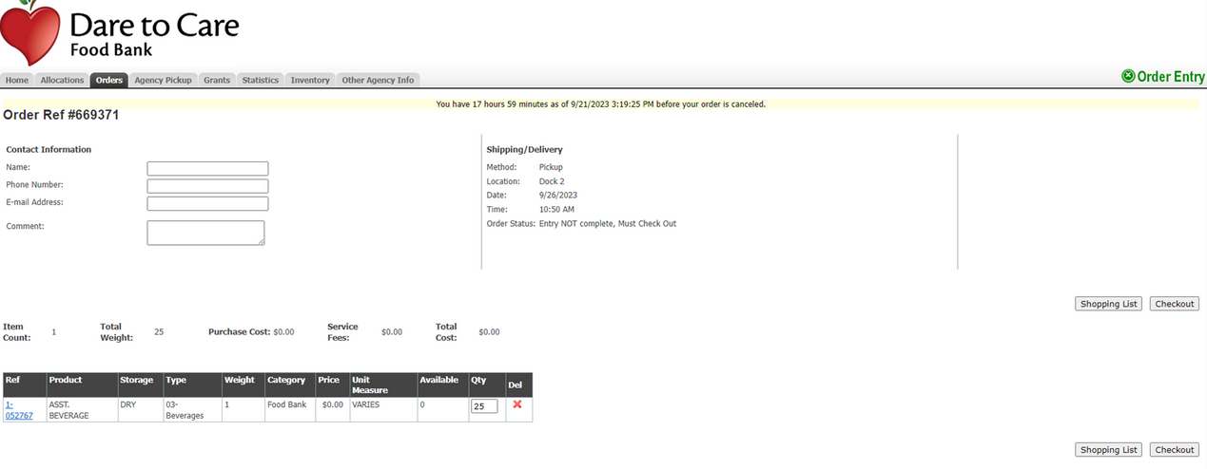

Slide 37
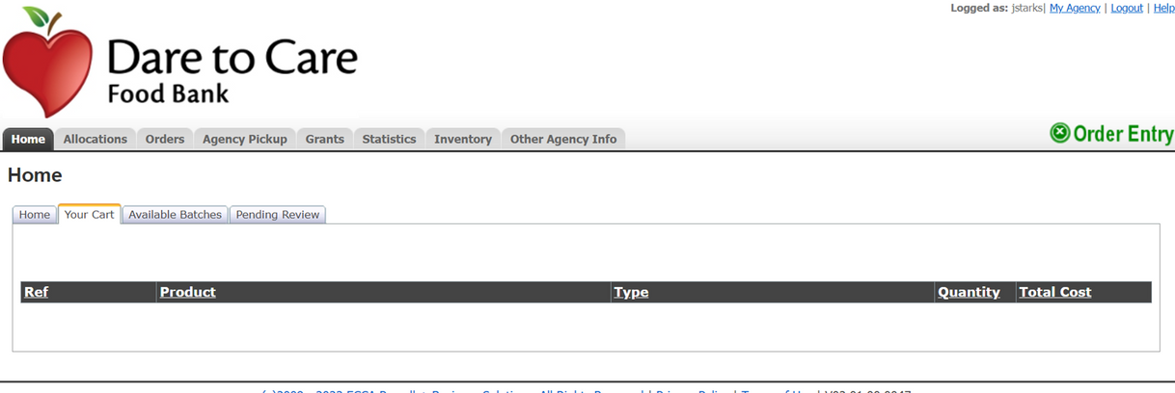
YOUR CART

Slide 38
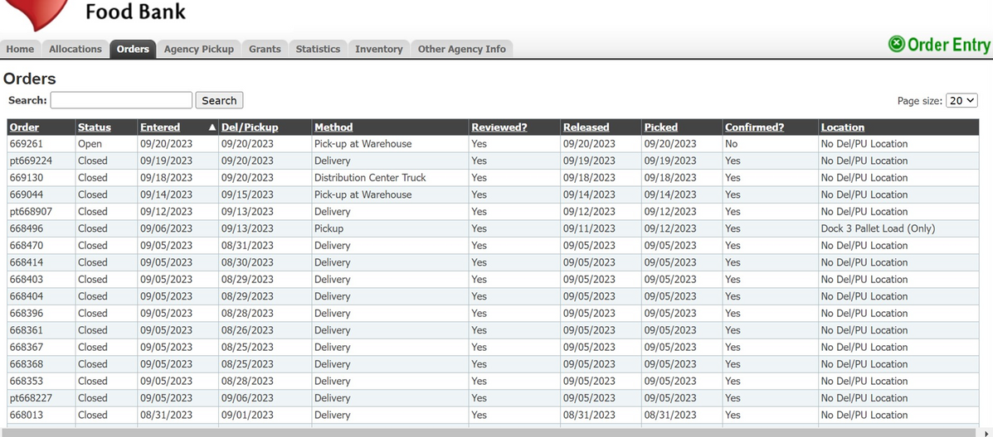
ORDER HISTORY

Slide 39
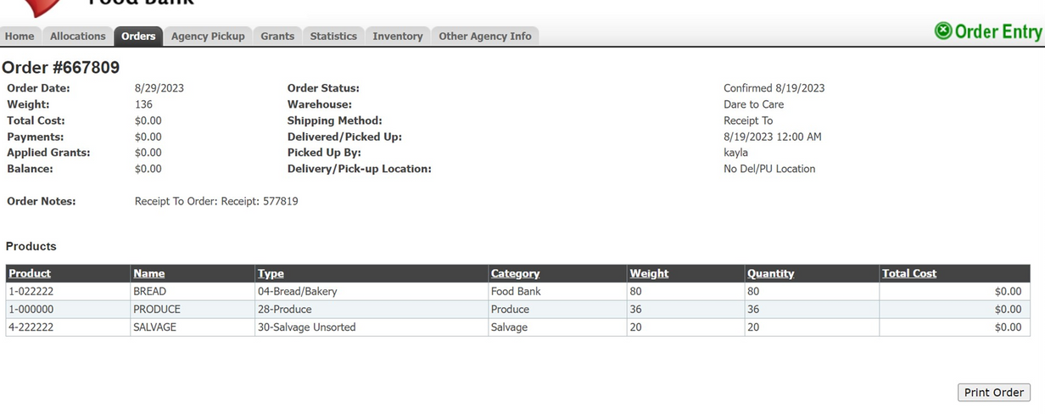
PRODUCE PICK UP ORDER
Notes:
You can come to the dock every day to pick up produce.

Slide 40
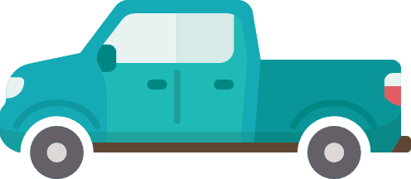
Arrive on time (no more than 15 minutes in advance)
Bring adequate vehicle
Load all items within allotted timeframe
Ensure you have enough staff/volunteers to load vehicle
Notify Partner Development if there are changes to your pickup time/day
Dock 1 & Dock 2 are interchangeable
Print out your order receipt day of and check for missing items (at the dock or in the parking lot) before leaving
Control time and temperature
DOCK PICKUPS

Slide 41
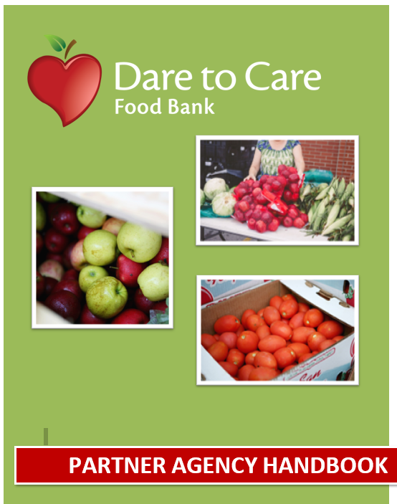
PARTNER HANDBOOK

Slide 42


Slide 43




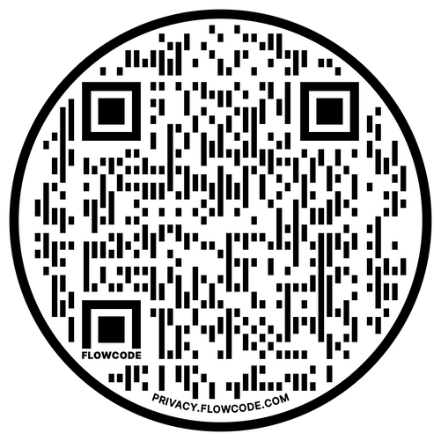

We want your feedback!

