Slide 1



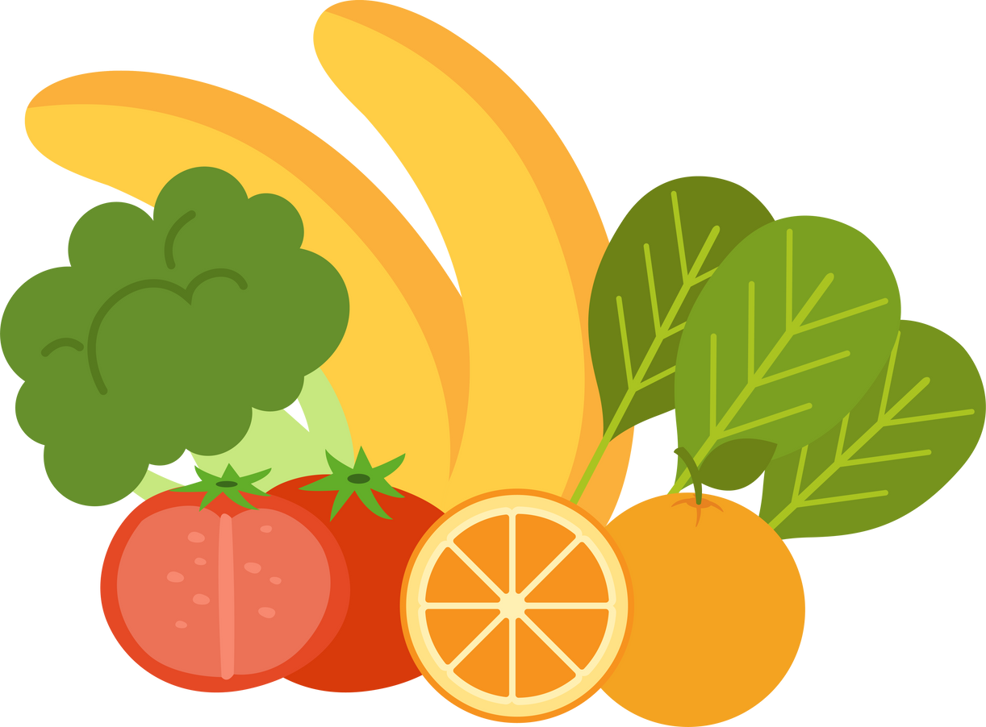
FOOD
SAFETY TRAINING
for Dare to Care Partners
Notes:
1.7.2013
Hello, and welcome! Thank you all for attending the Dare to Care Food Safety Training.
Food safety is a critical part of feeding our neighbors and one of the biggest things we’re checking during monitoring and pop-up visits.
We have had to end partnerships due to food safety concerns, so we appreciate your commitment to serving the community and keeping food safe!
This training is a required, biennial training for all Dare to Care partners.
Existing partners must take this training once every two years, and any new partners or new staff at your organization must complete this training as part of their onboarding with Dare to Care.
Please note: this training is not valid or transferable outside of our Dare to Care partnership.
We are here to answer any questions, so please feel free to ask and share your concerns.
‹#›

Slide 2
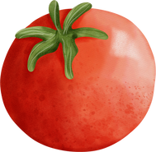



PARTNER DEVELOPMENT TEAM
PARTNER DEVELOPMENT TEAM
Trish Tobbe
Clifton Griffin
Maddie Monahan
Partner Development Manager
Partner Development Manager
Partner Development Manager
trish.tobbe@daretocare.org
clifton.griffin@daretocare.org
maddie@daretocare.org
(502) 736-9918
(502) 736-9915
(502) 736-9423
FOOD SOURCING
Mary Inman
Cara Monaco
RETAIL PICKUPS
Food Procurement Coordinator
Food Procurement Manager
mary.inman@daretocare.org
cara.monaco@daretocare.org
(502) 890-5592
(502) 890-5594
Notes:
Here are the members of the Partner Development Team!
Feel free to reach out to us any time regarding food safety questions and concerns.
We also have Kayla Slade here who manages all of our retail pickups!
If we don’t know the answer, we’ll be sure to consult or internal team, Feeding America, and the USDA if needed and get back to you.
2

Slide 3
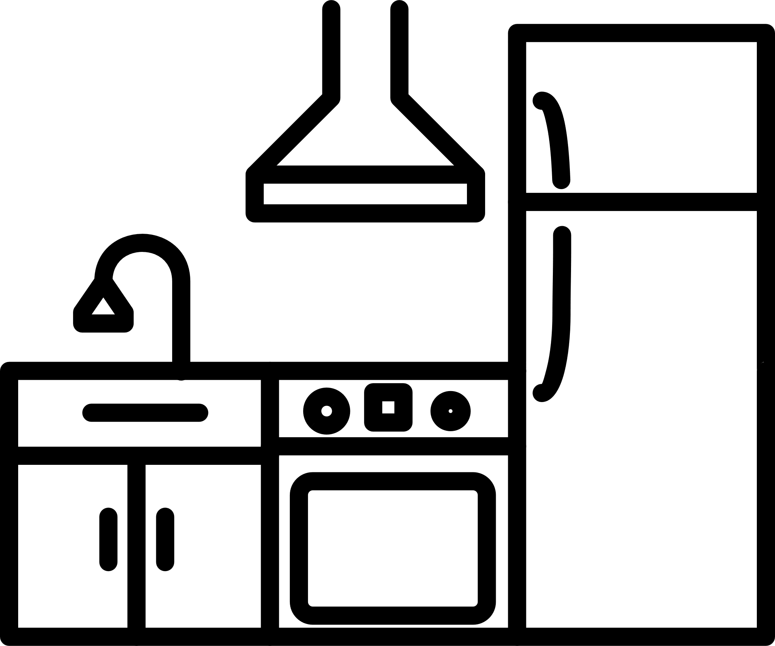

PARTNER DEVELOPMENT TEAM
AGENCY PARTNER DESIGNATIONS
ON-SITE
OFF-SITE
Agencies that prepare meals for consumption for neighbors (e.g., community kitchens, feeding sites)
Agencies that distribute food for neighbors to prepare at home (i.e., pantries)
Notes:
Here are some definitions to familiarize yourself with.
For agencies who prepare meals on site like community kitchens, residential facilities, or shelters, your agency designation is “on-site.”
For agencies who distribute food to neighbors for them to prepare at home, your agency designation is “off-site” – these would be your pantries.
3

Slide 4
OUTLINE
    How Food Becomes Unsafe
      Hazards from the environment
      How people can make food unsafe
      Understanding food allergies
    How to Keep Food Safe
      Practicing good personal hygiene
      Receiving, transporting, and storing
      Quality control
      Repacking food
    Maintaining a Clean Space
      Cleaning and sanitizing
      Pest control
    Preparing for a Monitoring Visit
Notes:
1.7.2013
Here is a brief overview of what we'll be covering in today's training.
First, we are going to talk about how food becomes unsafe;
Then we’ll talk about ways to keep food safe through good personal hygiene, receiving sand storing food, evaluating and quality control, repacking food
Maintain a clean space with cleaning and sanitizing and pest control.
What we’ll look for on our visits to make sure you’re in compliance.
We'll have time for questions and comments throughout the training, so please feel free to share.
‹#›

Slide 5
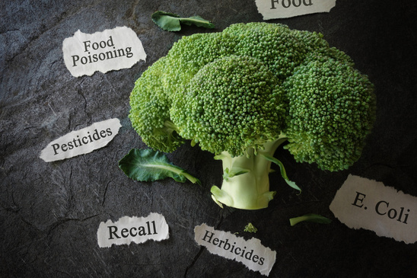
FOOD
SAFETY
IS IMPORTANT!
Notes:
Food safety is important!
People who receive food from a food pantry or kitchen trust you to keep them safe!
You are the last eyes on the food before it gets to the neighbors.
A major concern is foodborne illness or food poisoning, which is a disease that is transmitted to people through food.

Slide 6

HOW FOOD
BECOMES
UNSAFE
Notes:
1.7.2013
Many hazards can make food unsafe and cause a foodborne illness. Some come from the air, water, soil, and animals. Some come from dirty surfaces. Others happen when people don't handle food correctly.
It only takes 2 people with a foodborne illness to be considered an outbreak. Foodborne illness is almost always preventable. You just need to know how to handle it safely! We’ll talk about specific ways that food becomes unsafe and what you can do to make sure food is safe for consumption!
‹#›

Slide 7

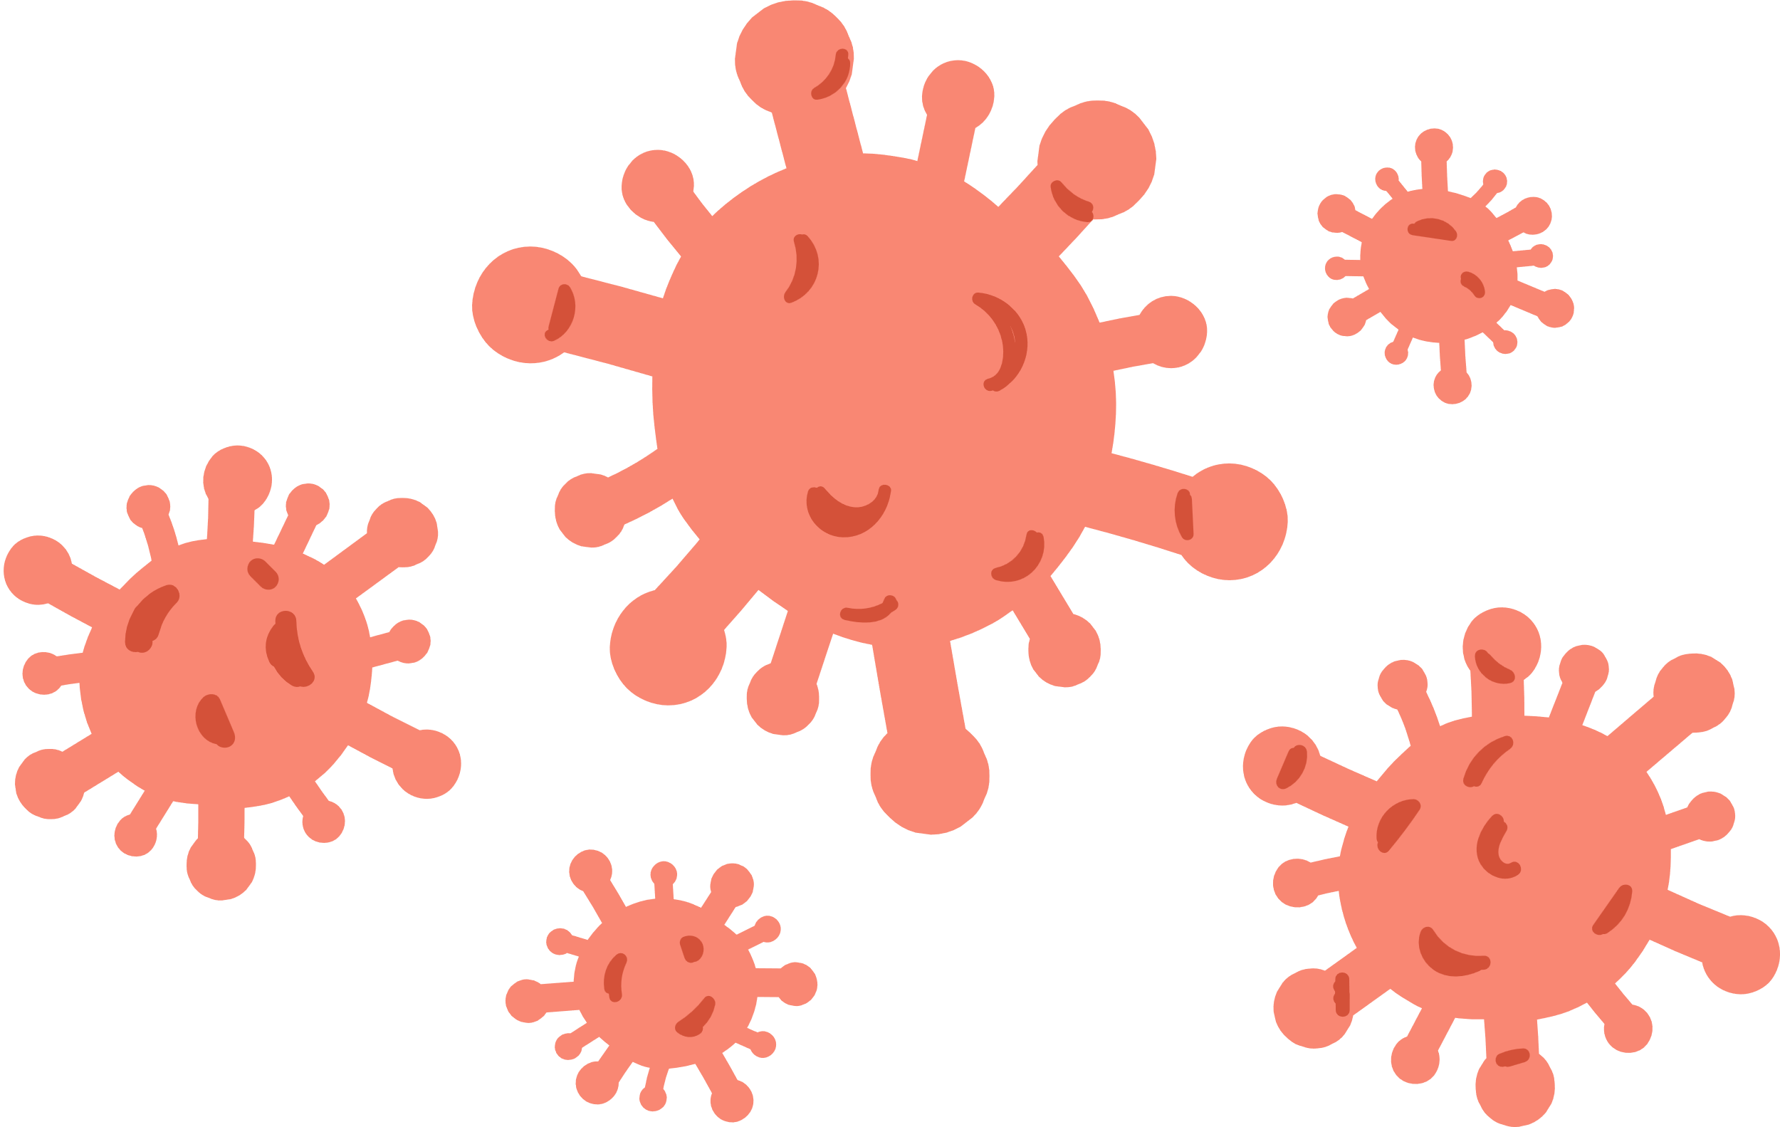

HAZARDS FROM THE ENVIRONMENT
BIOLOGICAL HAZARDS
PHYSICAL HAZARDS
CHEMICAL HAZARDS
Bacteria, viruses, parasites, fungi
Jewelry, glass, brittle plastics, ceramics, bandages
Cleaners, sanitizers, pesticides
Notes:
1.7.2013
Food become unsafe due to hazards from the environment.
Here are the three types of hazards make food unsafe.
They are biological hazards, physical hazards, and chemical hazards.
Biological hazards are tiny forms of life that you can't see, taste, or smell. They include bacteria, viruses, parasites, and fungi.
Some physical hazards occur naturally in food, such as bones in fish and fruit pits. Usually, physical hazards occur when objects fall into food. Some examples include jewelry, glass, ceramics, brittle plastics, and bandages.
Chemical hazards are chemicals in your building that can contaminate food. These include cleaners, sanitizers, and pesticides.
‹#›

Slide 8
HOW PEOPLE MAKE FOOD UNSAFE
POOR PERSONAL HYGIENE
CROSS-CONTAMINATION
& CONTACT
TIME-TEMPERATURE ABUSE
POOR CLEANING & SANITIZING
Notes:
eople can also make food unsafe! Once you understand what the dangers are, it's easy to avoid them. These four practices can make food unsafe and should be avoided:
Poor personal hygiene - transferring pathogens from your body to food.
Cross-contamination - transferring pathogens from one surface or food to another. Cross contact refers to contaminating a non-allergen food with a food allergen. We’ll get to that in a few slides!
Time-temperature abuse - letting food stay too long at temperatures that are good for pathogen growth.
Poor cleaning and sanitizing - transferring pathogens from incorrectly cleaned surfaces to food.
‹#›

Slide 9
Practice Good
Personal Hygiene
Control the Time & Temperature of Food
DON'T transfer pathogens from your body to food.
DON'T let food stay too long at temperatures that are good for pathogen growth.
What is your role in keeping food safe?
Prevent Cross-Contamination
& Contact
Clean & Sanitize Surfaces Correctly
DON'T transfer pathogens from one food to another.
DON'T transfer pathogens from one surface to another.
DON’T transfer allergens to non-allergen foods
Keep everything clean.
Clean and sanitize anything that touches food.
Notes:
1.7.2013
We all play a role in keeping food safe, from the farmers and donors, to transportation, to the Dare to Care Warehouse, to pantries and kitchens, and the neighbor! We are all responsible to keeping food safe and are held accountable by local, state, and federal regulations and to our neighbors! So, know that you play an important role in keeping food safe!
Knowing the hazards to food safety is just the start!
The next step is to make sure you work safely.
It is easy but critical that you follow these practices.
Practice good personal hygiene to prevent pathogens transferring from your body to food.
Prevent Cross-Contamination by preventing pathogens from transferring from one food or surface to another.
Control the time and temperature of food! Don’t let food stay in the danger zone (between 40-140F) too long, or pathogens can grow.
Clean and sanitize surfaces correctly. Keep things clean and organized and make sure you are cleaning and sanitizing anything that comes in contact with food (machinery, cold storage, sorting tables, etc.)
‹#›

Slide 10



Knowledge Check
Identify the food safety concern for each action.
1. Leaving raw chicken breasts on a pallet in a loading area that is not refrigerated | 2. Sneezing on food | 3. Keeping produce that raw meat juices have leaked on | 4. Scraping off food from an otherwise clean food-storage container
A. Time-temperature abuse | A. Time-temperature abuse | A. Time-temperature abuse | A. Time-temperature abuse
B. Poor personal hygiene | B. Poor personal hygiene | B. Poor personal hygiene | B. Poor personal hygiene
C. Cross-contamination | C. Cross-contamination | C. Cross-contamination | C. Cross-contamination
D. Poor cleaning and sanitizing | D. Poor cleaning and sanitizing | D. Poor cleaning and sanitizing | D. Poor cleaning and sanitizing
Notes:
1.7.2013
Let's test what we've learned so far about unsafe practices through a knowledge check.
What category of unsafe practices do the following actions fall under?
Column 1: Leaving raw chicken breasts on a pallet in a loading area that is not refrigerated.
Answer: Time-temperature abuse
Column 2: Sneezing on food
a. Answer: Poor personal hygiene
Column 3: Keeping produce that raw meat juices have leaked on
a. Answer: Cross-contamination
Column 4: Scraping off food from an otherwise clean food-storage container
a. Answer: Poor cleaning and sanitizing
‹#›

Slide 11


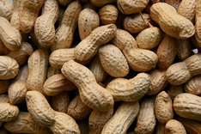
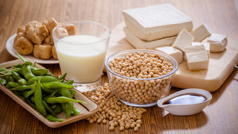

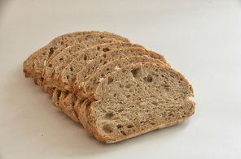
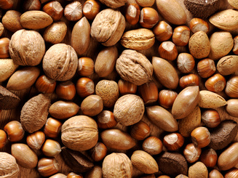
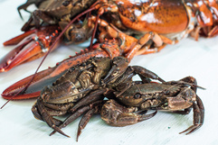
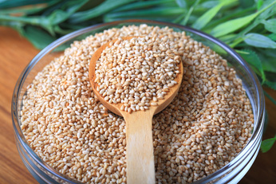
THE BIG
UNDERSTANDING FOOD ALLERGENS
9
FOOD ALLERGENS
milk
eggs
peanuts
fish
soy
such as bass, flounder, and cod
wheat
tree nuts
shellfish
such as almonds, walnuts, and pecans
crustaceans such as crab, shrimp, clams
sesame
Notes:
1.7.2013
Let's move on to allergens:
Some people are allergic to certain types of food.
The tiniest speck of a food they are allergic to, can make them sick or even cause death.
The proteins that cause allergic reactions are called allergens.
Many different food items can cause allergic reactions, but just nine food items cause most reactions.
These are called the Big Nine.
You need to be aware of the Big Nine and the products that contain them.
Milk, soy, tree nuts (almonds, walnuts, pecans), eggs, fish (bass, flounder cod), shellfish (crab, shrimp, clams), peanuts, wheat, sesame
‹#›

Slide 12
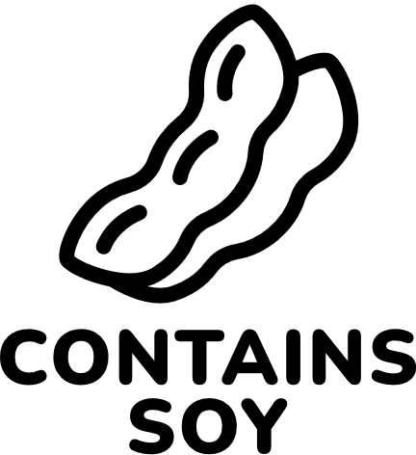
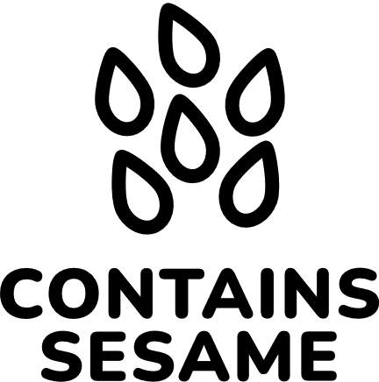





PREVENTING FOOD ALLERGEN CONTAMINATION
Prevent Cross-Contact:
    Clean and sanitize
    Inspect food packaging
    Store separately
    Wash your hands
Cheeseburger
Cheeseburger
Potato Salad
TIP: Labeling is the most important way to help keep people with food allergies safe.
Apple slices
Potato Salad
Orange Juice
Apple slices
Orange Juice
Notes:
1.7.2013
When a food item containing an allergen comes in contact with another food item and their proteins mix, it's called "cross-contact."
This can be dangerous for people with food allergies.
Food should be stored and handled in a way that prevents cross-contact.
You can also prevent cross-contact by:
Cleaning and sanitizing all surfaces that have come in contact with food containing an allergen.
Inspecting food packaging to ensure no leaks or spills have occurred that can cause cross-contact.
When possible, store food with allergens separately from allergen-free products. DO NOT store food containing allergens ABOVE allergen-free food. Use dedicated pallets and bins for products containing allergens.
Wash your hands and change gloves after handling a food containing allergens and before handling an allergen-free food.
Labeling is the most important way to help keep people with food allergies safe.
‹#›

Slide 13
Knowledge Check
Identify each food that is a common food allergen
or contains one.
COLUMN #1
COLUMN #2
COLUMN #3
Tea | Potatoes | Squash
Cod | Mushrooms | Soybeans
Wheat flour | Tomatoes | Sesame seeds
Melons | Pecan pie | Rice
Peanut butter | Citrus fruit | Omelet
Crab legs | Green peppers | Vanilla ice cream
Notes:
1.7.2013
Let's test what we've learned so far about food allergens.
Identify each food that is a common allergen or contains a common allergen.
Column 1: Cod, Wheat flour, Peanut butter, crab legs
Column 2: Pecan pie
Column 3: soybeans, sesame seeds, omelet
‹#›

Slide 14
PRACTICING
GOOD PERSONAL
HYGIENE
Notes:
1.7.2013
Let's move on to practicing good personal hygiene. The next few slides will go over some practices to ensure that we're keeping food safe through clean practices.
‹#›

Slide 15


How to Wash Your Hands
1. Wet hands
and arms
3. Scrub hands and arms
2. Apply soap
4. Rinse hands and arms
5. Dry hands and
arms
Notes:
1.7.2013
Handwashing is the most important part of personal hygiene. It is important because your hands can transfer pathogens to food. Correct handwashing only takes about 20 seconds.
1. Wet your hands and arms with warm water.
2. Apply soap and lather.
3. Scrub hands and arms vigorously for 10-15 seconds, don't forget to clean under your fingernails and in between your fingers.
4. Rinse hands and arms thoroughly.
5. Use a single-use paper towel or hand dryer to dry hands and arms. Do not use your apron or any part of your clothing. Use a single-use paper towel or hand dryer.
‹#›

Slide 16

When to Wash Your Hands
Touching your face, hair, or body
Touching clothing or aprons
Handling raw meat, poultry or seafood (before and after)
Using the restroom
Before you start working and after any of these activities
Sneezing, coughing, or using a tissue
Handling chemicals that can make food unsafe
Taking out the garbage
Smoking or vaping
Chewing gum or tobacco
Before putting on gloves at the start of a new task
Leaving and returning to the food-handling area
Eating or drinking
Touching anything else that may contaminate your hands
Notes:
1.7.2013
Wash your hands before you start working or after any of these activities.
Wash your hands after touching anything that may contaminate your hands like your phone.
‹#›

Slide 17

A note on
Hand Sanitizer
Notes:
1.7.2013
A note on hand sanitizers:
You can use a hand sanitizer after you wash your hands, but
Never use a hand sanitizer instead of washing your hands unless you do not have access to soap and water.
The CDC recommends using an alcohol-based hand sanitizer containing at least 60% alcohol
Rub the hand sanitizer all over your hands, making sure to get between your fingers and on the back of your hands.
Do not wipe or rinse off the hand sanitizer before it dries.
Do not use hand sanitizer if your hands are visibly dirty or greasy; wash your hands with soap and water instead.
‹#›

Slide 18
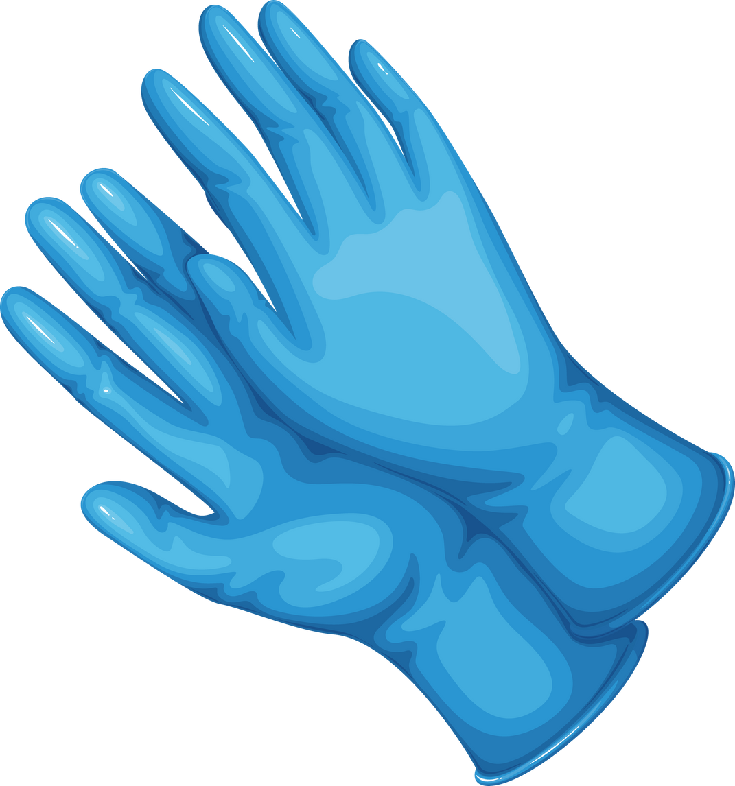
Gloves
Change Gloves when Necessary
As soon as they become dirty or torn
After handling raw meat, seafood, or poultry and before handling ready-to-eat food
Before beginning a different task
Before or after handling food with a known food allergen
After touching anything that can cause contamination
Use Gloves Correctly
Only use single-use gloves when handling food
NEVER rinse, wash, or reuse gloves
Make sure the gloves fit your hands
Wash your hands before putting on gloves and starting a new task
Notes:
Food workers are required to wear gloves when handling ready-to-eat foods to prevent the spread of bacteria and other contaminants from the hands of those who are handling the food.
Ready-to-eat foods include foods like produce (apples), prepared meals, etc.
Here are some tips on using gloves correctly:
Use only single-use gloves
Never rinse, wash, or reuse gloves
Make sure the gloves fit your hands
Wash your hands before putting on gloves or starting a new task
Here are some times when it’s necessary to change your gloves:
As soon as they become dirty or torn
After handling raw meat, seafood, poultry and before handling ready-to-eat food
Before beginning a different task
Before or after handling food with a known food allergen
After touching anything that may cause contamination like touching your phone
18

Slide 19

Hands & Nails
    Keep fingernails short and clean.
    Use single-use gloves if you are wearing nail polish or fake nails.
    Make sure wounds are correctly covered.
Notes:
1.7.2013
Follow these guidelines to maintain your hands and nails.
Keep fingernails short and clean. Long fingernails can be more difficult to keep clean.
If you will be handling exposed food, you must use single-use gloves if you are wearing nail polish or false fingernails. Nail polish can hide dirt under nails and may flake off in exposed food.
Infected wounds can contain bacteria. To keep food safe, make sure wounds are correctly covered.
hands or wrists: cover with a bandage or finger cot that prevents fluid from leaking out, then place a single-use glove over the cover.
arms: completely cover with a bandage that prevents fluids from leaking out.
body: cover with a dry, durable, tight-fitting bandage.
‹#›

Slide 20
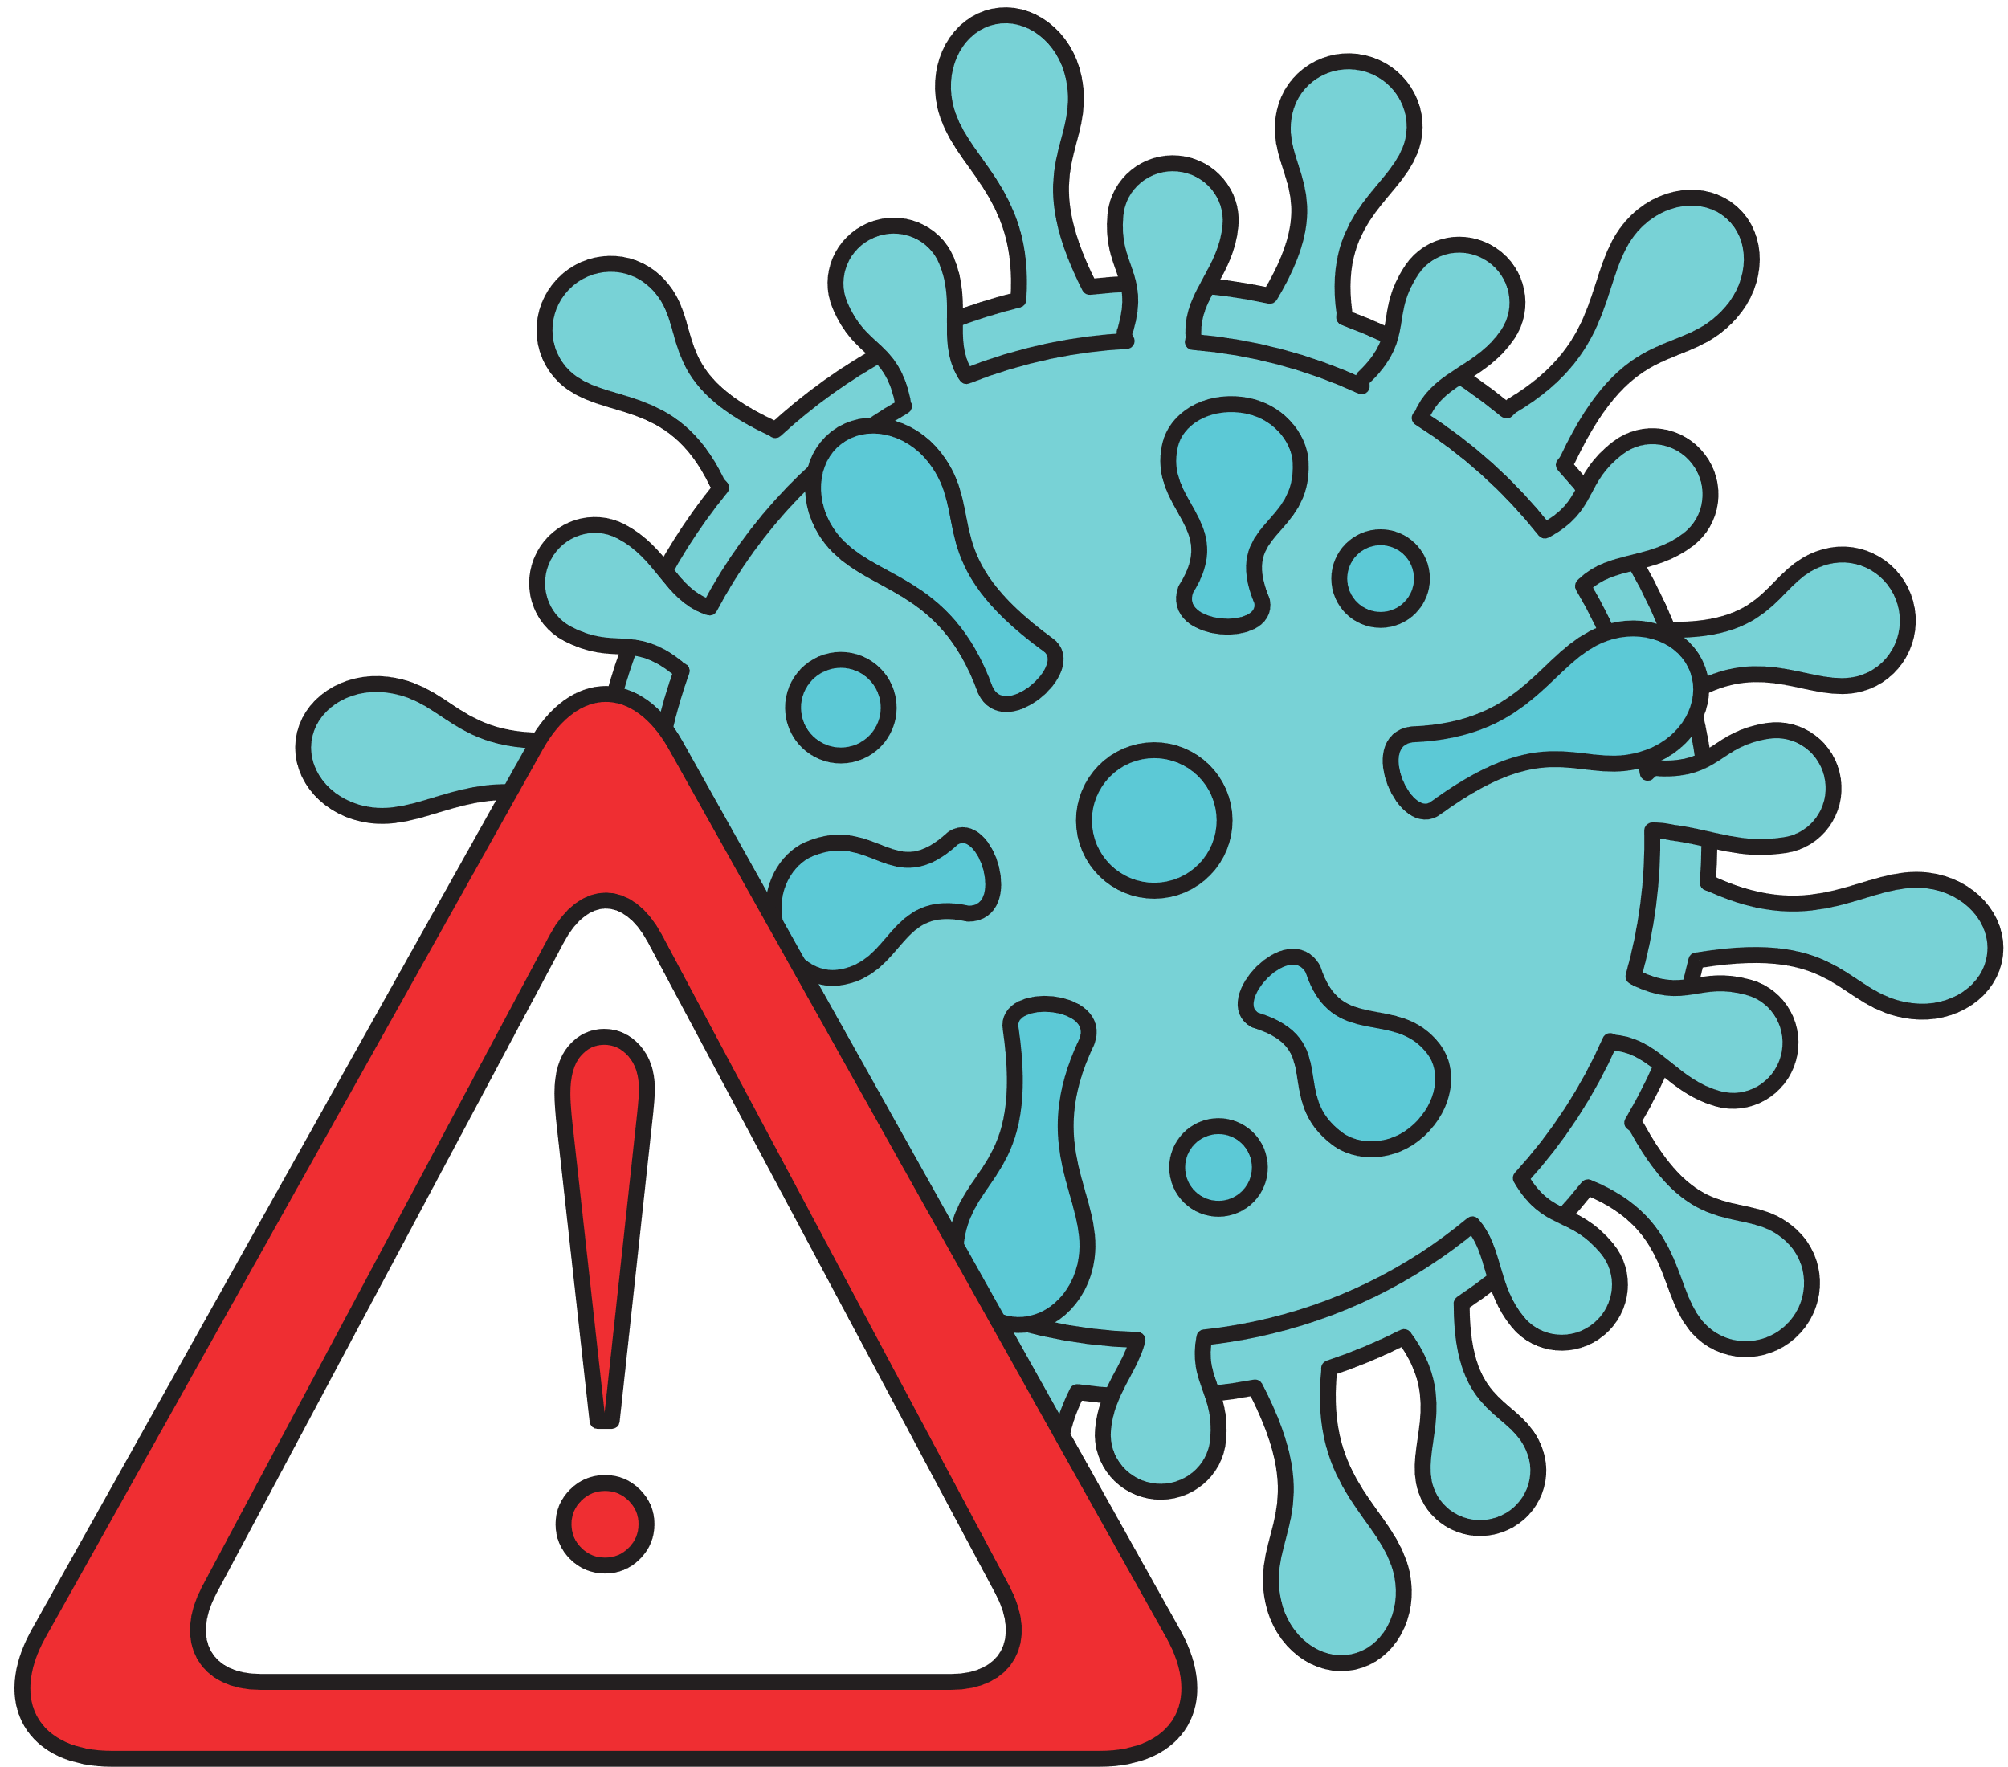
Other Important Practices
Dos & Don'ts
DO bathe regularly and wear clean clothes, gloves, and aprons
DO keep your hair tied back and use hair coverings
DO NOT wear jewelry
DO NOT eat, drink, smoke, or chew gum, or use your phone
DO NOT come to work sick.*
*If you have been diagnosed with a foodborne illness, you must alert your director or supervisor. You must also tell your director or supervisor if you are experiencing vomiting, diarrhea, jaundice (yellowing of skin and eyes), or sore throat with a fever.
Notes:
1.7.2013
If you fail to bathe or you wear dirty clothes while working with food, you can make people sick. Dirty hair, skin, and clothing may carry pathogens that can cause foodborne illness. Here are some other important practices to keep in mind:
Practice good hygiene.
And, if you're working with exposed food or in a food handling room, you may need to wear gloves, aprons, and hair coverings.
Avoid wearing jewelry like rings (except for a plain band), bracelets, and watches because they can contain bacteria and other pathogens.
Never eat, drink, smoke, or chew gum or tobacco in food-handling or food storage areas. Use designated areas only.
If you are sick, you could spread pathogens to food, equipment, and to people, so stay home!
‹#›

Slide 21
RECEIVING, TRANSPORTING
AND STORING FOOD
SAFELY
Notes:
1.7.2013
Next up: we'll discuss how to receive, transport and store food properly.
‹#›

Slide 22

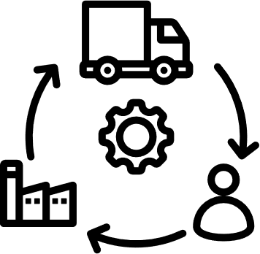
CONTROLLING TIME & TEMPERATURE
Notes:
1.7.2013
We’ll start with controlling time and temperature. The temperature of food must be controlled from the minute it's received from the donor, food bank, and pantry or kitchen to the minute it's handed to the neighbor.
This includes time food spends in the warehouse, on the truck, and at your organization.
Think of this as a "cold chain" that, if broken, can result in foodborne illness.
The cold chain is broken whenever food is held at temperatures between 40F and 140F. This is the temperature danger zone where pathogens can grow, making food unsafe for consumption.
‹#›

Slide 23
INSPECTING FOOD
DURING RECEIVING
TYPE OF FOOD | TEMPERATURE
Refrigerated Food | 41°F or lower
Frozen Food | Frozen solid. Recommended 0°F or lower
Cut Produce | 41°F or lower
Whole Produce | Dry storage temperatures (50-70°F) For more information, refer to Feeding America's produce handling guidelines.
Notes:
1.7.2013
Checking food when you receive it will help make sure it is safe.
Here are some things to keep in mind:
Reject the food delivery if the delivery vehicle or delivery containers do not meet acceptable standards, contain pests, or are excessively dirty
Perishable food must be received at the correct temperature in order for it to be safe. Reject any food that does not meet these temperatures. Feel free to pull off to the side of the warehouse parking lot out of traffic to do any inspection!
Here are the temperature guidelines for specific types of food:
Refrigerated food needs to be received at 41F or lower
Frozen food needs to be received frozen solid at 0F or lower
Cut produce should also be at 41F or lower
Whole produce can be stored at dry storage temperatures (between 50-70F). If you’re interested in learning more about produce handling guidelines, you can click the link here to the Feeding America resource.
‹#›

Slide 24
Knowledge Check
Is it the correct temperature?
Identify each item that was not received at the correct temperature.
A. Frozen meat received at 38°F
B. Bags of cut lettuce received at 50°F
C. Bags of cut melons received at 60°F
D. Milk received at 62°F
Notes:
1.7.2013
Let's test what we've learned so far about receiving food at the correct temperatures through a knowledge check.
Answer: all of them were not received at the correct temperature.
‹#›

Slide 25


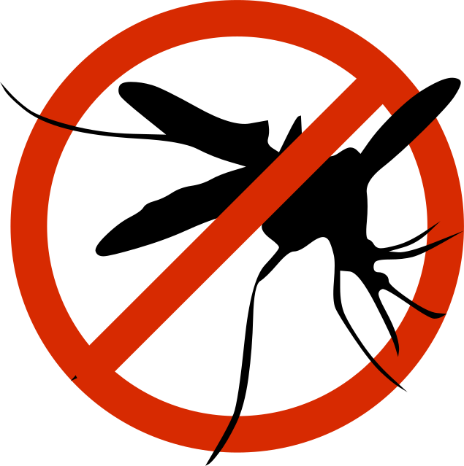
LOADING
FOOD SAFELY
Dos | Don'ts
Clean inside of vehicle once per week or as often as necessary | Never use a vehicle for food transport that is used to haul garbage.
Make sure vehicles are free of pests. | Do not bring pets.
Check refrigerated trucks to make sure they can keep food at 41°F or lower. | Do not leave vehicles unlocked when not loading/unloading.
Make sure coolers, ice packs, and thermal blankets are used in unrefrigerated vehicles. | Do not store raw food over ready-to-eat food.
Cover any product that may be exposed to air. | Do not store allergens over other products.
Keep drive times in unrefrigerated vehicles to 30 minutes or less. | Do not store chemicals with food products.
Notes:
1.7.2013
Vehicles must be inspected and maintained to protect food from contamination. That's true whether they are private vehicles or commercial trucks.
Here's what you should do to keep food safe.
Make sure to clean the vehicle and check for pests often.
For refrigerated trucks, make sure they are pre-cooled and that you are checking temperatures regularly, (before and after loading). Make sure the temperature is holding at 41F or lower.
If you don't have a refrigerated truck, make sure you are using coolers, ice packs, and thermal blankets.
Try to keep frozen items frozen.
Keep drive times in unrefrigerated vehicles to 30 minutes or less if possible.
Here’s what not to do:
Don't use a vehicle for food transport that is used for garbage.
Do not bring pets.
Do not leave vehicles unlocked when not loading/unloading.
Do not store raw food over ready to eat food
Do not store allergens over other products.
Do not store chemicals with food products.
‹#›

Slide 26


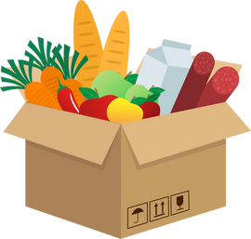


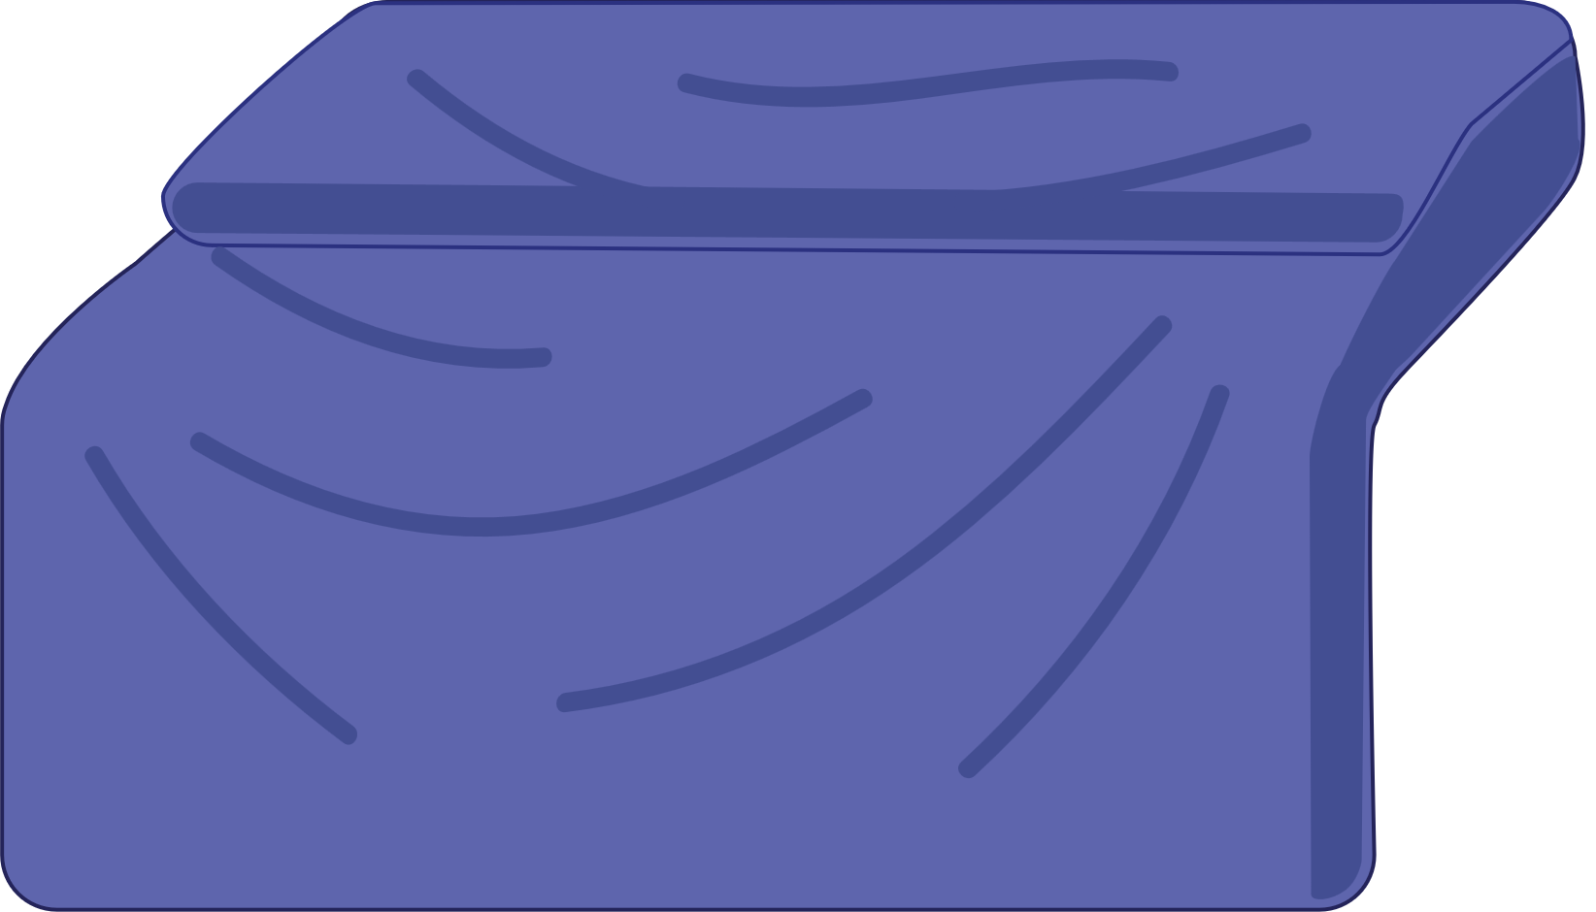






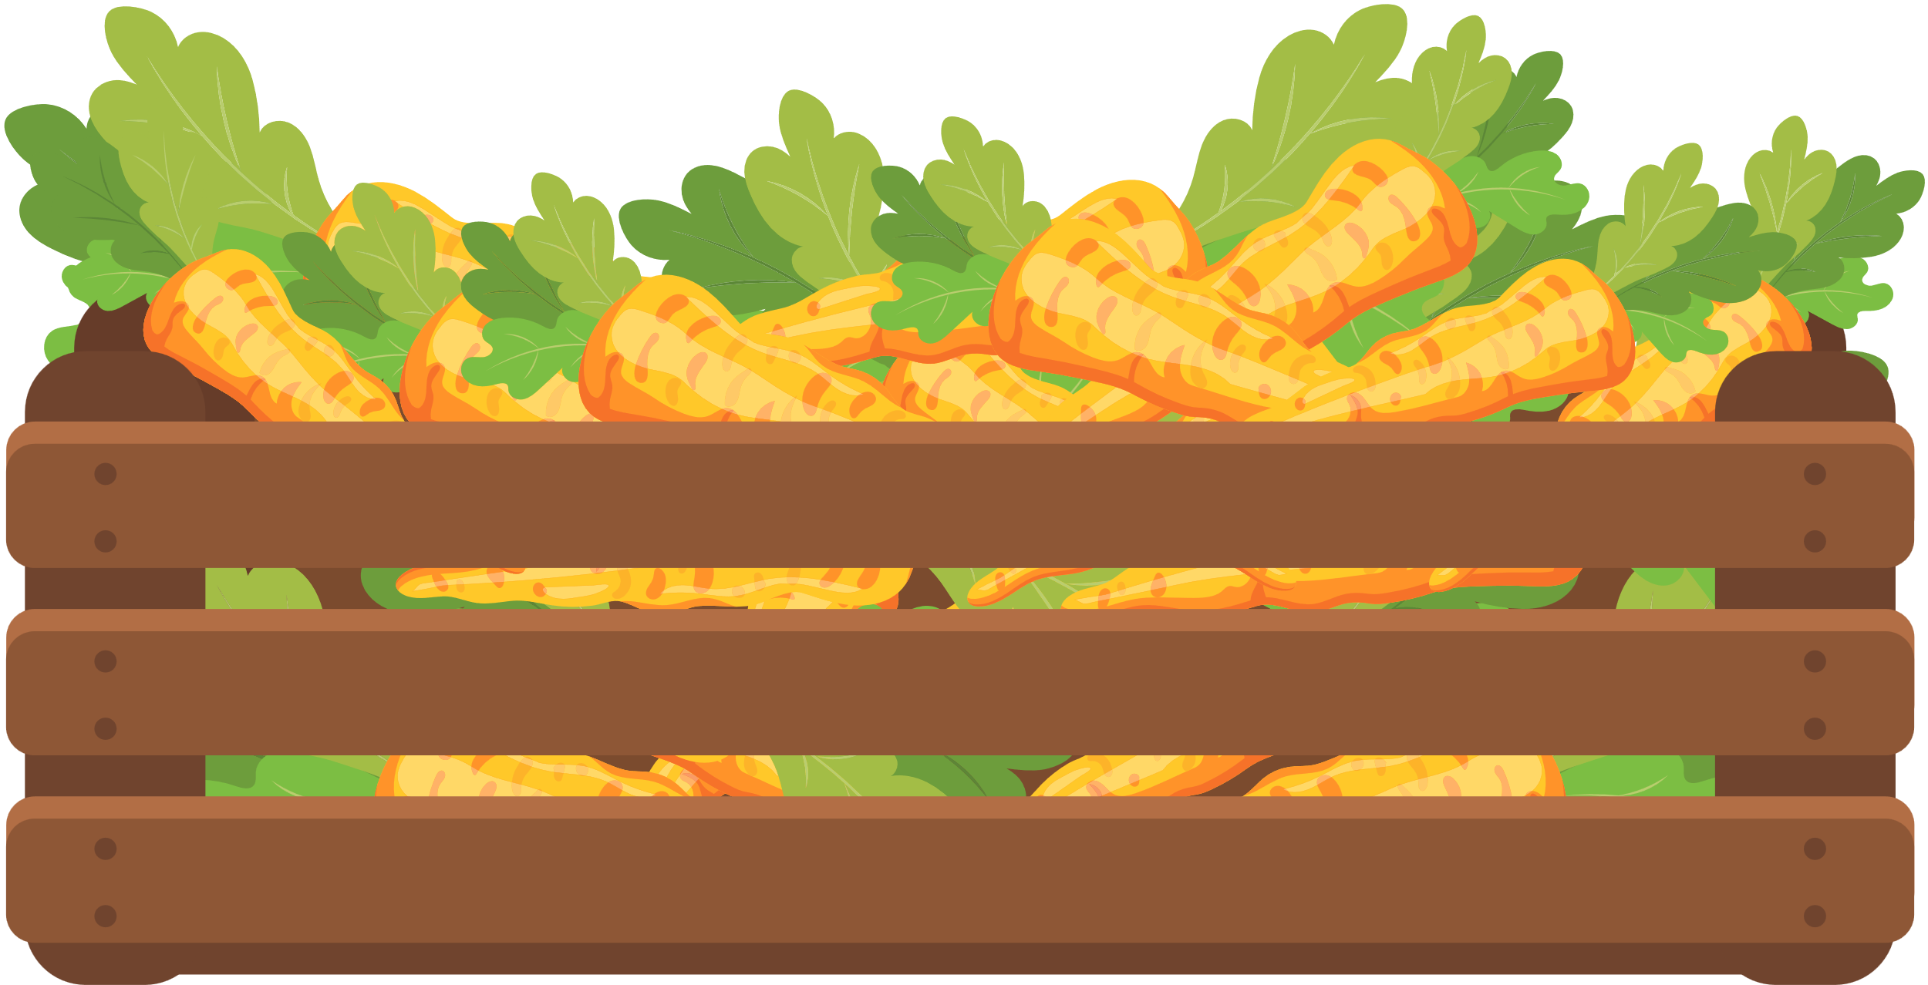

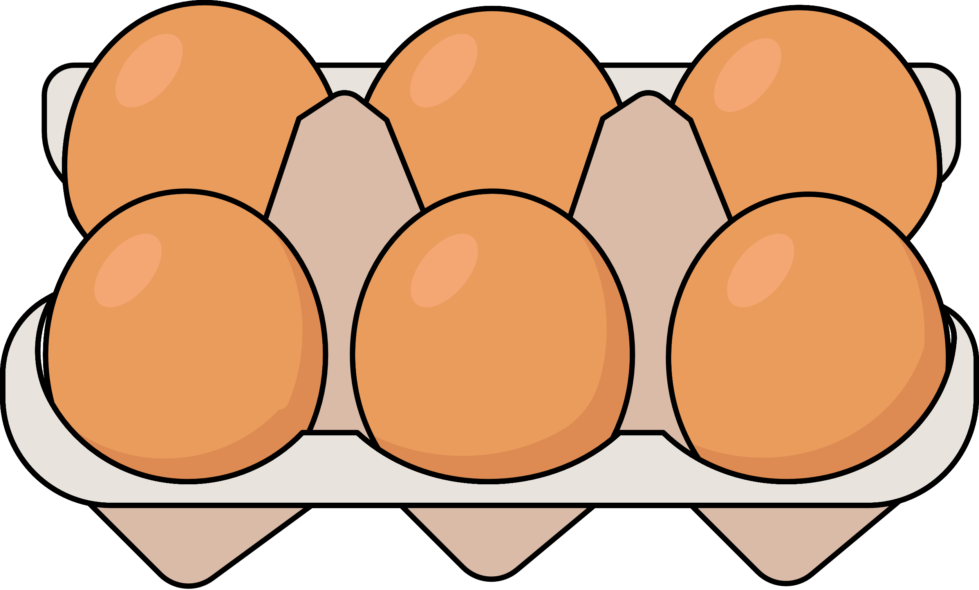
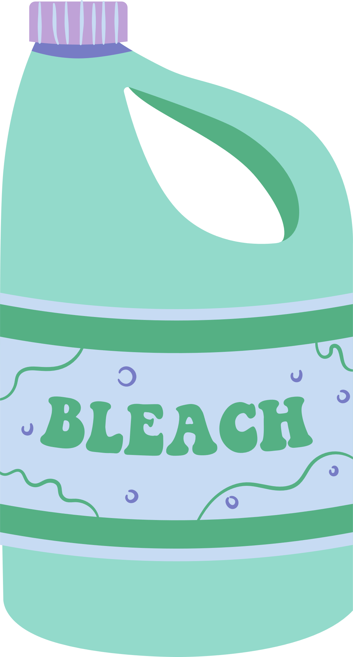


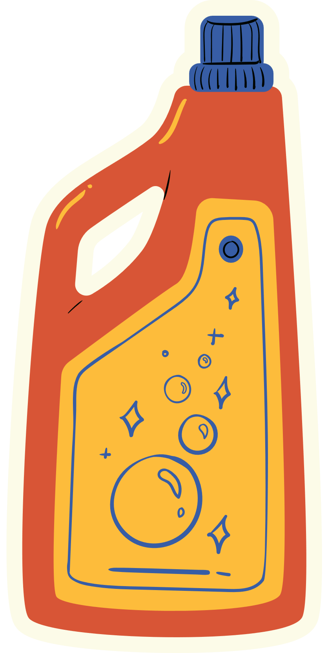
Knowledge Check
Identify each scenario where a mistake was made in loading.
Do not store raw food above ready to eat food.
Do not store chemicals with food.
Use a thermal blanket to keep food cold.
Notes:
1.7.2013
Let's test what we’ve learned about transporting food safely.
Identify each situation where a mistake was made.
Mistake #1: Storing raw food above ready to eat food (eggs on top of bananas)
Mistake #2: Storing food with chemicals
Correct Storage: Using a thermal blanket to keep food cold (when transporting food from our warehouse or doing home deliveries)
‹#›

Slide 27
STORING FOOD SAFELY
Store food away from toxic chemicals and products.
Store food in a way that prevents cross-contamination
Store food only in designated food-storage areas.
Store food off the floor and away from the walls and ceiling.
Store food at proper temperatures.
Store refrigerated food at 41°F or lower.
Keep frozen food frozen solid at 0°F or below.
Keep dry storage rooms between 50-70°F.
Notes:
1.7.2013
In addition to receiving food at correct temperatures, you also want to make sure you’re storing it at correct temperatures once the food gets back to your facility. Food can be contaminated if not stored correctly. It can also become unsafe if it is allowed to stay in the temperature danger zone (between 40-140F).
Here's what you can do to prevent this:
Store refrigerated food at 41 degrees or lower. This includes cut produce.
Keep frozen food frozen solid at 0 degrees or lower.
Keep dry storage rooms between 50-70 degrees. Add extra fans/AC units in the summer if needed.
Store food only in designated food-storage areas.
Store food at least 6 inches off the floor and away from the walls (4 inches) and ceiling (2 feet) for proper air flow and ventilation (about 4 inches).
Also note that food should not be stored near heaters, condensers, etc.
‹#›

Slide 28

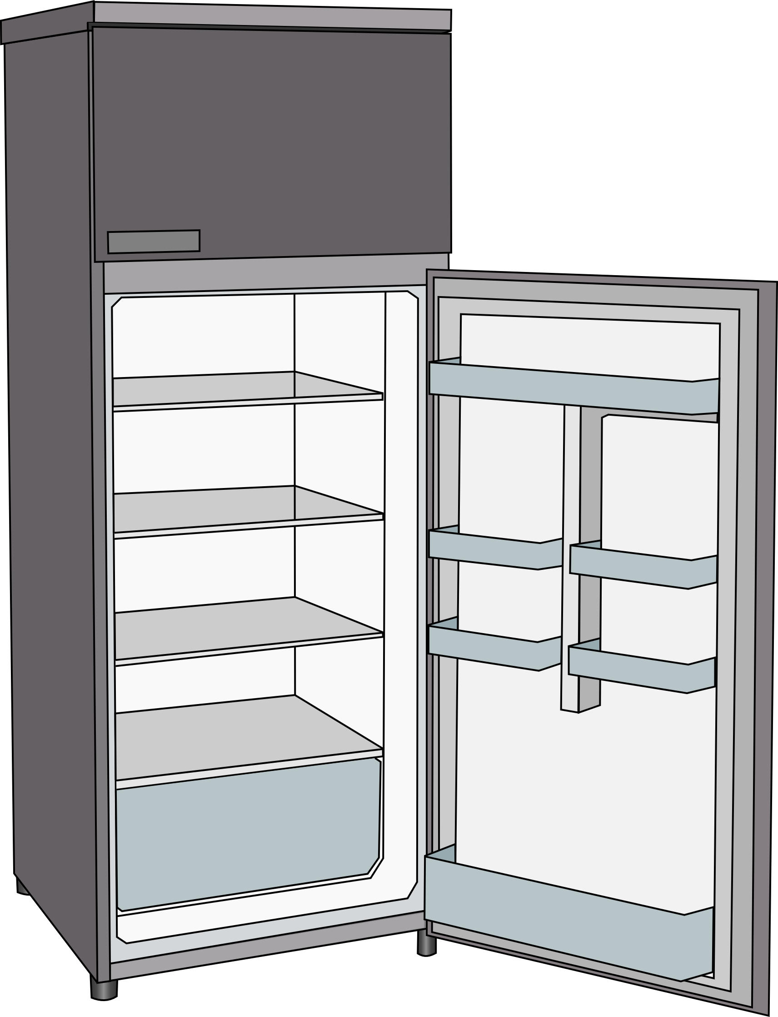

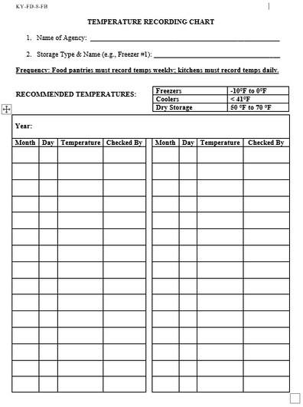

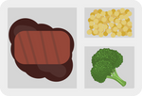
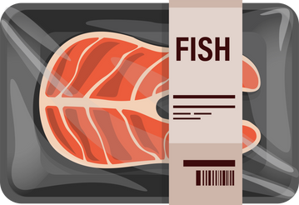
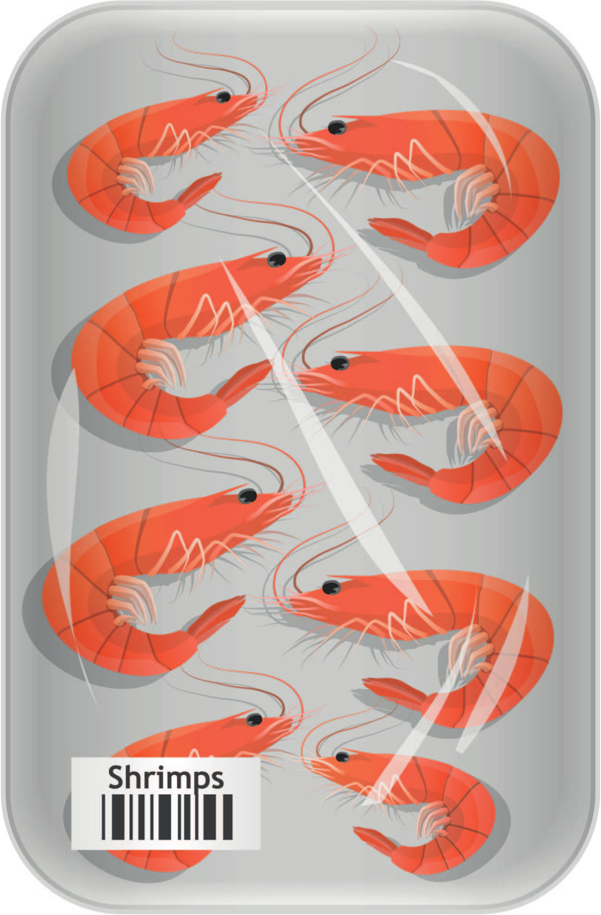


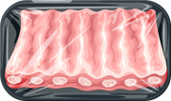

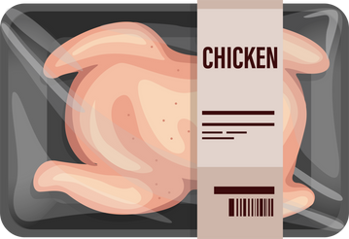
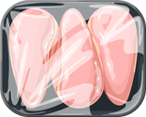
Put food away in the following order:
Freezer #1
  Refrigerated
  Frozen
  Dry
READY TO EAT
FISH & SEAFOOD
BEEF & PORK
POULTRY
Notes:
1.7.2013
Once received and back to your facility, put food away in the following order:
1. Refrigerated
2. Frozen
3. Dry
For refrigerated products, here are some extra tips to prevent cross-contamination!
Store ready-to-eat foods above raw seafood, meat, and poultry.
Do not store these items on the same shelf or pallet.
To minimize the risk of cross contamination, store lower risk foods at the top and higher risk foods at the bottom.
‹#›

Slide 29


























RECORDING TEMPERATURES
COLD & DRY STORAGE UNIT REQUIREMENTS:
LABELS & NAMES
THERMOMETERS
Inside all cold storage units.
Don't forget the dry storage!
"Fridge #1"
"Freezer #1"
"Dry Storage #1"
Temperature Recording Charts
TEMPERATURES
Must be kept on file for 3 years plus the current year.
Recorded DAILY for kitchens and WEEKLY for pantries.
DTC TIME & TEMPERATURE
SHEETS
DTC 2020
DTC 2021
DTC 2022
DTC 2023
Notes:
1.7.2013
Here are the cold and dry storage unit requirements: ​
Each cold and dry storage areas need to have an identifiable name (keep consistent) (i.e., freezer #1),​ Combo fridge/freezer units need to have their own thermometer ​
And their own time/temperature recording chart. ​
This includes cold storage units that have external thermometers. ​
Don't forget about the dry storage areas! Hang a thermometer and a time/temperature sheet in any areas that have shelf-stable goods. ​
Kitchens need to record temperatures daily and pantries need to record temperatures weekly.
Recordkeeping: ​
You can store your time and temperature sheets directly in dry storage areas on or the cold storage units; or you can keep them filed away. Make sure you keep the records for three years, plus the current year. ​
You can also store them digitally, if preferred. Just have them available for us when we come to monitor.​
‹#›

Slide 30
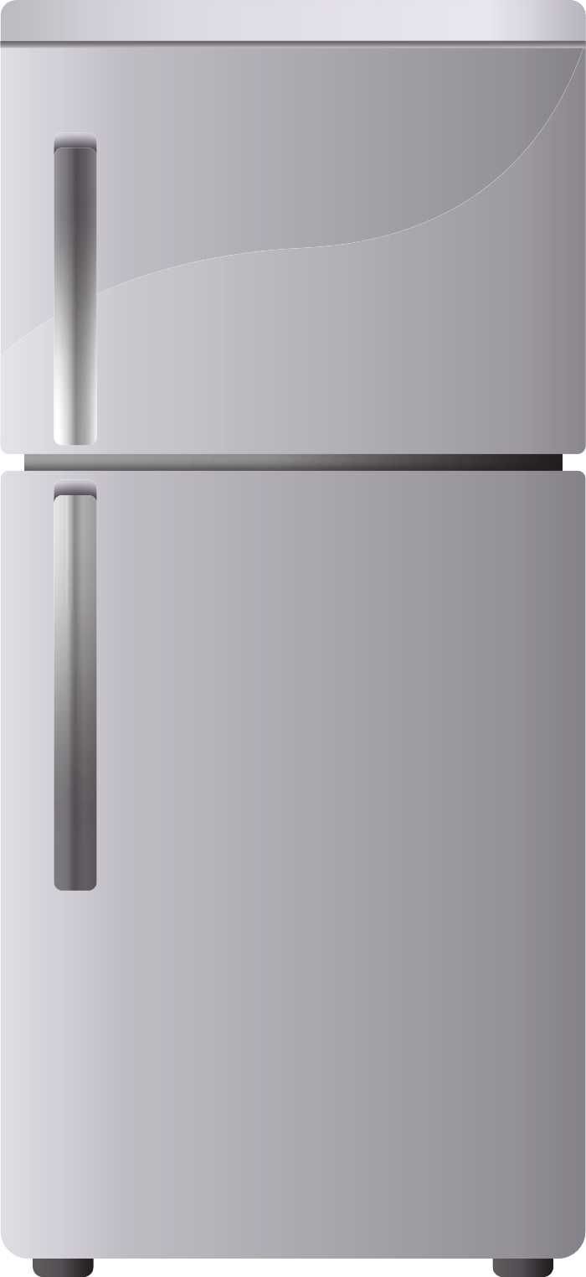

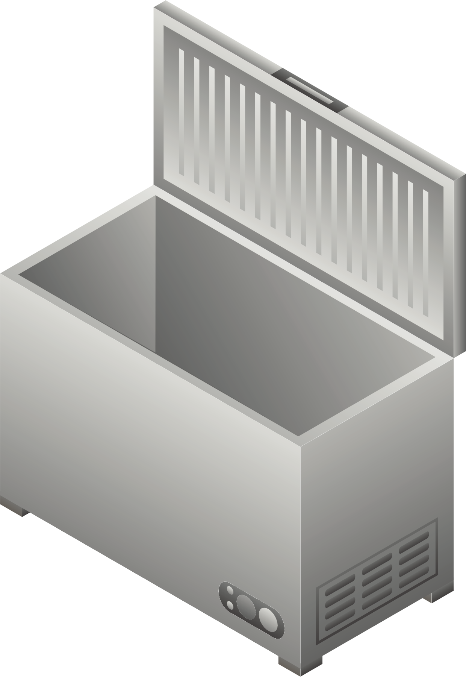
Freezer #1
Fridge #1
freezer #2
-10°F
Notes:
Here are some examples of what this looks like in practice:
Cold storage
If you have a fridge/freezer combo unit, you’ll want to have a thermometer and time and temperature sheet for the fridge and freezer.
Deep freezers:
Attach a thermometer to a string on the hinge for a deep freezer, they can be lost easily!
Notice how this deep freezer has a thermometer inside even though it has one on the outside in the event that the digital thermometer malfunctions or breaks.
30

Slide 31
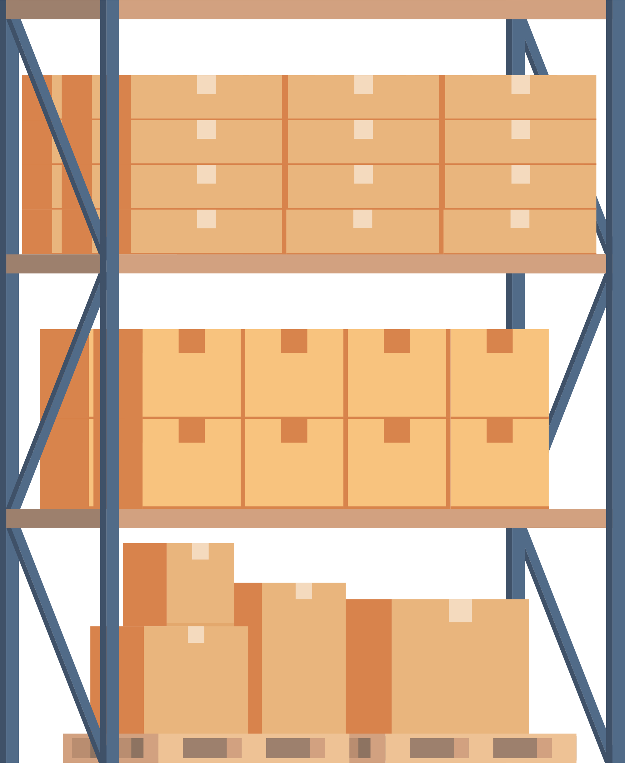

dry storage #1
Notes:
Here are some examples of what dry storage areas can look like based on the recommend safe storage practices.
Dry Storage
For any dry storage areas that store food, you’ll want to have a thermometer and time and temperature sheet as well.
31

Slide 32
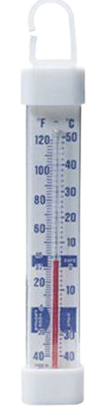
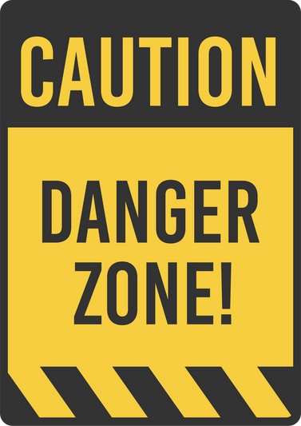


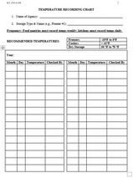

CONTROL TEMPERATURES AND PREVENT BREAKING THE COLD CHAIN
READING THERMOMETERS
KEEP HOT FOOD HOT
KEEP COLD FOOD COLD
Have at least two staff people trained on how to properly read a thermometer.
BLUE = SAFE ZONE
BETWEEN
40 - 140°F
Notes:
1.7.2013
​Danger zone
Do not leave refrigerated products in the danger zone for more than 2 hours; if it is above 90 degrees these foods should not be left out for more than 1 hour. ​
Keep cold foods cold and hot foods. Cold foods should be at 40 degrees or lower. To help keep cold items cold, items can be placed in coolers or on ice. Hot food (cooked foods) should be at 140 or higher and also temperature controlled. Food can place in chafing dished, stems tables, warming tables. ​
Thermometers
The thermometers that we supply to you with are simple refrigerator/freezer thermometer with blue safe zones which indicate the safe temperature for food storage in a refrigerator or freezer. ​
When the top of the red spirit is in the blue, the temperature is safe. This unit indicates temperature in a hanging or lay flat application.​
Make sure to have at least two staff people trained on reading a thermometer and try to designate one person to take the temperatures to keep consistency.
​
‹#›

Slide 33


Knowledge Check
Is the thermometer reading within a safe temperature range?
dry storage #1
Notes:
1.7.2013
Let's test what we've learned so far about recording temperatures through a knowledge check.
Is the temperature within a safe range for this dry storage area?
The temperature is currently reading at 90F.
Answer: NO – dry storage areas should be between 50-70 degrees. Make sure the AC is on and you have some extra fans to get more air flow.
‹#›

Slide 34

Knowledge Check
Is the thermometer reading within a safe temperature range?
Freezer #1
Notes:
1.7.2013
Let's test what we've learned so far about recording temperatures through a knowledge check.
Is the temperature within a safe range for this refrigerator?
The temperature is currently reading at about 35 degrees.
Answer: YES – refrigerators should be kept at 41 degrees or lower.
‹#›

Slide 35

Knowledge Check
Is the thermometer within a safe temperature range?
freezer #2
-10°F
Notes:
1.7.2013
Let's test what we've learned so far about recording temperatures through a knowledge check.
Is the temperature within a safe range for this deep freezer?
The temperature is currently reading at 40 degrees.
Answer: NO – freezers should be at 0 degrees or lower.
‹#›

Slide 36


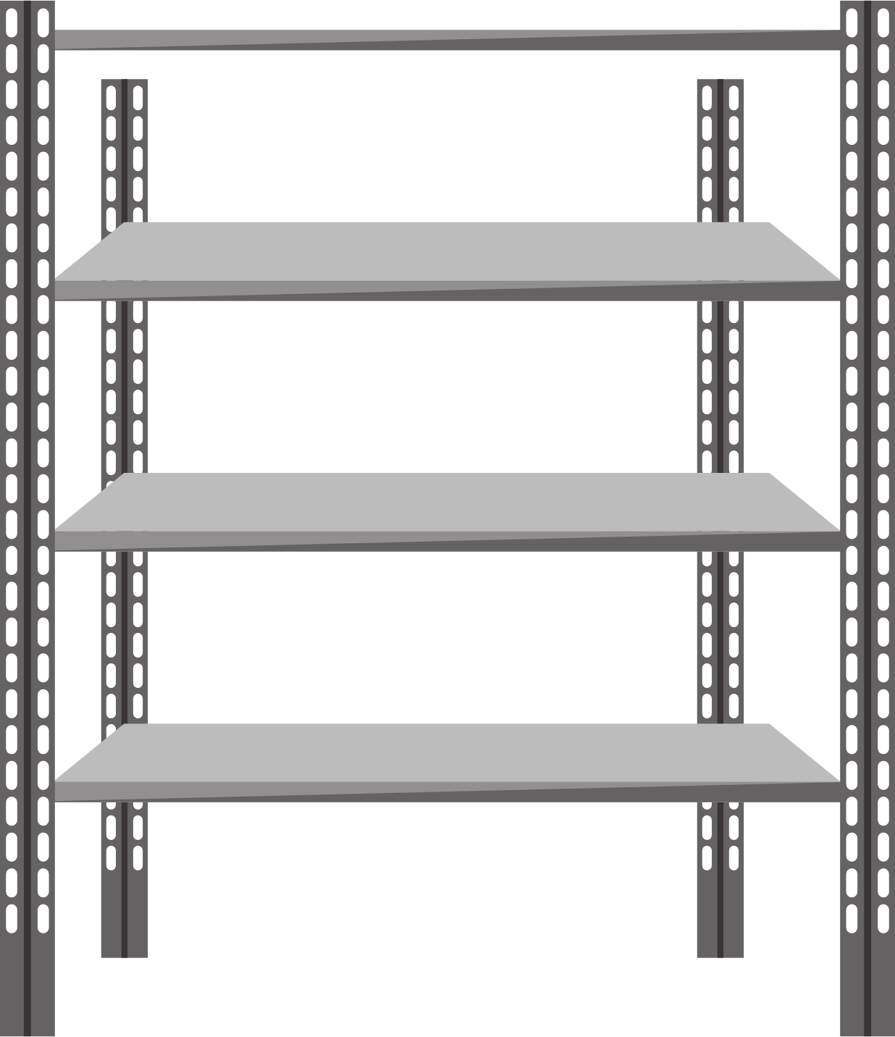

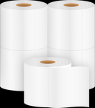

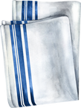
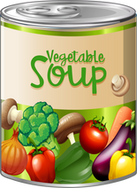
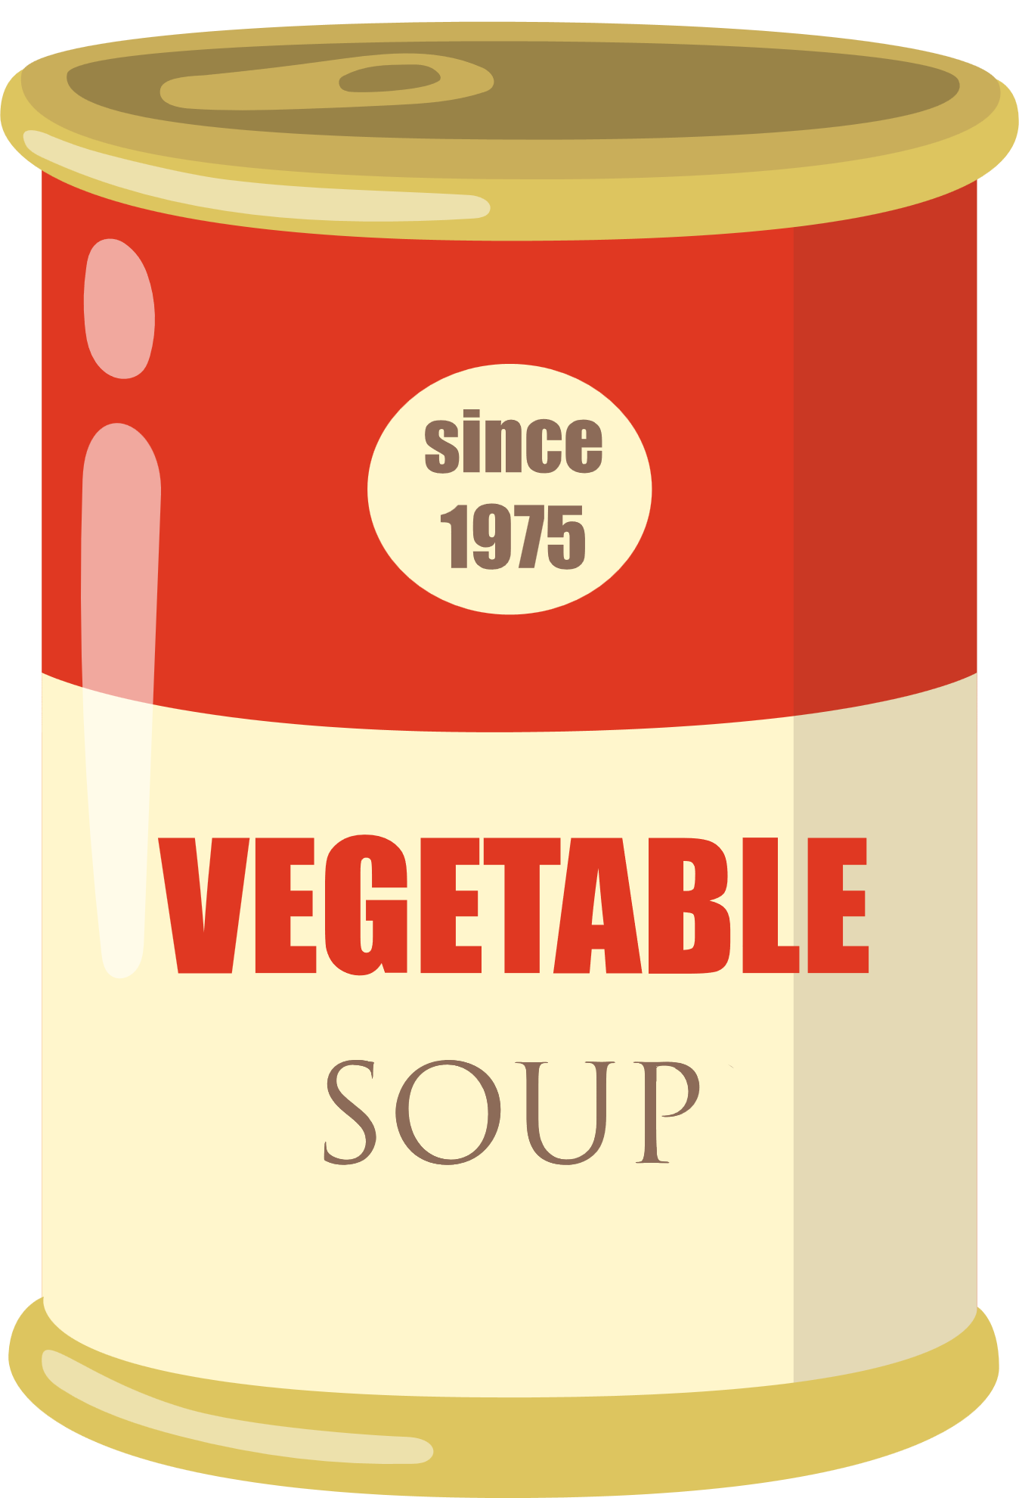
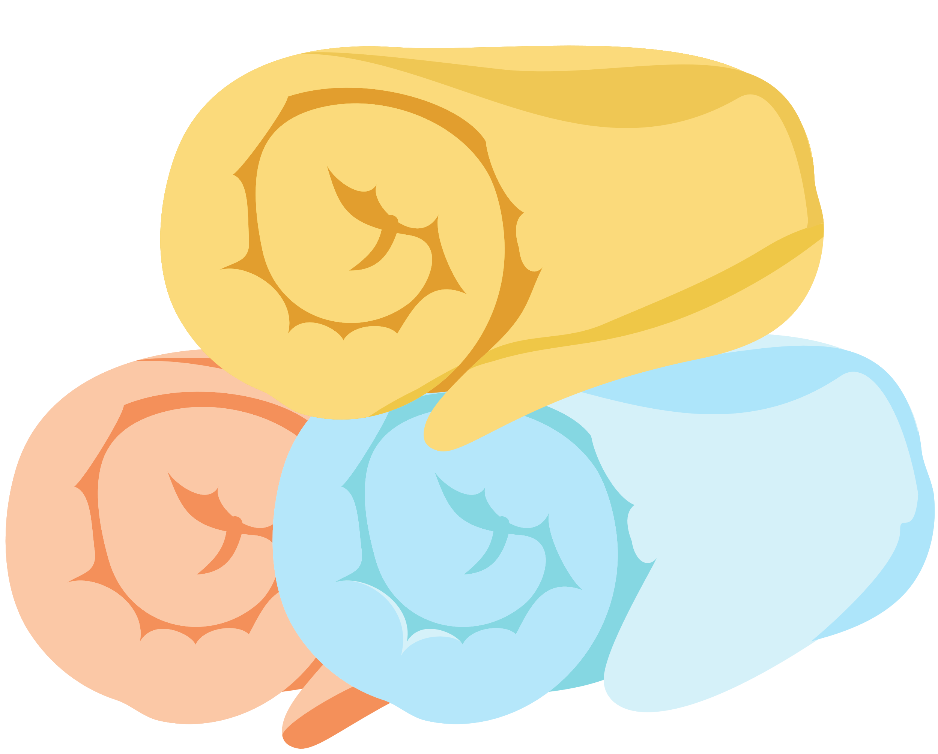
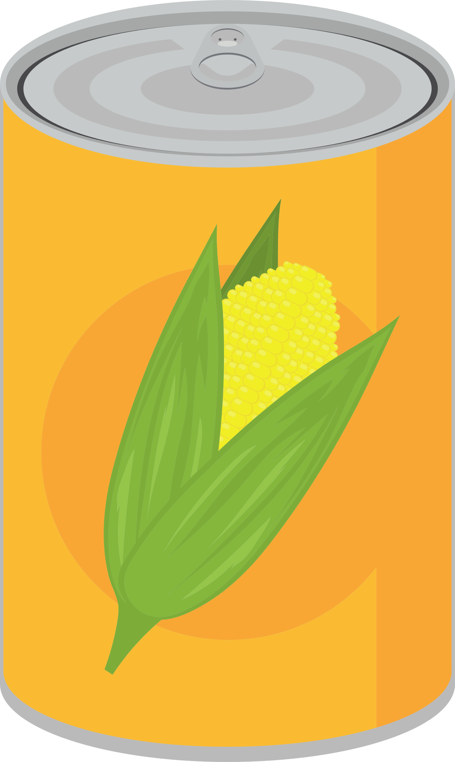
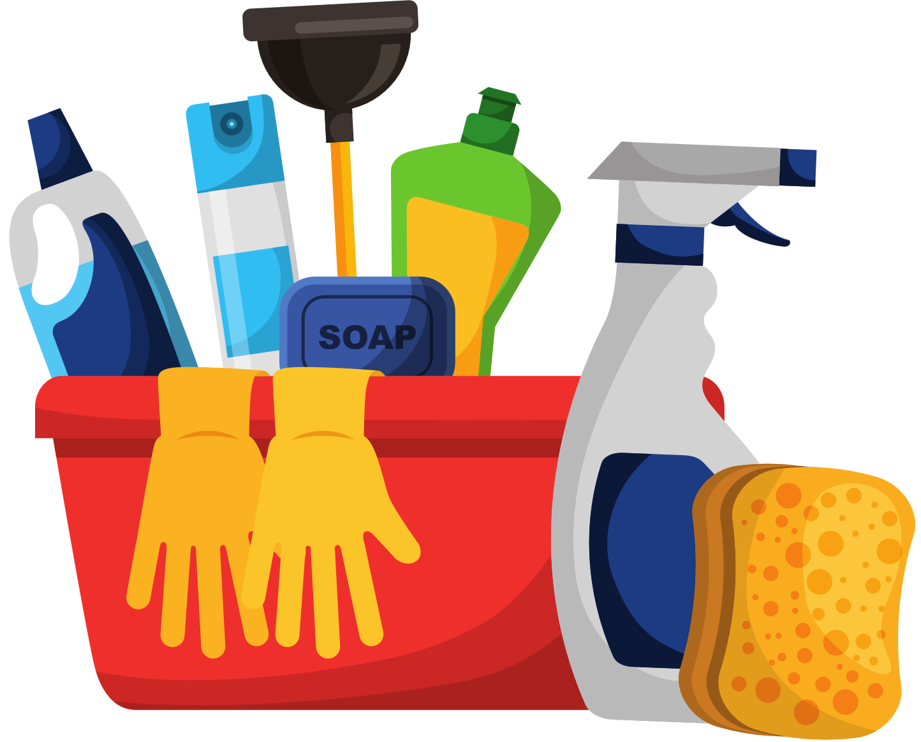

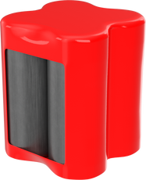


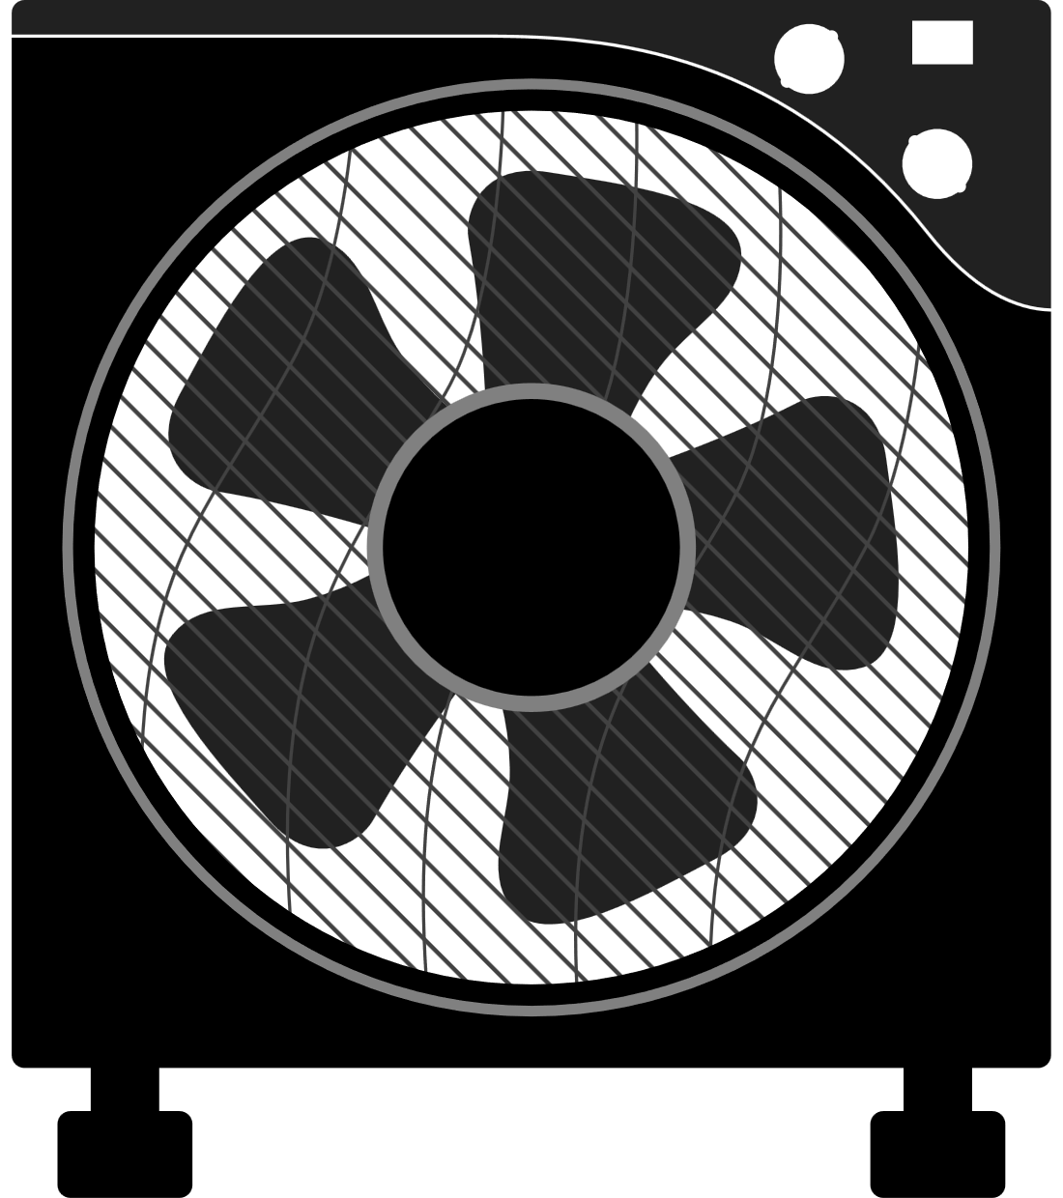
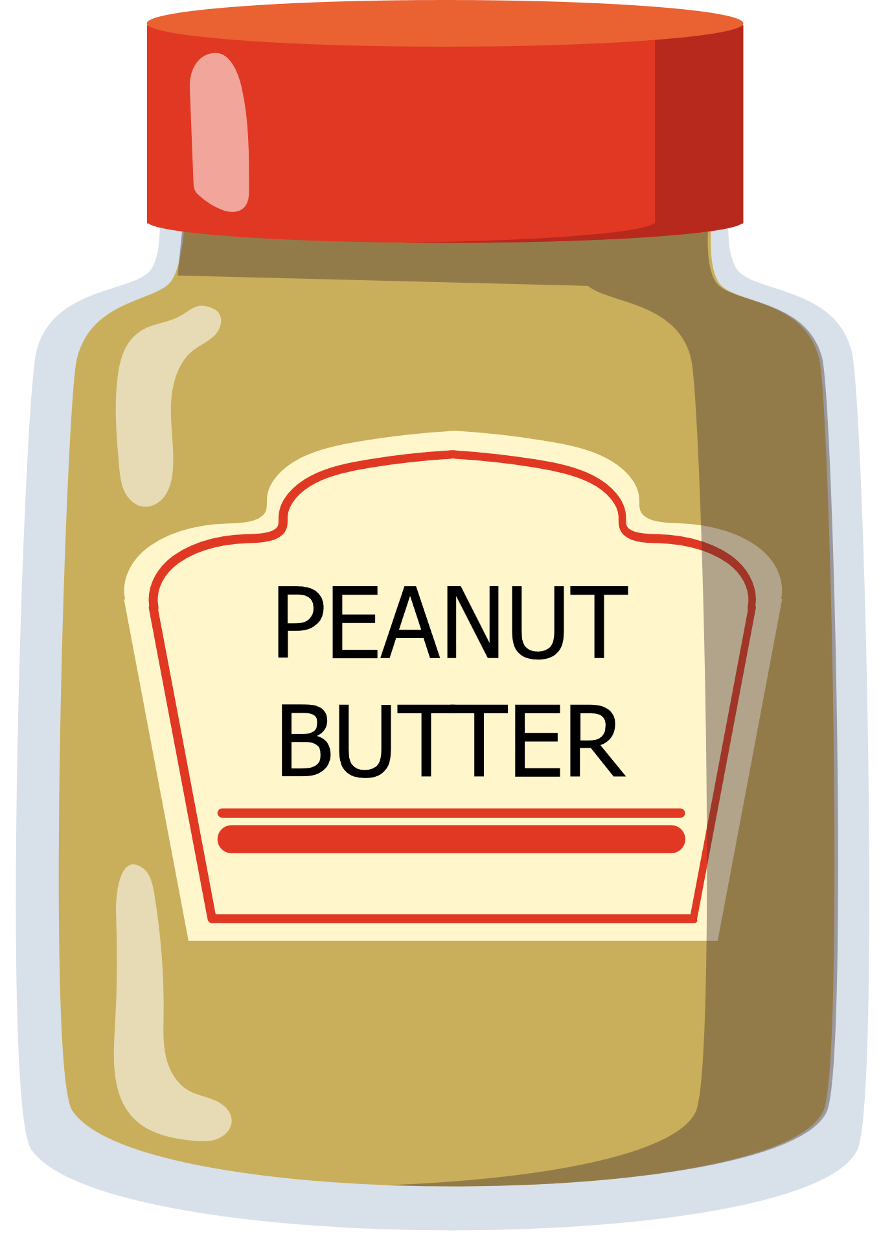
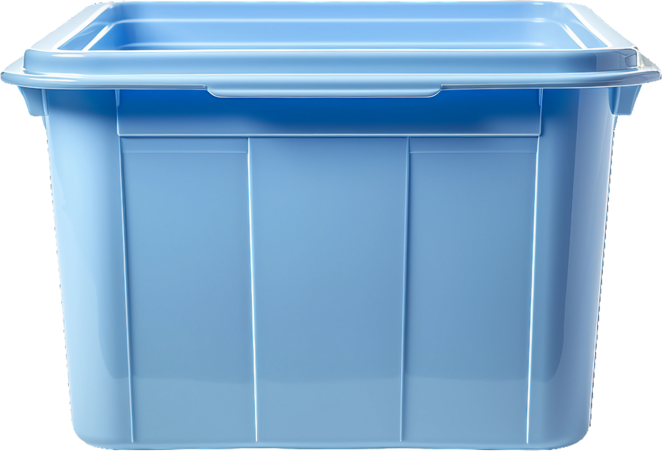
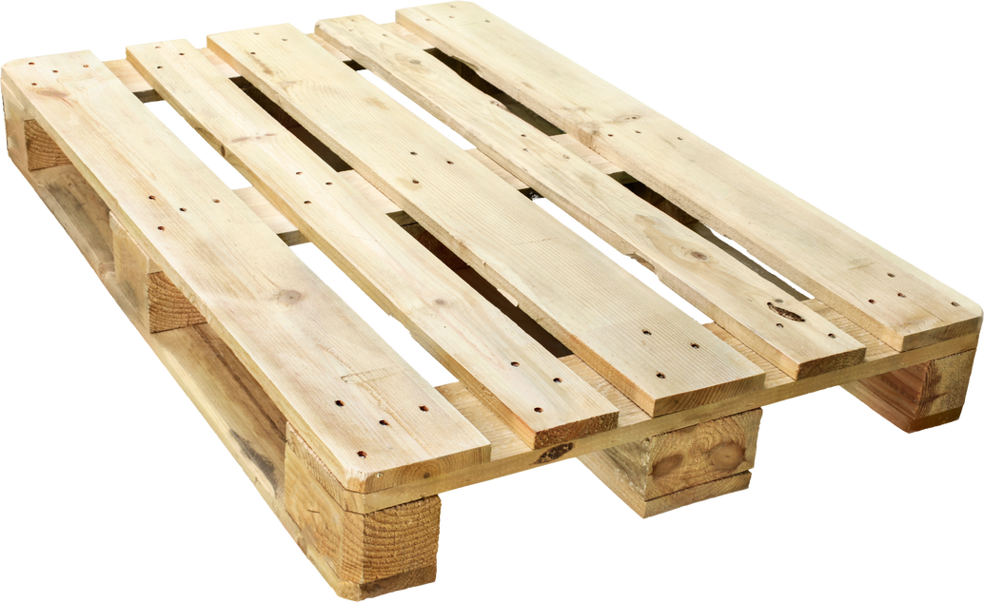
dry storage #2
2 FEET FROM CEILING
Cleaning Supplies Only
Food Only
4 INCHES FROM WALLS
Black Beans
7/30/2023
6 INCHES FROM FLOOR
Notes:
1.7.2013
Here are some more dry storage tips!
Store cleaning supplies and toxic chemicals either in a separate room or on a separate shelving unit. Never store toxic chemicals or cleaning supplies above food.
Make sure to store products 2 feet from the ceiling and 4 inches from the walls for proper air flow. You’ll also want to make sure that food is at least 6 inches off of the ground and elevated some way.
It can get hot in the summertime, so make sure to turn on the extra fans and air conditioning to get more air flow. Reminder: ideal temperature for dry storage is 50-70F.
‹#›

Slide 37
QUALITY
CONTROL
Notes:
In the next few slides, we’ll go over how to do some quality control on canned goods, jars and bottles, dry goods, produce, and medications.
An important part of food safety is evaluating the food you receive.
Not all of the products you receive will be ready for distribution.
Many products will require a closer look to see if they are usable.
Each product will be evaluated differently.
Never assume that the product has already been inspected and is safe for use. It is everyone's responsibility to inspect food for safety.
Then we’ll discuss what to do if you have food that is not safe for consumption.
45

Slide 38





FOOD PRODUCT DATING
PACKING OR MANUFACTURING DATE
BEST BY OR BEST IF USED BY DATE
    Used by manufacturers for tracking and recalls
    Not an expiration date
    This is a quality date.
    Tells neighbors the date by which the product should be eaten for best flavor or quality.
    Product is still safe to eat past this date.
USE BY OR EXPIRATION DATE*
SELL BY DATE
    This is a quality date.
    Tells the store how long to display the product for sale.
    Product is still safe to eat past this date.
    This is the last date recommended for the product while at peak quality.
    The product is still safe to eat past this date.
*Over the counter (OTC) medications, baby food, and baby formula must be rejected if past expiration or use-by date.
Notes:
1.7.2013
It can be difficult to understand the dates listed on a food label. Most storage dates on food are not related to food safety, so it can be difficult to decide how long food can be safely stored.
Here are some general guidelines to follow:
Packing or manufacturing date is for manufacturers to for tracking purposes and for recalls. It is not an expiration date.
Sell by date is just a quality date, it tells the store how long to keep the product on display for sale. Product is still safe to eat past this date.
Best by or best if used by date is also a quality date. It tells neighbors the date by which the product should be consumed for best flavor or quality.
A use by or expiration date is the last date recommended for the product while at peak quality. The product is still safe to eat past this date.
The hard and fast rule for expiration dates: no medications, baby food, or baby formula can be distributed past their expiration date.
‹#›

Slide 39


Download for Android
USDA FOODKEEPER
The FoodKeeper app is a tool to help reduce food waste by sharing storage methods that extend the shelf life of the foods and beverages.
Download for iPhone
Available for free on Android and iPhone
Notes:
Not sure how long a product will last? Use the USDA Food Keeper app!
The FoodKeeper app is a tool that shares storage methods to extend the shelf life of food and beverages.
It’s free to download on Android and iPhone, you can download it now by scanning the QR code or searching for it in your app store.
38

Slide 40



FIRST-EXPIRED, FIRST-OUT (FEFO)
Check the dates and label cases
Store food with the earliest date in front of food with later dates.
Use the food stored in the front first.
Notes:
1.7.2013
When you’re storing and distributing product:
You must make sure that the oldest food in storage is used first. This will reduce food waste and keep food safe. Food rotation should be based on either the expiration date or the delivery date of the food.
Make sure to have a system in place for practicing the First in First Out method and be sure to train your staff and volunteers on how to properly practice this method.
‹#›

Slide 41





CHECKING CANS FOR DEFECTS
SEVERE DENTS
SWOLLEN
in the seam, side, or top
or bulging cans
LABELS
missing or unreadable labels due to stains or tears, no code dates
RUST
that cannot be wiped off
HOLES
and visible signs of leaking (indicated by stained labels)
Notes:
1.7.2013
Canned food that is damaged or defective can cause foodborne illness.
Here are some common can defects. Discard cans if they have these problems:
Severe dents in the seam, side or top
Missing or unreadable labels
Holes and visible signs of leaking
Swollen or bulging cans
Rust that cannot be wiped off
‹#›

Slide 42

CHECKING JARS & BOTTLES FOR DEFECTS
LIDS
LIDS
swollen, rusted, or dented
loose, broken or missing seal
LABELS
LEAKAGE
missing or unreadable labels due to stains or tears, no code dates
chipped or broken
MOLD
APPEARANCE
or foreign objects or sign of dirt under lid
food is discolored or separated
*NEVER ACCEPT HOMEMADE PRODUCTS
Notes:
1.7.2013
Food in jars and bottles must be checked just as carefully as canned food.
Here are some common defects. Discard jars and bottles of food if they have these products.
Lids that are swollen, rusted or dented or are lose or have a broken or missing seal.
Labels that are missing, missing information, or unreadable
Evidence of leakage, chipped, or broken, jars
Mold or foreign objects or signs of dirt under the lid
Check for the appearance, are the product contents separated or discolored?
Important note: never accept homemade food.
‹#›

Slide 43

CHECKING PACKAGING FOR DEFECTS
LABELS
SIGNS OF PESTS
unlabeled, unreadable, no code dates, or labeled incorrectly
gnaw marks, droppings, insects (dead or alive), pin-sized holes in packaging
PACKAGING
double-packaged food with inner package that is damaged, wet, and/or stained
single-packaged food that is exposed due to packaging that is open, ripped, etc.
Notes:
1.7.2013
Discard commercially packaged dry food if it has an unusual appearance, is not in its original package or has these problems.
Missing or unreadable labels, or labeled in correctly, no date
Signs of pests
Damaged packaging
Make sure to have a pest control plan in place.
‹#›

Slide 44



CHECKING PRODUCE FOR DEFECTS
MOLD
SEVERE BRUISES
decay, rot, and/or bad odors
or skin not intact (bruises provide a way for pathogens to get inside)
SIGNS OF INSECTS
CUT PRODUCE
live insects, insect bodies, or insect eggs
not at 41°F or lower or without code dates
Notes:
1.7.2013
There are many ways that produce will show signs of spoilage. You should be able to recognize the obvious signs as well as those that indicate the produce will spoil quickly.
Discard produce if it has these problems.
Mold, decay, rot, bad odors
Severe bruises or torn skin
Signs of insects
Produce that has been repackaged in packaging that is not safe for food use (i.e. garbage bag)
Cut produce that is not at a temperature of 41F or lower.
We do our best to glean the produce at Dare to Care, but you might get bad produce. We don’t always have eyes on the retail produce before it gets to you. You are the last eyes on the produce before it gets to the neighbor, so please make sure you’re inspecting it before handing it out. If you have large quantities of spoiled produce, give us a call, or contact Kayla Slade for anything related to retail pickups.
‹#›

Slide 45

CHECKING OVER-THE-COUNTER PRODUCTS FOR DEFECTS
PACKAGING
LABELS
reject medications with broken tamper-resistant seals and damaged packaging
reject medications with labels that are not intact or readable or if the label does not include necessary information
DATES
reject medications with dates that are expired or past the use-by date
Notes:
1.7.2013
Check with your director or supervisor to see if OTC medications can be received at your site. Never accept products containing ephedrine or pseudoephedrine.
Here's what to look for when evaluating OTC medications.
Reject mediations with broken seals and damaged packaging
Product labels should have necessary information including common name of drug, list of ingredients, quantity of contents, instructions for correct use, recommended dose, and storage requirements, if not, reject.
Reject medications that are expired or past use by dates. This includes baby food and baby formula.
‹#›

Slide 46







RECALLS
Partner Response
Take action and post recall in view of neighbors and on your website/social media.
Food Bank Response
The team in the warehouse looks for and discards recalled product. The Partner Development Team is then informed, and we inform our partners.
What is a recall?
An industry and regulatory response to food which is unsafe for consumption.
Food Pantry Open
M-F 12-2pm
Notes:
1.7.2013
What is a recall?
A recall is an industry and regulatory response to food which is unsafe for consumption, because of adulteration (contamination) and/or misbranding (mislabeling)
Food Bank Response
As part of the food industry, food banks are required to react to recalls by identifying and removing recalled product from inventory. Tracing and accounting for all recalled product is also necessary.
The team in the warehouse looks for and discards recalled product. The partner development team is then informed, and we inform our partners.
Partner Response:
Partners might have received recalled product from food drives, church donations, or other means.
It is then your responsibility to inform your neighbors and take action. Post the recall where neighbors can see (on a bulletin board and/or social media).
Make sure all the necessary contacts are on the recall list. If you need to add or change anyone, let us know and we'll make sure they receive recall emails.
‹#›

Slide 47







DISCARDING UNSAFE FOOD
CONTAMINATED
Notes:
1.7.2013
In the event that you have unsafe or rejected foods due to damage, contamination, etc., please contact your waste management service and Dare to Care for further advice.
A general rule of thumb is to make the product as "unconsumable" as possible for our neighbors who may be searching for some food in the dumpsters.
Make sure the food is marked as "contaminated."
Please note: if you receive TEFAP product that is unsafe for consumption (a case or more), you MUST contact Dare to Care BEFORE discarding the product and we will walk you through the required procedures and documentation process.
‹#›

Slide 48
REPACKING
Notes:
In the next few slides, we’ll go over the guidelines for repackaging food.
52

Slide 49




Cheeseburger
GUIDELINES FOR REPACKING FOOD
Potato Salad
Apple slices
Orange Juice
Food Pantries | Kitchens
Cannot repackage any food besides bulk produce and shelf-stable baked goods* | Can repack bulk products for individual servings
Notes:
1.7.2013
Food pantries are not allowed to repackage any food besides bulk produce. ​
Feeding sites like soup kitchens may receive foods in bulk and can repack the items that are the right size for neighbors. Follow the standard food safety protocols as defined by your food handler's or ServSafe certification and from your local health department.
Because you will be breaking down bulk product for individual portions, you'll want to post a menu visible to your neighbors so they can see what food options are being offered for the day. You will also need to post a list of allergens.
If you are a pantry and receive bulk product from Dare to Care, please contact us and we will help connect you with a kitchen who can use the product.
When we visit you for a monitoring visit, one of the things we’ll look for is to make sure no bulk product besides produce has been repackaged. Any product that has been repackaged will need to be discarded.
If you are repacking bulk produce and bulk shelf-stable baked goods, make sure to pack it in packaging that is food safe (not garbage bags).
‹#›

Slide 50







Bulk Repacking Guidelines for Food Pantries
PRODUCE
What can be repacked:
Produce that has been exposed to air and is not in a sealed bag or container.
What cannot be repacked:
Produce that has been pre-washed, cut, OR is in a sealed container or packaging (cut or uncut).
Notes:
1.7.2013
‹#›

Slide 51




Bulk Repacking Guidelines for Food Pantries
BAKED GOODS
What can be repacked:
Shelf-stable baked goods (not in manufacturer packaging)
Items that have been prepared by bakeries in the grocery store and sold in plastic clamshell containers.
Containers with larger numbers of individual servings, such as cookie trays or croissant.
What cannot be repacked:
Cakes, pies, pastries, etc. that must be cut to for individual servings.
Any bread or pastry product from a manufacturer (such as a loaf of Sara Lee bread or sleeve of Thomas bagels).
Today's Menu
Notes:
1.7.2013
‹#›

Slide 52



Bulk Repacking Guidelines for Food Pantries
OTHER BULK PRODUCTS
What cannot be repacked:
Meats not individually wrapped, #10 cans, large sacks of grains (e.g., rice, flour)
Notes:
1.7.2013
‹#›

Slide 53
My pantry received bulk products, what should I do?
Actions to Take Before | Actions to Take After
On the shopping list: Review your order before hitting submit! Avoid items like “Assorted Meats packed in 1-40lb case” | If your pantry already received bulk product like #10 cans or bulk meat, contact a Dare to Care kitchen partner near you and work out a transfer, or
At the dock: Train your pickup personnel on what bulk product looks like. Advise them to reject any bulk product. | Distribute it to a family with a large household size.
Notes:
1.7.2013
‹#›

Slide 54

FOOD SAFETY FOR REPACKING
Gloves
  Single-use gloves must be worn during the repacking activity. Change when switching between tasks, product, and disposed whenever removed and not re-worn.
Designated Space
  There should be a space in the facility that is used for repacking only.
Cleaning and Sanitizing Surfaces
  Before and after repacking and after 4 hours.
Use Food Safe Packaging
  Use packaging that is safe to hold food (i.e., no garbage or grocery bags).
Today's Menu
Notes:
1.7.2013
‹#›

Slide 55
MAINTAINING
A CLEAN
SPACE
Notes:
Moving on to cleaning and sanitizing. There is a difference! Let’s talk about it!
57

Slide 56

CLEANING VS. SANITIZING
Notes:
1.7.2013
Not all surfaces are handled the same way. Some only need to be cleaned. Others must be cleaned and sanitized.
Cleaning removes food and other dirt from a surface.
Sanitizing reduces pathogens on a surface to a safe level.
All surfaces that need to be cleaned and rinsed include
Walls and floors
Storage shelves
Garbage containers.
Any surface that touches food must be cleaned and sanitized. Examples include:
Plastic food bins
Ladles
Scales
Prep tables/sorting tables
Scoops
‹#›

Slide 57
HOW TO CLEAN & SANITIZE
1. REMOVE FOOD FROM SURFACE
2. WASH THE SURFACE
3. RINSE THE SURFACE
4. SANITIZE THE SURFACE
5.ALLOW THE SURFACE TO AIR DRY
Notes:
1.7.2013
Follow these steps to properly clean and sanitize surfaces.
Remove food from the surface.
Wash the surface with soap and warm water
Rinse the surface
Sanitize the surface
Allow the surface to air dry
‹#›

Slide 58
When to Clean & Sanitize Surfaces
WHEN CHANGING TO A NEW PRODUCT OR BETWEEN ALLERGENS
Any time the item has become contaminated
BEFORE AND AFTER USE
AFTER FOUR HOURS IF THE SURFACES HAVE BEEN IN CONSTANT USE
BEFORE REPACKING BULK PRODUCT
Notes:
1.7.2013
All food-contact surfaces need to be cleaned and sanitized at these times
Before and after use
Before repacking food
When changing to a new product or in between allergens
After four hours if the items have been in constant use
Any time an item has become contaminated
‹#›

Slide 59

SPOTTING & CONTROLLING PESTS
Look for droppings, nests, and damages to products, packaging, and the facility.
Notes:
1.7.2013
Last topic! Undoubtedly, you are likely to run into a problem with pests. It’s the nature of the business! Please have professional or in-house pest control plan in place that monitors and treats your facility regularly.
Pests, such as insects and rodents, carry pathogens that can make people sick. Insect parts can even be a source of physical contamination.
By practicing the food safety guidelines outlined in this presentation, you will reduce the risk of having pests in your facility, but it is possible that they will still pay you a visit.
Look for evidence of droppings, nests, and damages to packaging and/or the facility. Be sure to take action and let us know if you’re having issues!
Make sure to have either a pest control plan in place and have the facility treated regularly.
‹#›

Slide 60


FOOD SAFETY MONITORING CHECKLIST
 | Has the primary contact been trained in Dare to Care’s Food Safety Training within the past 2 years?
 | Does at least one person on staff have a current food safety manager certification (kitchens only)?
 | Does the facility have a current health inspection (kitchens only)?
 | Besides bulk produce and shelf-stable baked goods not in retail packaging, food is not being repacked (pantries only).
 | Are temperatures being recorded (daily for kitchens, weekly for pantries)?
 | Does each dry, refrigerated, and frozen storage have a working thermometer and time and temperature chart?
 | Are chemicals and cleaning products stored separately from food?
 | Is food stored 6 inches off the floor, 4 inches away from the walls, and 2 feet from the ceiling?
 | Is food stored in a temperature-controlled, locked area with limited access?
Notes:
1.7.2013
Food safety is one of the sections we’ll review when we come see you for a monitoring visit! Here are a list of items we’ll review to make sure you’re in compliance. We’ll work together to make sure guidelines are being followed.
‹#›

Slide 61
FOOD SAFETY MONITORING CHECKLIST
 | Is food stored in a way that prevents cross contamination?
 | Is the First Expired First Out (FEFO) method being utilized?
 | Is there an extermination plan in place?
 | Are all recommendations from DTC's food safety training and its respective health department being followed?
Notes:
1.7.2013
‹#›

Slide 62

Acts & Regulations
USDA Regulations
all partners that receive TEFAP must agree to and adhere all USDA regulations
FDA Act
Dare to Care and its partner agencies must ensure that any donated product adheres to the standards set forth by the Food, Drug, and Cosmetics Act of 1938
Good Samaritan Act
protects nonprofit organizations that act in good faith to donate, recover and distribute excess food
Notes:
1.7.2013
The following acts and regulations are what legally enforces food safety standards
The Good Samaritan Act
protects citizens, businesses, volunteers and nonprofit organizations that act in good faith to donate, recover and distribute excess food. It limits liability to acts of gross negligence or intentional misconduct and, absent these, donors and others shall not be subject to civil and criminal liability arising from the nature, age, packaging, or condition of the seemingly wholesome food of the apparently fit grocery products received as donations.
FDA Act
The United States Federal Food, Drug, and Cosmetic Act, is a set of laws passed by Congress in 1938 giving authority to the U.S. Food and Drug Administration (FDA) to oversee the safety of food, drugs, and cosmetics. Dare to Care and its partner agencies must ensure that any donated product adheres to the standards set forth by the Federal Food, Drug and Cosmetics Act and any regulations that follow.
Dare to Care is committed to the health and food safety of the population we serve.
USDA provides food products funded through TEFAP. DTC distributes this food through a contract with the KY and IN Departments of Job and Family Services.
The Dare to Care Partnership Agreement clearly states that all partner agencies must agree to and adhere all USDA regulations and must keep copies of the USDA contract and intake records.
‹#›

Slide 63

QUESTIONS?
Notes:
66

Slide 64







SIGN
NOW!
We want your
feedback!
You have completed the biennial Food Safety Training!
Notes:
1.7.2013
Congratulations! You've completed the required biennial food safety training! You will need to renew this training in two years.
If you have anyone that is new to your organization that works directly with food, they will need to be trained. Just let us know, and we'll send them the training information.
A couple of reminders:
We hold this trainings monthly, so there are ample opportunities for any new staff to be trained! See you again in two years.
This training is only valid for Dare to Care and is not transferrable outside of our partnership
If you are a kitchen, you will need to get food safety certified through your local health department and have a current health inspection (despite what county says)
Please sign the Food Safety Training agreement and we'll collect them.
Feel free to fill out the survey by scanning the QR code to provide feedback on this training.
Thank you again for your participation!
‹#›

